Slide 1
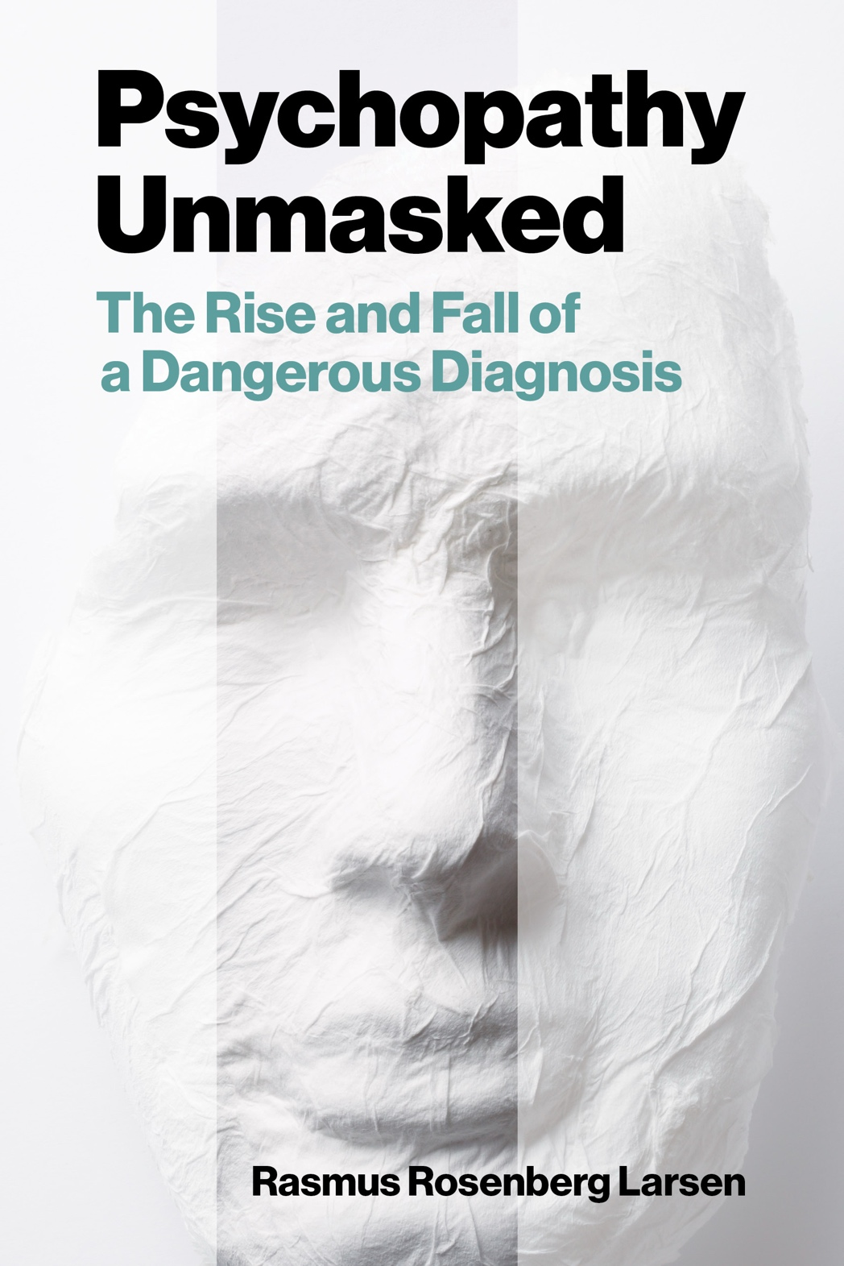
Psychopathy and Crime
The Science, Ethics, and Legal Influence of a Controversial Diagnosis
Module 5
Psychopathy and Moral Psychology
Are “psychopaths” morally colorblind?
Copyright © Rasmus Rosenberg Larsen
Licensed under CC BY 4.0.

Slide 2
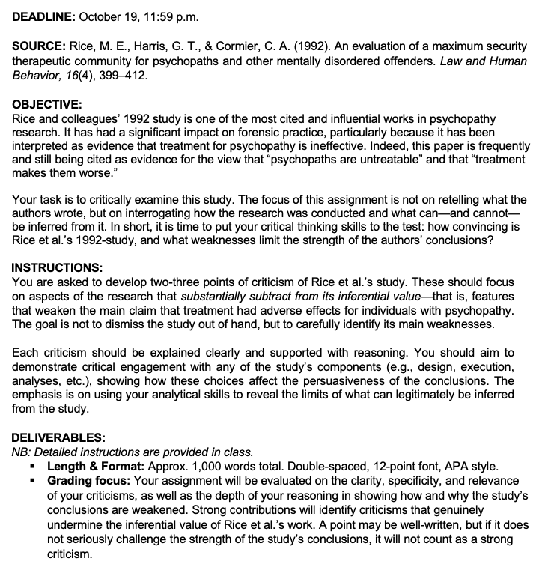
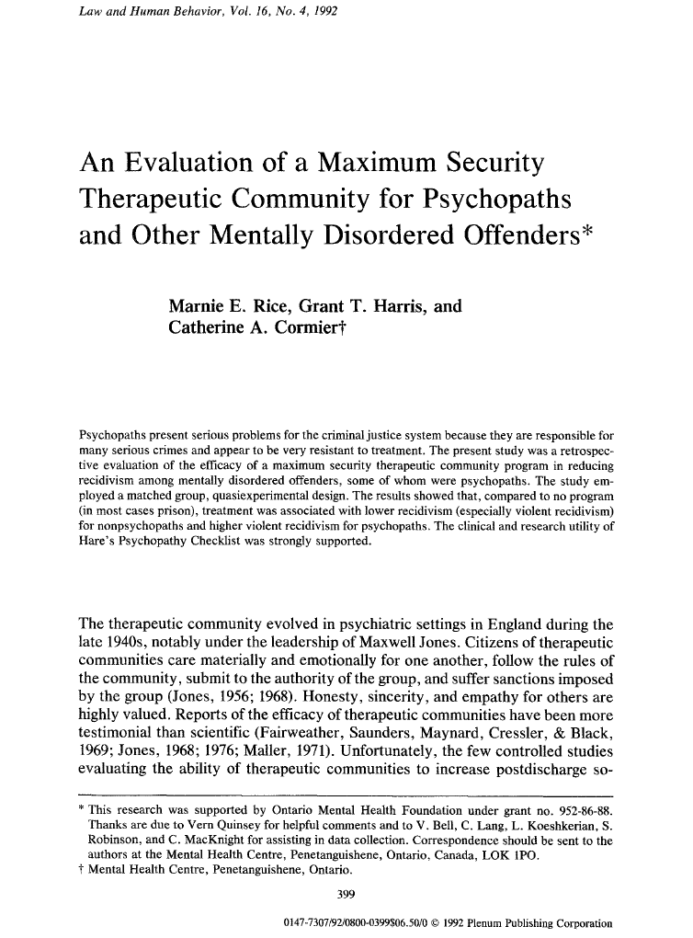
Assignment #1

Slide 3
Assignment #1
Assignment #1:
Critical Analysis of Rice et al. (1992)

Slide 4
Assignment #1
Objectives
Your task is to critically examine Rice et al. (1992).
The focus of this assignment is not on retelling what the authors wrote, and trivially framing their study as problematic.
Instead, you must interrogate how the research was conducted and what can—and cannot—be inferred from it.
In short, it is time to put your critical thinking skills to the test:
  How convincing is Rice et al.’s 1992-study, and what weaknesses limit the strength of the authors’ conclusions?

Slide 5
Assignment #1
Instructions
Develop two-three points of criticism of Rice et al.’s study.
These should focus on aspects of the research that substantially subtract from its inferential value—that is, features that weaken the study’s main claim.
  NB: The goal is not to dismiss the study out of hand, but to carefully identify its main weaknesses according to your analysis.
Each criticism should be explained clearly and supported with reasoning.
You should aim to demonstrate critical engagement with any of the study’s components (e.g., design, execution, analyses, etc.).
The emphasis is on using your analytical skills to reveal the limits of what can legitimately be inferred from the study.

Slide 6
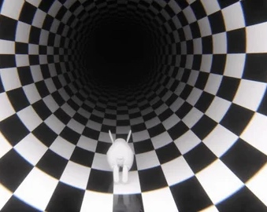


Assignment #1
Instructions
Identify Main Weaknesses
Critical Investigation
Low Hanging Fruit
A study may have many weaknesses, but you must identify the most important.
Be Warned: Rice et al. (1992) is full of surprises.
Sometimes the most important weakness is not the most obvious one.

Slide 7
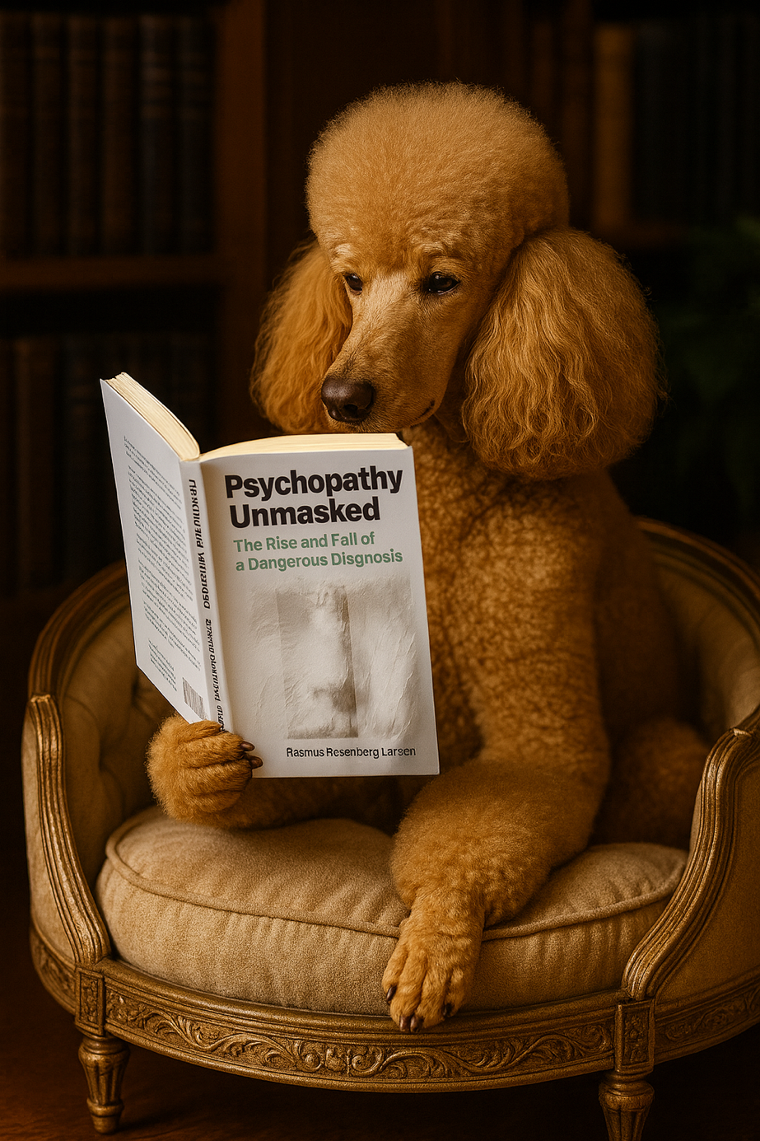
Any questions..?
© OpenAI (LLM-generated image)

Slide 8
Psychopathy and Crime
FSC350
Module 1
Introduction – What is Psychopathy?
Module 7
Two Theories of Psychopathy
Module 2
The Problem of Psychopathy
Module 8
Psychopathy and Scientific Spin
Module 3
Psychopathy and Forensic Risk
Module 9
Psychopathy and Ethics
Module 4
Psychopathy and Treatment
Module 10
Explaining a Lack of Evidence (Part I)
Module 5
Psychopathy and Moral Psychology
Module 11
Explaining a Lack of Evidence (Part 2)
Module 6
The Neuroscience of Psychopathy
Module 12
The Future of Psychopathy Research

Slide 9
This Module’s Agenda:
Psychopathy and Moral Deficits
Empathy Research in PCL samples
Moral Reasoning Research in PCL Samples
Critical Reflections

Slide 10
Psychopathy and Moral Deficits

Slide 11
Psychopathy & Moral Deficits:
Psychopathy and Moral Psychology
Classic mainstream stipulation (i.e., not a fact)
Mainstream accounts of psychopathy stipulate profound impairments of moral psychological capacities (e.g., remorse, empathy).
Specifically: diminished ability to grasp why it is wrong to harm others.
Non-psychopathic (ordinary) individuals:
  They know what society disapproves of (laws, norms).
  They intuitively comprehend why some behaviors are immoral.
Psychopathic individuals:
  They may know of norms and laws (e.g., that violence is illegal).
  They are alleged/claimed to lack moral intuition, impairing the insight into why, say, violence is morally wrong.

Slide 12


Psychopathy & Moral Deficits:
Moral Intuition
Perhaps you all perceive and understand why there is a “moral” difference between:
Cutting down a tree vs. slaying a human being… it’s the same physical act, yet “different”…
vs.

Slide 13
Psychopathy & Moral Deficits:
The Historical Roots of the View
Historically, psychopathy was always conceptualized as a deficit of the “moral faculty” or “moral sense”
Recall that Benjamin Rush (1786) describes psychopathy (or “anomia”) as a disease of the moral faculty.
The concept “moral faculty,” refers to the inner capacity to “distinguishing and choosing between good and evil.”
Rush argued that when psychopathic persons act violently, it’s because they have lost the capacity for moral discernment.
The same explanation was echoed in the 19th century by Pinel, Esquirol, Prichard, Maudsley, etc. (see Werlinder, 1978).

Slide 14
Psychopathy & Moral Deficits:
The Deeper “Philosophical” Roots
If humans have a “moral faculty” or “moral sense,” it is perhaps straightforward to argue it can be diseased
Earl of Shaftesbury (1699) and Francis Hutcheson (1725) developed the concept of a “moral sense”:
  An innate human ability to perceive moral values and form moral judgments.
The basic idea is that humans instinctively approve benevolent actions; this moral sense operates independently of self-interest or education.
The moral sense was believed to be universal, implanted by God, and the basis for moral and prosocial behavior.
These philosophical ideas are today known as moral sentimentalism.
Notes:
Benjamin Rush was very familiar with moral sentimentalist philosophy, and he was allegedly a good friend of David Hume (a contemporary sentimentalist).

Slide 15
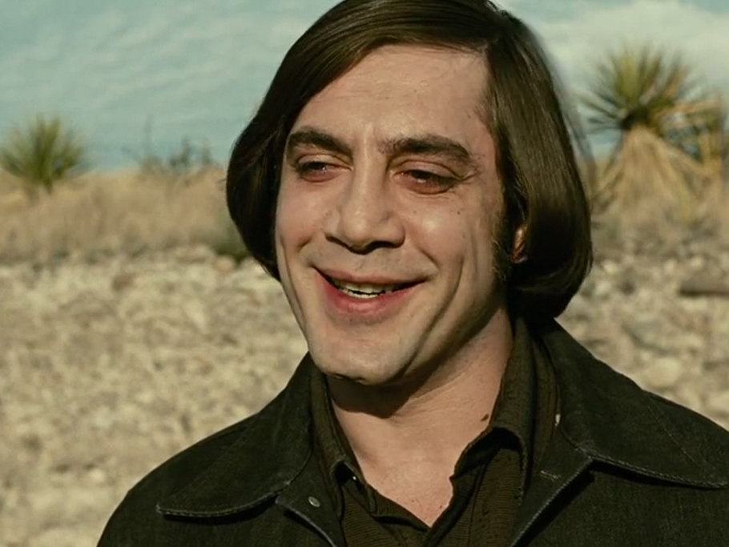

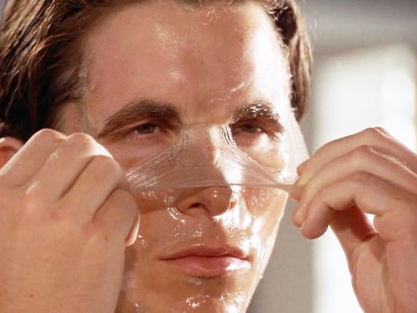
Psychopathy & Moral Deficits:
Lacking a Moral Sense
Modern popular culture has been fascinated by this idea for decades…
Anton Chigurh
No Country for Old Men
Dexter Morgan
Dexter
Patrick Bateman
American Psycho

Slide 16
Psychopathy & Moral Deficits:
The Notion of “Moral Colorblindness”
Central Notion: Distinguish between the literal denotative meaning of moral terms vs. the emotional connotative reference.
In his work, The Mask of Sanity, Hervey Cleckley uses the metaphor that psychopathy is a peculiar form of “moral colorblindness.”
Like with colorblindness, a person can know color terms but not their qualitative meaning (e.g., “vermilion” meaningless to a colorblind).
In Robert Hare’s 1993-book, Without Conscience, psychopaths are described as if they “see the [moral] world in shades of gray.”
A slightly different, yet similar metaphor was used by Blair and colleagues: “[Psychopaths] know the words, but not the music.” (2006)

Slide 17
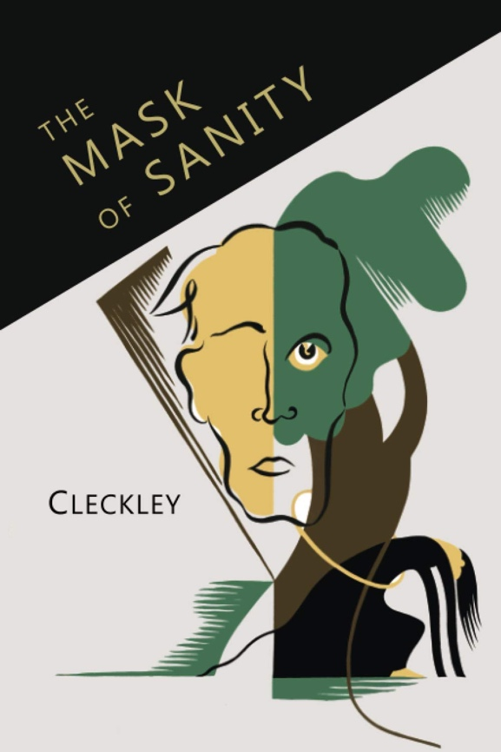
Psychopathy & Moral Deficits:
Hervey Cleckley’s Concept of Psychopathy
Quote: Cleckley (1988), The Mask of Sanity (p. 59)
“[The psychopath] is unfamiliar with the primary facts or data of what might be called personal values and is altogether incapable of understanding such matters. It is impossible for him to take even a slight interest in the tragedy or joy or the striving of humanity as presented in serious literature or art. He is also indifferent to all these matters in life itself. Beauty and ugliness, except in a very superficial sense, goodness, evil, love, horror, and humor have no actual meaning, no power to move him. He is, furthermore, lacking in the ability to see that others are moved. It is as though he were colorblind, despite his sharp intelligence, to this aspect of human existence. It cannot be explained to him because there is nothing in his orbit of awareness that can bridge the gap with comparison. He can repeat the words and say glibly that he understands, and there is no way for him to realize that he does not understand.”

Slide 18
Psychopathy & Moral Deficits:
“Without suffering or enjoying in significant degree the integrated emotional consequences of experience, the psychopath will not learn from it to modify and direct his activities as other men whom we call sane modify and direct theirs. […] It is entirely impossible for him to see another person from the aspect of major affective experience, since he is blind to this order of things or blind in this mode of awareness.”
Cleckley (1988), The Mask of Sanity (p. 373)

Slide 19
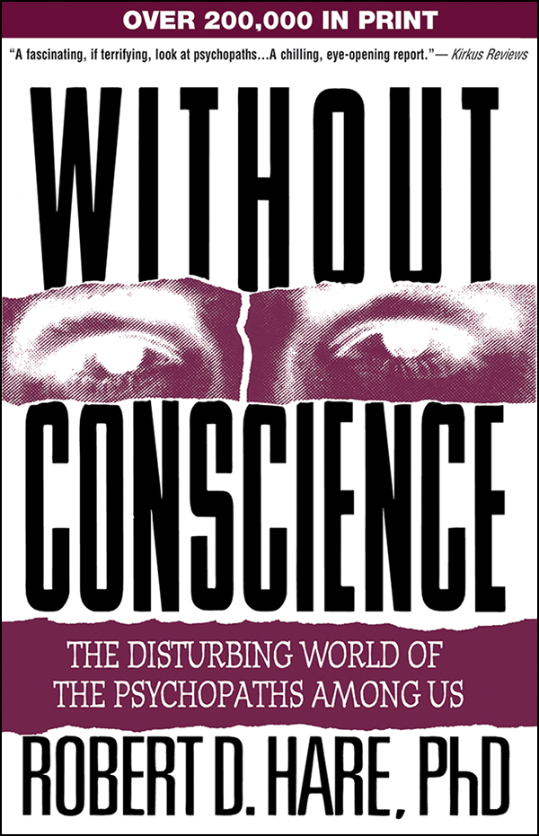
Psychopathy & Moral Deficits:
“A simple analogy here will help. The psychopath is like a color-blind person who sees the world in shades of gray but who has learned how to function in a colored world. He has learned that the light signal for "stop" is at the top of the traffic signal . When the color-blind person tells you he stopped at the red light, he really means he stopped at the top light. He has difficulty in discussing the color of things but may have learned all sorts of ways to compensate for this problem, and in some cases even those who know him well may not know that he cannot see colors. Like the color-blind person, the psychopath lacks an important element of experience-in this case, emotional experience but may have learned the words that others use to describe or mimic experiences that he cannot really understand.”
Quote from Without Conscience (1993)

Slide 20
Psychopathy & Moral Deficits:
Two Central Prognostic Claims
Researchers typically promote two prognostic claims when describing the “moral impairment” view
Claim #3 – Moral Impairment: Often described as morally blind or without conscience, psychopathic persons are portrayed as incapable of moral reasoning and empathy; and extreme personality unconstrained by law, norms, and values.
1:
Lack of Empathy: Psychopathic individuals are said to be incapable of understanding or mirroring the feelings of others, allegedly due to their own callous and unemotional disposition.
2:
Impaired Moral Reasoning: Psychopathic individuals are said to approach moral issues differently, allegedly because they fail to recognize and grasp underlying moral values.
Notes:
NB: There’s not necessarily a widespread consensus on this view. Some researchers do not believe psychopathy is correlated with moral incapacities (see Chapter 6), and some researchers might describe psychopathy as a lack of empathy but not necessarily a lack of moral reasoning (and vice versa). It can be somewhat confusing to navigate the history of this literature.

Slide 21
Empathy Research in PCL Samples

Slide 22
Empathy Research in PCL Samples:
What is Empathy?
Empathy is believed to be a complex human disposition, encompassing many different sub-types of empathy (see Bateson, 2009).
  Cognitive empathy – imagining or understanding another’s perspective.
  Affective empathy – sharing or mirroring another’s emotional state
  Compassionate empathy – feeling concern and motivation to help others.
As such, empathy involves thought, emotion, and action.
Many psychologists believe empathy is elemental to moral judgment.
Empathy: The general capacity to understand, share, and be motivated by the feelings or perspectives of others.

Slide 23

Empathy Research in PCL Samples:
What is Empathy?
Affective Empathy: An empathy subtype defined as the capacity to emotionally respond to or mirror another person’s feelings.

Slide 24
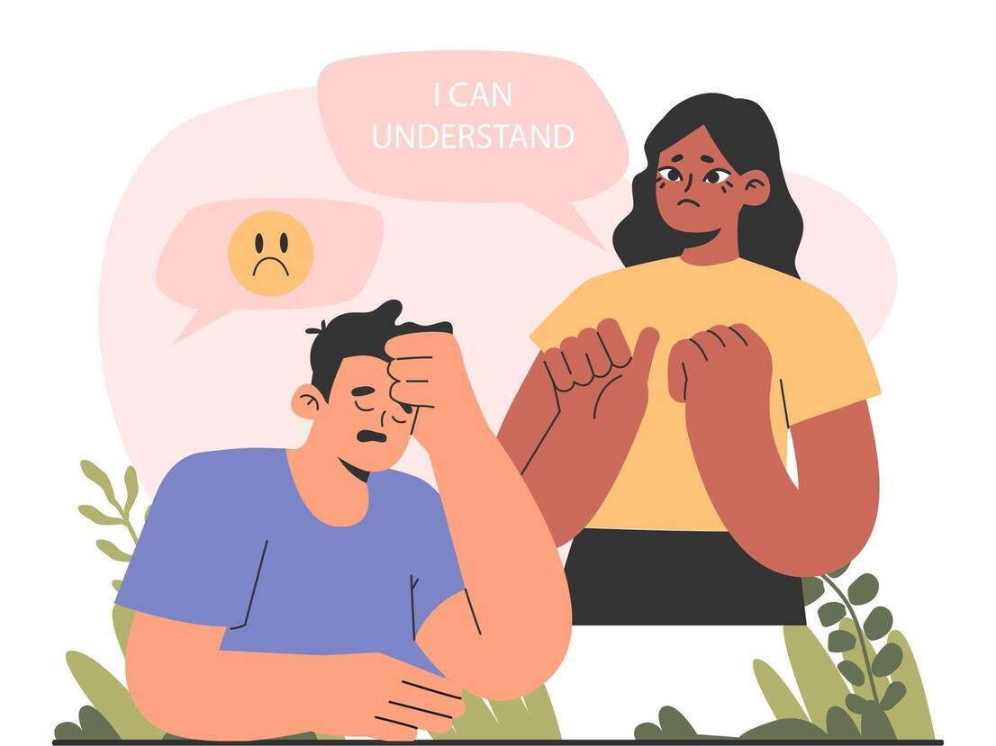
Empathy Research in PCL Samples:
What is Empathy?
Cognitive Empathy: An empathy subtype defined as the capacity to intuitively understand or perceive (without verbal cues) what another person is feeling and thinking.

Slide 25
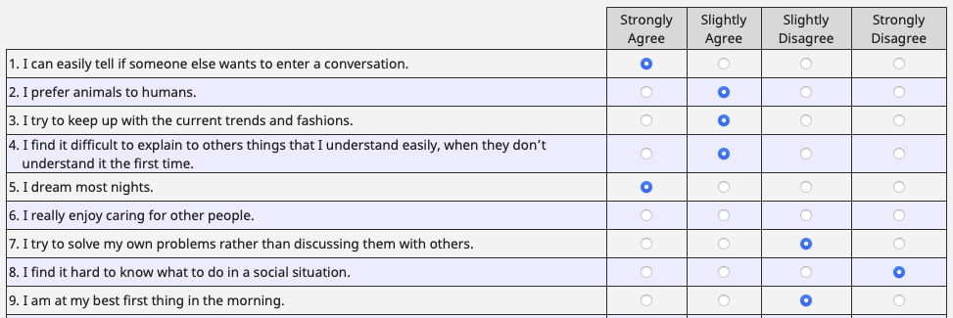
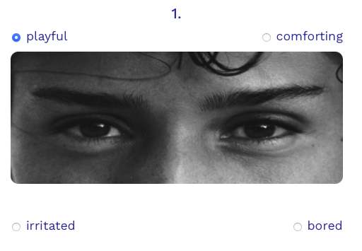
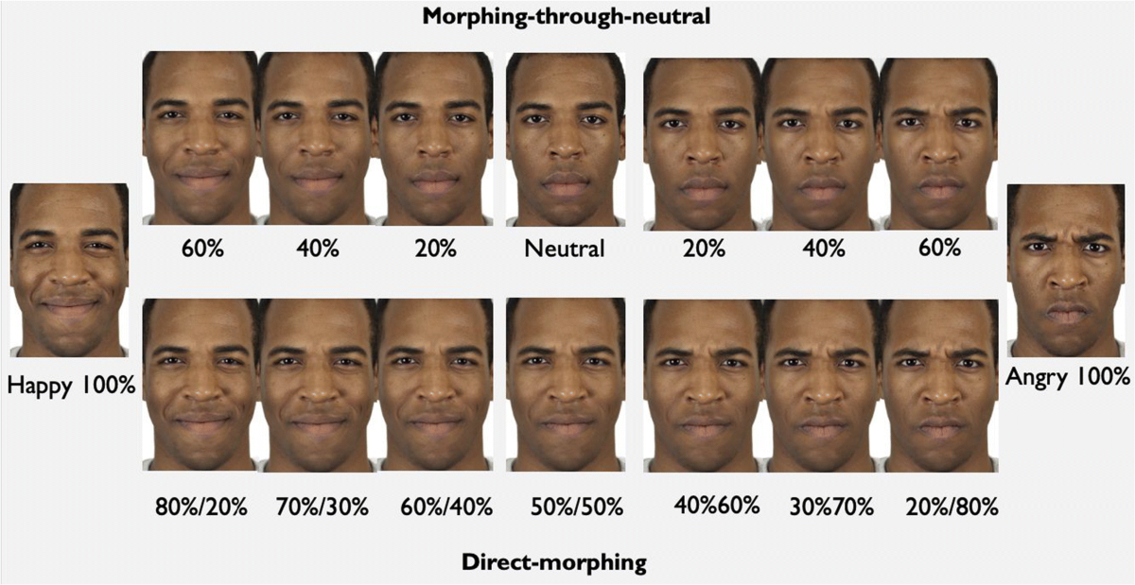
Empathy Research in PCL Samples:
Empathy Research Paradigm
A total of 66 publications (Larsen et al., 2025) using two different test paradigms (across 71 studies)
Hypothesis: PCL psychopathic persons have relatively poorer performance on these tests
Empathy Assessment Tools: Psychological tools specifically designed to quantify and measure both cognitive and affective empathic capacities.
Emotion Recognition Tests: A performance-based psychological test that measures the ability to accurately detect nonverbalized emotional expressions (i.e., a main component of cognitive empathy).
For example: Empathy Quotient (EQ)
Reading the Mind in the Eye
Facial Emotion Morphing
Notes:
There’s a relatively large research output in the study of empathy PCL psychopathic samples (n = 66, Larsen et al., 2025) NB: some publications have more than one study; hence, why there are n = 71 studies.
This research generally aims to test two separate hypotheses: that psychopathic persons are differently disposed in terms of their (1) cognitive empathy,, and/ or (2) affective empathy.
These two types of empathic capacities have been investigated using two different test paradigms:
(a) empathy assessment tools, which are psychological tools specifically designed to quantify and measure both cognitive and affective empathic capacities, and
(b) emotion recognition tests, a performance-based psychological test that measures the ability to accurately detect nonverbalized emotional expressions (i.e., a main component of cognitive empathy).

Slide 26
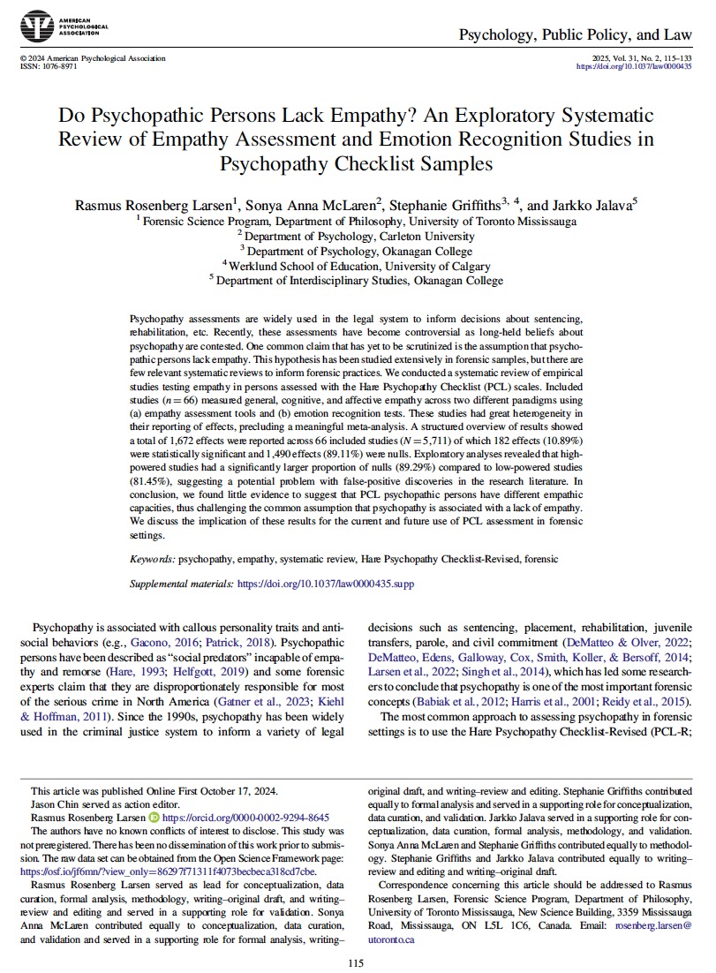

Empathy Research in PCL Samples:
Detailed Overview of Empathy Research
Larsen et al. (2025)

Slide 27
Empathy Research in PCL Samples:
Empathy Assessment Tool Studies
Published studies between 1980-2023
A total of 34 studies, with 2,712 participants and 559 effects.
Research Highlights:
  474 effects (85%) = null results (no empathy differences)
  15 studies (44%) = 100% null findings.
  85 effects (15%) = statistically significant
    66 → worse empathic capacities
    19 → better empathic capacities
Overall: Little evidence that PCL psychopathic persons have diminished empathic capacities.

Slide 28
Empathy Research in PCL Samples:
Emotion Recognition Test Studies
Published studies between 1980-2023
A total of 37 studies, with 3,398 participants and 1,113 effects.
Research Highlights:
  1,016 effects (91%) = null results (no emotion recognition differences)
  16 studies (43%) = 100% null findings
  97 effects (9%) = statistically significant
    76 → worse performance
    21 → better performance
Overall: Little evidence that PCL psychopathy linked to an impaired ability to recognize emotions (→ no impaired cognitive empathy).

Slide 29
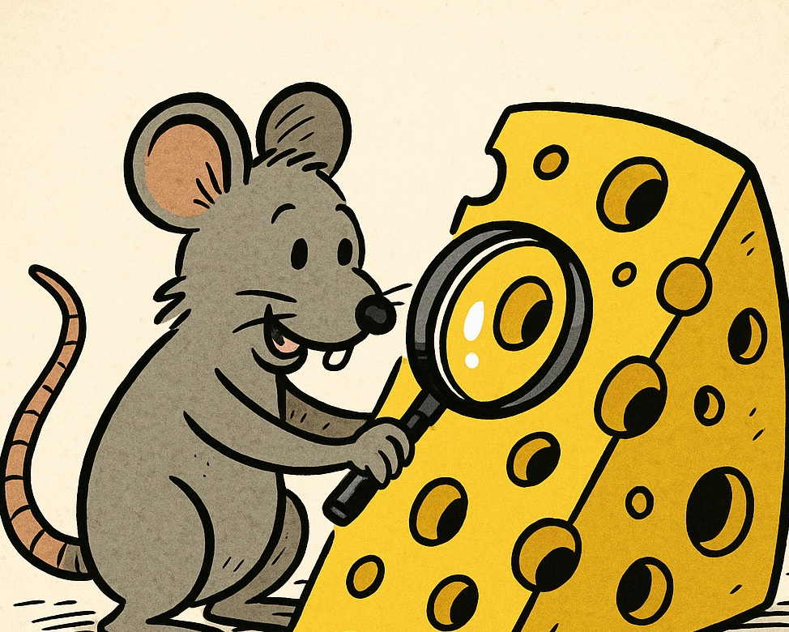


Empathy Research in PCL Samples:
Interpreting Empathy Research in PCL Samples
Exploratory Research
Family-Wise Error Rate
Non-Reported Effects
Many empathy studies were exploratory, using less rigorous methods and looser statistical thresholds that increase false positives. Yet, despite this, null findings remained overwhelmingly high (84.79% and 91.38%).
Of 1,672 effects, only 31% controlled for family-wise error rate (FWER). In uncorrected studies, null effects were 86.6%, but with FWER correction, nulls rose to 94.8%. This suggests that the few significant results are likely false positives.
Another issue was incomplete reporting: 476 effects were omitted (e.g., where researchers are only reporting results from some of the emotions tested). Selective reporting likely hides null results and distorts the true null vs. significant ratio.
Notes:
FWER: See p. 101 in Psychopathy Unmasked.
The family-wise error rate (FWER) is the probability of making at least one Type I error (a false positive) across a set—or "family"—of statistical tests.
Why it matters
In research, multiple comparisons are often run at once (e.g., testing many hypotheses, checking many variables).
If each test is conducted at a standard significance level (say, α = 0.05), the chance of a false positive accumulates.
For example, running 20 independent tests at α = 0.05 means the probability of at least one false positive is much higher than 5%—in fact, about 64%.
Controlling FWER
Statisticians use methods to reduce this inflated error rate, ensuring that the overall chance of one or more false positives in the family of tests does not exceed the desired α level. Common methods include:
Bonferroni correction (dividing α by the number of tests).
Holm–Bonferroni method (a stepwise, less conservative approach).
Summary
FWER = probability of ≥1 false positives across multiple tests.
It protects against over-interpreting results when many hypotheses are tested at once.

Slide 30
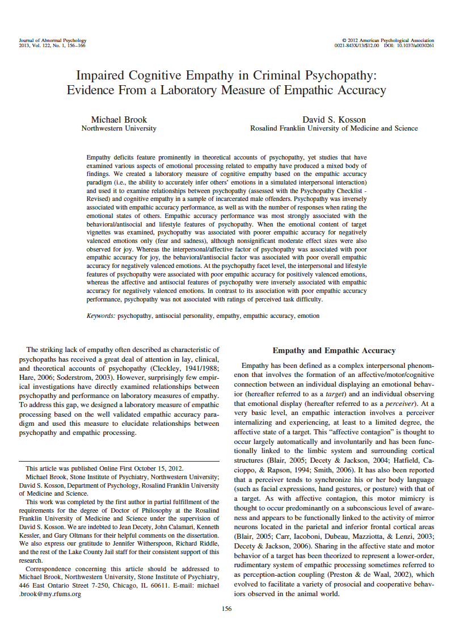
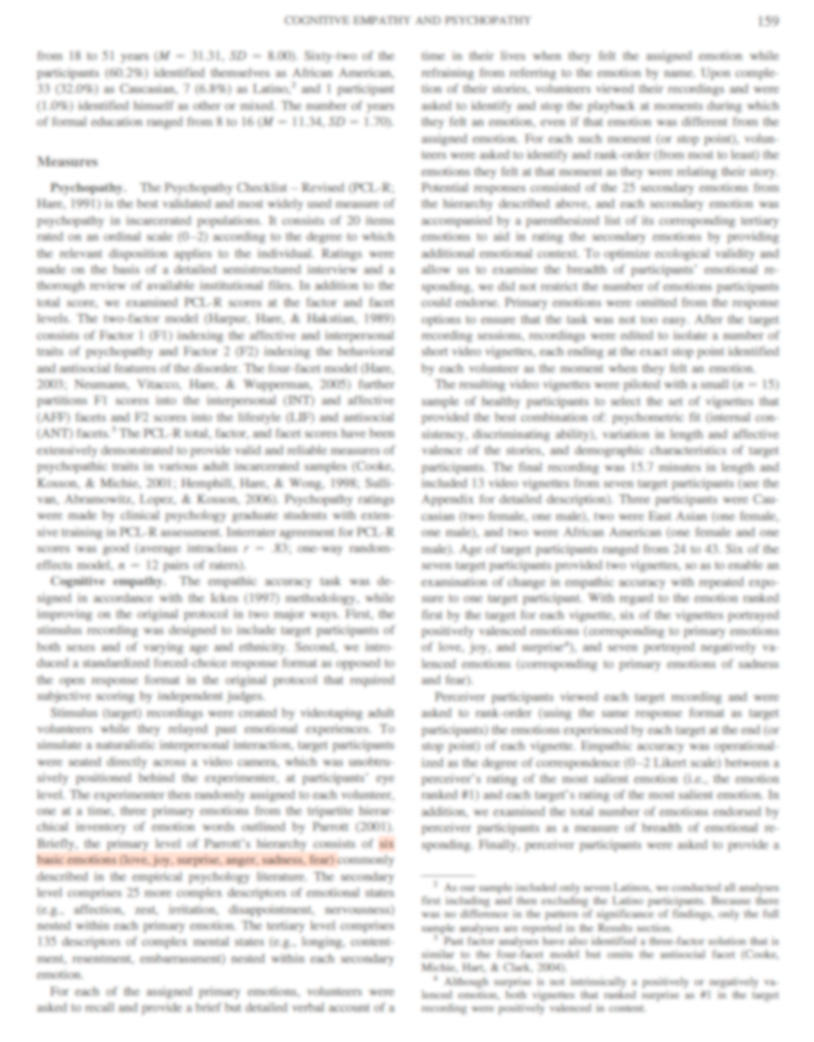
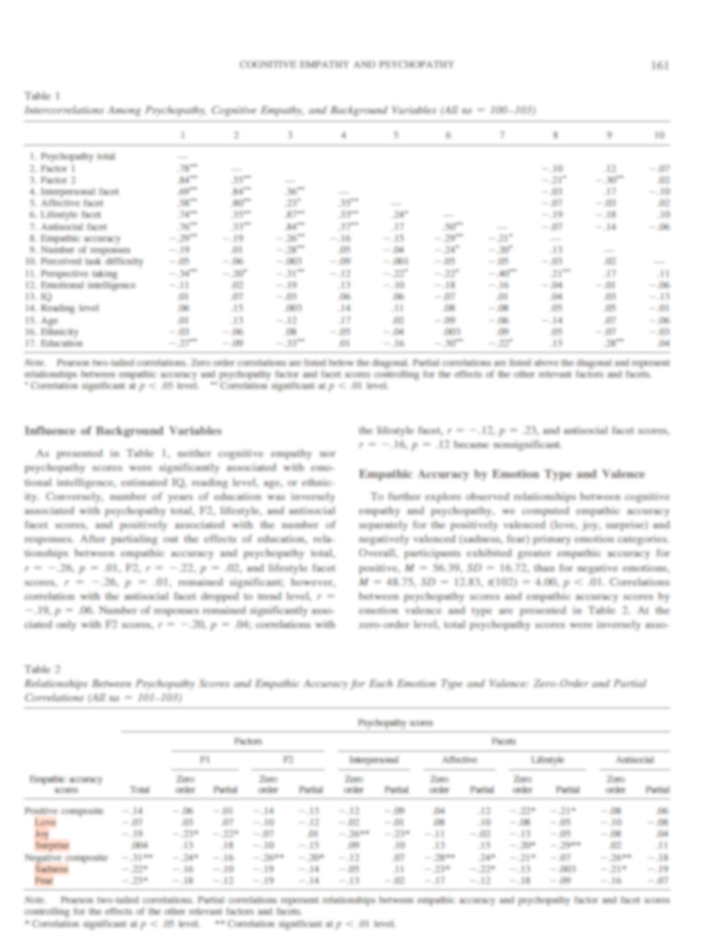
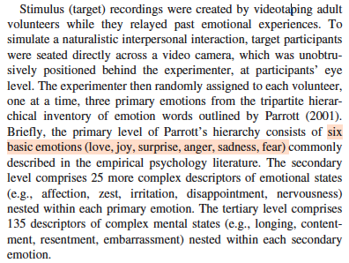
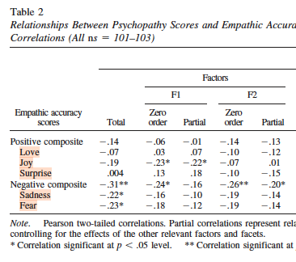

Empathy Research in PCL Samples:
Example of Non-Reported Effects
Only reporting results from five (instead of six) emotions…
Brook & Kosson (2013)
Notes:
Brook & Kosson’s study (2013) had more non-reported effects that significant effects. They still had a null ratio of 73.42%

Slide 31
Moral Reasoning Research in PCL Samples

Slide 32
Moral Reasoning Research in PCL Samples:
Research Designs
A total of 21 studies published between 1980 and 2023
Moral Reasoning Tests:
Studies that measure/track how people approach and think about moral issues. If psychopathic persons are morally impaired, we should be able to observe difference on these tests.
Moral/Conventional
Moral Dilemma
Others
Nutshell: Testing the ability to distinguish between moral (harm-based) and conventional (rules-based) transgressions.
Nutshell: Testing the variation and patterns in answers to short dilemmas such as the trolley problem (i.e., dilemma = no clearly correct answer).
Other studies includes
Defining issue test.
Moral sensitivity test.
Moral foundations questionnaire.
N = 5
N = 5
N = 11
Notes:
The moral/conventional test: A psychological test paradigm used to distinguish between moral transgressions (e.g., hitting, stealing—wrong because they harm others) and conventional transgressions (e.g., talking out of turn, breaking dress codes—wrong only because rules say so). It examines whether individuals judge moral rules as more serious, universally binding, and independent of authority, while conventional rules are seen as contingent and alterable.
The Moral Dilemma Test: A standardized assessment of moral reasoning that presents respondents with short hypothetical scenarios involving moral conflicts and asks them to judge the acceptability of actions and rank the importance of different reasons for their decisions. Unlike Kohlberg’s open-ended Moral Judgment Interview, the MDT provides a structured and quantitative format, making it less time-consuming and easier to score. The results are used to identify the level of moral development reflected in the respondent’s reasoning, such as whether it is driven by self-interest, social conformity, or principled considerations.
The Defining Issues Test (DIT), developed by James Rest in the 1970s, is a standardized instrument for assessing moral reasoning, grounded in Lawrence Kohlberg’s theory of moral development. Instead of focusing on the decision made in a moral dilemma, the DIT evaluates the reasoning behind it by asking respondents to rate and rank the importance of various considerations presented in short scenarios. Scoring reflects the extent to which individuals rely on personal interests, maintaining social norms, or postconventional principles such as justice and rights. Widely validated across contexts, the DIT is used in psychology, education, and professional ethics research to study how moral judgment develops and how it may be influenced by training and education.
The Moral Sensitivity Test (MST) is an assessment tool designed to measure an individual’s ability to recognize and interpret moral dimensions in complex situations. Unlike instruments that focus on reasoning about moral dilemmas, the MST emphasizes the awareness of ethical issues, including the ability to perceive how actions may affect others, identify value conflicts, and anticipate potential harm. It typically presents respondents with scenarios that involve ambiguous or ethically charged elements and asks them to evaluate or respond to these situations. By capturing the early stage of moral decision-making—recognizing that a situation has moral implications—the MST is widely used in fields such as healthcare, education, and professional ethics to better understand how individuals perceive ethical challenges and how such awareness influences subsequent reasoning and behaviour.
The Moral Foundations Questionnaire (MFQ) is a self-report instrument developed within Moral Foundations Theory to assess the underlying dimensions of human moral judgment. Rather than focusing on a single developmental trajectory, the MFQ measures how strongly individuals endorse different moral intuitions thought to be universal yet variably emphasized across cultures and individuals. These include care/harm, fairness/cheating, loyalty/betrayal, authority/subversion, and sanctity/degradation, with later versions sometimes adding liberty/oppression. Respondents rate their agreement with statements or the relevance of considerations when making moral judgments, producing a profile that reflects the weight they place on each foundation. Widely used in psychology, political science, and cultural studies, the MFQ has been applied to explore differences in moral outlook across ideological, cultural, and professional groups, offering insights into how diverse moral priorities shape reasoning, identity, and social conflict.

Slide 33


Moral Reasoning Research in PCL Samples:
Moral/Conventional Tests
Research design and assumptions (see Nucci & Turiel, 1978; see also, SEP)
Conventional Rule
Moral Rule
vs.
The Basics:
Participants read vignettes that depicts moral vs. conventional transgressions.
Asked: Is it permissible? How serious? Does authority changing rule matter?
  Moral transgressions: rated more serious, less permissible, unaffected by authority.
  Conventional transgressions: authority change alters permissibility.

Slide 34
Moral Reasoning Research in PCL Samples:
Moral/Conventional Tests
Research design and assumptions (see Nucci & Turiel, 1978; see also, SEP)
An M/C study assumes that humans learn to differentiate between:
  Moral rules: Wrong due to harm/justice (authority-independent).
    For example – Bullying or punching another person = wrong on moral grounds (still wrong even if authority allows).
  Conventional rules: Wrong due to authority or custom.
    For example – Speaking in class without permission = wrong by convention.
Participants read vignettes that depicts moral vs. conventional transgressions.
Asked: Is it permissible? How serious? Does authority change matter?
  Moral transgressions: rated more serious, less permissible, unaffected by authority.
  Conventional transgressions: authority change alters permissibility.

Slide 35
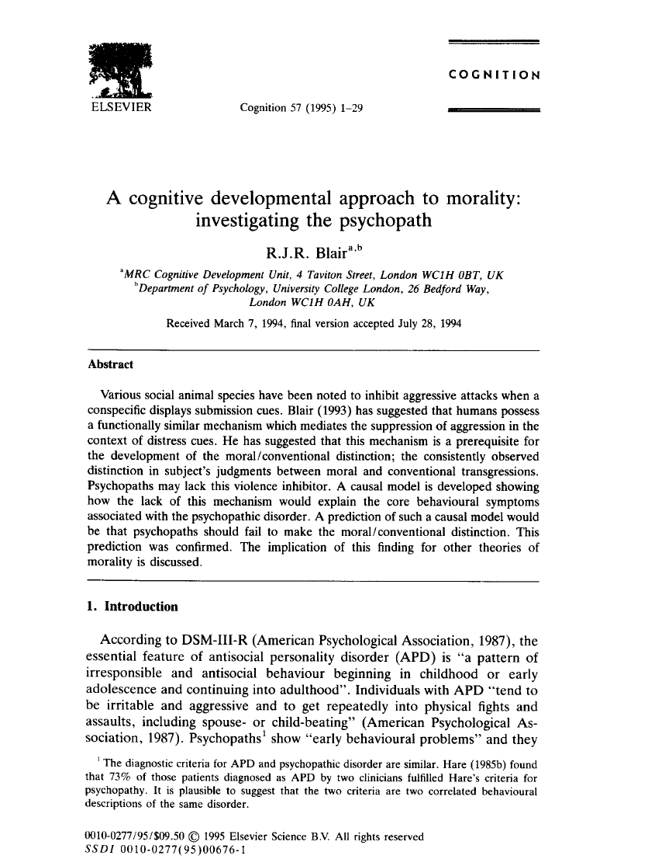
Moral Reasoning Research in PCL Samples:
Blair (1995): Moral/Conventional Study
NB: One of the most cited experiments in psychopathy research (2,407 citations on Google Scholar)
Forensic psychiatric sample: 10 high-PCL (M=31.6) vs. 10 low-PCL (M=16.1).
High-PCL group failed to distinguish moral vs. conventional transgressions.
  Rated both as equally serious and authority-independent.
Limitations:
  Very small, non-random sample (“excluded the middle”).
  Possible response bias (participants motivated for release).
  No control for family-wise error rate (FWER).
  Overall, data reliability questionable.

Slide 36
Moral Reasoning Research in PCL Samples:
Overall Summary of Moral Reasoning Research
Early Support (1990s): James Blair’s 1995 moral/conventional study might have provided initial support to the “moral colorblindness” thesis.
However, there are major quality issues across the 21 moral-reason studies:
  Studies often rely on selective reporting, biased sampling, and weak statistics.
  For example: Excluding the middle (omitting mid-range PCL-R scores); and failure to correct for family-wise error rate (FWER).
This explains why the subfield struggles with a complete lack of replications.
Larger more rigorous moral/conventional studies (e.g., Aharoni et al. 2014) did not replicate Blair (1995).
Overall, evidence for moral deficits in psychopathy is weak and unreliable.

Slide 37
Critical Reflections

Slide 38
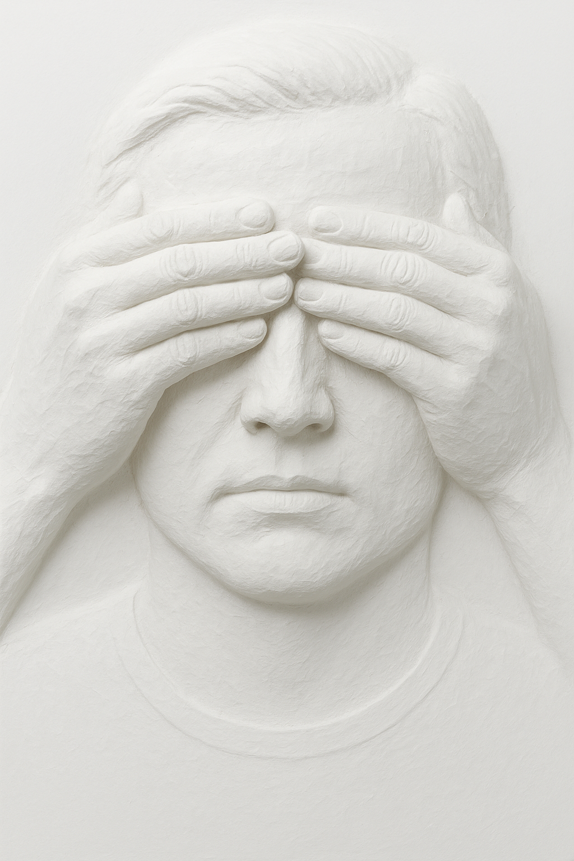
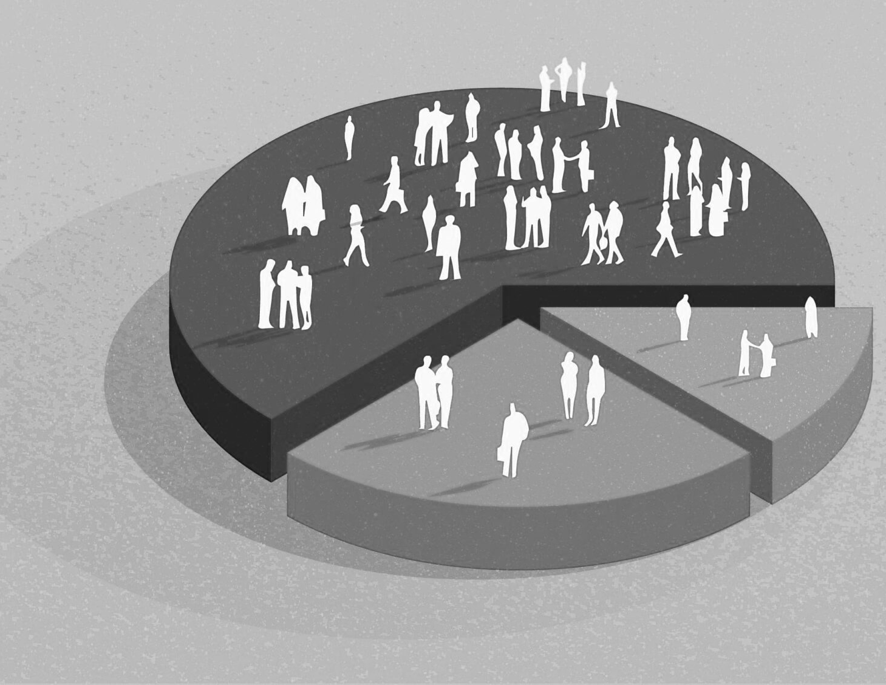
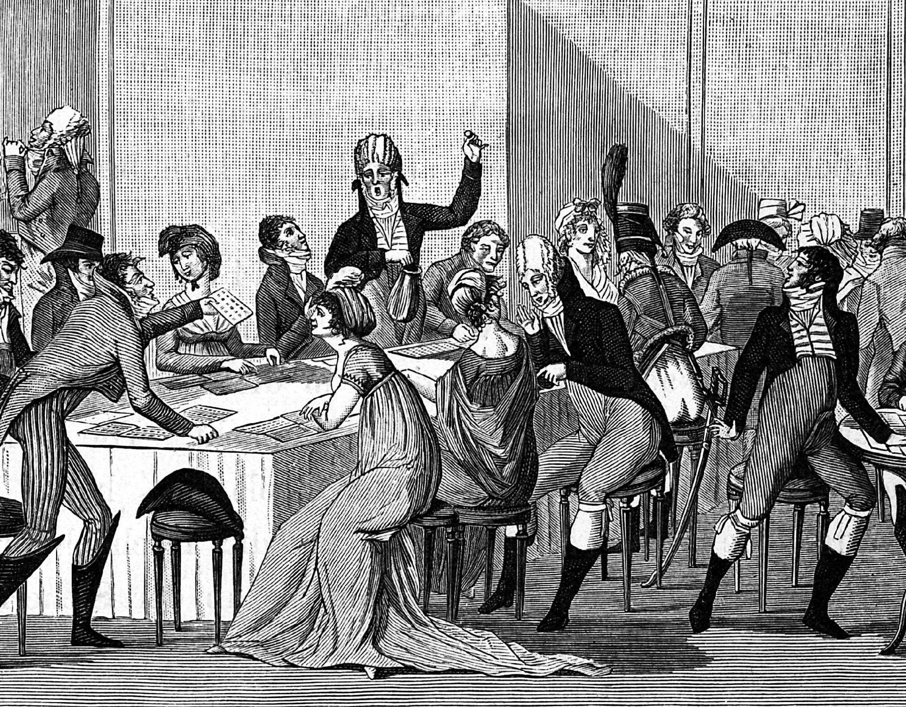
Critical Reflections:
Suspicious Observations and Unanswered Questions
Meaningful Claim?
Sample Hacking
Academic Parlor Game?
Does it really make sense to describe psychopathy as “moral colorblindness”? This assumes moral reasoning is a discrete capacity that can be selectively impaired, but many psychologists argue moral judgment is not unitary or simple.
Many studies manipulate sample composition by omitting participants with mid-range PCL-R scores (e.g., 20-30). This artificially exaggerates group differences, undermines randomness, and risks biasing results.
Flashy studies that make bold or provocative claims receive far more citations than careful, methodologically sound work, leading flawed findings to persist in the literature long after they have been undermined.
Notes:
Flashy studies that make bold or provocative claims often receive far more citations than careful, methodologically sound work, leading flawed findings to persist in the literature long after they have been undermined. This dynamic resembles an academic parlor game, where success depends less on accuracy and more on saying what others want to hear—aligning with fashionable narratives to remain visible and relevant—thereby reinforcing attention to questionable studies while sidelining more rigorous critique.

Slide 39

Critical Reflections:
Question 1: Was it morally wrong that Dr. Lecter ate the human tissue? Why or why not?
Question 2: Do you think your reasoning/judgment was driven by a single moral intuition/sense/faculty?
“Dr. Lecter is working in a laboratory that studies human tissue samples. One day, while analyzing a sample of human flesh from a legally obtained donor, Dr. Lecter becomes curious about its taste. Instead of destroying the sample in the incinerator, Dr. Lecter cooks and eats the tissue. No one else is present, and the act has no impact on the research or anyone else”.
Notes:
NB: If moral judgments are the outcome of complex mental functions, then it may make little sense to claim that this function can be impaired in the way researchers have historically claimed with psychopathy.

Slide 40
Critical Reflections:
A Familiar Pattern…?
In the 1990s, early studies (e.g., Blair, 1995) fueled enthusiasm about moral deficits in PCL psychopathy.
However, this was followed by a wave of research that directly refutes these early claims and conclusions.
Yet the trope about moral deficiency persists, much similar to the claims about “extreme danger” and “untreatability.”
These tropes are apparently sustained by selective emphasis by contemporary researchers on a few flawed studies.

