Slide 1
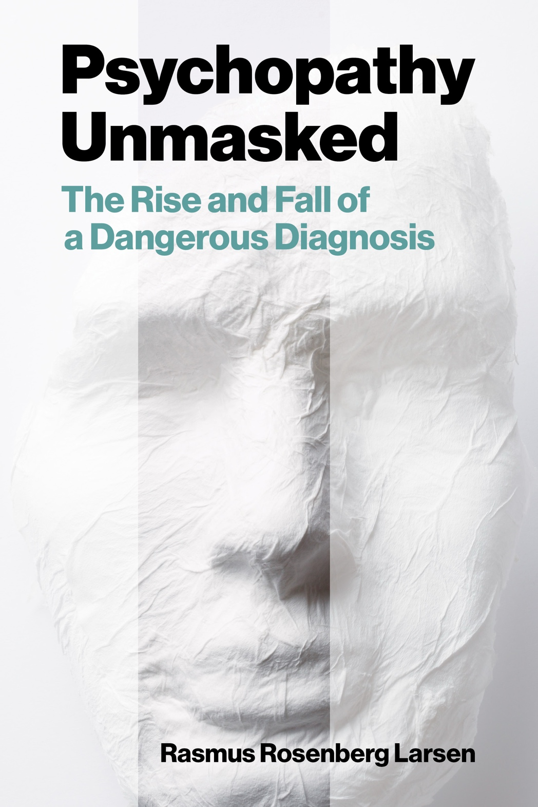
Psychopathy and Crime
The Science, Ethics, and Legal Influence of a Controversial Diagnosis
Module 9
Psychopathy and Ethics
Are psychopathy assessments ethical?
Copyright © Rasmus Rosenberg Larsen
Licensed under CC BY 4.0.

Slide 2

Any questions..?
© OpenAI (LLM-generated image)

Slide 3
Psychopathy and Crime
FSC350
Module 1
Introduction – What is Psychopathy?
Module 7
Two Theories of Psychopathy
Module 2
The Problem of Psychopathy
Module 8
Psychopathy and Scientific Spin
Module 3
Psychopathy and Forensic Risk
Module 9
Psychopathy and Ethics
Module 4
Psychopathy and Treatment
Module 10
Explaining a Lack of Evidence (Part I)
Module 5
Psychopathy and Moral Psychology
Module 11
Explaining a Lack of Evidence (Part 2)
Module 6
The Neuroscience of Psychopathy
Module 12
The Future of Psychopathy Research

Slide 4
This Module’s Agenda:
Research and Professional Ethics
APA Ethics Code
Ethical Analysis of PCL-R Assessments
Critical Reflections.

Slide 5
Research and Professional Ethics

Slide 6
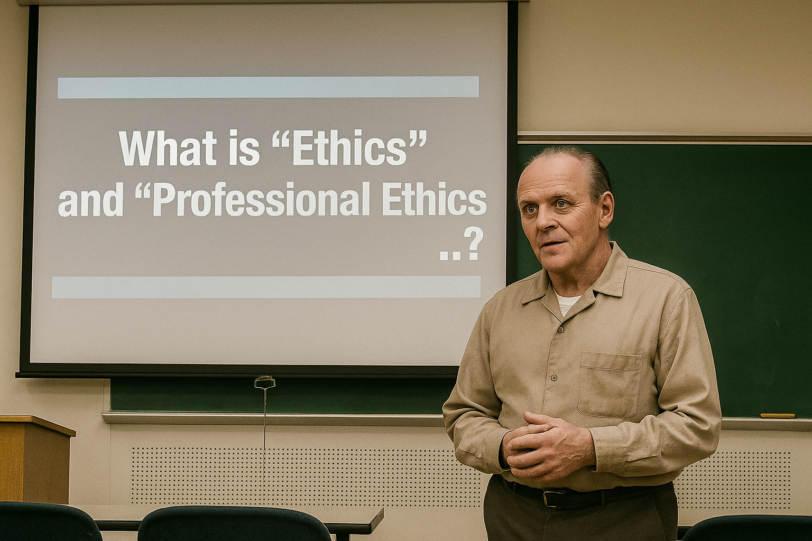
Research and Professional Ethics
© OpenAI (LLM-generated image)

Slide 7
Research and Professional Ethics:
Generally speaking, whenever we use the term ethics, we are referring to rules that designate what is right/wrong behavior.
In society, we often speak of what is “ethical” vs. “unethical”.
Similarly, professions such as forensic psychology will have a set of conventionally established “ethical rules” which guide its practitioners.
This ethics code defines what psychologists can and cannot do.
Professional associations (e.g., CPA, APA) usually have an independent committee that investigates and sanctions unethical conduct.
Professional Ethics: A set of conventionally established rules meant to provide ethical guidance for professionals in the field (i.e., researchers and practitioners).

Slide 8



Research and Professional Ethics:
Rationale for Professional Ethics
NB: There are many interrelated motivations for a discipline to develop a professional ethical code
Professional Conduct
Social Contract
Supervision
Ethical guidelines serve the function of upholding conventions about what the profession defines as proper professional conduct.
By upkeeping high ethical standards society then “allows” a discipline to monopolize their knowledge base and skills (i.e., social contract).
The discipline is tasked with the obligation to supervise, monitor, and sanction practitioners in order to upkeep professional ethical conduct.

Slide 9

Research and Professional Ethics:
But how do professional communities “decide” what is right vs. wrong…?

Slide 10
Research and Professional Ethics:
History and Evolution
Professional ethics grew out of an international response to a variety of problematic behaviors by scientists, governments, and institutions.
Most prominently perhaps were notorious cases of physical abuse in human experimentation:
  The Nazi medical experiments, years 1939-45 (link)
  Tuskegee Syphilis Study, years 1932-1972 (link)
  Manchu Detachment or Unit 731, years 1932-1945 (link)
Other events involved fraud (e.g., Piltdown man) and unchecked scientific advancement (e.g., development of atomic bomb).
Notes:
Nazi Medical Experiments (1939–1945)
During the Second World War, Nazi physicians subjected prisoners in concentration camps to non-consensual and often fatal experiments under the pretense of advancing racial science and military medicine. Victims were exposed to freezing conditions, deliberate infection with diseases, sterilization procedures, and toxic substances. These experiments caused immense suffering and were conducted without regard for human dignity or survival.
Tuskegee Syphilis Study (1932–1972)
In the United States, the Tuskegee Study involved hundreds of African American men who were misled into believing they were receiving treatment for syphilis when, in fact, care was deliberately withheld to observe the natural progression of the disease. Even after penicillin became a proven cure, participants were denied access, leading to unnecessary deaths and transmission of the illness to families. The study epitomizes systemic racism and profound violations of medical ethics.
Unit 731 in Manchuria (1932–1945)
In Japanese-occupied Manchuria, Unit 731 operated as a covert biological warfare research facility. Prisoners of war and civilians were subjected to horrific experiments, including deliberate infection with plague, anthrax, and cholera, as well as vivisection without anesthesia. The unit also tested chemical and biological weapons directly on human subjects. These atrocities highlight the destructive potential of science employed in the service of militarism and imperial expansion.

Slide 11
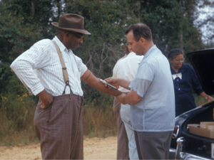
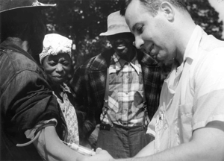
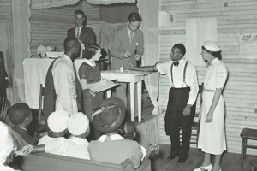
Research and Professional Ethics:
Abusive Human Experimentation
The Tuskegee Syphilis Study was a 40-year experiment where nearly 400 African-American men with syphilis in Alabama were misled and left untreated by U.S. government researchers, who wanted to observe the disease’s natural effects. Overall, effective treatment was knowingly withheld by participating doctors, leading to more than 100 deaths and sparking major reforms in research ethics oversight (link, link).
Notes:
Participants were lied to; told that they were enrolled in an experimental treatment where in reality they were given placebo. Early into the experiment it became widely known that penicillin could effectively cure syphilis. However, experimenters withheld this treatment.

Slide 12
Research and Professional Ethics:
The Nuremberg Code of 1947
The outcome of a US-military court ruling in 1947
The Nuremberg Code (1947) is a foundational set of ten principles for ethical medical research involving human subjects.
The code came out of U.S. v. Brandt (1946-1947), the first of 12 “subsequent” Nuremberg trials in the response to Nazi war crimes.
Includes codified requirements for medical research/practice, such as:
  Voluntary informed consent
  Scientifically valid basis for research
  Minimization of risk and suffering
  The right of participants to withdraw at any time
These principles have had lasting influence and formed the groundwork for later ethical codes in research and professional work.
Notes:
Lead defendant was Dr. Karl Brandt, Adolf Hitler’s personal physician and the Reich Commissioner for Health and Sanitation.
United States v. Brandt (1946–1947), commonly referred to as the Doctors’ Trial, was the first of the twelve subsequent Nuremberg trials conducted by the U.S. military after the Second World War. It prosecuted 23 German physicians and administrators for their roles in organizing and carrying out inhumane medical experiments on concentration camp prisoners and other victims under the Nazi regime. The defendants were charged with war crimes and crimes against humanity, including conducting lethal experiments without consent, performing sterilizations, and developing euthanasia programs. The tribunal resulted in 16 convictions, 7 death sentences, and established legal precedents that directly informed the creation of the Nuremberg Code, which emphasized the necessity of voluntary informed consent and the protection of research subjects from unnecessary harm.

Slide 13
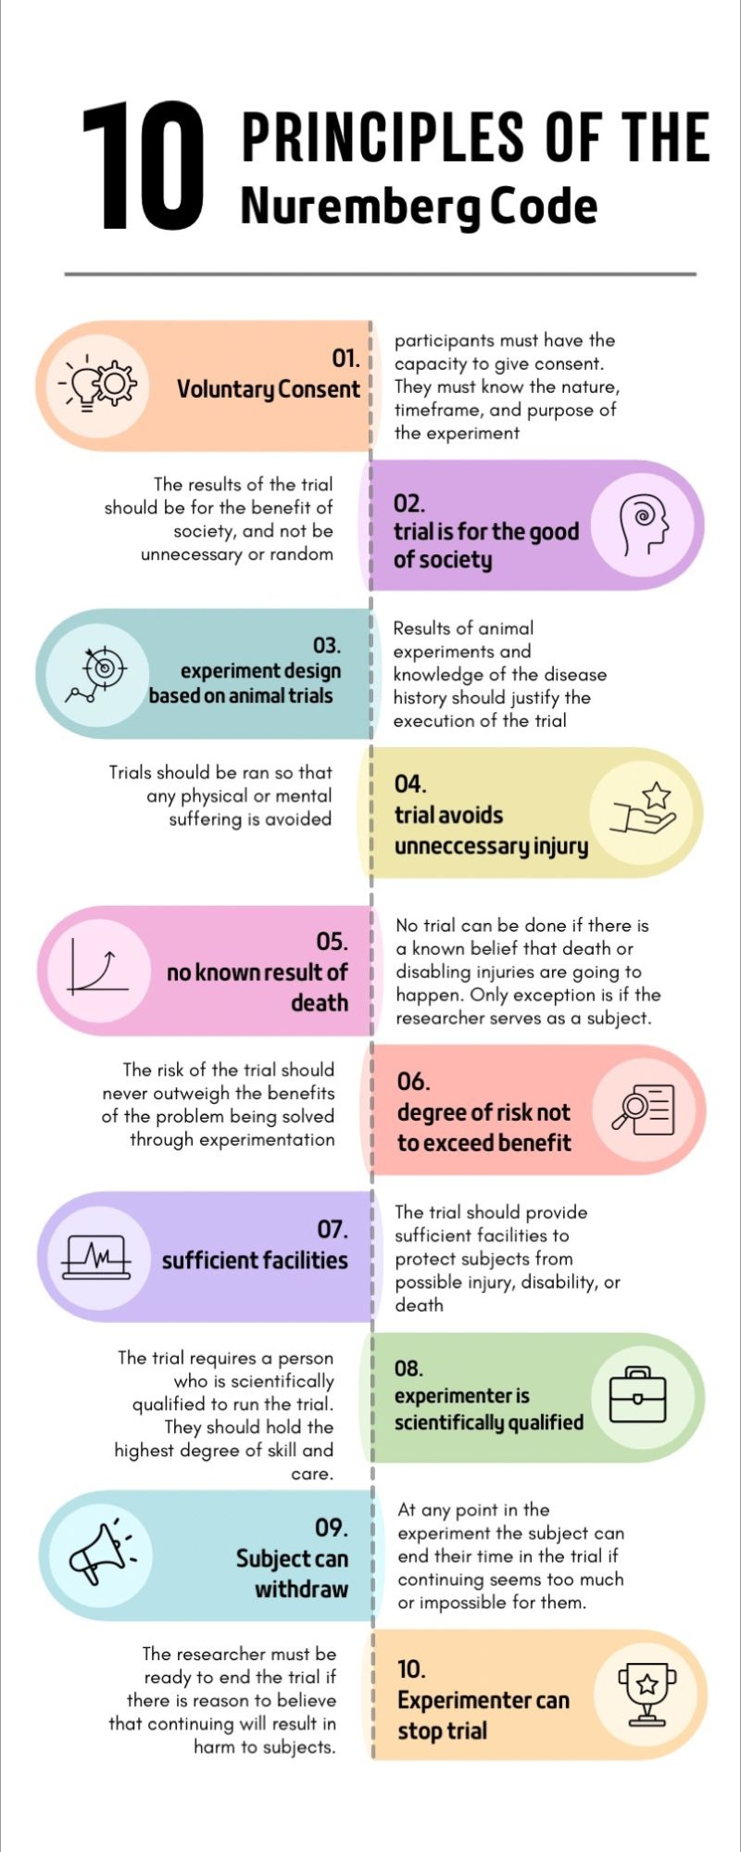
Research and Professional Ethics:
The Nuremberg Code of 1947

Slide 14
Research and Professional Ethics:
The Declaration of Helsinki (1964)
Adopted by the 18th World Medical Assembly, Helsinki, Finland, June 1964
The Declaration of Helsinki (1964), issued by the World Medical Association, expanded on the Nuremberg Code.
Established more detailed guidance for ethical research with humans.
  Respect for individuals, their right to make informed decisions
  Independent ethical review
  Additional protections for vulnerable populations
The Helsinki Declaration has been revised multiple times and remains a central international standard for biomedical research ethics.
Most national and institutional ethics policies adhere to Helsinki.

Slide 15
Research and Professional Ethics:
Nuremberg Code vs. Helsinki Declaration
The Declaration of Helsinki did not replace the Nuremberg Code but expanded and refined it for biomedical research
Institutionalization of Ethical Oversight
Risk–Benefit Analysis
Nuremberg Code: Focused primarily on voluntary consent by participants, placing the responsibility of compliance on individual researchers.
Helsinki Declaration: Introduced the concept of independent ethical review, requiring that research protocols be assessed by committees (what would later become Institutional Review Boards or Research Ethics Boards).
Nuremberg Code: Emphasized that experiments should avoid unnecessary suffering and should not proceed if death or disabling injury was likely.
Helsinki Declaration: Expanded this into a formal principle that the risks must be weighed against potential benefits, for both individuals and society, and that research could only proceed if the benefits justified the risks.
Notes:
The Nuremberg Code (1947) and the Declaration of Helsinki (1964) are both foundational documents in research ethics, but they differ in scope, emphasis, and institutionalization. The Declaration of Helsinki did not replace the Nuremberg Code but rather expanded and refined it for the practice of biomedical research. The major additions and advancements include:
1. Institutionalization of Ethical Oversight
Nuremberg Code: Focused primarily on voluntary consent by participants, placing responsibility on individual researchers.
Helsinki Declaration: Introduced the concept of independent ethical review, requiring that research protocols be assessed by committees (what would later become Institutional Review Boards/Research Ethics Committees).
2. Risk–Benefit Analysis
Nuremberg Code: Emphasized that experiments should avoid unnecessary suffering and should not proceed if death or disabling injury was likely.
Helsinki Declaration: Expanded this into a formal principle that the risks must be weighed against potential benefits, for both individuals and society, and that research could only proceed if the benefits justified the risks.
3. Distinction Between Therapeutic and Non-Therapeutic Research
Nuremberg Code: Did not differentiate between clinical (therapeutic) research on patients and non-therapeutic experiments.
Helsinki Declaration: Explicitly recognized this difference, permitting a degree of risk in therapeutic research if it could benefit the patient, while demanding stricter safeguards for non-therapeutic research.
4. Role of Physicians and Professional Duty
Nuremberg Code: Focused on universal principles of human rights and voluntariness, without reference to specific professions.
Helsinki Declaration: Framed research ethics within the medical profession, stressing the physician’s duty to prioritize the health, well-being, and rights of the patient/research subject above scientific interests.
5. Consent as a Process, Not Just a Statement
Nuremberg Code: Required voluntary informed consent as an absolute.
Helsinki Declaration: Retained informed consent but acknowledged circumstances (e.g., with incompetent patients or minors) where proxy consent could be obtained, provided safeguards were in place.
In summary: The Declaration of Helsinki broadened the ethical framework from a post-war safeguard against abuse (Nuremberg) into a systematic, professionalized, and institutionally enforced code for modern biomedical research. It introduced ethics committees, formalized risk–benefit considerations, distinguished types of research, and clarified physicians’ duties, shaping research governance for decades to follow.

Slide 16
Research and Professional Ethics:
The Belmont Report (1978)
The Belmont Report by the National Commission for the Protection of Human Subjects of Biomedical and Behavioral Research
Purpose: Commission formed through National Research Act (1974); tasked with identifying fundamental ethical principles for biomedicine.
Motivation: Developed in response to unethical research practices, most notably the Tuskegee Syphilis Study (1932–1972).
Contributions: Established three foundational ethical principles:
  Respect for Persons: Upholding autonomy and protecting those with diminished autonomy.
  Beneficence: Maximizing possible benefits and minimizing harm.
  Justice: Ensuring fair distribution of research burdens and benefits.
Notes:
The Belmont Report was completed in 1978 by the National Commission for the Protection of Human Subjects of Biomedical and Behavioral Research, which had been established by the U.S. Congress in 1974 in response to revelations of unethical studies, most infamously the Tuskegee Syphilis Study (1932–1972), where African American men were denied treatment in order to study disease progression. It was formally published in the Federal Register in April 1979, ensuring its principles would guide regulation and practice. The report identified three foundational ethical principles that continue to structure biomedical ethics: Respect for Persons (recognizing autonomy and protecting those with diminished autonomy), Beneficence (maximizing benefits while minimizing harm), and Justice (ensuring a fair distribution of the benefits and burdens of research). Serving as the ethical cornerstone of modern research oversight, the Belmont Report laid the foundation for Institutional Review Boards (IRBs), informed the U.S. “Common Rule,” and influenced international standards for research involving human subjects.

Slide 17
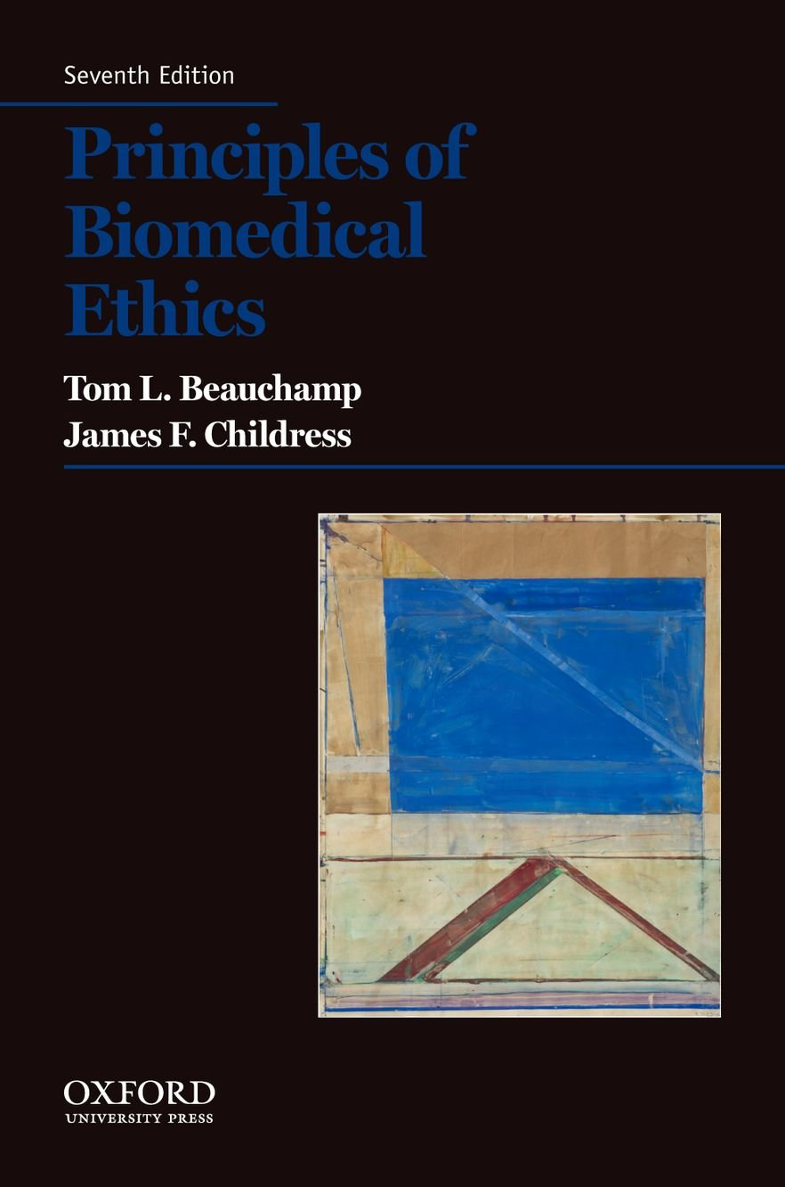
Research and Professional Ethics:
Beauchamp and Childress (1979)
Principles of Biomedical Ethics
A foundational text in research and professional ethics.
Expanded the Belmont principles:
  Respect for Autonomy: Individuals’ right to self-determination.
  Beneficence: Obligation to promote well-being.
  Non-Maleficence: Obligation to avoid harm.
  Justice: Fairness in distribution of benefits and burdens.
Translated the Belmont principles into a broader ethical framework for biomedical and clinical practice.
Legacy: Established the enduring vocabulary of modern clinical and research ethics.
Notes:
Beauchamp and Childress’s Principles of Biomedical Ethics emerged from the same historical and intellectual milieu as the Belmont Report, during a period when biomedical research faced a profound crisis of trust and legitimacy. The atrocities exposed at the Nuremberg Trials, followed by domestic scandals such as the Tuskegee Syphilis Study and unethical hospital research at Willowbrook and the Jewish Chronic Disease Hospital, revealed that the exploitation of vulnerable populations persisted well into the modern era. At the same time, civil rights, women’s rights, and patient advocacy movements challenged the paternalism of medicine, reframing ethical discourse around autonomy, informed consent, and human rights, while rapid clinical advances—such as organ transplantation, intensive care, and genetic testing—introduced unprecedented moral complexity. Within this context, Beauchamp and Childress belonged to a new generation of philosophers engaged in applied ethics, rejecting grand moral theories in favor of a flexible, principle-based framework that could guide moral reasoning in real-world contexts. Beauchamp, who served as a staff philosopher for the U.S. National Commission that authored the Belmont Report, helped translate its policy principles—Respect for Persons, Beneficence, and Justice—into a broader moral theory for all biomedical practice by adding Non-Maleficence and deepening their philosophical justification. In doing so, Principles of Biomedical Ethics transformed policy-driven ethical principles into a coherent and teachable moral framework, providing a shared ethical vocabulary that bridged philosophical reasoning, clinical practice, and regulatory oversight.

Slide 18
Research and Professional Ethics:
Ethical Principles of Biomedical Ethics
Beauchamp and Childress identified four core ethical principles that undergirds research and professional clinical ethics
The Principle of Beneficence: You must strive to give primacy to the interest and well-being of participants and must actively ensure that services are tailored and optimized toward such patient-centered ends.
The Principle of Non-Maleficence: You can under no circumstances inflict undue harm and/or compromise the well-being of participants, whether this is done through intentional or negligent behavior.
The Principle of Respect for Autonomy: You must recognize and appreciate the participant as a dignified individual capable of making their own decisions, and proactively aim to enhance, as well as refrain from exerting restraint on this capacity.
The Principle of Justice: You must orient your conduct in such a way that individuals are treated according to what is fair, appropriate, and bound by the assumption of social equality.

Slide 19
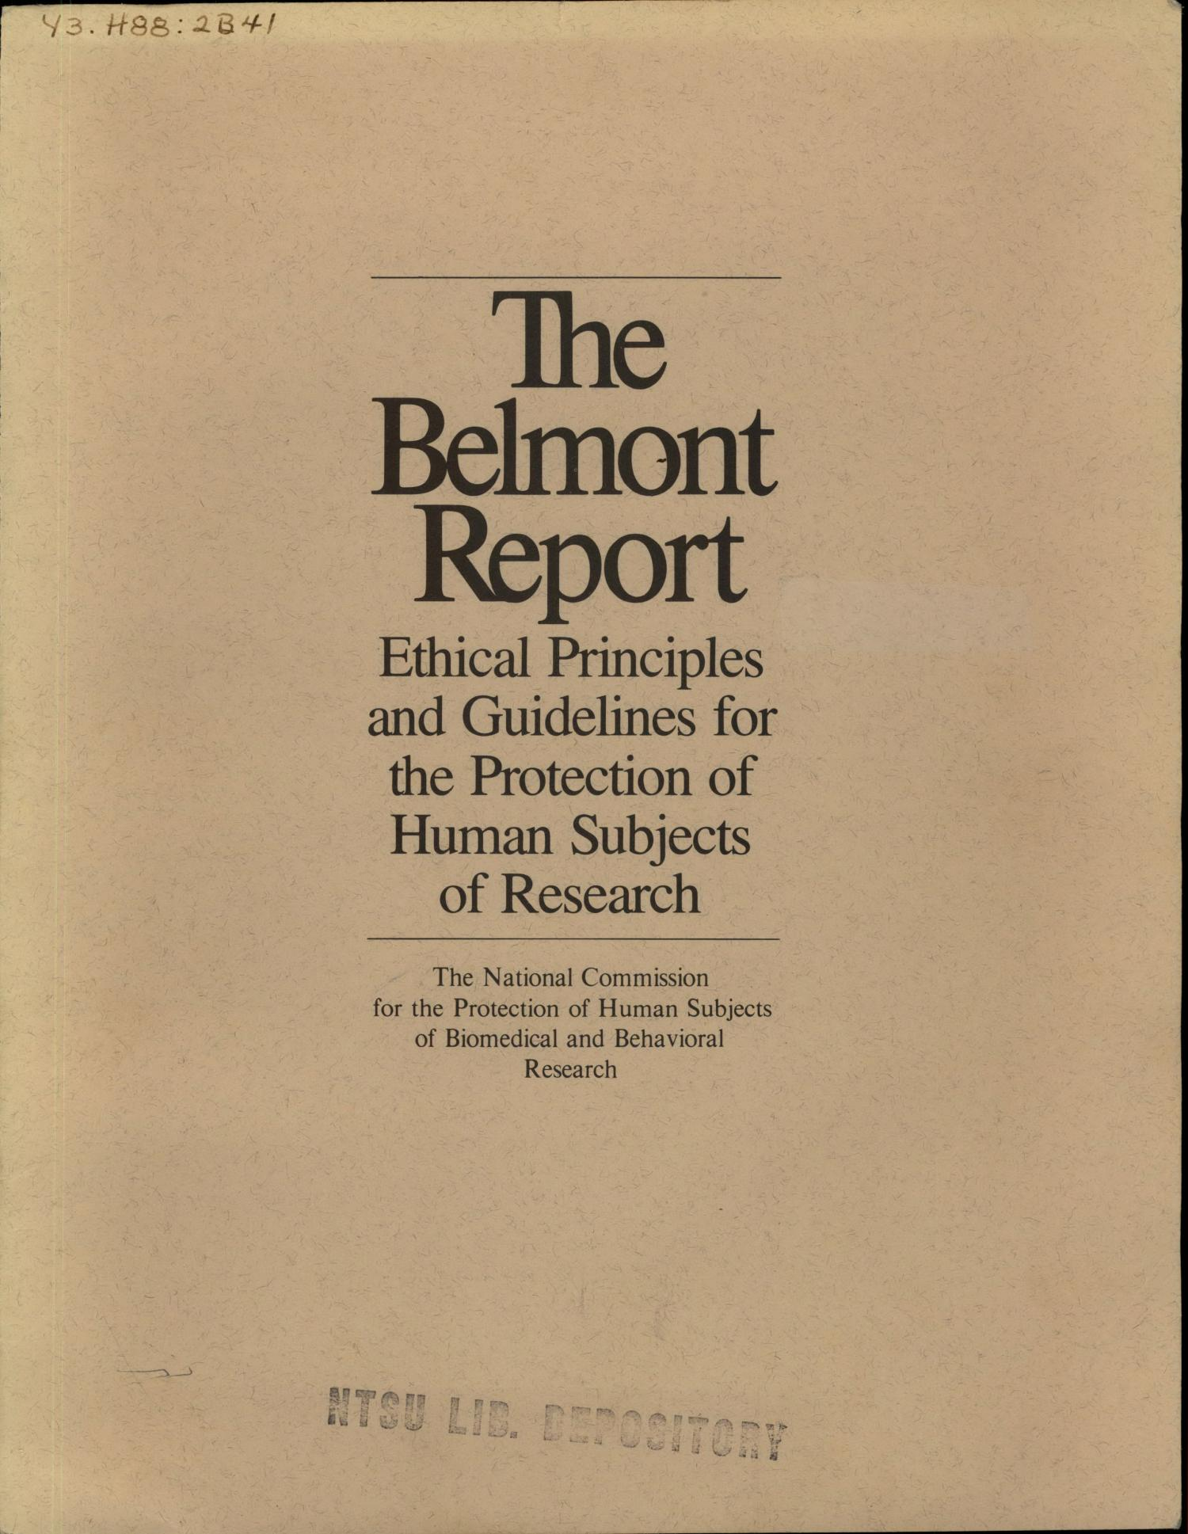
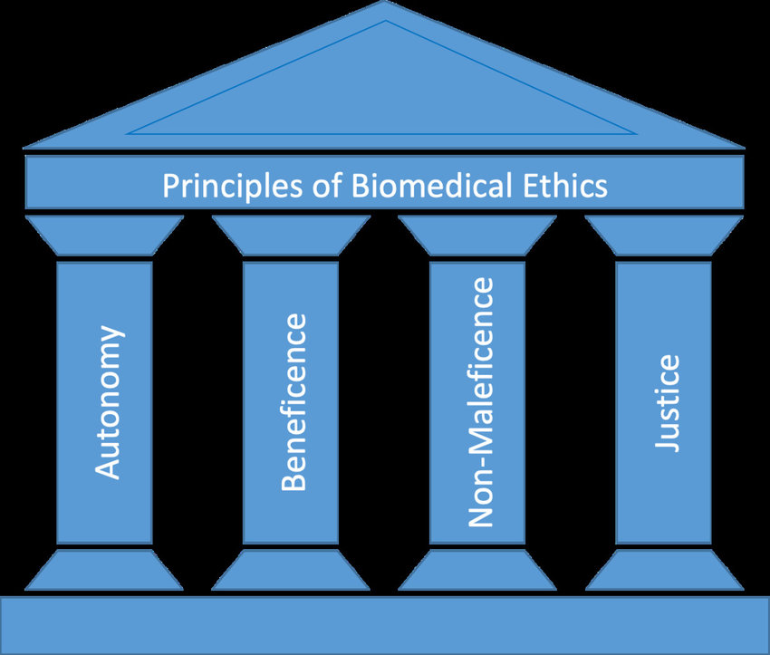
Research and Professional Ethics:
Ethical Principles of Biomedical Ethics
Beauchamp and Childress identified four core ethical principles that undergirds research and professional clinical ethics
Link
Notes:
These four principles—beneficence, nonmaleficence, respect for autonomy, and justice—are widely recognized as the cornerstone of modern biomedical ethics, codified most prominently in the 1979 Belmont Report and later systematized in Beauchamp and Childress’s Principles of Biomedical Ethics. While their conceptual roots extend back to Hippocratic traditions and philosophical theories of morality, their articulation in the late twentieth century reflected a response to growing concerns about patient rights, medical paternalism, and abuses in research such as the Tuskegee Syphilis Study. Together, they provided a practical, mid-level framework for guiding ethical decision-making in healthcare and research, balancing professional duties to patients with broader societal concerns. Their influence has been profound: they underpin international guidelines such as the Declaration of Helsinki, inform the work of ethics committees worldwide, and remain central to contemporary debates about emerging technologies, end-of-life care, and equitable access to healthcare.

Slide 20
Research and Professional Ethics:
Ethical Principles of Biomedical Ethics
Beauchamp and Childress identified four core ethical principles that undergirds research and professional clinical ethics
Professional Ethics: A set of conventionally established rules meant to provide ethical guidance for professionals in the field (i.e., researchers and practitioners).

Slide 21
The APA Ethics Code

Slide 22
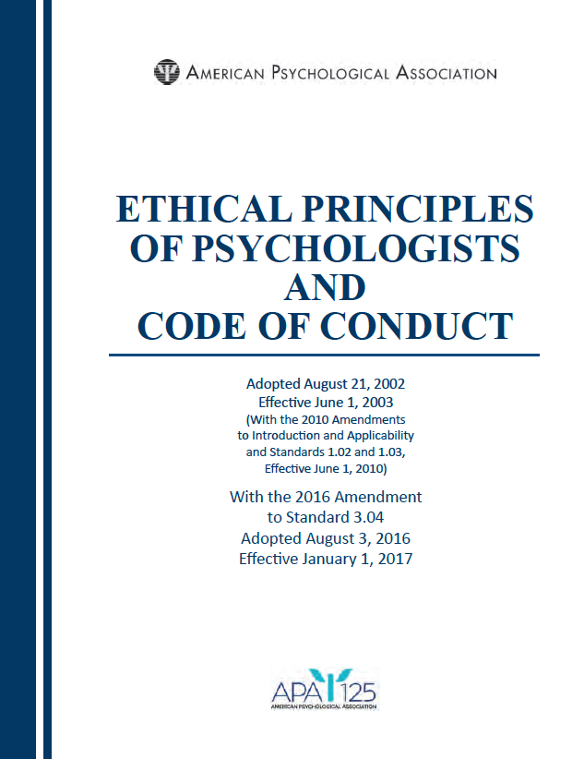
The APA Ethics Code:
The APA Ethics Code (2017)
American Psychological Association
Purpose: Provide ethical guidance in both research and practice.
It consists of:
  Four General Principles: Aspirational values intended to inspire ethical ideals and promote integrity in professional conduct.
  Ten Ethical Standards: Ten sets of enforceable rules that define clear professional obligations and can form the basis for sanctions when violated.
Aim: Promote high-quality and ethically sound psychological services.
  For example, to ensure that practitioners acknowledge, protect, and respect the rights and dignity of those they serve.

Slide 23
The APA Ethics Code:
The CPA Ethics Code (2017)
Canadian Psychological Association
Purpose: Provide a framework for ethical decision-making and professional conduct across all areas of psychology.
It consists of:
  Four General Principles: broad, hierarchical values that guide ethical reasoning and action. Ethical Standards: Each principle includes a list of “standards” specifying concrete expectations for behaviour.
Aim: Support ethical decision-making in complex professional contexts and balance responsibilities to individuals, communities, and society.
  For example, to ensure that psychologists act with integrity and social responsibility while respecting the dignity and well-being of those they serve..
Notes:
The APA and CPA ethics codes share a strong overlap in foundational ethical values (respect, competence, integrity, avoiding harm, accountability). The differences are more nuanced than radical: language, framing, societal emphasis, decision-making processes, and regulatory contexts differ somewhat.
The CPA code invites a broader societal perspective and emphasises responsibility beyond the individual client (for example, implications of research/diagnostics for society).

Slide 24

The APA Ethics Code:
The APA Ethics Code (2017)
General Principles: The APA Ethics Code includes five general principles, which serve as aspirational goals intended “to guide and inspire psychologists toward the very highest ethical ideals of the profession” (APA, 2017, p. 2).
Standards: The APA Ethics Code includes ten enforceable standards, which are framed as “rules” that psychologists must adhere to and use to guide decision-making in practice, research, and education.

Slide 25
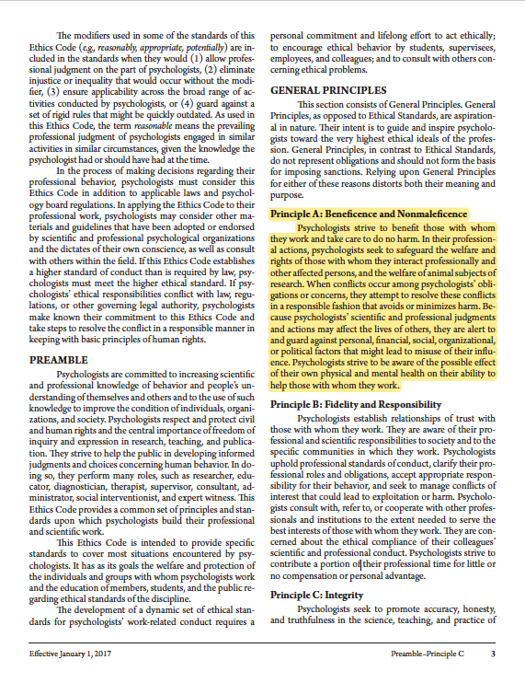
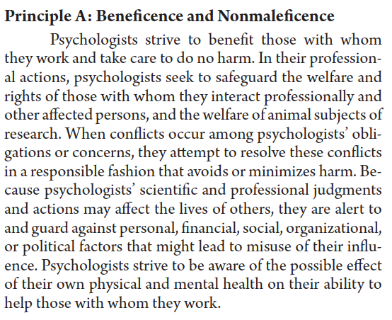

The APA Ethics Code:
Example of the “General Principles”

Slide 26
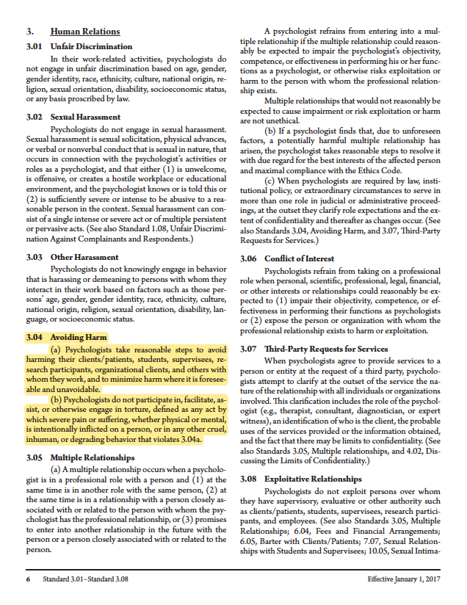
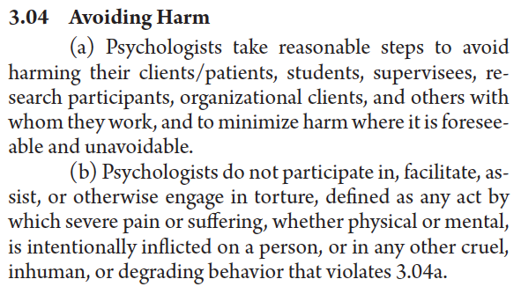
The APA Ethics Code:
Example of “Standards”

Slide 27
The APA Ethics Code:
Violating the Ethics Code
It’s not necessarily illegal to violate the APA Ethics Code.
However, practitioners who do violate ethical “principles” and “standards” are still doing something wrong.
Violations of Ethics Code “standards” can lead to sanctions such as: reprimand, censure, termination of certification, etc.
Generally, if a psychologist is found to have violated the Ethics Code, this can have great negative impact on their professional career.
For instance, it may lead to being fired from an institution or loss of license.
Effectively, unethical professional conduct is being limited, though it still occurs to an arguably non-trivial degree (i.e., there’s no ethics police).

Slide 28
Ethical Analysis of
PCL-R Assessments

Slide 29



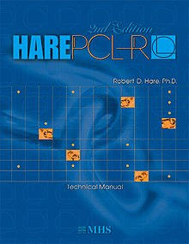

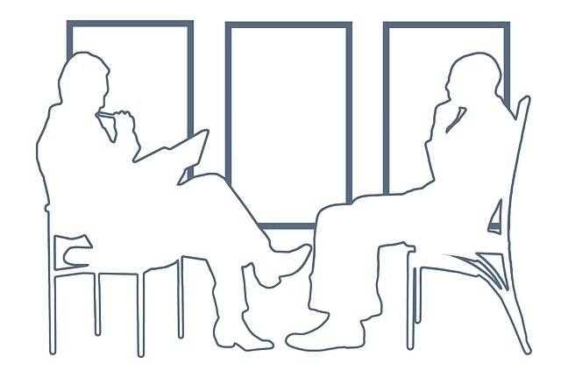

Ethical Analysis of PCL-R Assessments:
The Ethical Key Question:
Is it ethically defensible for a clinician to conduct a PCL assessment…?
Hello, I’m Tom…
PCL-R
Assessment
PCL-R Score
+30 (out of 40)
Resembles the Psychopathy Prototype
+

Slide 30
Ethical Analysis of PCL-R Assessments:
Recall: The Five Common Claims
We must analyze the “ethical question” with awareness that these five claims are either false and/or highly misleading…
1:
Psychopathic persons are extremely dangerous
2:
Psychopathy is chronically untreatable
3:
Psychopathic persons are deprived of morality
4:
Psychopathy is a biological condition
5:
Psychopathy is theoretically corroborated

Slide 31
Ethical Analysis of PCL-R Assessments:
Recall: Common Implications of a High PCL Score
NB: On average, a high PCL score will “nudge” or increase the chance of a restrictive decision
Sentencing: Judges may use a high PCL score as aggravating information (negative impact on bail, sentencing severity, etc.).
Dangerous Offender Status: A high PCL score is used to justify indeterminate sentencing, extended supervision, and parole restrictions.
Correctional Placement: A high PCL score often leads to classification as “high-risk” and may support placement in higher security settings.
Treatment Exclusion: A high PCL score may be seen as a barrier to rehabilitation programs due to the assumption of chronic, untreatable traits.
Capital Punishment: Courts may cite psychopathy as a chronic risk factor, favoring capital sentences over life without parole.
Parole Denial: PCL scores can negatively impact parole by signaling high risk, lack of remorse, and poor rehabilitation prospects.

Slide 32
Ethical Analysis of PCL-R Assessments:
Does the practice of PCL assessments comply with or violate the four ethical principles…?
The Principle of Beneficence: You must strive to give primacy to the interest and well-being of participants and must actively ensure that services are tailored and optimized toward such patient-centered ends.
The Principle of Non-Maleficence: You can under no circumstances inflict undue harm and/or compromise the well-being of participants, whether this is done through intentional or negligent behavior.
The Principle of Respect for Autonomy: You must recognize and appreciate the participant as a dignified individual capable of making their own decisions, and proactively aim to enhance, as well as refrain from exerting restraint on this capacity.
The Principle of Justice: You must orient your conduct in such a way that individuals are treated according to what is fair, appropriate, and bound by the assumption of social equality.

Slide 33
Ethical Analysis of PCL-R Assessments:
Violation of The Principle of Beneficence
For example: APA Standard 10.10 – Terminating Therapy (disengage non-beneficial therapeutic services)
Core Idea: Practitioners aim for beneficial outcomes (heal, well-being).
Intent vs. Function: Beneficence concerns why a tool is used, not merely what it does (e.g., scissors can both heal or harm).
Implications for PCL Assessments:
  The PCL-R’s function is to “measure psychopathy.”
  This measurement is ordinarily used to support restrictive measures (e.g., harsher sentencing, denial of parole, exclusion from rehabilitation).
Ethical Concern: Such uses serve institutional control rather than client welfare, thus violating the principle of beneficence.
Notes:
10.10 Terminating Therapy
(a) Psychologists terminate therapy when it becomes reasonably clear that the client/patient no longer needs the service, is not likely to benefit, or is being harmed by continued service.
(b) Psychologists may terminate therapy when threatened or otherwise endangered by the client/patient or another person with whom the client/patient has a relationship.
(c) Except where precluded by the actions of clients/patients or third-party payors, prior to termination psychologists provide pretermination counseling and suggest alternative service providers as appropriate.

Slide 34
Ethical Analysis of PCL-R Assessments:
Violation of The Principle of Non-Maleficence
For example: APA Standard 3.04 – Avoiding Harm (prohibits activities that cause or risk harm)
Core Idea: Abstain from causing harm; a duty rooted in the Hippocratic Oath (primum non nocere; “first do no harm”).
Caveat: Some harm may be permissible only if it is necessary and proportionate to achieve a clear therapeutic goal.
Implications for PCL Assessments:
  High PCL-R scores frequently lead to restrictive or punitive outcomes (e.g., harsher sentences, parole denial, capital punishment).
  These consequences are harmful and lack offsetting therapeutic benefit.
Ethical Concern: When used to intensify punishment rather than promote well-being = clear ethical violation.
Notes:
3.04 Avoiding Harm
(a) Psychologists take reasonable steps to avoid harming their clients/patients, students, supervisees, research participants, organizational clients, and others with whom they work, and to minimize harm where it is foreseeable and unavoidable.
(b) Psychologists do not participate in, facilitate, assist, or otherwise engage in torture, defined as any act by which severe pain or suffering, whether physical or mental, is intentionally inflicted on a person, or in any other cruel, inhuman, or degrading behavior that violates 3.04(a).

Slide 35
Ethical Analysis of PCL-R Assessments:
Violation of The Principle of Respect for Autonomy
For example: APA Standard 3.10 – Informed Consent or 3.08 – Exploitative Relationships
Core Idea: Every person must be treated as an autonomous agent; capable of self-determination and informed decision-making.
Legality: Rooted in democratic ideals of personal freedom and dignity (e.g., Bill of Rights, Canadian Charter of Rights and Freedoms).
Implications for PCL Assessments:
  True autonomy requires voluntary, informed participation.
  PCL-R assessment is often coerced or uninformed.
  Individuals rarely gain any benefit, and refusal may carry negative legal consequences.
Ethical Concern: valid informed consent for a PCL-R assessment is practically impossible; so, they violates respect for autonomy.
Notes:
3.10 Informed Consent
(a) When psychologists conduct research or provide assessment, therapy, counseling, or consulting services in person or via electronic transmission or other forms of communication, they obtain the informed consent of the individual or individuals using language that is reasonably understandable to that person or persons except when conducting such activities without consent is mandated by law or governmental regulation or as otherwise provided in this Ethics Code. (See also Standards 8.02, Informed Consent to Research ; 9.03, Informed Consent in Assessments ; and 10.01, Informed Consent to Therapy.)
(b) For persons who are legally incapable of giving informed consent, psychologists nevertheless (1) provide an appropriate explanation, (2) seek the individual's assent, (3) consider such persons' preferences and best interests, and (4) obtain appropriate permission from a legally authorized person, if such substitute consent is permitted or required by law. When consent by a legally authorized person is not permitted or required by law, psychologists take reasonable steps to protect the individual's rights and welfare.
(c) When psychological services are court ordered or otherwise mandated, psychologists inform the individual of the nature of the anticipated services, including whether the services are court ordered or mandated and any limits of confidentiality, before proceeding.
(d) Psychologists appropriately document written or oral consent, permission, and assent. (See also Standards 8.02, Informed Consent to Research ; 9.03, Informed Consent in Assessments ; and 10.01, Informed Consent to Therapy.)

Slide 36
Ethical Analysis of PCL-R Assessments:
What is “Informed Consent”…?
Four essential preconditions…
Disclosure: Practitioner provides full, comprehensible information about purpose, risks, and benefits.
Understanding: The individual demonstrates comprehension of the information provided.
Voluntariness: The decision is free from coercion, manipulation, or implicit pressure.
Competence: The individual possesses sufficient cognitive and legal capacity to decide.
Informed Consent: A process ensuring that individuals have the information, understanding, and freedom necessary to make voluntary decisions about participation in healthcare or research.
Notes:
Relevance to PCL Assessments:
Because these evaluations often entail harm (e.g., harsher sentencing) and lack personal benefit, genuine informed consent is rarely achievable.
In legally mandated cases, psychologists must still ensure their actions align with ethical obligations — or refuse participation if autonomy cannot be respected.

Slide 37
Ethical Analysis of PCL-R Assessments:
Violation of The Principle of Justice
For example: APA Standard 3.01 – Unfair Discrimination and 9.02 – Use of Assessments (Empirically Reliable)
Core Idea: Justice means fair and equal distribution of healthcare benefits and burdens; justice demands evidence-based care.
Implications for PCL Assessments:
  The PCL-R lacks robust empirical support for its five common claims.
  Continued use reinforces bias and discriminatory legal decision-making.
  In short, the PCL-R is a source of disinformation.
Ethical Concern: Such practices violate justice by denying individuals fair, evidence-based services.
Notes:
3.01 Unfair Discrimination
In their work-related activities, psychologists do not engage in unfair discrimination based on age, gender, gender identity, race, ethnicity, culture, national origin, religion, sexual orientation, disability, socioeconomic status, or any basis proscribed by law.
9.02 Use of Assessments
(a) Psychologists administer, adapt, score, interpret, or use assessment techniques, interviews, tests, or instruments in a manner and for purposes that are appropriate in light of the research on or evidence of the usefulness and proper application of the techniques.
(b) Psychologists use assessment instruments whose validity and reliability have been established for use with members of the population tested. When such validity or reliability has not been established, psychologists describe the strengths and limitations of test results and interpretation.
(c) Psychologists use assessment methods that are appropriate to an individual's language preference and competence, unless the use of an alternative language is relevant to the assessment issues.

Slide 38
Objections

Slide 39
Potential Objections:
Objection #1: My Client is the Legal Institution!
Objection #1: Forensic practitioners’ ethical obligations apply only to the legal institution commissioning the assessment (e.g., courts, parole boards, or correctional services). They have no ethical obligations to the person being evaluated.
Response #1: This view misinterprets professional ethics codes. The APA explicitly affirm that all persons under a practitioner’s care are entitled to ethically responsible services, regardless of who pays.
Response #2: PCL assessment involves direct engagement with a person in a clinical context. In such cases, the assessed individual must be regarded as a person deserving of respect and dignity
Response #3: Precedents from former professional ethics cases underscore that ethical duties are not suspended when working for third-party entities (e.g., see the Hoffman Report).

Slide 40
Potential Objections:
Objection #2: We Use the PCL-R Exclusively as a Risk Assessment
Objection #2: PCL-R assessments are ethically defensible if used only as statistical inference about risk, and not as a diagnostic claim about psychopathy (similar to other “risk assessment” tools only make statistical inferences).
Response #1: This suggestion is impossible to implement in forensic practices, as it would require a fundamental change in how PCL assessments are currently used = it’s the decision-makers who decide how to interpret the score, not the clinician conducting the assessment.
Response #2: Why then use the PCL-R? Evidence consistently shows that PCL-R assessments are outperformed by standard risk assessment instruments, calling into question the added value of PCL.
Response #3: Objection #2 undermines the very rationale for using a PCL-R assessment in the first place; namely, as an instrument to diagnose psychopathy.

Slide 41
Potential Objections:
Objection #3: There’s a Social Benefit to PCL-R Assessments
Objection #3: A PCL-R assessment provides a social benefit that outweighs individual harm, insofar that it assists a practitioner in identifying extreme offender types.
Response #1: Harming clients is only defensible when it (1) brings large benefits; (2) that they are certain to be achieved; (3) and when such benefits are only obtainable through harmful practice.
Response #2: However, there’s no evidence to suggest that a PCL-R assessment “identifies” individuals who exert such great dangers to society.
Response #3: Furthermore, the APA Ethics Code does not specify any prioritized obligations to society, but only to individual clients. Responsibility to society only regards alerting about imminent threats.

Slide 42
Potential Objections:
Objection #4: I’m Obliged to Service a Legal Institution
Objection #4: Practitioners are justified in conducting PCL assessments as they have a professional obligation to assist in the administration of justice; even when this obligation conflicts with their ethical duties toward the individual being assessed.
Response #1: This misrepresents the hierarchy of ethical obligations. The APA states that practitioners must resolve conflicts by adhering to ethical codes, not by deferring to the demands of legal authorities.
Response #2: APA Standard 1.02 makes clear that when ethical and legal responsibilities collide, psychologists must clarify the conflict and affirm their commitment to ethical standards.
Response #3: True exceptions (e.g., Tarasoff liability) apply only when practitioners face potential criminal liability for noncompliance. PCL assessments do not fall into this category.

Slide 43
Potential Objections:
Objection #5: Forensic Practitioners Are Unique..!
Objection #5: Forensic psychologists have a unique set of ethical obligations that differ from those in the APA ethics codes. Principles such as beneficence, nonmaleficence, etc. does not apply in full within the legal context.
Response #1: Objection #5 is factually incorrect. All psychologists, including those in forensic subspecialties, are bound by the same ethical codes of their respective professional organizations.
Response #2: Some scholars have argued for why a “separate” or “unique” ethics code should apply in forensics (e.g., Appelbaum, 1997), but these are academic debates; not professional realities.

Slide 44
Critical Reflections

Slide 45


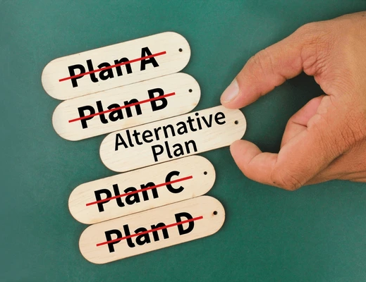
Critical Reflections:
Are Psychopathy Assessments Ethical…?
Moratorium..?
Sanctions and Misconduct
Alternatives
A near-universal moratorium on PCL use in forensic settings is warranted. The tool lacks proven benefit, causes demonstrable harm through punitive outcomes, and undermines autonomy and justice. In short, its minimal forensic utility does not outweigh personal harms it causes.
Continuing to use a scientifically disputed and ethically problematic instrument exposes practitioners to a growing risk of professional and ethical sanctions, making cessation not only responsible but necessary.
Recommending a moratorium is both viable and urgent. Forensic practitioners already have access to validated alternative assessment tools that provide empirically supported evaluations without the ethical liabilities associated with the PCL.

