Slide 1

Psychopathy and Crime
The Science, Ethics, and Legal Influence of a Controversial Diagnosis
Module 3
Psychopathy and Forensic Risk
Are Psychopathic Persons Extraordinarily Dangerous?
Copyright © Rasmus Rosenberg Larsen
Licensed under CC BY 4.0.

Slide 2

Any questions..?
© OpenAI (LLM-generated image)

Slide 3
Psychopathy and Crime
FSC350
Module 1
Introduction – What is Psychopathy?
Module 7
Two Theories of Psychopathy
Module 2
The Problem of Psychopathy
Module 8
Psychopathy and Scientific Spin
Module 3
Psychopathy and Forensic Risk
Module 9
Psychopathy and Ethics
Module 4
Psychopathy and Treatment
Module 10
Explaining a Lack of Evidence (Part I)
Module 5
Psychopathy and Moral Psychology
Module 11
Explaining a Lack of Evidence (Part 2)
Module 6
The Neuroscience of Psychopathy
Module 12
The Future of Psychopathy Research

Slide 4
This Module’s Agenda:
Calibrating Biases About Violence
Psychopathy and Dangerousness
Discussion: Forensic Risk
What is an Effect Size?
Risk Prediction Research (on PCL Samples)

Slide 5
Calibrating Biases About Violence

Slide 6
Peer Note-Taker Needed…
– WARNING –
POSSIBILITY OF GRAPHIC AND EXPLICIT CONTENT
– FORENSIC COURSE CONTENT WARNING –
Forensic Science courses may present content that includes (but is not limited to) visual depictions or discussions of assault, violent crimes, human tissue, victimization of children, death, psychological trauma, and systemic oppression. Students should be aware that some content may be distressing or unsettling.
Forensic courses provide an open space for the critical and civil exchange of ideas, and students are expected to create an atmosphere of mutual respect and sensitivity.

Slide 7
Peer Note-Taker Needed…
Uncontroversial Observation:
The World is Rife with Violence and Destruction
Past two centuries +200 million people have died in armed conflicts.
Most of these victims were innocent women and children.
Many of these victims were subject to persecution and denigration.
According to the United Nations, a record high of +120 million are currently displaced or seeking refuge in other countries.

Slide 8
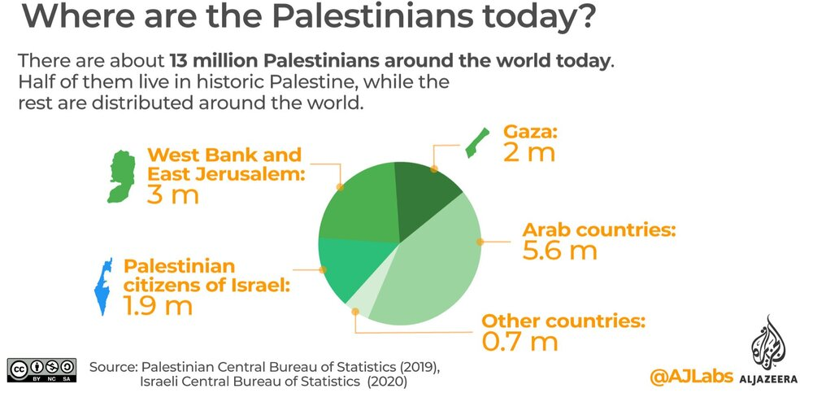

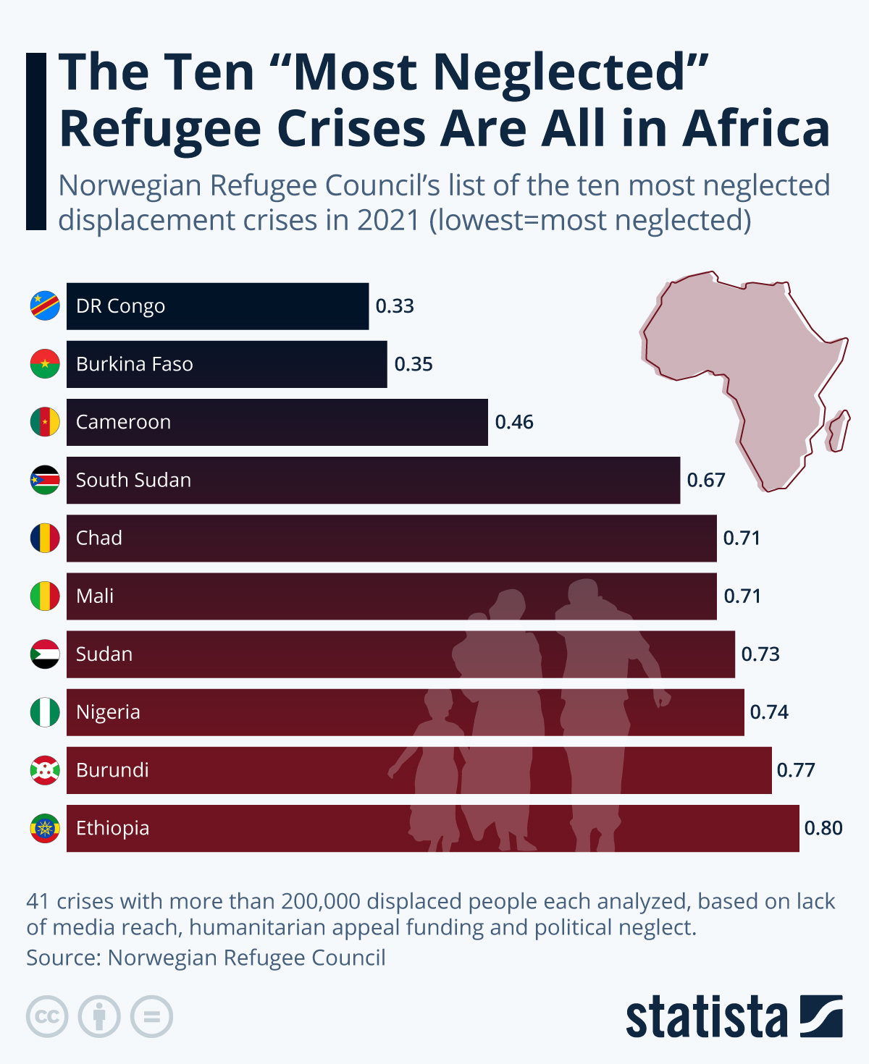

Peer Note-Taker Needed…
The World is Rife with Violence and Destruction
Victims are primarily innocent civilians…

Slide 9
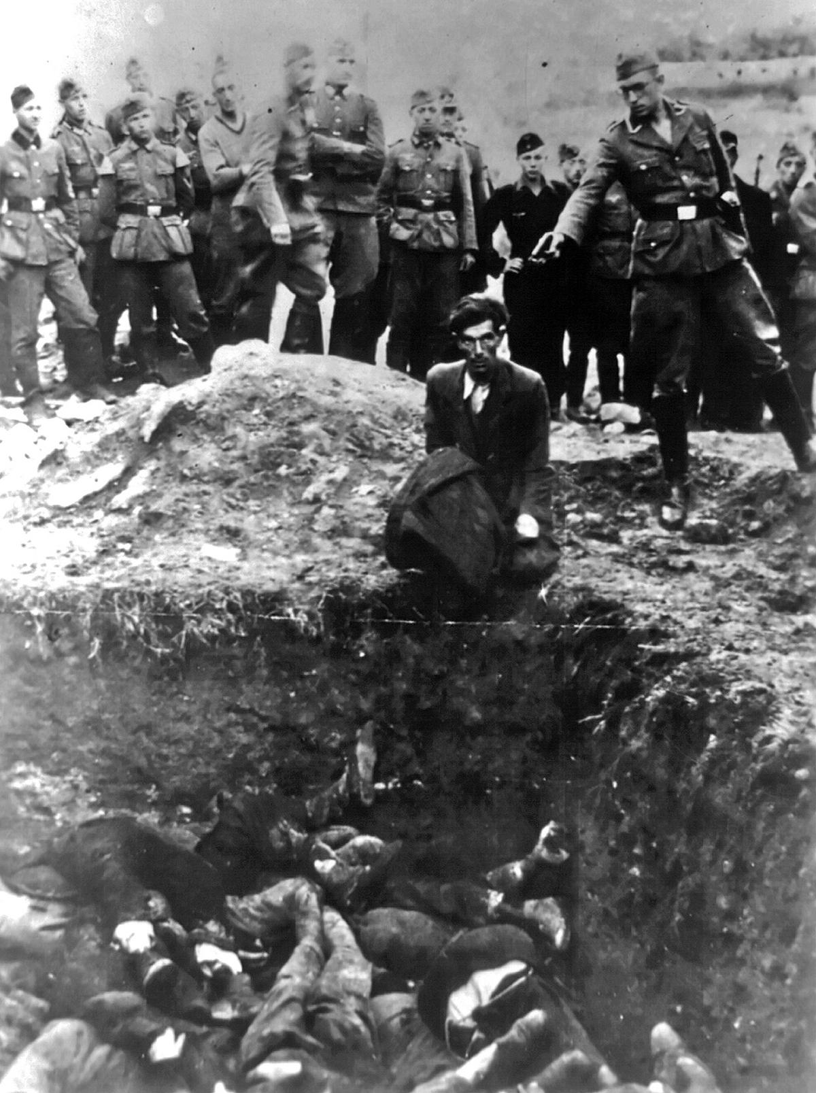

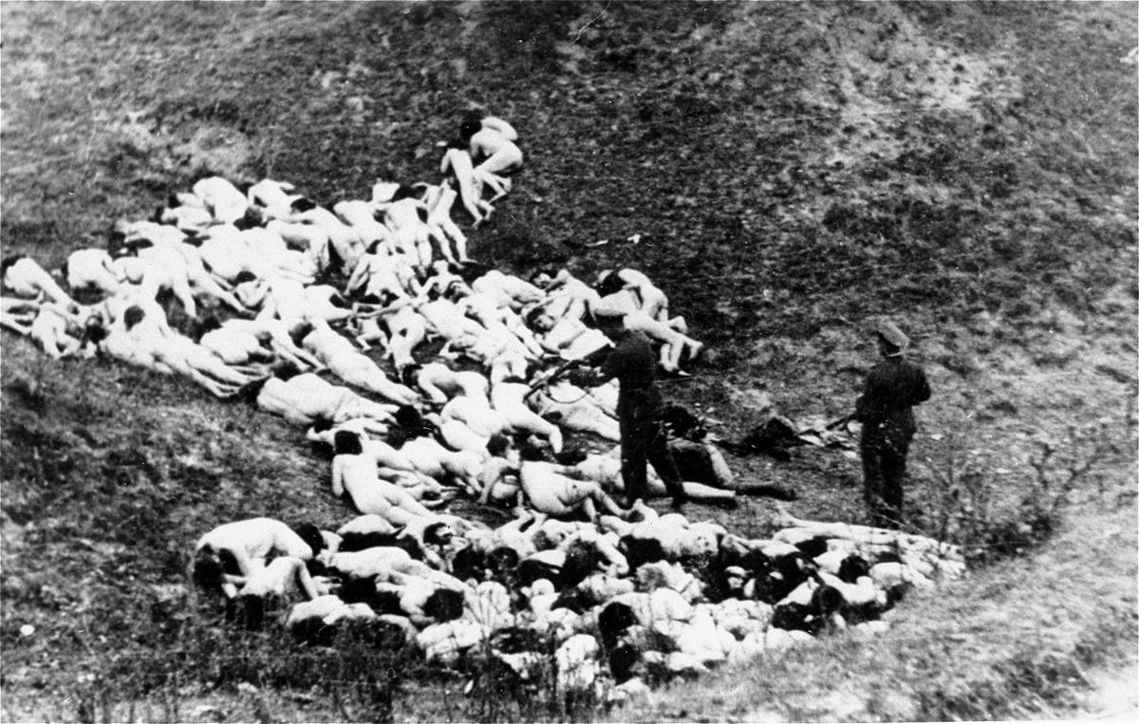

Peer Note-Taker Needed…
The World is Rife with Violence and Destruction
Many victims of armed conflict were subjects of ideological perpetration and genocide.

Slide 10

Peer Note-Taker Needed…
…why is the world rife with violence and destruction…?

Slide 11
Peer Note-Taker Needed…
The Problem of Psychopathy
Since Rush’s initial 1786-contribution, psychopathy has consistently been pitched as an explanation for social unrest and crime…
Described as a rare condition: 0.6% to 2.3% of the general population.
However, psychopathic persons are alleged to be disproportionately responsible for the majority of serious violent crime in North America.
Estimated that up to 35% of incarcerated individuals have psychopathy.
The monetary toll of psychopathy in US and Canadian societies might range between $245 to $1,591 billion (i.e., the cost of social turmoil they cause).
Psychopathic persons are allegedly overrepresented in business and political leadership roles, causing deep problems with social justice issues.
See also: Kiehl & Hoffman, 2011; De Brito et al., 2021

Slide 12




Peer Note-Taker Needed…
Psychopathy is Not the Full Story
Remember: Even if the Problem of Psychopathy is true, it doesn’t explain all social havoc and crimes
…in short, “normal” people can behave in unsavory ways…

Slide 13
Psychopathy and Dangerousness

Slide 14
Psychopathy & Dangerousness:
The Mainstream View
Psychopathy is claimed to be associated with extreme dangerousness
In the 1990s, “psychopaths” were often described as social predators.
The concept conveys a message about extremely dangerous individuals with devastating impact on society.
Many descriptions of what it means for someone to be categorized as extremely dangerous, but three claims are often highlighted:
  Psychopathic persons are relatively much more criminally prolific.
  Psychopathic persons are responsible for most serious and violent crimes.
  Psychopathic persons are relatively more prone to instrumental violence.
  Psychopathic persons are chronically dangerous.

Slide 15

Psychopathy & Dangerousness:
“Psychopaths are social predators … [who are] completely lacking in conscience and in feelings for others, they selfishly take what they want and do as they please, violating social norms and expectations without the slightest sense of guilt or regret.”
Quote from Without Conscience (1993)

Slide 16

Psychopathy & Dangerousness:
“Psychopathic offenders tend to be among the most chronic, habitual, and frequent offenders in the population, and studies have linked psychopathy to violent crime, property crime, weapons-oriented crime, drug crime, and diverse other offenses. In addition […] they commit crime that is ruthlessly instrumental and targeted, and then express little in the way of guilt or responsibility for their crimes.”
Quote from Psychopathy as a Unified Theory of Crime (2016)

Slide 17
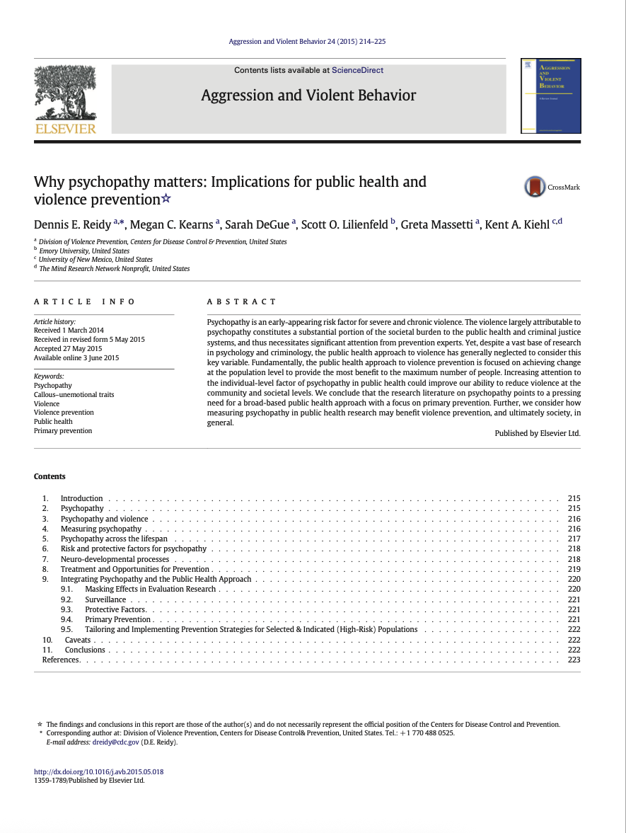
Psychopathy & Dangerousness:
“[Psychopathic offenders] are at least five times more likely to recidivate violently than nonpsychopathic offenders […] and they commit twice as many violent crimes as nonpsychopathic offenders.”
Dennis E. Reidy and colleagues (2015)

Slide 18



Psychopathy & Dangerousness:
Quintessential Examples of Psychopathy
Scholars occasionally point to real-life people they associate with (high) psychopathy
Ted Bundy
e.g., in Meloy (1988)
Aileen Wuornos
e.g., in DeLisi (2016)

Slide 19
Psychopathy & Dangerousness:
Getting Specific About the Claim
It’s a truism that some people appear to be extremely dangerous.
For example, a Canadian study found that nearly 38% of all federal prisoner released in 2011-2012 reoffended within 5 years (2019).
Some people appear fundamentally peaceful, where others are not.
However, researchers claim that psychopathy is be a strong predictor and explanation of extreme instances of repeat offending.
Notice that this is a prognostic claim, which is empirically testable.
Claim #1 – Extraordinary Dangerousness: Comparing psychopathic vs. non-psychopathic groups reveal a much higher rate of repeat offending in the psychopathic group, including higher rates of serious crimes and instrumental violence.

Slide 20

Psychopathy & Dangerousness:
Claim #1 – Extraordinary Dangerousness: Comparing psychopathic vs. non-psychopathic groups reveal a much higher rate of repeat offending in the psychopathic group, including higher rates of serious crimes and instrumental violence.
Group Selection
Prognostic Claim
Group A:
Non-psychopathic
Justice-Involved = a person that has violated the criminal code.
A: Non-psychopathic = a “justice-involved” person that “scores <30 on the PCL-R”.
B: Psychopathic = a “justice-involved” person that “Scores >30 on PCL-R”.
Claim #1:
“Very Large difference in future criminal behavior”
Group B:
Psychopathic

Slide 21
Discussion:
Forensic Risk

Slide 22
Discussion: Forensic Risk
Defining Forensic Risk
Forensic risk is broadly defined as the propensity to cause any form of harm to oneself, property, and/or other people.
When we say that a person is “dangerous,” the concept usually refers to a substantially elevated level of “forensic risk.”
In prediction studies, we typically deal with a narrower form of risk, namely: the risk of violating criminal laws (or institutional rules).
Forensic Risk: The possibility of causing physical and psychological harm to oneself, property, or other people (e.g., “high” vs. “low” forensic risk).

Slide 23








Discussion: Forensic Risk
Discussion Question:
How much more dangerous must a person be before we are justified in referring to the as “extraordinarily dangerous” or as a “social predator”?
Mean = 10
The curves indicate a fictional example of normal distribution of two groups in terms of their post-release reconviction rates.
Bold Curve: Non-Psychopathic Group
Dotted Curve: Psychopathic Group
Number of Persons
0 | 2 | 4 | 6 | 8 | 10 | 12 | 14 | 16 | 18 | 20
Number of Reconvictions
NB: This figure illustrates the “though experiment” provided in Psychopathy Unmasked, pp. 44-45

Slide 24
What is an Effect Size?

Slide 25
What is an Effect Size?
Probability Values vs. Effect Sizes
Results from risk prediction research are typically reported using conventional descriptive and inferential statistics.
This includes a probability value (p-value) to estimate the “likelihood” of the observed results (“statistical significance” at .05 [alpha]).
Researchers also calculate effect sizes, which are an expression of the “magnitude” of the observed results (e.g., between-group difference).
Effect sizes are usually reported in Cohen’s d, Pearson’s r, odds ratios, hazard ratios, Area Under the Curve (from ROC), etc.

Slide 26
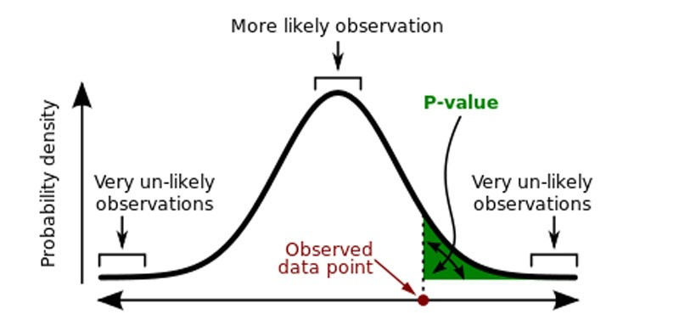
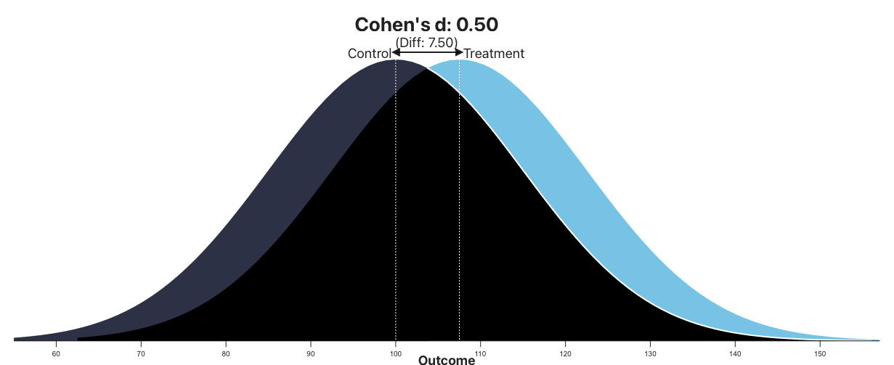
What is an Effect Size?
Probability Values vs. Effect Sizes
vs.
Notes:
Assume no difference
Start from the null hypothesis: the two Labrador groups are equally fast in the population.
Measure the observed gap
In our sample, Group A averaged 16.26 sec, Group B 16.86 sec → a difference of 0.60 sec.
Scale the gap by the noise
We know there’s natural variation (some dogs faster, some slower). To judge whether 0.60 sec is “big,” we divide it by the typical amount of random variation we’d expect between two groups of this size.
This calculation gives the t-value.
In our case, t ≈ 2.24.
Compare to the reference distribution
The t-distribution (with 78 degrees of freedom here) tells us what values of t are common or rare if there really were no difference.
Find the probability
A t of 2.24 falls out in the “rare” part of the distribution. The probability of seeing such a large t by chance is about 0.028 (2.8%). That’s the p-value.
In plain words: The p-value tells us how surprising the observed gap is under the assumption that there’s no true difference. A value of 3% means such a difference would be rare by chance, so we consider it evidence that the two groups do, in fact, differ.
Rundown in plain words:
Measure the gap (0.60 sec).
Compare it to the natural noise (Standard Error of Difference [SE] = 0.268).
Express the result as a t-value (2.24).
See where that t-value lands on the t-distribution (df = 78).
The area in the tails gives the p-value (≈ 0.028).
1. What has to be computed
To get a p-value in a two-sample t-test, you need to:
Compute the group means.
Compute the standard deviation within each group.
From these, calculate the standard error of the mean difference.
Divide the observed difference by that standard error → the t-value.
Now comes the tricky part: to know how unusual that t-value is, you need to know the shape of the t-distribution for your degrees of freedom.
2. The t-distribution isn’t “nice”
Unlike the normal distribution, which has a simple formula involving the bell curve and tables of the standard normal, the t-distribution involves the gamma function (a generalization of factorials). The probability density function is:

Slide 27


What is an Effect Size?
The Labrador Agility Showdown: American vs. English
Study Design and Methods
NB: This is a fictitious study designed to advance effect size interpretation
In the grand tradition of pitting friendly rivals against one another, researchers set out to test whether the American Labrador Retriever (Group A) or the English Labrador Retriever (Group B) holds the upper paw on the agility course.
Eighty Labradors (40 from each breed) were recruited for the challenge. With ears flapping and tails wagging, each dog sprinted, leapt, and wove through a standardized agility track while the researchers timed their runs with military-grade stopwatches (and a few backup biscuits for motivation).

Slide 28
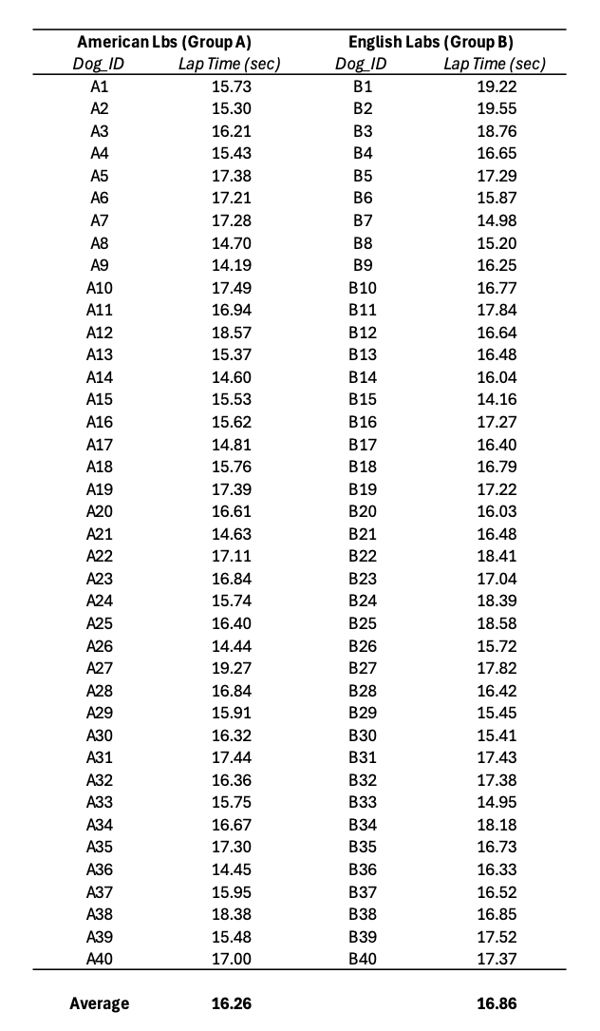
What is an Effect Size?
The Labrador Agility Showdown: American vs. English
The Data
NB: This is a fictitious study designed to advance effect size interpretation
Question
Can you tell by “the naked eye” which group was the fastest…?
Notes:
Sometimes a dog in Group A is quicker than a dog in Group B, and vice versa.

Slide 29
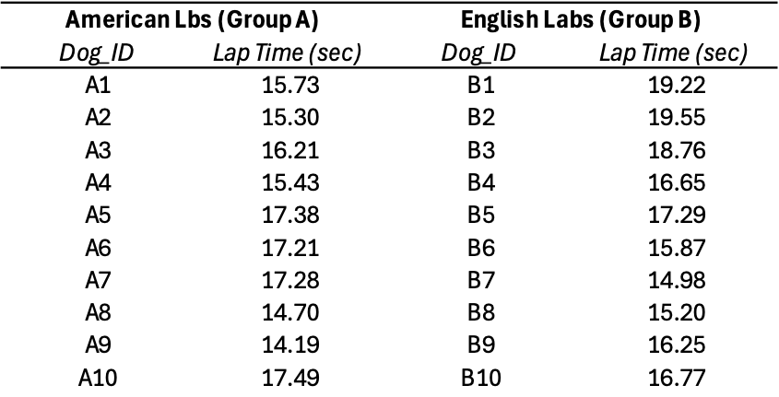
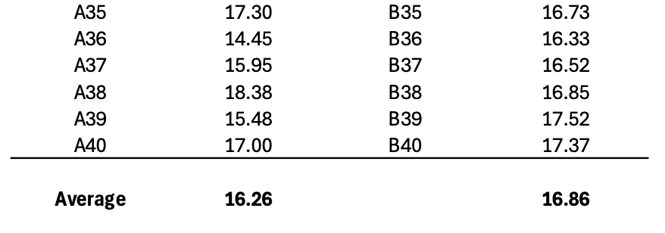
What is an Effect Size?
The Labrador Agility Showdown: American vs. English
The Data
NB: This is a fictitious study designed to advance effect size interpretation
Notes:
Sometimes a dog in Group A is quicker than a dog in Group B, and vice versa.

Slide 30

What is an Effect Size?
The Labrador Agility Showdown: American vs. English
Results
NB: This is a fictitious study designed to advance effect size interpretation
Average Completion Times:
Total Sample 16.56 seconds
American Labs (Group A) 16.26 seconds
English Labs (Group B) 16.86 seconds
Statistics:
P-Value t(78) = 2.24, p = 0.028
Standard Deviation (pooled) 1.20 seconds
Effect Size Cohen’s d = 0.50
In sum, American Labs (Group A) were faster by about 0.6 seconds on average (i.e., half of one SD unit).
Notes:
In the study, two groups of Labradors (Group A and Group B) were timed while running an agility course. The goal was to see whether one group consistently outperformed the other. When the results were tallied, Group A completed the course in an average of 16.26 seconds, while Group B averaged 16.86 seconds—a difference of about 0.6 seconds.
To determine whether this observed difference was likely due to chance or reflected a real underlying distinction between the groups, the data were analyzed statistically. Researchers compared the group means while also taking into account the amount of variability in run times within each group. This produced a test statistic, which was then used to calculate a p-value: the probability of observing a difference this large (or larger) if the groups were truly equal in the broader population. The p-value was 0.028, meaning such a difference would occur by chance only about 3% of the time. Because this value falls below the conventional 5% threshold, the difference was judged to be statistically significant. Put simply, the p-value reflects how surprising the observed group difference would be if the two groups of Labradors were, in fact, equally fast.

Slide 31
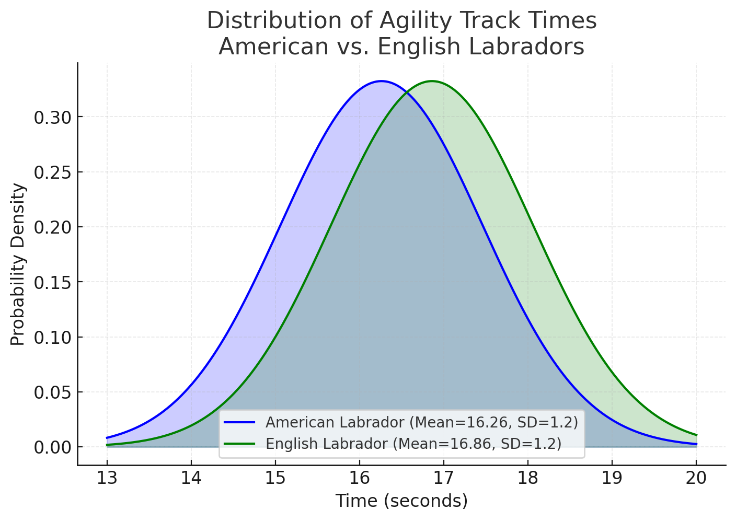
What is an Effect Size?
The Labrador Agility Showdown: American vs. English
The Data
NB: This is a fictitious study designed to advance effect size interpretation
d = 0.5
0.60 seconds
(= 0.5 SD)
Standard Deviation (pooled) 1.20 seconds
Effect Size Cohen’s d = 0.50

Slide 32

What is an Effect Size?
The Mississauga Prison Prediction Study
Study Design and Methods
NB: This is a fictitious study designed to advance effect size interpretation
Researchers examined whether two groups of individuals classified by their score on the PCL-R assessment would show measurable differences in the number of days it took for them to commit an institutional violation (e.g., refuse to clean cell, insult staff, inmate infraction, etc.).
The sample consisted of 80 participants, 40 in each group:
Group A – psychopathic PCL-R Total Score >30)
Group B – non-psychopathic (PCL-R Total Score <30).
Participants were monitored over a fixed 30 days period.

Slide 33

What is an Effect Size?
The Mississauga Prison Prediction Study
Results
NB: This is a fictitious study designed to advance effect size interpretation
Average Time Before Violation:
Total Sample 16.56 days
Psychopathic (Gr. A) 16.26 days
Non-Psychopathic (Gr. B) 16.86 days
Statistics:
P-Value t(78) = 2.24, p = 0.028
Standard Deviation (pooled) 1.20 days
Effect Size Cohen’s d = 0.50
In sum, psychopaths(Group A) were faster to violate rules by about 0.6 days on average (i.e., half of one SD unit).

Slide 34
What is an Effect Size?
Converting Effect Sizes
Results
NB: This is a fictitious study designed to advance effect size interpretation
Average Time Before Violation:
Total Sample 16.56 days
Psychopathic (Gr. A) 16.26 days
Non-Psychopathic (Gr. B) 16.86 days
Statistics:
P-Value t(78) = 2.24, p = 0.028
Standard Deviation (pooled) 1.20 days
Effect Size Cohen’s d = 0.50
In sum, psychopaths(Group A) were faster to violate rules by about 0.6 days on average (i.e., half of one SD unit).
Hazard Ratio
Cohen’s d = 0.50 corresponds to a hazard ratio of ≈ 1.9 (link).
A hazard ratio of 1.9 means that, on any given day, persons in the psychopathic group (A) had nearly twice the risk of violating institutional rules compared to persons in the non-psychopathic group (B).
NB: Sometimes descriptions of effect sizes can make them “seem” more substantial than they are.

Slide 35
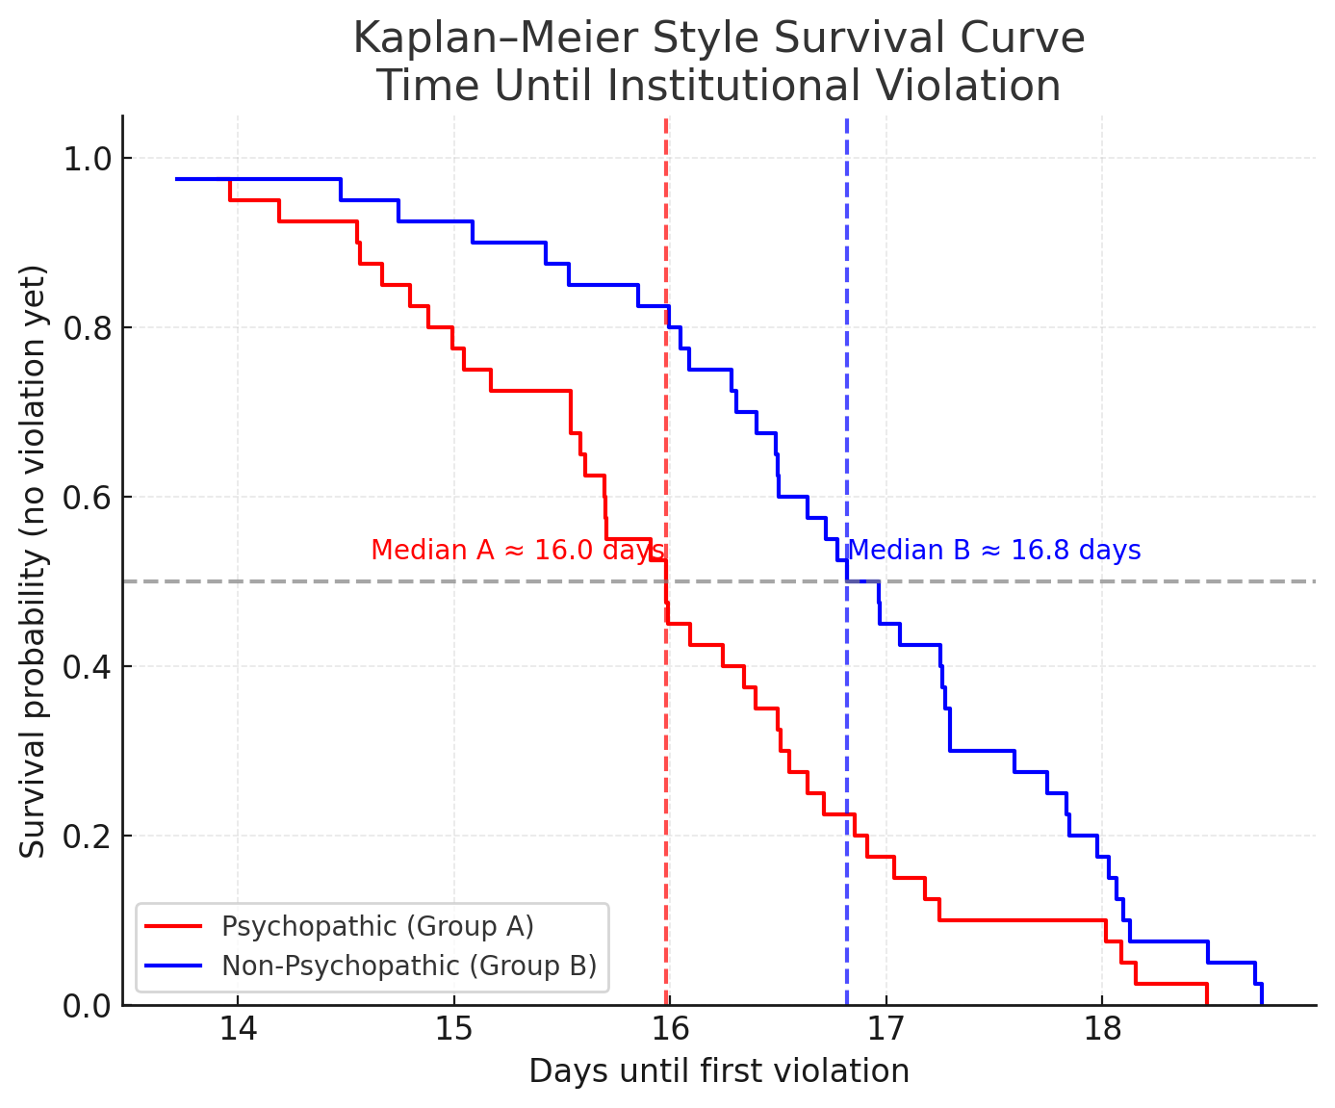
What is an Effect Size?
Converting Effect Sizes
Results
NB: This is a fictitious study designed to advance effect size interpretation
Hazard Ratio
Cohen’s d = 0.50 corresponds to a hazard ratio of ≈ 1.9 (link).
A hazard ratio of 1.9 means that individuals classified as psychopathic (Group A) were more likely to violate institutional rules faster on any given day. On average, they committed a violation about 14.5 hours (0.6 days) faster than their non-psychopathic counterparts.
Kaplan–Meier survival curve :
Psychopathic group (red): Median time to first violation ≈ 16.0 days.
Non-psychopathic group (blue): Median time to first violation ≈ 16.8 days.
The dashed vertical lines show where each group’s survival probability drops below 50%.

Slide 36
Risk Prediction Studies
(on PCL Samples)

Slide 37

Risk Prediction Studies:
Study Designs
#1: Predictive / Prospective designs
Collect baseline data first, then test whether it forecasts future outcomes.
Stronger evidence of validity because cause and effect are temporally separated.
Example: Risk score measured at intake predicts violations in the following 12 months.
#2: Postdictive / Retrospective designs
Datasets where outcomes have already happened (i.e., looking backward).
Easier to conduct but more vulnerable to bias (e.g., hindsight confirmation).
Example: Comparing risk scores today with violation records from last year.

Slide 38
Risk Prediction Studies:
Claim #1 – Extraordinary Dangerousness: Comparing psychopathic vs. non-psychopathic groups reveal a much higher rate of repeat offending in the psychopathic group, including higher rates of serious crimes and instrumental violence.
Group Selection
Prognostic Claim
Group A:
Non-psychopathic
Justice-Involved = a person that has violated the criminal code.
A: Non-psychopathic = a “justice-involved” person that “scores <30 on the PCL-R”.
B: Psychopathic = a “justice-involved” person that “Scores >30 on PCL-R”.
Claim #1:
“Very Large difference in future criminal behavior”
Group B:
Psychopathic
NB: Sometimes a study might measure a correlation coefficient between PCL scores and recidivism (i.e., no groups).

Slide 39
Risk Prediction Studies:
Study Quality
Gillespie et al. (2023) and Holper et al. (2025) have found significant quality concerns in PCL risk prediction studies
Study Design: Predictive (prospective) > Postdictive (retrospective); adequate and pre-defined follow-up period.
Sample: Large representative sample; minimal selection bias.
Measurement: Blind raters; reliable scoring; clear outcome definitions.
Analytical Rigor: Disclosure of missing data; no massaging of data; control for confounding variables.
Bias: Independent evaluation; developer bias.
Transparency: Pre-registration; open-access data.

Slide 40
Risk Prediction Studies:
Research Output & Systematic Reviews
Since 1980, more than +200 published prediction studies on PCL samples and forensic risk outcomes (e.g., Holper et al. 2025).
Systematic Reviews: Transparent collection, synthesis, and summary of all available evidence.
Systematic reviews follow protocols to reduce bias and randomness:
  PRISMA Guidelines and/or Cochrane Reviews.
Meta-Analysis: A statistical technique within systematic reviews
  Pools effect sizes across studies → produces a single, more precise estimate.
NB: Holper et al. (2025) is not included in Psychopathy Unmasked as the study was published after the book was printed.

Slide 41
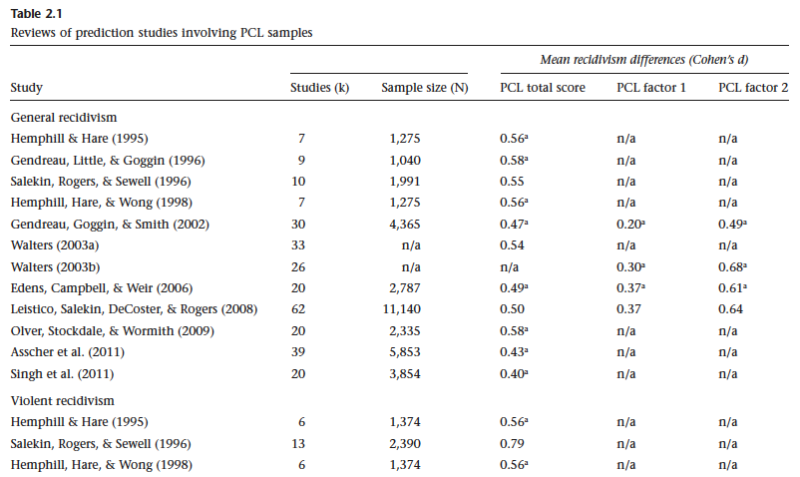
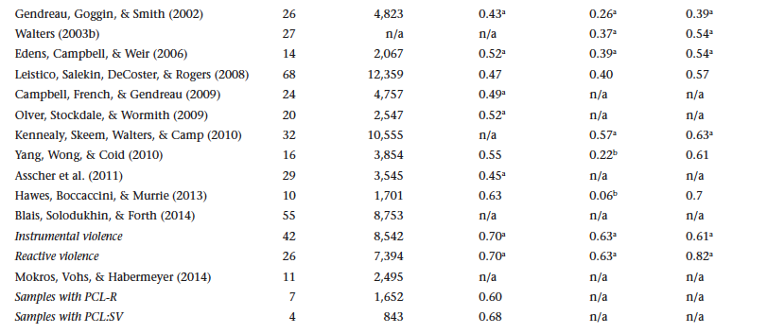
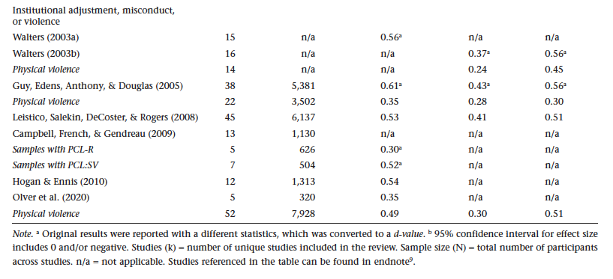
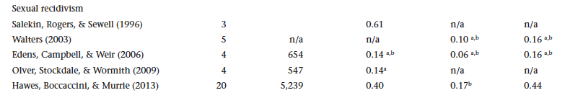
Risk Prediction Studies:
Source: Psychopathy Unmasked, pp. 47-49.

Slide 42
Risk Prediction Studies:
Systematic Review Highlights
The most recent and largest study to date is by Holper et al. (2025); see also, Leistico et al. (2008)
There’s a very small (<0.20) to small (0.21-0.50) to medium (0.51-0.80) between-group difference across outcome variables and reviews:
  General recidivism: d = 0.40 – 0.58
  Violent recidivism: d = 0.43 – 0.79
  Sexual recidivism: d = 0.14 – 0.61
  Institutional misconduct: d = 0.30 – 0.61
In addition, systematic reviews have reported on issues that subtracts from the inferential value of the evidence (e.g., quality, moderators).

Slide 43
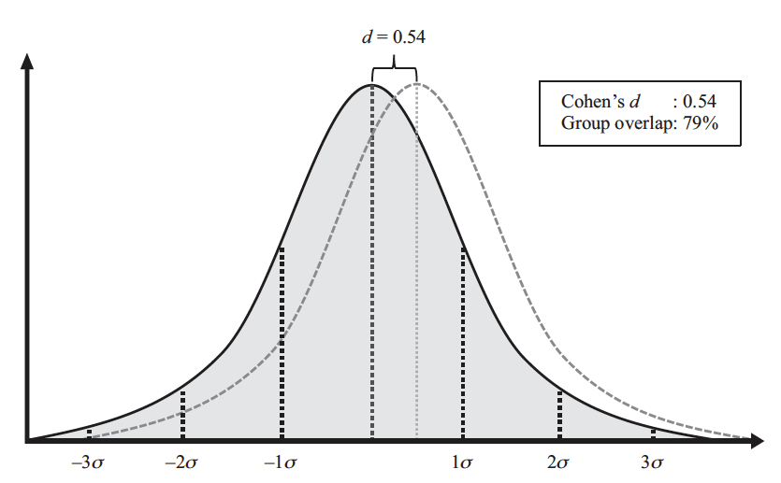
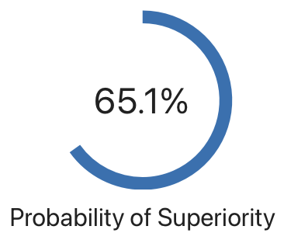
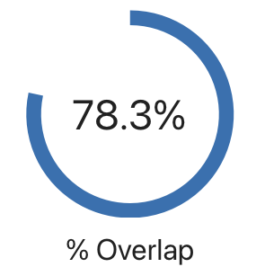
Risk Prediction Studies:
Interpreting Effect Sizes
Example of Cohen’s d = 0.55 | from meta-analysis by Holper et al. (2025)
d = 0.55
Roughly 65% chance that a randomly selected individual from the psychopathic group is of higher forensic risk than a person from the non-psychopathic group.
Roughly 78% of the range of forensic risk is shared between the two groups, that is: psychopathic vs. non-psychopathic individuals fall within a risk-range common to both groups.
An illustration of group differences. This compares the non-psychopathic group (left) to PCL psychopathic group (right) with an effect size of Cohen’s d = 0.55. The sigma (σ) symbol indicates one standard deviation unit.
Notes:
Probability of Superiority
There is about a 65% chance that a randomly selected individual from the psychopathic group has a higher forensic risk score than a randomly selected individual from the non-psychopathic group.
Conversely, in ~35% of comparisons, the non-psychopathic individual has the higher risk score.
Contextual note: This indicates a modest group-level tendency, not a reliable individual-level rule; psychopathy increases the odds of higher risk but does not determine it.
Overlap
Roughly 78% of the range of forensic risk is shared between the two groups.
Most individuals—across both groups—fall within a common risk range, with no clear boundary separating them.
Contextual note: Heavy overlap means group averages translate poorly into individual classifications.
Important
If a practitioner infers that individuals in the psychopathic group are “much higher” risk (rather than modestly higher on average), the likelihood of false positives increases substantially.
Strong or categorical risk labels amplify error because the underlying distributions are highly overlapping and only moderately separated.

Slide 44
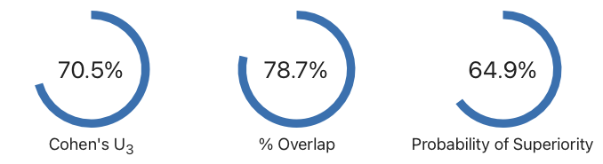
Risk Prediction Studies:
Interpreting Effect Sizes
Example of Cohen’s d = 0.54 | e.g., see Holper et al. (2025) and Leistico et al. (2008)
With a Cohen's d of 0.54, 70.5% of the “psychopathic” group will be above the mean of the “non-psychopathic” group (Cohen’s U₃), 78.7% of the two groups will overlap, and there is a 64.9% chance that a person picked at random from the “psychopathic” group will have a higher or worse forensic outcome than a person picked at random from the “non-psychopathic” group (probability of superiority).
An illustration of group differences. This compares the non-psychopathic group (left) to PCL psychopathic group (right) with an effect size of Cohen’s d = 0.50. The sigma (σ) symbol indicates one standard deviation unit.
NB: Kristoffer Magnusson’s interactive effect size illustrator

Slide 45
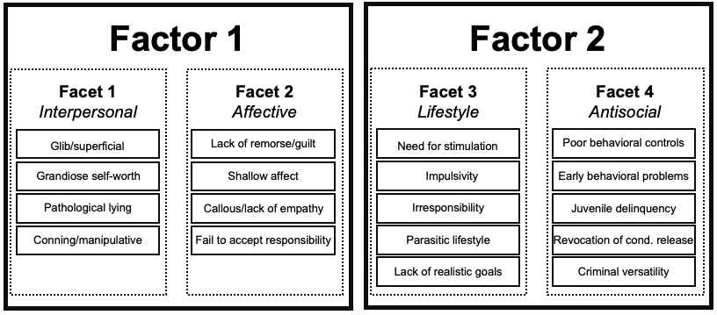

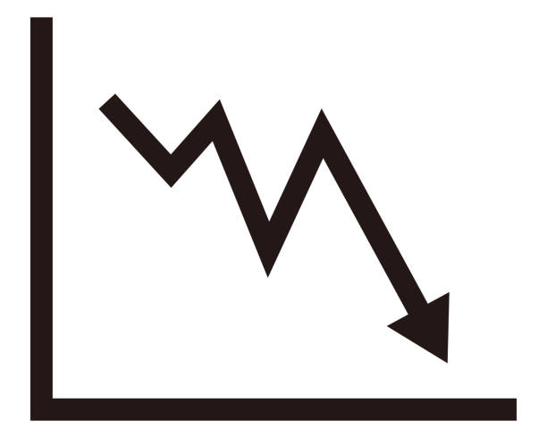

Risk Prediction Studies:
Important Caveats
From systematic reviews by Holper et al. (2025), Gillespie et al. (2023), and Leistico et al. (2008)
Factor 2 Items Predict
Factor 1 Items Distort
High Quality Studies Have Lower Effect Sizes
Various Moderating Variables
Age
Gender
Geography
Ethnicity

Slide 46
Risk Prediction Studies:
Interpreting Effects Sizes
Jacob Cohen on Small-Medium Effect Size
So, there is a very small-medium difference between psychopathic vs. non-psychopathic persons in forensic risk (i.e., across multiple studies).
Jacob Cohen (who created “Cohen’s d”) has a creative way of conceptualizing such a difference.
Only medium-large effect sizes are discernible to “the naked eye.”
Cohen described it as the difference in height between 15- and 16-year-old girls (i.e., small) and 14- and 18-year-old girls (i.e., medium).
Put in other words: The difference is often too small to be discerned without relying on sophisticated data analysis.

Slide 47
Risk Prediction Studies:
Issue #1: Criminogenic Items Are the Predictors
PCL-R personality traits or Factor 1 items appear to decrease overall predictability; the PCL-R predicts because of Factor 2 items, which are essentially made up of common criminogenic factors (see also, Yang et al., 2010)
Notes:
A central debate in the prediction studies summarized in Table 2.1 concerns whether the observed group differences are primarily driven by certain parts of the PCL. Researchers have found that the lifestyle and antisocial items—known as factor 2—account for much of the predictive signal. By contrast, the interpersonal and affective items of factor 1, often considered the core psychological traits of psychopathy, show much weaker associations with forensic outcomes. Looking across the data, effect sizes for factor 1 are consistently smaller—sometimes by as much as 50%—compared to factor 2. This means that group differences in recidivism and related outcomes are more strongly tied to antisocial lifestyle indicators than to the so-called “distinctive” features of psychopathy.
The puzzle is that factor 2 items are not unique to psychopathy but are common criminogenic features found broadly among offender populations, such as juvenile delinquency, parasitic lifestyle, and criminal versatility. If these variables alone drive most of the predictive results, then a PCL total score is not a reliable tool for isolating individuals at extraordinary risk. In fact, one could argue that grouping people simply on the basis of these common criminogenic items might be more informative than relying on the psychopathy label. This challenges the notion that PCL scores, particularly when interpreted as marking “social predators,” provide a meaningful or distinctive way to identify who is truly high risk.

Slide 48
Risk Prediction Studies:
Issue #2: Quality Discrepancy Across Reviews
Some systematic reviews/meta-analyses may be misleading.
Gillespie et al. (2023): most reviews showed serious quality issues (flawed statistics, inconsistent reporting, bias)
Only one review rated “high quality”: Edens et al. (2006):
  General recidivism: d = 0.49
  Violent recidivism: d = 0.52
  Sexual recidivism: d = 0.14 ( Confidence interval overlap with zero = spurious)
Average effect size (d = 0.38) ≈ 25% lower than Leistico et al. (2008).
Conclusion: Low-quality reviews likely overestimate effect sizes.
Notes:
Scholars have cautioned that systematic reviews and meta-analyses of prediction studies may provide a misleading picture of risk. A 2023 review by Gillespie and colleagues examined the quality of all published review studies and found that most suffered from serious methodological flaws, including problematic statistical practices, inconsistent reporting, and bias. Out of all the studies they assessed, only one—Edens et al. (2006)—was rated as high quality.
Interestingly, the effect sizes reported by Edens and colleagues were consistently smaller than those in lower-quality reviews: d = 0.49 for general recidivism, d = 0.52 for violent recidivism, and d = 0.14 for sexual recidivism (the latter indistinguishable from zero). Averaging across these outcomes gives a weak effect size of d ≈ 0.38, about 25% lower than the estimate reported by Leistico et al. (2008). This pattern suggests that low-quality reviews may systematically overestimate the predictive strength of psychopathy, underscoring the importance of critically evaluating study quality when interpreting aggregated evidence.

Slide 49
Risk Prediction Studies:
Issue #3: Moderating Variables
A moderator variable is a fact (e.g., gender) that changes the strength or direction of the relationship between two variables.
Moderator analyses show recidivism rates vary by various factors:
  Sex: Psychopathic men have lower recidivism than psychopathic women
  Country: Higher recidivism in Canada vs. United States
  Ethnicity: Lower recidivism in ethnic minority groups vs. non-minority groups
Key concern: Ethnic minority men are overrepresented in PCL assessments, yet show lower risk.
Conclusion: Moderators challenge the claim that PCL psychopathy universally predicts “extraordinary dangerousness” in populations.
Notes:
Researchers have found that the weak to moderately higher risk levels observed in PCL psychopathy groups do not generalize well across all individuals. The results presented in Table 2.1 (in Psychopathy Unmasked) represent aggregated findings, but when researchers conduct what is known as a moderator analysis, they see significant variation in recidivism rates depending on demographic characteristics such as gender, country, and ethnicity.
For example, Leistico and colleagues (2008) reported that psychopathic men showed relatively lower recidivism rates compared to psychopathic women. They also found that recidivism rates were higher in Canadian samples than in U.S. samples, and that individuals from ethnic minority groups had significantly lower recidivism rates compared to non-minority groups. This latter finding is particularly concerning, since ethnic minorities are disproportionately likely to undergo PCL assessments due to their overrepresentation in the justice system. Taken together, these results not only challenge the notion that psychopathic individuals are uniformly “extraordinarily dangerous,” but also undermine the assumption that risk levels associated with high PCL scores generalize across all populations.

Slide 50
Risk Prediction Studies:
Critical Question #1
Based on the empirical evidence, do you think we are justified in referring to psychopathic persons as “extraordinarily dangerous” or as a “social predator”?

Slide 51
Risk Prediction Studies:
Critical Question #2
If research findings show only weak to moderate risk levels in PCL samples, and these vary by gender, country, and ethnicity…
Why do experts continue to describe psychopathic persons as “extraordinarily dangerous”…?

