Slide 1

Psychopathy and Crime
The Science, Ethics, and Legal Influence of a Controversial Diagnosis
Module 6
The Neuroscience of Psychopathy
Is psychopathy a brain disorder?
Copyright © Rasmus Rosenberg Larsen
Licensed under CC BY 4.0.

Slide 2
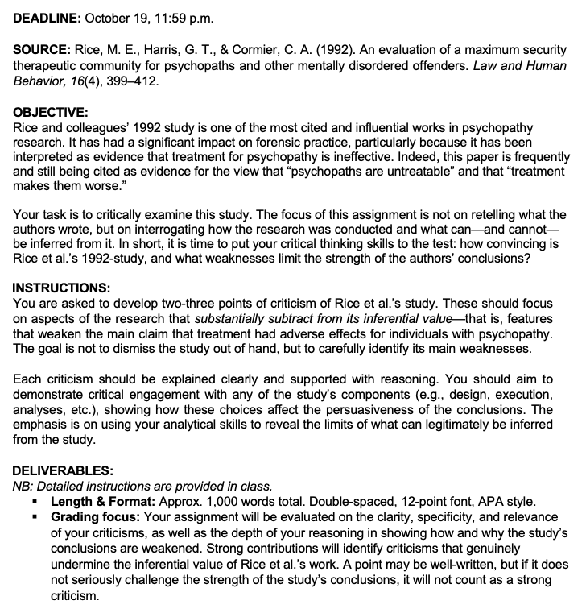
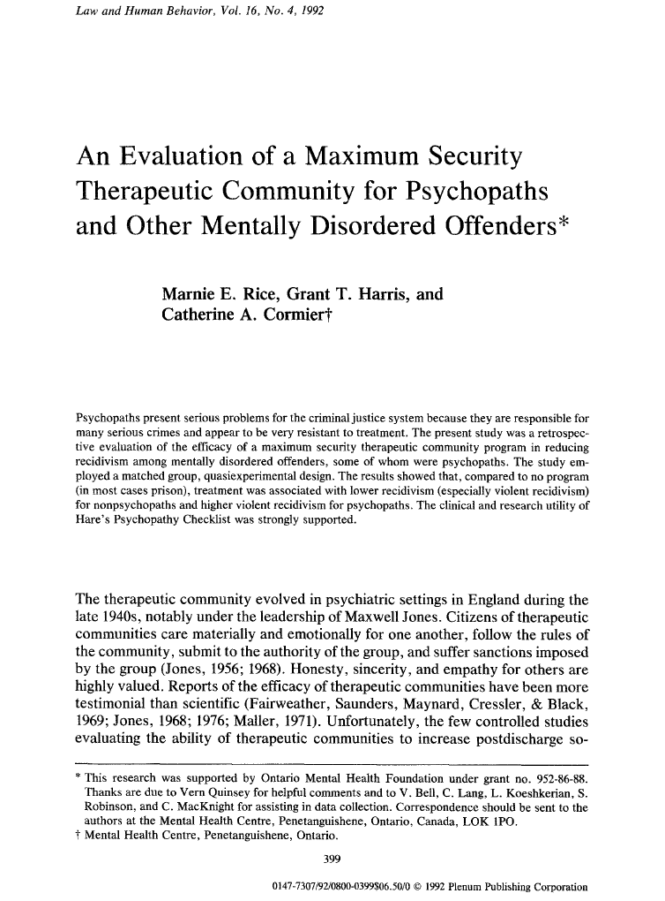
Assignment #1

Slide 3
Assignment #1
Assignment #1:
Critical Analysis of Rice et al. (1992)

Slide 4
Assignment #1
Objectives
Your task is to critically examine Rice et al. (1992).
The focus of this assignment is not on retelling what the authors wrote, and trivially framing their study as problematic.
Instead, you must interrogate how the research was conducted and what can—and cannot—be inferred from it.
In short, it is time to put your critical thinking skills to the test:
  How convincing is Rice et al.’s 1992-study, and what weaknesses limit the strength of the authors’ conclusions?

Slide 5
Assignment #1
Instructions
Develop two-three points of criticism of Rice et al.’s study.
These should focus on aspects of the research that substantially subtract from its inferential value—that is, features that weaken the study’s main claim.
  NB: The goal is not to dismiss the study out of hand, but to carefully identify its main weaknesses according to your analysis.
Each criticism should be explained clearly and supported with reasoning.
You should aim to demonstrate critical engagement with any of the study’s components (e.g., design, execution, analyses, etc.).
The emphasis is on using your analytical skills to reveal the limits of what can legitimately be inferred from the study.

Slide 6
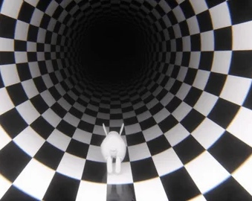


Assignment #1
Instructions
Identify Main Weaknesses
Critical Investigation
Low Hanging Fruit
A study may have many weaknesses, but you must identify the most important.
Be Warned: Rice et al. (1992) is full of surprises.
Sometimes the most important weakness is not the most obvious one.

Slide 7

Any questions..?
© OpenAI (LLM-generated image)

Slide 8
Psychopathy and Crime
FSC350
Module 1
Introduction – What is Psychopathy?
Module 7
Two Theories of Psychopathy
Module 2
The Problem of Psychopathy
Module 8
Psychopathy and Scientific Spin
Module 3
Psychopathy and Forensic Risk
Module 9
Psychopathy and Ethics
Module 4
Psychopathy and Treatment
Module 10
Explaining a Lack of Evidence (Part I)
Module 5
Psychopathy and Moral Psychology
Module 11
Explaining a Lack of Evidence (Part 2)
Module 6
The Neuroscience of Psychopathy
Module 12
The Future of Psychopathy Research

Slide 9
This Module’s Agenda:
Biological Research on Personality Disorders
Psychopathy as a Biological Condition
Neuroimaging Technology
MRI Research in PCL Samples
Critical Reflections

Slide 10
Biological Research on Personality Disorders

Slide 11
Biological Research on Personality Disorders:
The Obvious Complexity of Mental Health
The Biopsychosocial Model: Mental disorders as complex constructs
Mental health problems are widely believed to arise from the complex interaction of biological, psychological, and social factors.
  Biological: genetics, hormones, neurobiology, physical health.
  Psychological: thoughts, emotions, coping skills, personality traits.
  Social: relationships, culture, socioeconomic status, environment.
Understanding mental disorders requires looking at the individual in context, not only at symptoms or few (potential) biological causes.
So, by studying the brain of PCL psychopathic persons, we are not necessarily endorsing reductionism. (i.e., brain is part of the puzzle).
Notes:
EXAMPLE:
Imagine a university student named Alex who is diagnosed with Major Depressive Disorder (MDD).
Biological factors:
Alex has a family history of depression—his mother and grandfather both experienced MDD. This suggests a possible genetic predisposition that influences how his brain regulates neurotransmitters such as serotonin and dopamine. In addition, Alex has been sleeping poorly and skipping meals, which can further disrupt mood-regulating biological systems.
Psychological factors:
Alex tends to be highly self-critical and perfectionistic. After failing an exam, he interprets the setback as evidence that he is “a failure,” rather than as an isolated event. These maladaptive thought patterns—sometimes referred to as cognitive distortions—intensify feelings of guilt, hopelessness, and low self-worth.
Social factors:
Recently, Alex moved to a new city to attend university. He no longer has daily contact with close friends and family and is finding it difficult to build new social connections. The resulting social isolation, combined with financial stress and social comparison on social media, contributes to his worsening mood and sense of disconnection.

Slide 12
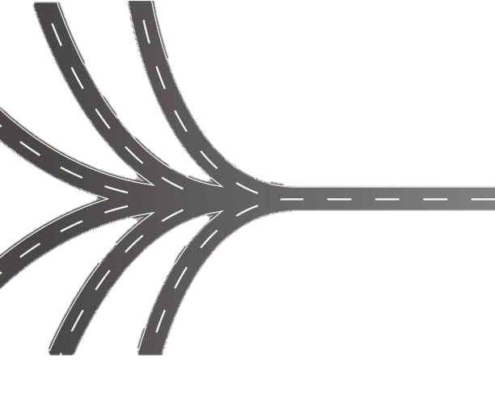
Biological Research on Personality Disorders:
The Role of Biology in Mental Health Research
A complex mix of interdisciplinary subfields
Biological research typically investigates causal mechanisms (etiology).
For example, genetics, neurochemistry, endocrinology, and brain structure/function.
The goal is to identify mechanisms that contribute to symptoms and resilience, not to reduce complex experiences to biology alone.
Biological explanations are understood as one of many dimensions.

Slide 13


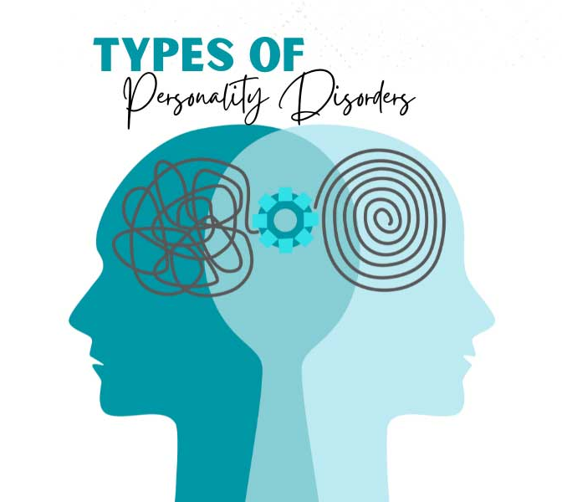
Biological Research on Personality Disorders:
Studying Biological Causes of Personality Disorders
General and important challenges
Moving Target
Causal Complexity
Practical Limitations
?
Personality disorders are notoriously difficult to diagnose, as definitions in diagnostic manuals such as the DSM often overlap. Within clinical practice and research, there is debate over whether personality disorders can be categorized.
Genetics, brain, and environment are assumed to be causally intertwined in personality disorders, and they might not have discrete and generalizable biological mechanisms.
Practical limitations—such as technology, methods, assessment tools, and small sample sizes—make biological research on personality disorders challenging and maybe even impossible.
Notes:
In the ICD-11 (World Health Organization, 2022), the classification of personality disorders has moved away from distinct categorical diagnoses such as “Borderline,” “Antisocial,” or “Narcissistic” Personality Disorder. Instead, it adopts a dimensional model, where all personality disorders are understood as variations of a single underlying condition characterized by disturbances in self and interpersonal functioning. The severity of impairment—mild, moderate, or severe—is rated, and specific trait domains (e.g., negative affectivity, dissociality, disinhibition, anankastia, detachment) are used to describe the individual’s presentation. This framework reflects growing evidence that personality pathology exists on a continuum, rather than as discrete categories.
By contrast, the DSM-5 (American Psychiatric Association, 2013) and its text revision (DSM-5-TR, 2022) have retained the traditional categorical system, keeping diagnoses like Borderline and Antisocial Personality Disorder. However, the DSM also introduced an alternative dimensional model in Section III (“Emerging Measures and Models”), which parallels the ICD-11 approach by focusing on impairments in personality functioning and pathological traits. Despite this, the categorical model remains the official diagnostic framework for clinical and legal use in North America.

Slide 14
Psychopathy as a Biological Condition

Slide 15
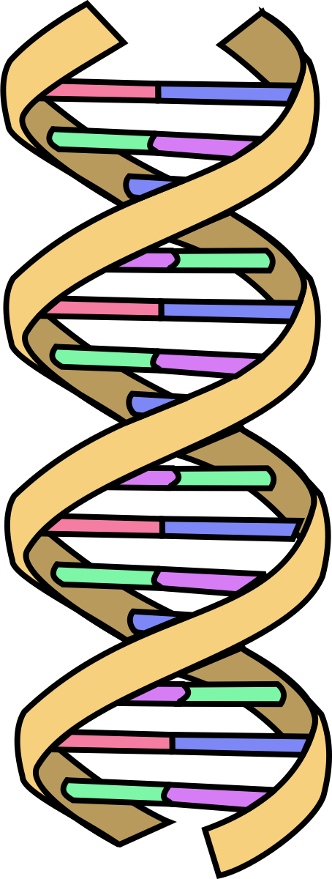
Psychopathy as a Biological Condition:
Searching for the Cause(s) of Psychopathy
Genetics and heritability
Psychopathy has long been assumed to have “biological” causes.
Since the modern period (i.e., early–mid 20th century), research has focused almost exclusively on genetic and neurological explanations.
Early focus on genetics research:
  1950s–1970s: Karyotyping → speculation about an “extra Y chromosome” in psychopathic persons (link, link, link)
  1970s–1980s: Early DNA sequencing → tests of heritability (link, link).
However, there is still no clear empirical support for the hypothesis that PCL psychopathy is heritable (e.g., Griffiths et al., 2022).
See also: Ferreira et al. (2025) | NB: includes studies with non-PCL samples

Slide 16
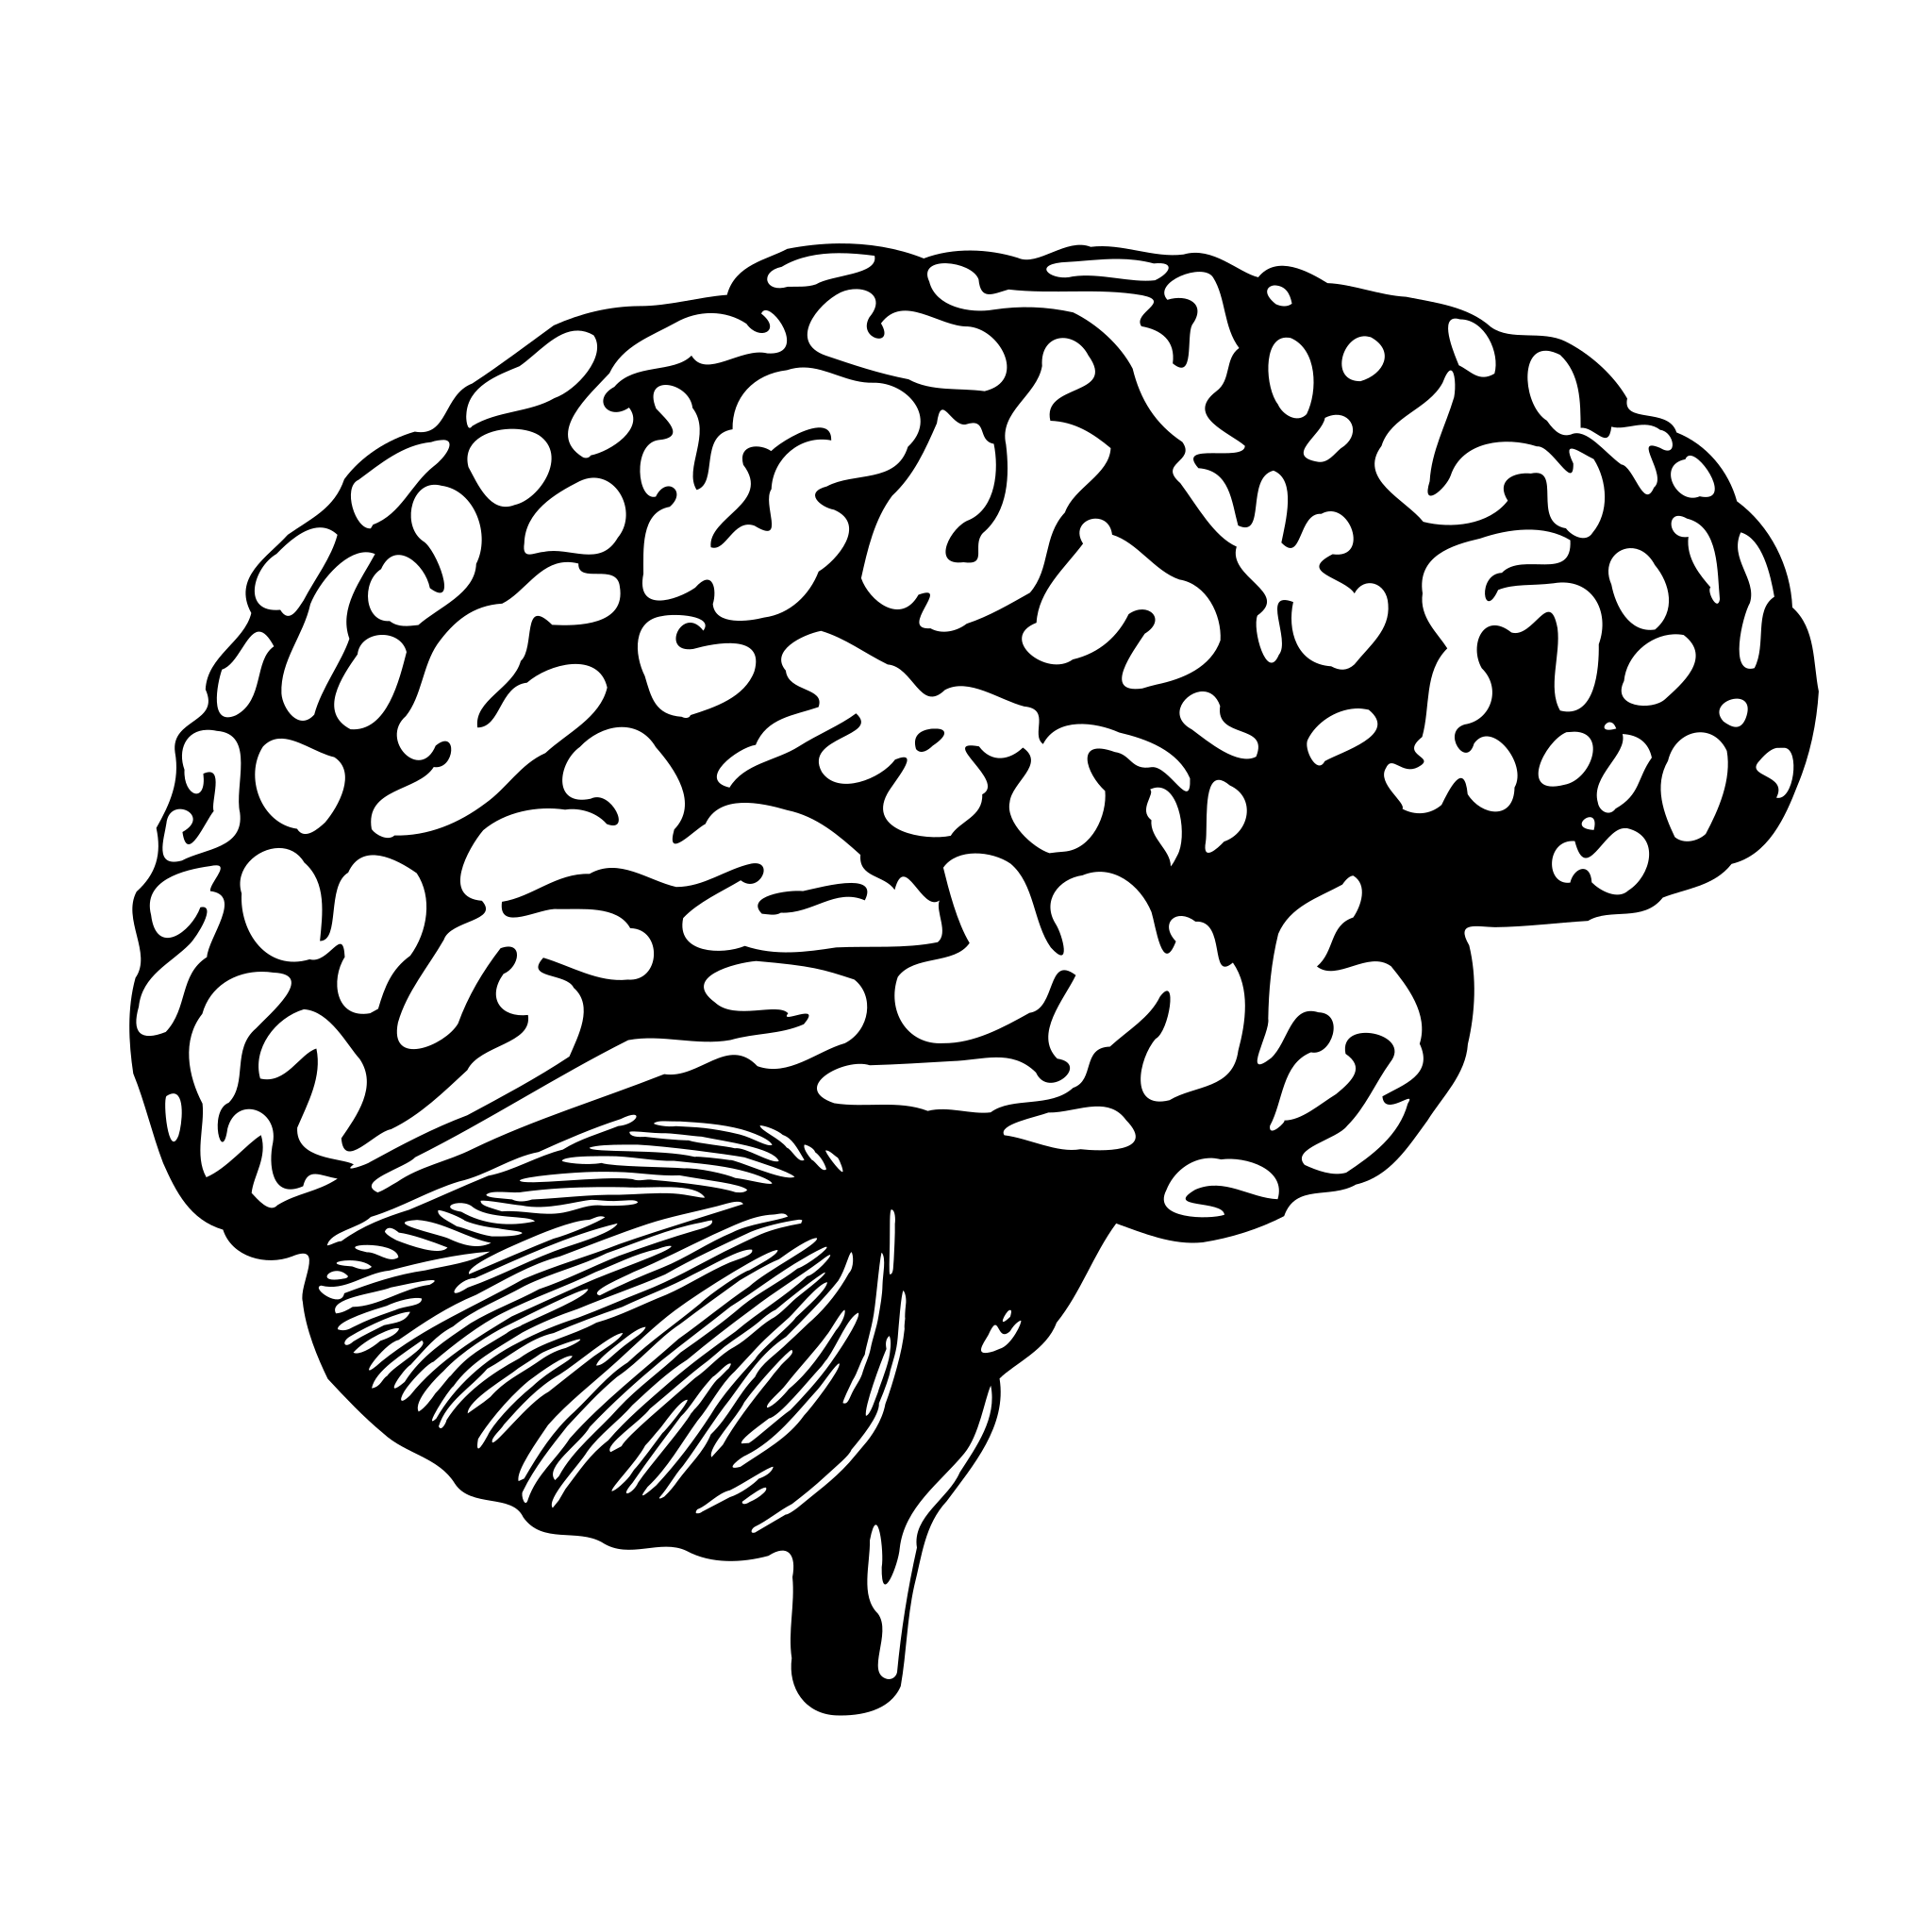
Psychopathy as a Biological Condition:
Searching for the Cause(s) of Psychopathy
Neurobiology and brain abnormalities
Psychopathy has long been described as a brain-based disorder (and sometimes as a “neurodevelopmental” disorder = genes + brain).
This assumption typically includes on two premises:
  Specific brain regions/systems/chemistry are central to pro-social behavior (e.g., impulse control, moral reasoning, empathy, kindness).
  Psychopathy arises from abnormalities or dysfunctions in these very regions/systems/chemistry.
This basic assumption has led to hundreds of studies using neuroimaging and neurochemical methods and technology.

Slide 17
Psychopathy as a Biological Condition:
Two Central Prognostic Claims
Today, researchers typically promote two prognostic claims when describing psychopathy as a neurological condition
Claim #4 – Psychopathy is Biological: Historically been assumed to be closely linked to genetic and neurological factors. Today, it is typically described primarily as a brain-based disorder.
1:
Structural Correlates: Hypothesized to be associated with atypical brain anatomy, such as reduced volume in regions linked to emotional processing and executive control.
2:
Functional Correlates: Hypothesized to be associated with atypical patterns of brain activity, particularly in areas involved in emotional processing and executive control.

Slide 18
Psychopathy as a Biological Condition:
Historical Roots
Psychopathy has almost always been either described or conceptualized as a brain-based disorder
The idea of psychopathy as a brain disorder dates back to the 18th–19th centuries:
  1786: Benjamin Rush proposed a “disease” of the moral faculty (brain).
The brain-disorder view gained traction in the 20th century, especially through the work of Hervey Cleckley, David Lykken, and Robert Hare.
Influenced by neurological research suggesting the brain is compartmentalized (e.g., Broca, Wernicke → language areas).
NB: modern research shows that mental functions emerge from dynamic, distributed neural networks, not from isolated “areas”
Notes:
NB: Benjamin Rush was a proponent of the pseudoscientific “humors theory,” but he frequently makes references to the function of the brain in mental health.

Slide 19
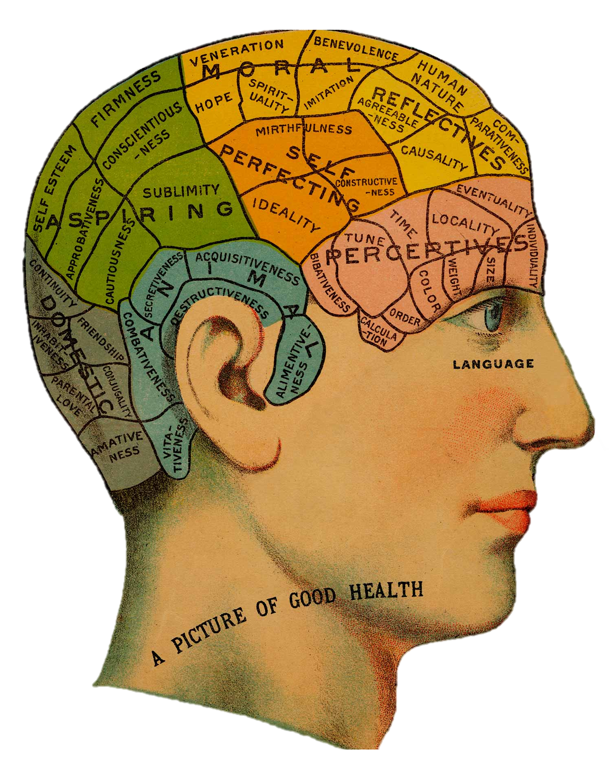
Psychopathy as a Biological Condition:
Historical Roots
Since the 18th century, the brain was believed to be strictly compartmentalized (like a Swiss army knife), a foundational view in the pseudoscientific theory of phrenology.
The Moral Faculty
Notes:
NB: The brain is not strictly compartmentalized in the way early neurologists like the early phrenologists, or even people like Broca and Wernicke once proposed. While their discoveries were historically pivotal, contemporary research shows that language and cognition emerge from dynamic, distributed neural networks, not from isolated “centres.”

Slide 20
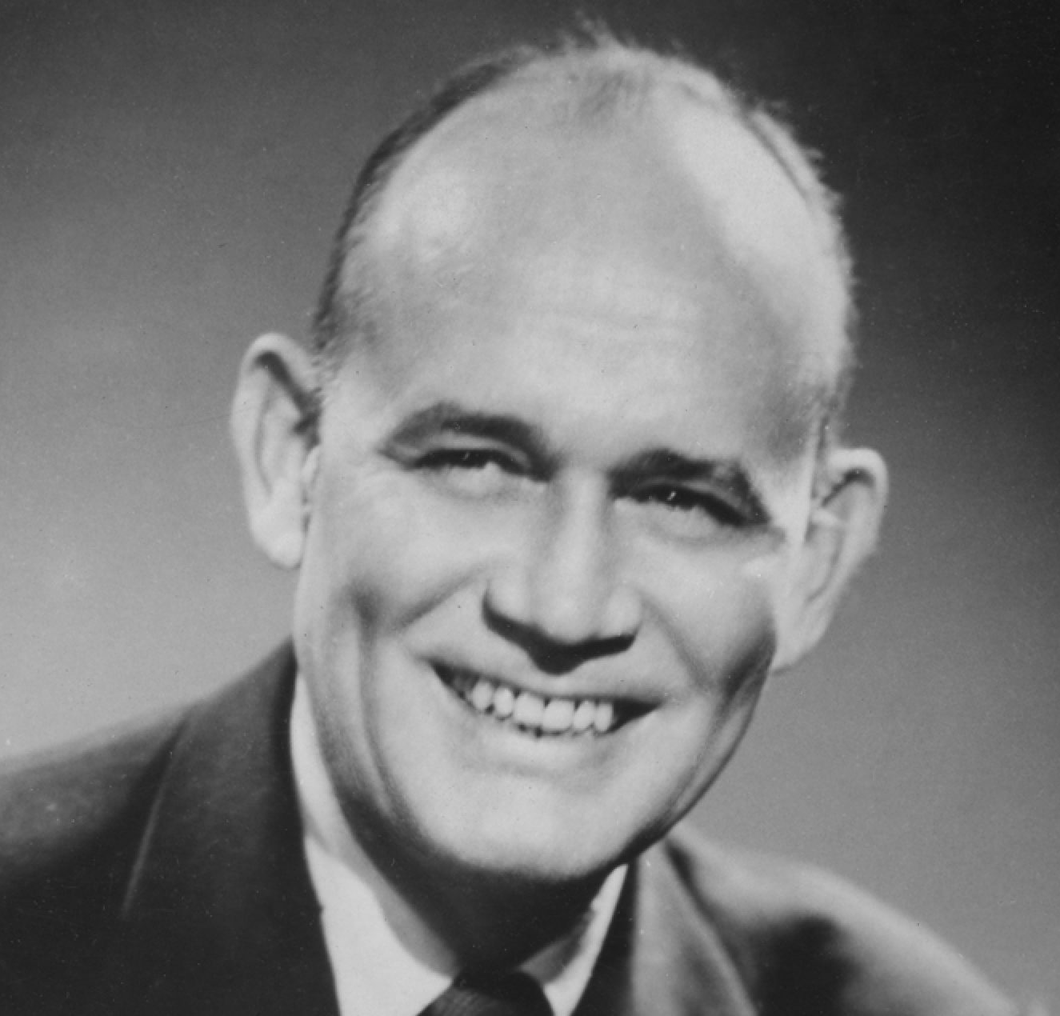
Psychopathy as a Biological Condition:
Hervey Cleckley’s Speculations
Perhaps more than anyone else in the mid-20th century, Cleckley popularized the idea of psychopathy
In The Mask of Sanity, Cleckley drew inspiration from neurology, especially Henry Head’s studies of brain trauma.
Henry Head had found that strokes can cause discrete cognitive dysfunction, such impairing language capabilities (e.g., aphasia).
Similarly, Cleckley speculated that psychopathy could reflect a specific and compartmentalized brain-based defect:
  The loss of subjective emotional experience, despite intact reasoning in other domains → Cleckley (confusingly) described this as a type of semantic aphasia.
Notes:
Confusingly: In the preface to the fifth edition of The Mask of Sanity, Cleckley addresses critics who thought it was confusing to describe psychopathy as a type of semantic aphasia.
From Cleckley (1988, p. 377): “Various degrees of impairment may be found in those aphasias classified by Henry Head as verbal, nominal, or syntactic. Some aphasic patients may utter clear sounds but fail to put syllables together into words. Others may hit upon words but not succeed in making comprehensible sentences or even phrases. Many of those seriously affected by such a disorder understand simple statements made by others. Some can communicate with us far better in writing than by the spoken word. In most, however, along with a serious defect in their own meaningful use of speech, we find some impairment in the understanding of spoken or written language. Even those considerably handicapped in reading, speaking, writing, or grasping the significance of what they are told may retain a relatively good use of "inner speech" and may be able still to make silent use of words for thinking or reasoning. Such people are aware of their difficulty and realize in exasperation that they cannot say what they intend and that language once quite familiar has, for them, somehow lost much of what it formerly conveyed.”

Slide 21

Psychopathy as a Biological Condition:
“The surface of the psychopath, however, that is, all of him that can be reached by verbal exploration and direct examination, shows up as equal to or better than normal and gives no hint at all of a disorder within. Nothing about him suggests oddness, inadequacy, or moral frailty. His mask is that of robust mental health. Yet he has a disorder that often manifests itself in conduct far more seriously abnormal than that of the schizophrenic.”
Cleckley (1988), The Mask of Sanity (p. 373)

Slide 22
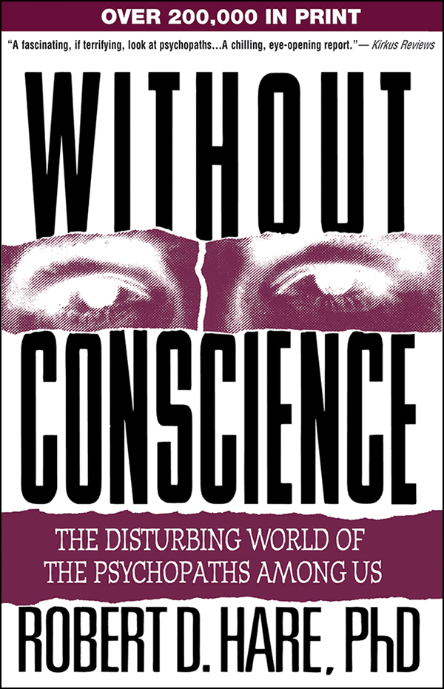
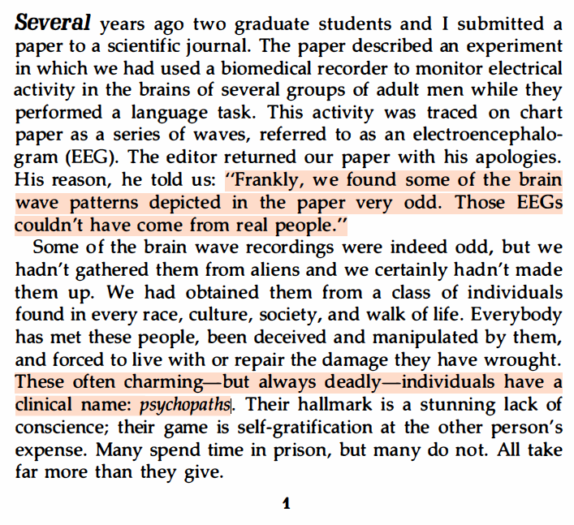
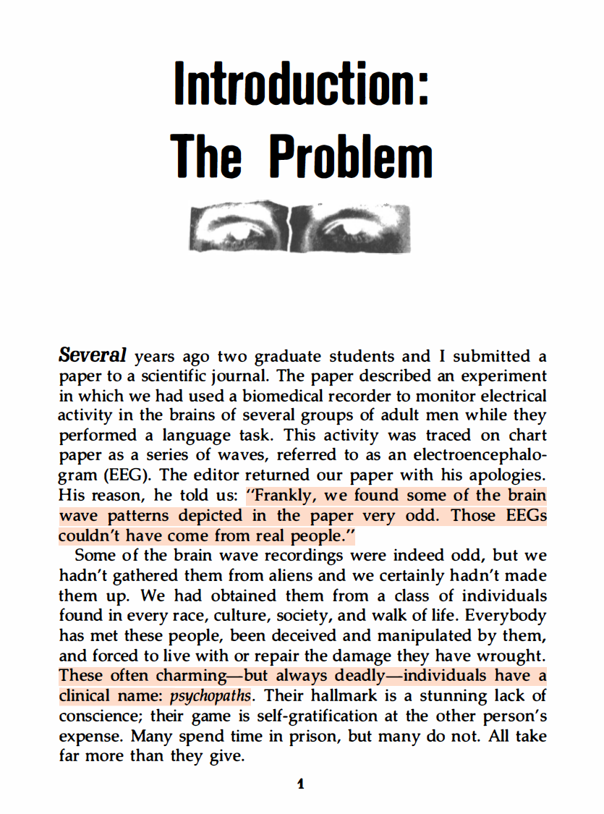

Psychopathy as a Biological Condition:
NB: The first page of Without Conscience
Robert Hare in Without Conscience (1993, p. 1)

Slide 23
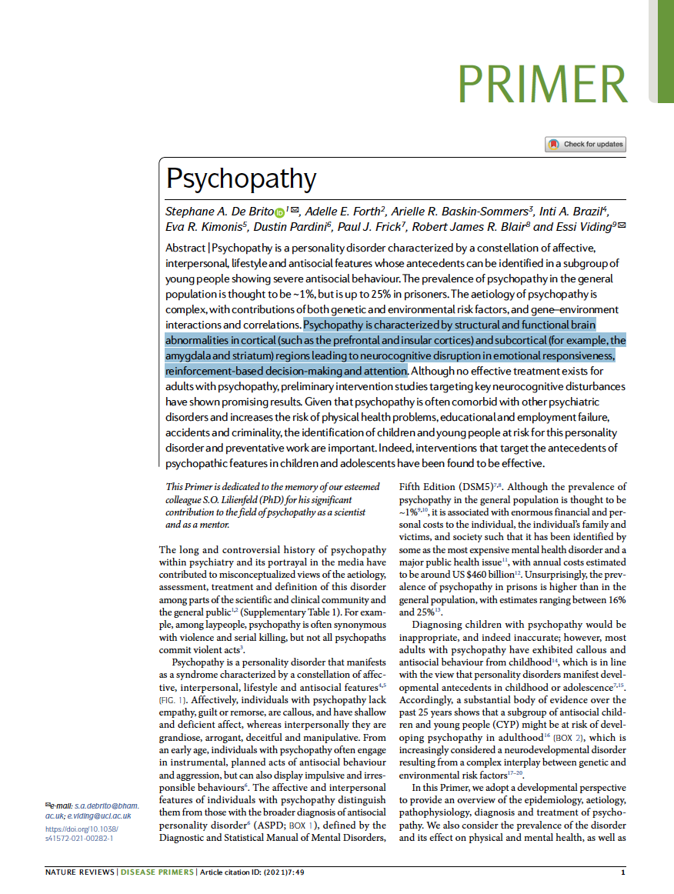
Psychopathy as a Biological Condition:
“Psychopathy is characterized by structural and functional brain abnormalities in cortical (such as the prefrontal and insular cortices) and subcortical (for example, the amygdala and striatum) regions leading to neurocognitive disruption in emotional responsiveness, reinforcement-based decision-making and attention.”
De Brito et al. (2021) in Nature’s Disease Primer

Slide 24
Neuroimaging Technology

Slide 25
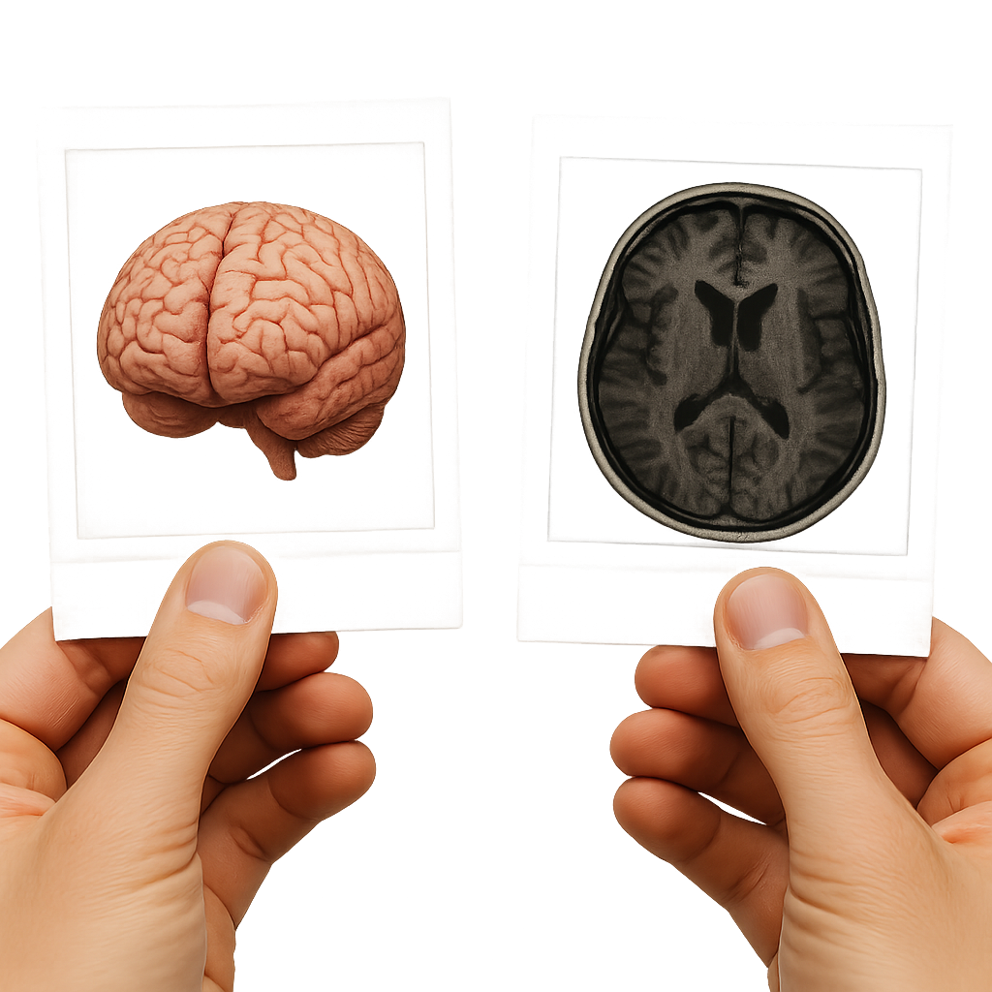
Neuroimaging Technology:
What is Neuroimaging?
“Image” is a metaphor: Neuroimaging not “photographing” the brain!
Instead, crude cartographic presentations created by measuring signals (e.g., magnetic fields, blood flow, electrical activity).
Common use of neuroimaging technology:
  Diagnose brain injury and disease.
  Investigate how brain regions support cognitive and emotional processes.
  Advance basic and clinical neuroscience research.
Neuroimaging: A collection of technologies that allow us to study a brain’s structure, function, or chemistry in living organisms (facilitates in vivo brain research).

Slide 26
Empathy Research in PCL Samples:
Different Neuroimaging Technologies
Structural Capabilities
(e.g., anatomical structure, volume)
Functional Capabilities
(e.g., temporal and spatial activity)
Computerized Tomography (CT): Uses X-rays to produce cross-sectional “slices” that represent differences in tissue density.
Functional Magnetic Resonance Imaging (fMRI): An imaging method that uses Blood Oxygen Level–Dependent (BOLD) contrast to track brain activity, serving as an indirect measure of neural processing.
Structural Magnetic Resonance Imaging (sMRI): Uses strong magnetic fields and radio waves to excite hydrogen atoms, producing cross-sectional “slices” that reveal differences in soft tissue composition and contrast.
Positron Emission Tomography (PET): Uses radioactive tracers to visualize brain metabolism and neurotransmitter activity.
Electroencephalography (EEG): Measures electrical activity of the brain through electrodes placed on the scalp, capturing rapid changes in neural signals.
Magnetoencephalography (MEG): Detects tiny magnetic fields generated by neuronal activity, providing precise timing and spatial information about brain function.
Notes:
Structural Neuroimaging
CT (Computed Tomography)
Uses X-rays to create cross-sectional “slices.”
Fast, cheap, excellent for acute injury, bleeding, bone.
Limitation: radiation exposure, poorer soft tissue contrast.
MRI (Magnetic Resonance Imaging)
Uses magnetic fields and radio waves to excite hydrogen atoms.
High-resolution soft tissue contrast, no radiation.
Limitation: slower, expensive, not suitable for all patients (implants/metal).
Functional Neuroimaging
fMRI (Functional MRI)
Builds on MRI technology.
Most common method is blood oxygen level–dependent (BOLD) signals as a proxy for neural activity.
Widely used in cognitive neuroscience.
PET (Positron Emission Tomography)
Injects radioactive tracers to track metabolism or receptor binding.
Useful for studying neurotransmitters and brain disorders.
Limitation: invasive, radiation exposure.
EEG (Electroencephalography)
Records electrical activity via scalp electrodes.
Excellent temporal resolution (milliseconds).
Limitation: poor spatial resolution.
MEG (Magnetoencephalography)
Measures magnetic fields produced by neuronal activity.
Good balance of spatial and temporal resolution.
Limitation: extremely costly and requires specialized facilities.

Slide 27
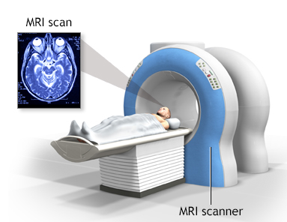
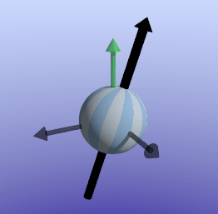

Empathy Research in PCL Samples:
Magnetic Resonance Imaging (MRI)
The physics of magnetic resonance
In a nutshell: Hydrogen atoms in your brain are suspended by magnetic field emitting from the machine “bore,” and then “agitated” by radio waves, thus giving off a spatially and temporally detectable resonance signal.
Notes:
Magnetic Resonance Imaging (MRI) works by using strong magnetic fields and radio waves to create detailed pictures of the inside of the body — especially soft tissues like the brain or muscles.
Here’s the basic idea in simple terms:
Magnet alignment: Your body is mostly water, and water contains hydrogen atoms. Each hydrogen atom has a tiny magnetic property. When you lie inside the MRI scanner, a very strong magnet causes these hydrogen atoms to line up in the same direction — like tiny compass needles all pointing north.
Radio signal: The machine then sends short bursts of radio waves toward your body. These waves knock the hydrogen atoms slightly out of alignment.
Signal release: When the radio pulse stops, the hydrogen atoms “relax” back into alignment with the magnet. As they do, they release energy in the form of faint radio signals.
Image formation: The scanner detects these returning signals, and a computer translates them into images. Because different tissues (like fat, muscle, or brain matter) cause the hydrogen atoms to relax at different speeds, each type of tissue gives a unique signal — creating the contrast we see in the final MRI image.
In short: MRI works by listening to how the hydrogen atoms in your body respond to magnetic and radio energy, then using that information to build a detailed map of your internal structure.

Slide 28
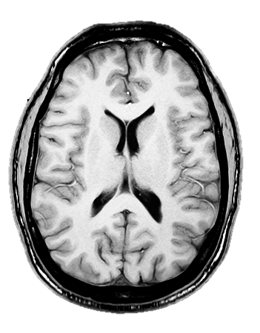

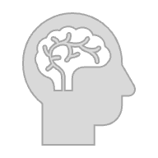
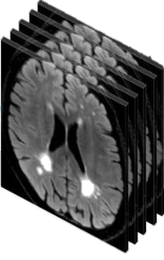
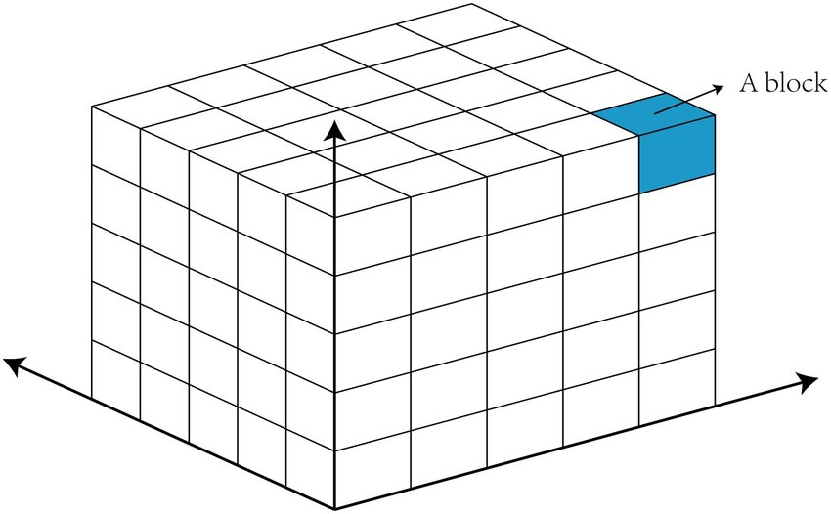
Empathy Research in PCL Samples:
Magnetic Resonance Imaging (MRI)
Structural and Functional MRI (sMRI and fMRI)
2D Gray-Scale Pixel
(x,y Axis)
Image Slices
Volumetric Stack
2D Grayscale Grid
(x,y Axis)
3D Grayscale “Voxel” Cluster
(x,y,z Axis)
Voxel Cluster (125 voxels)
1-3 mm cubic
Voxel
Notes:
From 2D Pixels to Standardized 3D Brain Maps
Raw Signal Acquisition
MRI measures radiofrequency signals from hydrogen atoms.
Signals are encoded by magnetic gradients and stored in k-space (frequency domain).
Reconstruction into 2D Slices
A Fourier transform converts k-space data into a 2D image.
Each pixel corresponds to tissue signal intensity in that slice.
Stacking into 3D Voxels
Multiple slices are acquired sequentially.
Stacking slices creates a 3D volume where each voxel represents the averaged signal from a small tissue volume.
Spatial Normalization
Individual brains differ in size, shape, and orientation.
To compare across people, MRI data are transformed into a standard brain space (e.g., MNI template or Talairach coordinates).
This involves mathematical warping and alignment so each voxel in one person’s brain corresponds to the same anatomical region in another’s.

Slide 29
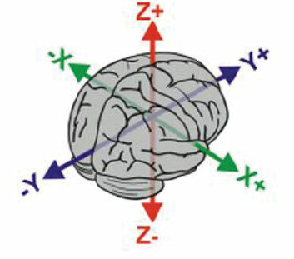
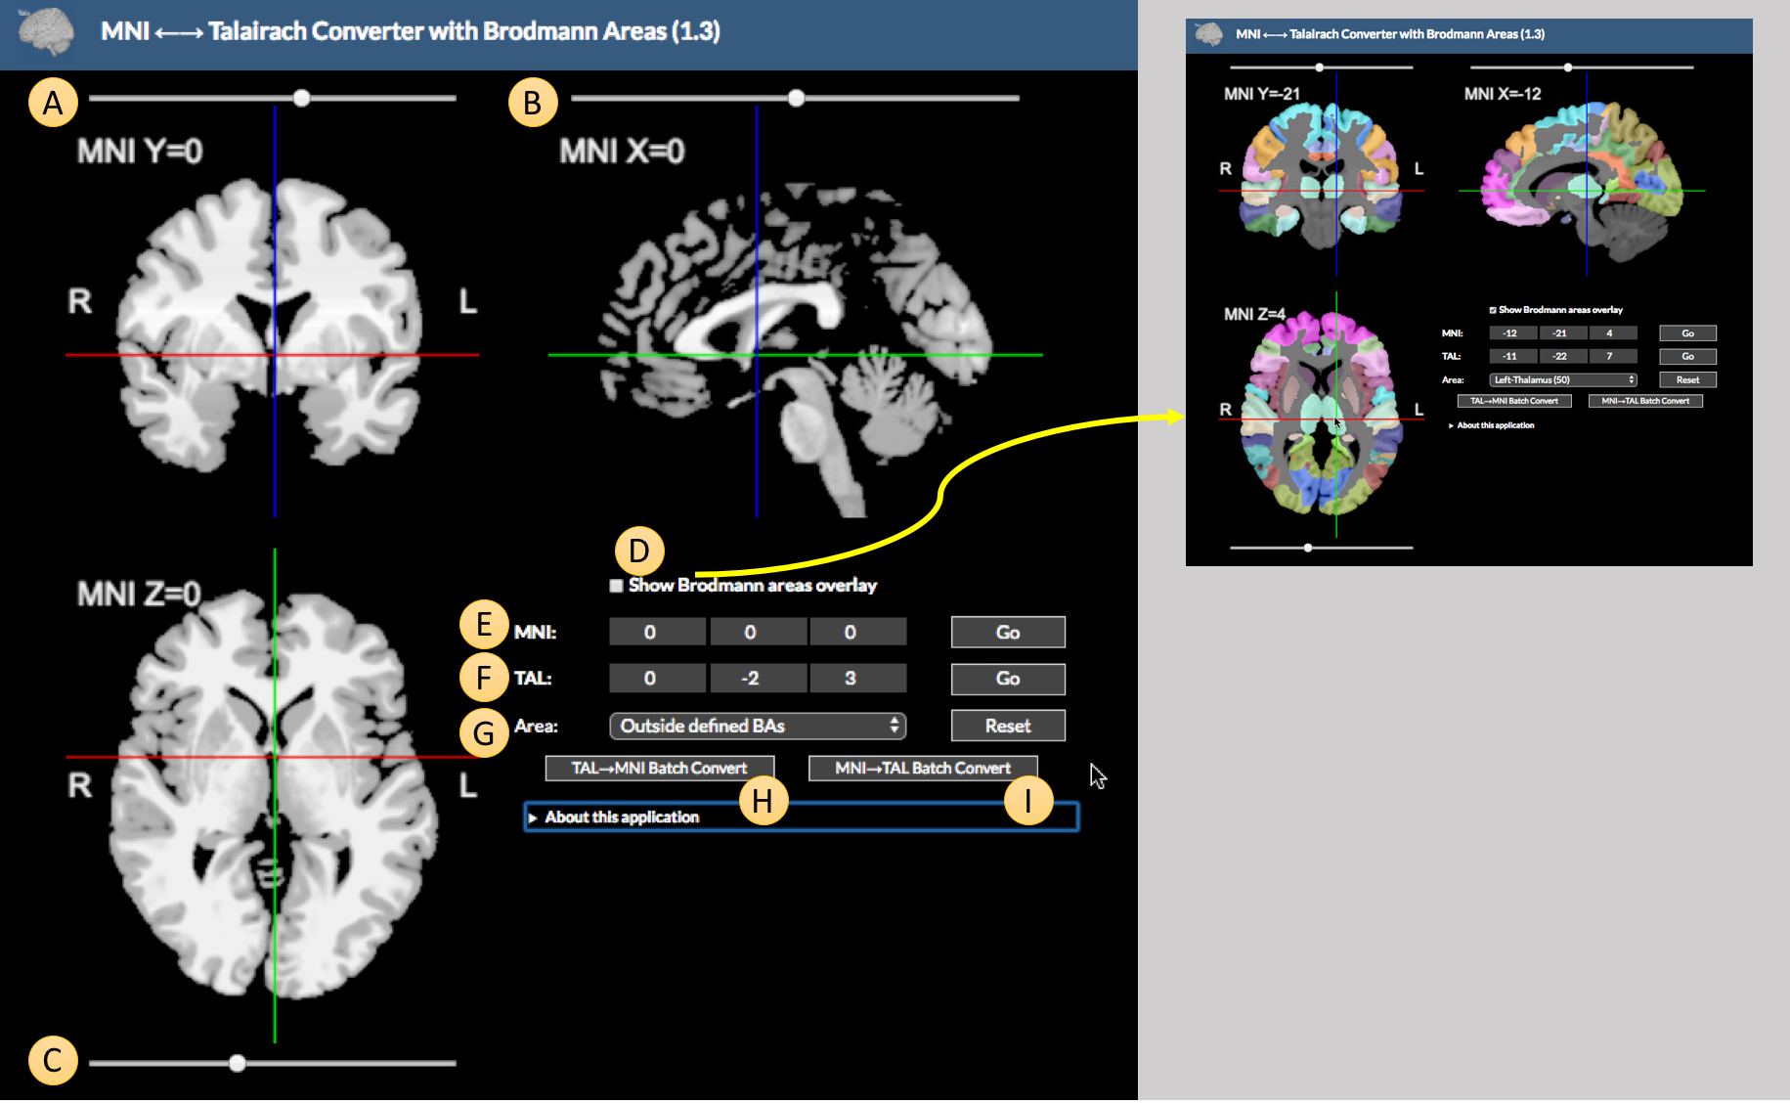
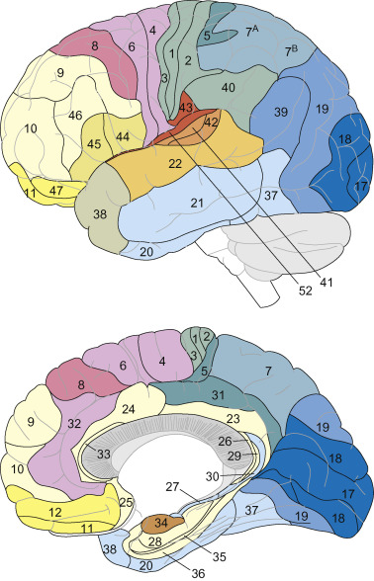
Empathy Research in PCL Samples:
Spatial Normalization of MRI Data
Spatial Normalization: Because every brain differs in size and shape, raw MRI data cannot be directly compared across individuals. Spatial normalization solves this by mathematically aligning each brain to a standard template (e.g., MNI or Talairach 3D/x,y,z-coordinates). This process “warps” individual voxel data into a common coordinate system, allowing researchers to compare brain regions across people and conduct group-level analyses.
Voxel Cluster (125 voxels)
1-3 mm cubic
Voxel
Notes:
NB: Most MRI studies analyze voxel clusters rather than single voxels. A voxel represents a tiny 3D unit of brain tissue, but its signal is often noisy on its own. By grouping neighboring voxels that show similar activity, researchers can identify spatially coherent patterns and reduce false positives, making cluster-level analyses a more reliable way to detect meaningful brain effects.
The number of voxels in a typical fMRI cluster can vary widely, depending on factors like image resolution, smoothing, and the statistical threshold used.
Roughly speaking:
In standard fMRI analyses with 2–3 mm³ voxels, clusters often contain between 20 and 200 voxels.
Small clusters (≈10–30 voxels) may reflect highly localized activity, but they’re often considered less reliable.
Large clusters (hundreds or even thousands of voxels) can appear when activity spans broader brain regions or when the data have been spatially smoothed more heavily.
In short, while the exact size varies, most reported clusters in modern fMRI studies fall within the tens to low hundreds of voxels range.

Slide 30
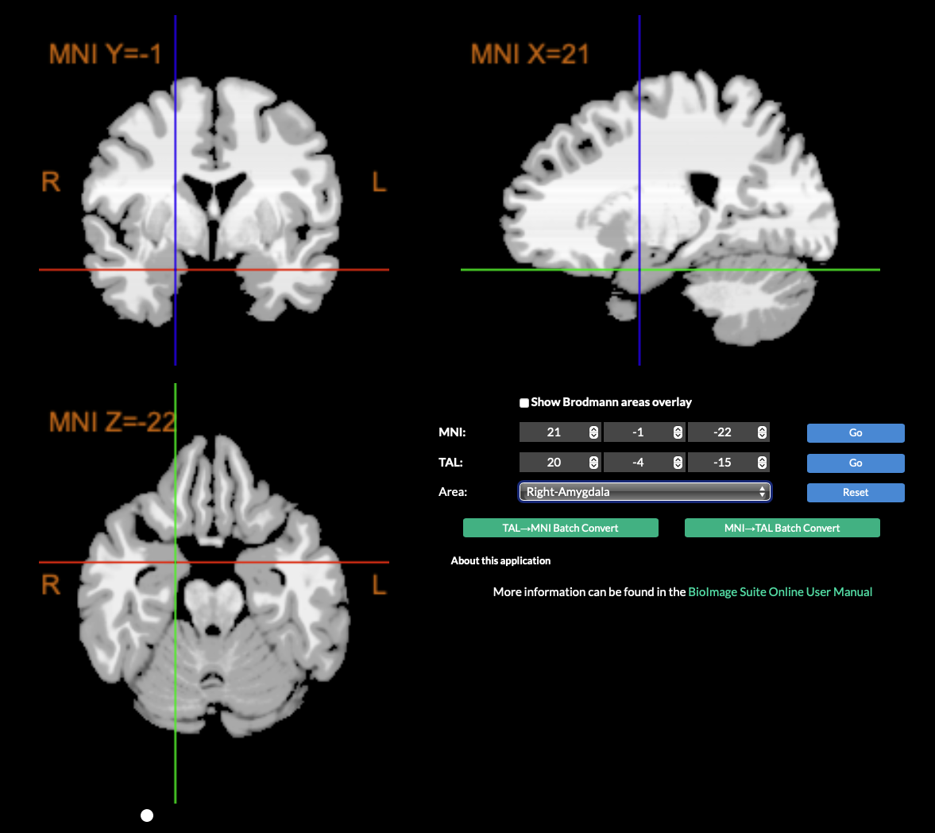
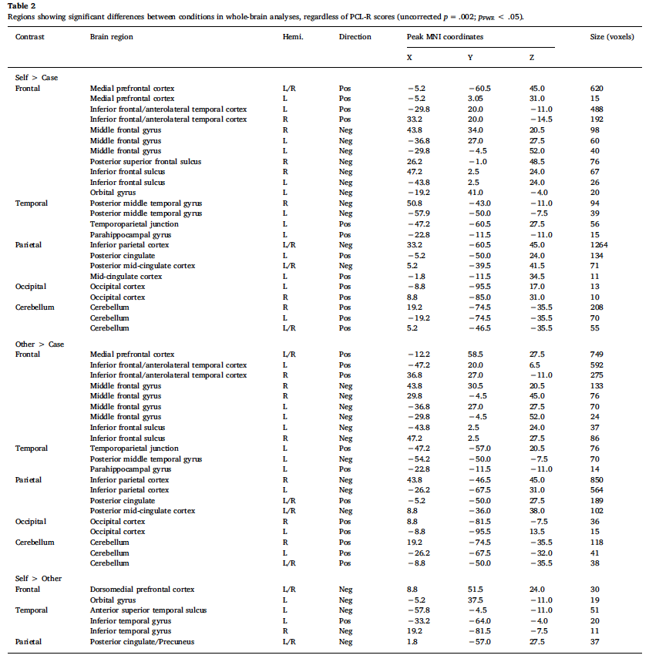
Empathy Research in PCL Samples:
Spatial Coordinates and Brodmann Areas
There are 52 Brodmann areas, each corresponding to a set of MNI or Talairach coordinates
Random example of how results are reported in published research
52 Brodmann Areas
Link to converter

Slide 31
Empathy Research in PCL Samples:
Spatial Coordinates and Brodmann Areas
There are 52 Brodmann areas, each corresponding to a set of MNI or Talairach coordinates

Slide 32
Empathy Research in PCL Samples:
Key Terminology in MRI Studies
Whole Brain Study: An analysis that examines activity across the entire brain, without restricting to predefined areas, to detect widespread or unexpected patterns.
Region of Interest (ROI): An analysis that focuses only on specific brain regions chosen in advance, usually based on theory or prior research.
Blood Oxygen Level–Dependent signal (BOLD): A contrast mechanism in MRI based on differences in the magnetic properties (presumably) of oxygenated vs. deoxygenated hemoglobin. BOLD changes are used in fMRI as an indirect measure of neural activity, since brain activation alters local blood flow and oxygen balance.
Task-Based fMRI: A study design where participants perform specific tasks (e.g., viewing images, solving problems) while brain activity is measured over time, to identify regions engaged by that task.
Notes:
Whole-Brain Studies
Goal: Examine activity or structure across the entire brain without pre-selecting specific regions.
Approach: The analysis is data-driven — statistical tests are run voxel by voxel (millions of small 3D pixels) across the whole brain to find where significant effects occur.
Advantages: Allows for discovery of unexpected results, identifying new or widespread networks involved in a cognitive or clinical process.
Limitations: Requires heavy statistical correction for multiple comparisons, which can make it harder to detect subtle effects.
ROI (Region of Interest) Studies
Goal: Focus on one or more specific brain areas thought to be relevant based on prior research or hypotheses (e.g., the amygdala, prefrontal cortex).
Approach: The analysis is hypothesis-driven — researchers extract and analyze signal data only from the defined regions.
Advantages: More statistically powerful and targeted; reduces the number of comparisons and often provides more interpretable results.
Limitations: May miss important activity outside the chosen regions; conclusions are constrained by the initial assumptions.

Slide 33
MRI Research in PCL Samples

Slide 34
MRI Research in PCL Samples:
Overview of Research
Conclusion: After 20+ years of MRI research, no consistent or replicable neural correlates has been identified in PCL samples
First Study: Raine et al (2000) analyzed gray matter structure (sMRI).
Rapid Growth: Since 2000, probably ~100 MRI studies published.
Key Problem = Heterogeneity:
  Despite the impressive number of studies, results are highly inconsistent.
  No clear or replicated brain-based patterns have emerged.
  Findings often contradict each other (e.g., reduced vs. increased gray matter in the same region).
  Some studies report effects in unexpected regions (e.g., cerebellum, occipital cortex).
The level of heterogeneity has been reported since 2011:
  Koenigs et al. (2011): First review to highlight lack of consistency in results.
  Griffiths & Jalava (2017): First review to “map” the extent of heterogeneity across brain regions.
Notes:
Fun Fact: For a 100-person fMRI study with justice-involved participants at a North American academic 3 T core, a defensible direct-cost range is roughly US $85k–$150k before any contingency for correctional logistics. With a reasonable contingency and staff effort, many teams plan for a six-figure budget (often $110k–$200k all-in), depending on local rates, bundling, and the correctional partnership.

Slide 35
MRI Research in PCL Samples:
Testing Two Main Hypotheses
Using sMRI and fMRI research methods
Amygdala: a small (~2 cm³) structure in the limbic system that plays a key role in emotion processing and regulation. Researchers have long hypothesized that the emotional abnormalities linked to psychopathy may stem from amygdala dysfunction. If this is true, MRI studies should reveal either structural differences in the amygdala or atypical activation patterns during emotion-related tasks.
Prefrontal Cortex (PFC): a large (~300 cm³) region at the front of the brain, comprising key subregions such as the ventromedial (vmPFC), dorsomedial (dmPFC), and anterior cingulate cortex (ACC). It plays a central role in personality, executive function, and impulse control. Researchers have proposed that the aggressive and irresponsible behaviors often associated with psychopathy may stem from abnormalities within these PFC subregions. If so, such differences should be observable in MRI studies as structural or functional deviations in PFC activity.

Slide 36
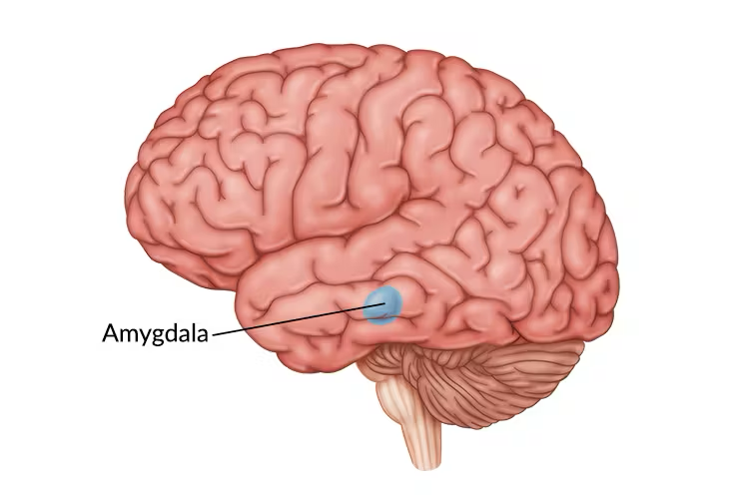
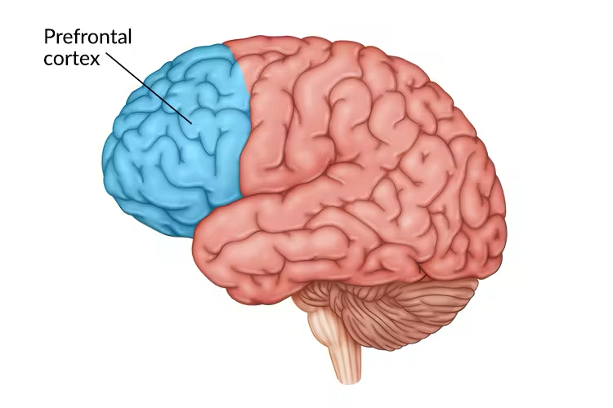
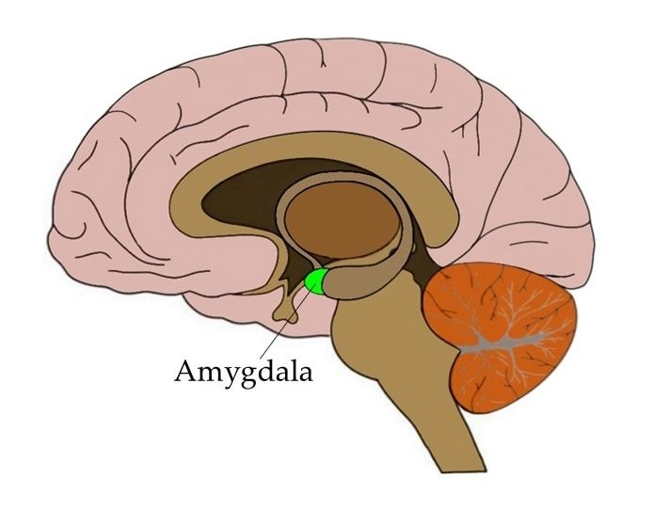
MRI Research in PCL Samples:
Regions of Interest
The Amygdala Hypothesis
Deming et al. (2022)
The PFC Hypothesis
Deming et al. (2024)

Slide 37
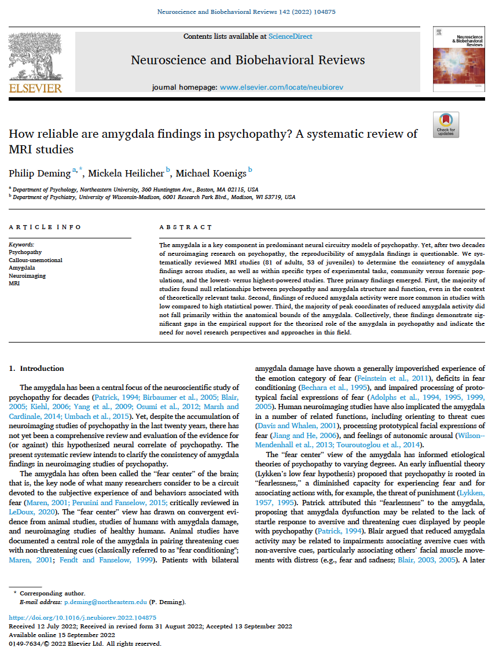
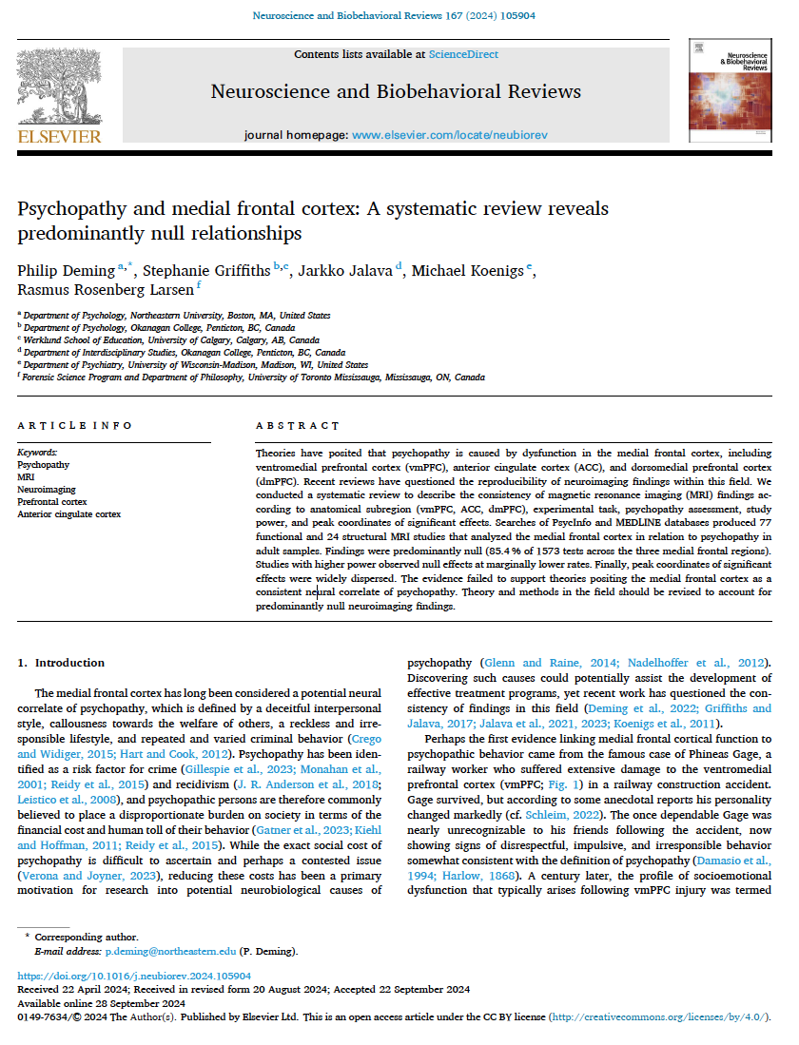
MRI Research in PCL Samples:
Two Systematic Reviews
The Amygdala Hypothesis
Deming et al. (2022)
The PFC Hypothesis
Deming et al. (2024)

Slide 38
MRI Research in PCL Samples:
Deming et al. (2022)
Systematic review (N = 60) of all MRI studies between 2000-2022 in adult PCL samples testing the amygdala hypothesis
20 sMRI studies (n = 1,177): 38 nulls (70%), 16 significant effects (30%)
40 fMRI studies (n = 2,652): 152 nulls (77%), 45 significant effects (23%)
Most common finding:
  Null findings were the single most replicated result
  For example, 35 studies (58%) reported 100% null effects
Evidence does not support a clear or consistent link between PCL psychopathy and amygdala abnormalities (structural or functional).

Slide 39
MRI Research in PCL Samples:
Mislabeling of Research Results
From the analysis of the “amygdala hypothesis” in Deming et al. (2022)
Deming et al. checked whether reported MRI “amygdala” signals (x, y, z coordinates) actually originated from the amygdala region.
Findings:
  33% of “amygdala” negative effects were completely mislabeled (0% overlap).
  40% were partially mislabeled (0–50% cluster overlap).
  Only 27% of negative effects truly originated from the amygdala.
  Positive effects were somewhat better: 50% full overlap, 50% partial.
Conclusion: Most fMRI studies labeled as “amygdala findings,” the results/signal did not clearly originate from the amygdala region.
Notes:
Excerpt from Psychopathy Unmasked, p. 132: “..the lead author, Philip Deming—a good colleague of mine—has told me that as a neuroscience graduate student he had grown suspicious about the reliability of these fMRI amygdala experiments as he had discovered by coincidence that some researchers had mislabeled their results (i.e., reporting an effect in the amygdala, where the fMRI coordinate is not actually corresponding to the brain region on the map)—hence the motivation of their unorthodox analysis.”

Slide 40
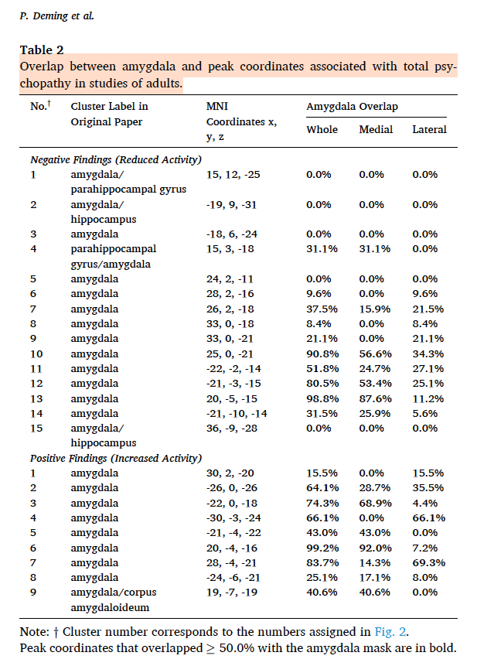
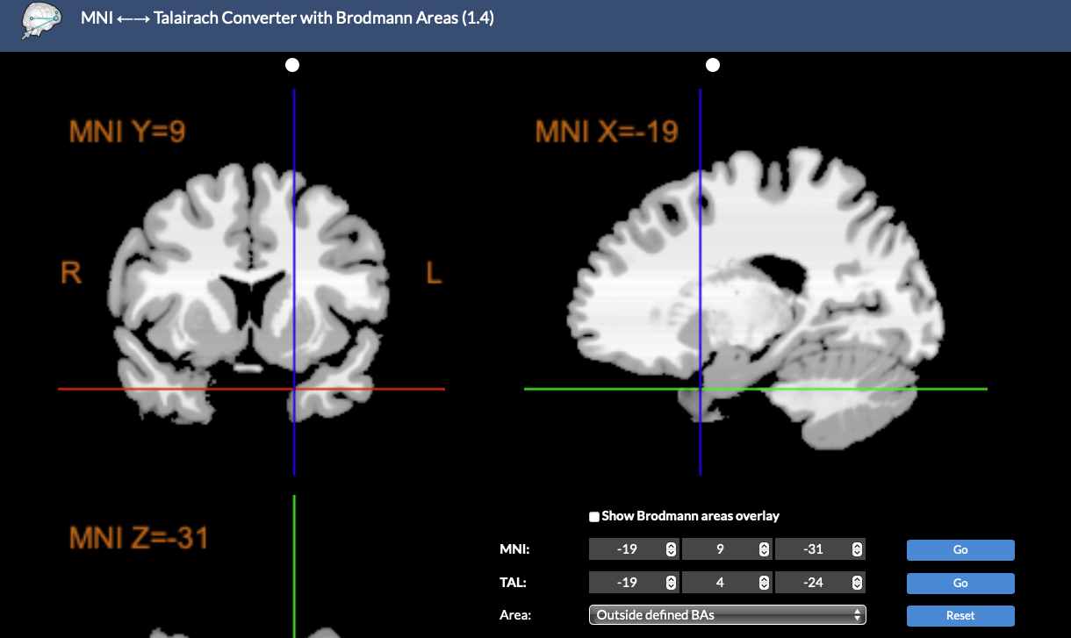
MRI Research in PCL Samples:
Mislabeling of Research Results
From the analysis of the “amygdala hypothesis” in Deming et al. (2022)
Link

Slide 41
MRI Research in PCL Samples:
The Issue of Statistical Power
From the analysis in Deming et al. (2022)
Deming et al. (2022) also found that statistically significant effects were more common in small-sample fMRI studies.
  Larger-sample studies showed 86.7% null results, higher than the overall average of 77% nulls.
Interpretation:
  Larger samples = higher statistical power, meaning greater ability to detect true effects.
  Smaller samples = low power, which increases the risk of false positives.
Conclusion: The trend suggests that reported amygdala effects in psychopathy research may be spurious, driven by underpowered studies.

Slide 42
MRI Research in PCL Samples:
Deming et al. (2024)
Systematic review (N = 69) of all MRI studies between 2000-2023 in adult PCL samples testing the PFC hypothesis
Examined three main PFC subregions in adult PCL samples (Table 5.1):
  Ventromedial (vmPFC) | Dorsomedial (dmPFC) | Anterior cingulate cortex (ACC)
  20 sMRI (202 effects; 1,755 participants)
  49 fMRI (951 effects; 3,246 participants)
Main Finding: Mostly null effects – 58.8% (sMRI) and 61.3% (fMRI) of all studies reported 100% null findings.
Conclusion: No consistent structural or functional abnormalities have been identified in the PFC subregions among PCL samples.

Slide 43
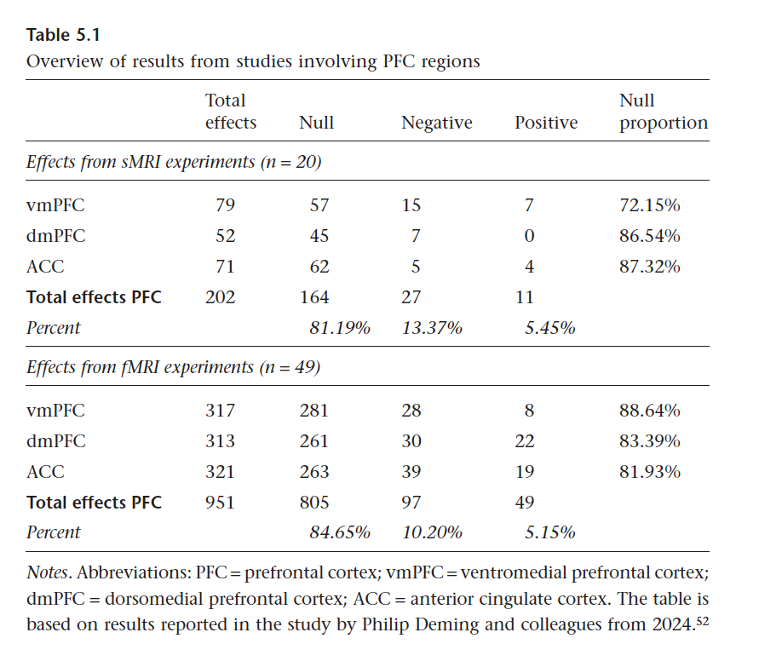
MRI Research in PCL Samples:
Deming et al. (2024)
Systematic review (N = 69) of all MRI studies between 2000-2023 in adult PCL samples testing the PFC hypothesis

Slide 44
MRI Research in PCL Samples:
Summary and Critical Observations
From the analysis of the “PFC hypothesis” in Deming et al. (2024)
Inconsistent Significant Effects:
  About ⅔ show decreased and ⅓ show increased gray matter or functional activity.
  No consistent pattern — suggesting many effects are spurious or confounded.
Potential Confounds:
  Substance use, head trauma, and psychiatric medication can alter brain signals in MRI.
  Most studies did not control for these factors (e.g., via moderator analyses).
Sample Size Trends:
  sMRI: Larger samples → higher null proportion (88% vs 81% average).
  fMRI: Opposite trend (79% nulls in large samples vs 85% average).
  Indicates inconsistent reliability across study types.

Slide 45
Critical Reflections

Slide 46
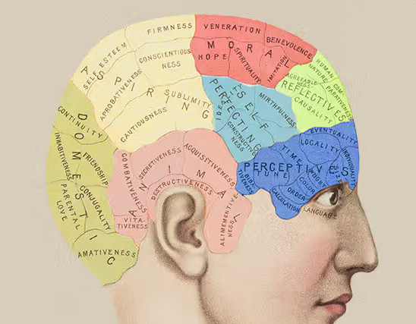
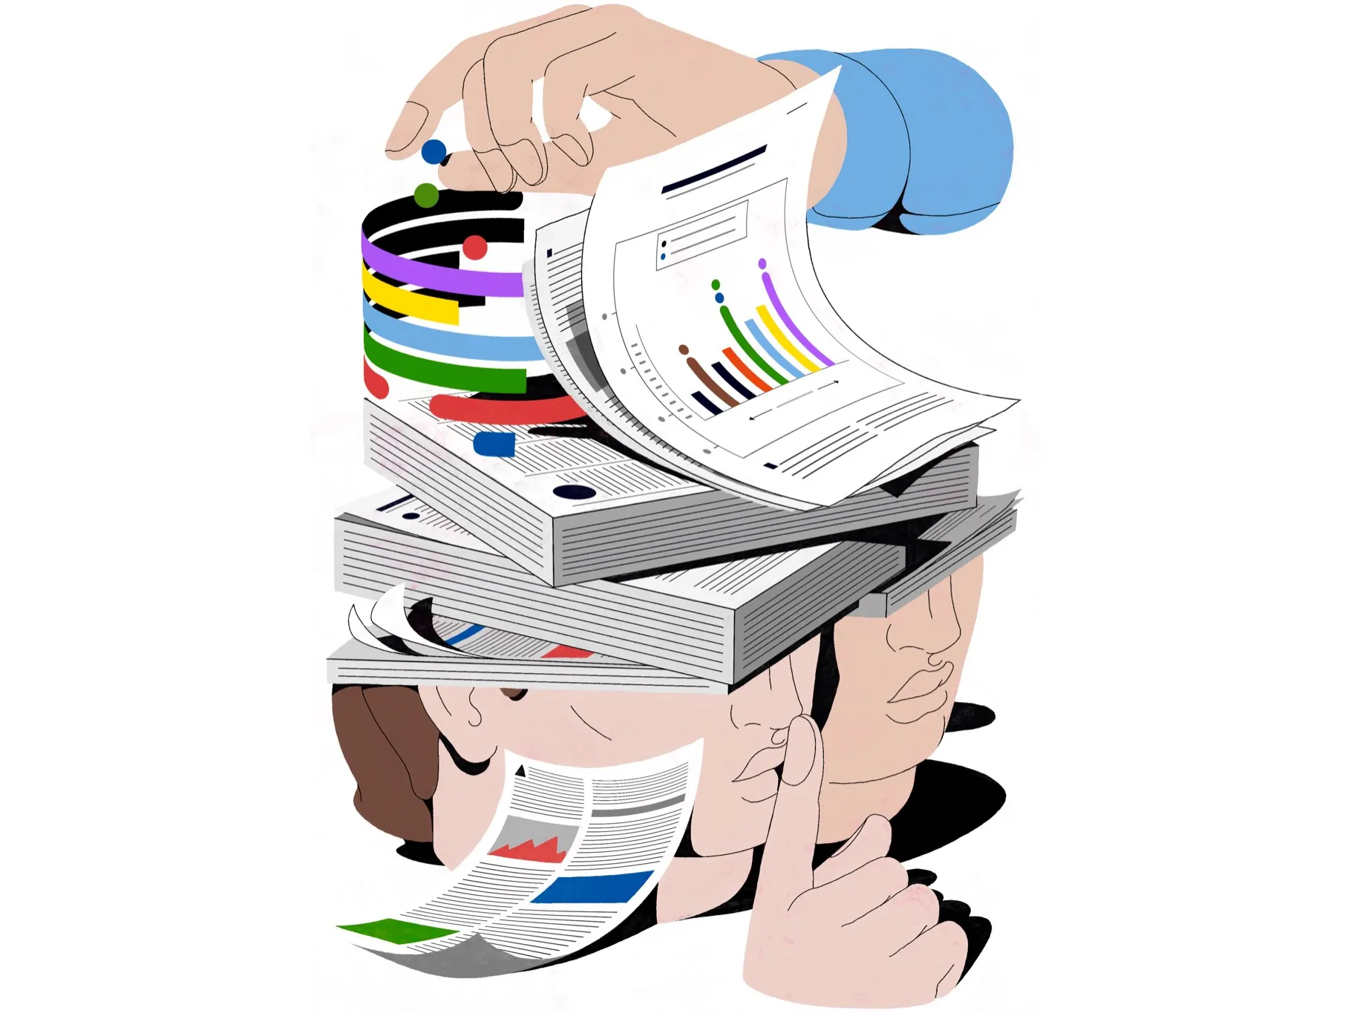
Critical Reflections:
Unanswered Questions in an “Ocean of Null Findings”
Meaningful Claim?
Researcher Shenanigans
We might ask if it even makes sense to assume that psychopathy stems from discrete brain abnormalities. The brain is not neatly compartmentalized; functions like emotion and decision-making emerge from distributed, interacting networks.
There are numerous cases of research “shenanigans,” including mislabeled results and flexible analytic choices, such as failing to control for known confounds.

