Slide 1

Psychopathy and Crime
The Science, Ethics, and Legal Influence of a Controversial Diagnosis
Module 8
Psychopathy and Scientific Spin
Is rhetoric eclipsing the empirical evidence?
Copyright © Rasmus Rosenberg Larsen
Licensed under CC BY 4.0.

Slide 2

Any questions..?
© OpenAI (LLM-generated image)

Slide 3
Psychopathy and Crime
FSC350
Module 1
Introduction – What is Psychopathy?
Module 7
Two Theories of Psychopathy
Module 2
The Problem of Psychopathy
Module 8
Psychopathy and Scientific Spin
Module 3
Psychopathy and Forensic Risk
Module 9
Psychopathy and Ethics
Module 4
Psychopathy and Treatment
Module 10
Explaining a Lack of Evidence (Part I)
Module 5
Psychopathy and Moral Psychology
Module 11
Explaining a Lack of Evidence (Part 2)
Module 6
The Neuroscience of Psychopathy
Module 12
The Future of Psychopathy Research

Slide 4
This Module’s Agenda:
Background: The Replication Crisis
Scientific Spin and QRPs
Spin and QPRs in Psychopathy Research
Psychopathy in Public Media
Critical Reflections

Slide 5
Background:
The Replication Crisis

Slide 6
Background: The Replication Crisis
Null Findings and Spurious Results
There is an overwhelming lack of reproducible results in the field of psychopathy research
A main observation in Larsen (2025) is that the five common claims about psychopathy has never been clearly corroborated.
  Psychopathy is not linked to (1) extraordinary dangerousness, (2) untreatability, (3) moral deficiencies, (4) biological causes, or (5) emotional shallowness and impulse-control deficits.
This empirical discovery must be understood in the context of the ensuing “replicability crisis” in behavioral science.
Indeed, psychopathy research rose to prominence in a period where scientists were largely unaware that this crisis was “brewing.”

Slide 7
Background: The Replication Crisis
What is the “Replication Crisis”..?
Replication Crisis refers to an ensuing decline in credibility and progress across scientific fields (e.g., medicine, psychology, etc.).
The “crisis mode” might have been ignited by the iconic 2005-paper by J. Ioannidis, entitled Why Most Published Research Findings Are False.
At the heart of the replication crisis is a well-grounded suspicion that most published research results are false positives.
  In short, the scientific record contains “falsehoods” represented as “truths.”
  When scientists replicate certain studies, they cannot reproduce earlier results.
Hence, why this situation is also referred to as “reproducibility crisis.”

Slide 8
Background: The Replication Crisis
Many Interrelated Causes
There are many known (and perhaps many unknown) mechanisms driving the replication crisis
Academic Reward System
Fraud
Education
The academic “research world” incentivizes publication of novel and ground-breaking research (i.e., careerism).
There are many examples of fraudulent research (e.g., studies based on fabricated data and “research paper mills”).
Conducting high-quality research is difficult and requires enormous resources, such as good education.
Lack of Experience
Bias
Questionable Research Practices
False-positive results may be the outcome of bad research conducted by inexperienced researchers.
Cognitive biases such as “confirmation bias” may skew research procedures and analyses.
Researchers can engage in a set of analytical and methodological decisions that will increase the likelihood of false-positive results.

Slide 9




Background: The Replication Crisis
Three Central and Interlinked Concepts
The field of psychopathy research appears to be deeply implicated in all three concepts
Questionable Research Practices
Scientific Spin
The Replication Crisis

Slide 10
Scientific Spin and QRPs

Slide 11
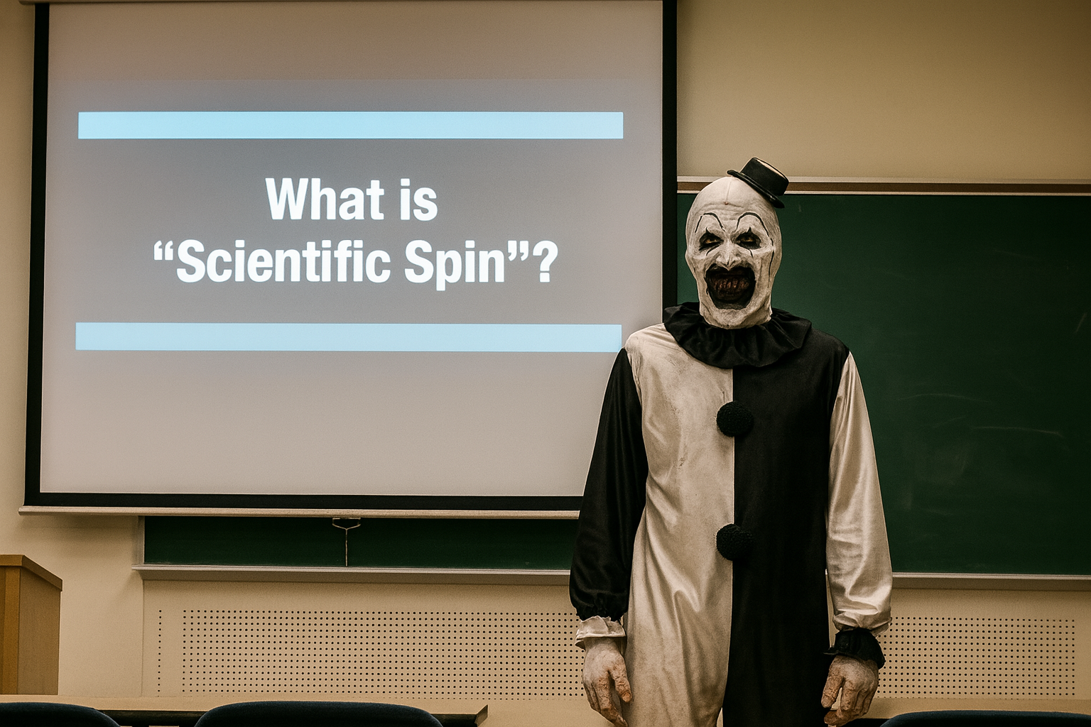
What is a “Theory”?

Slide 12
Scientific Spin and QRPs:
Defining Scientific Spin
NB: From term “spin” as it’s used in politics to refer to when the public is knowingly misled and manipulated
Scientific spin refers to a deliberate act of distortion with the aim of misleading “consumers” of scientific research (e.g., the public).
The primary purpose of spin is to make research appear more informative or meaningful than it actually is.
The act of “spin” is primarily during the dissemination of research but can also be part of the research article itself (e.g., abstract, discussion).
Common spin tactics include selective reporting and interpretative manipulation, thus hindering critical appraisal of the research.
Notes:
NB: Political spin is arguably a form of “propaganda”.
NB: Some researchers argue that scientific spin can occur in a non-deliberate (unconscious) way. This is slightly problematic, as it would label any mistakes done out of ignorance as “spin”. Sometimes, researchers are simply wrong, and we probably shouldn’t label such mistakes as “spin”.
Facilitator of spin or Spin Tactics: refers to any reporting practice that hinders critical appraisal by forcing readers to make assumptions about the study’s methods or results. For example, this occurs when authors report performance measures without clarifying whether they represent apparent or internally validated (optimism-corrected) estimates in model development studies.

Slide 13
Scientific Spin and QRPs:
Three Common Examples of Scientific Spin
From Navarro et al. (2024), Chiu et al. (2017), Meichenbaum & Lilienfeld (2018)
Exaggerated Language
Overstated Relevance
Ignore Limitations
Use of strong or optimistic language that overstates research findings, creating a misleading sense of certainty or significance. Common examples include describing results as “remarkable,” “excellent,” or “novel” despite weak evidence or methodological flaws.
Claiming that research results are relevant for applications in “practical” or “real life” contexts without sufficient explanation how and why (e.g., stating that results informs treatment but where it’s unclear how).
The failure to mention or an omission of a sufficient discussion of methodological weaknesses that could temper or significantly undermine confidence in research findings (e.g., small sample size, lack of blinding, risk of bias).
Notes:
TEN COMMON EXAMPLES OF SCIENTIFIC SPIN:
Selective Reporting: Highlighting favourable or statistically significant outcomes while omitting or downplaying nonsignificant or contradictory results.
Exaggerated Language (Linguistic Spin): Using strong, affirmative, or superlative wording such as “remarkable,” “novel,” “clearly demonstrates,” or “breakthrough” to inflate the perceived importance of findings.
Overinterpretation of Statistical Significance: Equating a p-value below .05 with strong evidence or clinical relevance, often without considering effect size or confidence intervals.
Causal Claims from Non-Causal Data: Using causal language (“reduces,” “prevents,” “leads to”) in observational or correlational research designs that cannot establish causality.
Inconsistent Abstracts: Presenting more optimistic or definitive claims in the abstract or conclusion than those supported in the full text or data.
Neglect of Study Limitations: Omitting or minimizing discussion of methodological weaknesses (e.g., small samples, bias, confounding, poor generalizability).
Unjustified Clinical Applicability: Claiming a model or intervention is ready for clinical or policy implementation without adequate external validation or replication.
Focus Shift to Secondary Outcomes: When primary outcomes are nonsignificant, selectively emphasizing positive secondary or exploratory results to portray overall success.
Unfair or Incomplete Comparisons: Claiming superiority of a method or intervention without equivalent benchmarks, adjustment for context, or transparency in analysis.
Speculative Extrapolation: Extending conclusions beyond the data’s scope—for instance, generalizing from limited or non-representative samples to entire populations or systems.

Slide 14
Scientific Spin and QRPs:
The Prevalence of Scientific Spin
Scientific spin is widely believed to be an endemic problem across all scientific disciplines
The behavioral and social sciences have historically been greatly impacted by, and struggle to weed out scientific spin.
Leslie John et al. (2012) surveyed 2,155 psychology researchers and found that over half admitted to using spin tactics (e.g., data omission).
Scientific spin is driven largely by careerism in the academic reward systems that prioritize exciting results and eye-popping results.
Careerism (in Science): The tendency of researchers to prioritize personal advancement over the pursuit of truthful and rigorous inquiry, often leading to practices that compromise scientific integrity.
Notes:
NB: Political spin is arguably a form of “propaganda”.

Slide 15
Scientific Spin and QRPs:
Questionable Research Practices
Scientific spin is part of and linked to the use of so-called “questionable research practices” (QRP)
QRPs are ordinarily not categorized as “fraud” (= ethical gray zone), perhaps mostly because the use of QRP can be unintentional.
While fraud is clearly problematic, many scientists argue that QRP is a much larger problem (science dying “by a thousand cuts”).
Three major issues with QRPs is their:
  (1) Omnipresence, (2) Opaqueness (undetectable), (3) Efficiency (give results!).
In many scientific fields, QRPs appear to be institutionalized and engrained.

Slide 16
Scientific Spin and QRPs:
Three Common QRP Categories
HARKing
P-Hacking
Scientific Spin
The term HARKing is an acronym for “Hypothesizing After the Results are Known”. Essentially, when researchers are HARKing their data, they are “making the hypothesis fit the data”, by generating their hypothesis after the data has been collected. This effectively means that the researchers are also generating a false-positive discovery.
The term “p-hacking” refers to a set of methodological and analytical strategies researchers can engage in that drastically increases the likelihood of – and sometimes guarantees – making a false-positive discovery (aka. “data dredging”). When p-hacking is performed in Null-Hypothesis Statistical Testing, researchers are effectively “making the data fit their hypothesis”.
Scientific research is supposed to be disseminated and judged on its own merits. However, there are numerous ways in which a scientist can impact how their research gets disseminated and interpreted (i.e., on a non-merit basis). For example, a research article can be written in a way that makes the results seem more novel and impactful than they are. Conclusively, such behavior contributes to “publication bias”.

Slide 17

Scientific Spin and QRPs:
“Essentially, p-hacking exploits the problem of multiplicity, that is, α-error accumulation due to multiple testing [15]. Specifically, the probability to make at least one false- positive test decision increases as more hypothesis tests are conducted” (Stefan & Schönbrodt, 2023, p. 2)
P-Hacking

Slide 18
Scientific Spin and QRPs:
P-Hacking
Selective Reporting
Optional Stopping
Scale Redefinition
Researchers perform a series of hypothesis tests on different dependent or independent variables, but only report on the variable that was significant (p-value <0.05) and omit the rest.
As researchers are collecting data, they decide to arbitrarily stop data collection once they have obtained the significant results they were hypothesizing (aka. “data peeking”).
Researchers may study constructs that are measured using a scale with a dimensional score, but where there is no clear consensus on the appropriate “cut-off” score for the construct.
EXAMPLE: You study the impact of alcohol on numerous dependent variables (e.g., longevity, mental health, obesity, work-life- balance, etc.), but only report the significant effects that was found for the variable of obesity.
EXAMPLE: You study the impact of playing violent computer games and bullying in pre-teens, hypothesizing a positive correlation. You planned to visit 10 schools and collect data from 100 bullying cases. But after 47 case, you realize you have found a significant positive correlation...
EXAMPLE: You the difference in work-life balance between groups of “clinically depressed” and ordinary people. You realize that if you lower the threshold for scoring a persons as “clinically depressed”, group-differences are then significant.

Slide 19

Scientific Spin and QRPs:
P-Hacking
Link

Slide 20
Scientific Spin and QRPs:
False-Positive Psychology
Psychology as a scientific discipline is arguably still in a state of crisis
Origin: Term popularized by Simmons, Nelson, & Simonsohn (2011).
  Demonstrated that common, seemingly innocuous research practices can dramatically increase the likelihood of false positives (e.g., Selective reporting, Multiple testing without correction).
Consequences: Non-replicable findings and undermines credibility.
Core Idea: Even honest researchers can produce false results when analytic freedom meets publication pressure.
False-Positive Psychology: A phenomenon where research methods and analytic flexibility lead scientists to report statistically significant results that are meaningless.

Slide 21

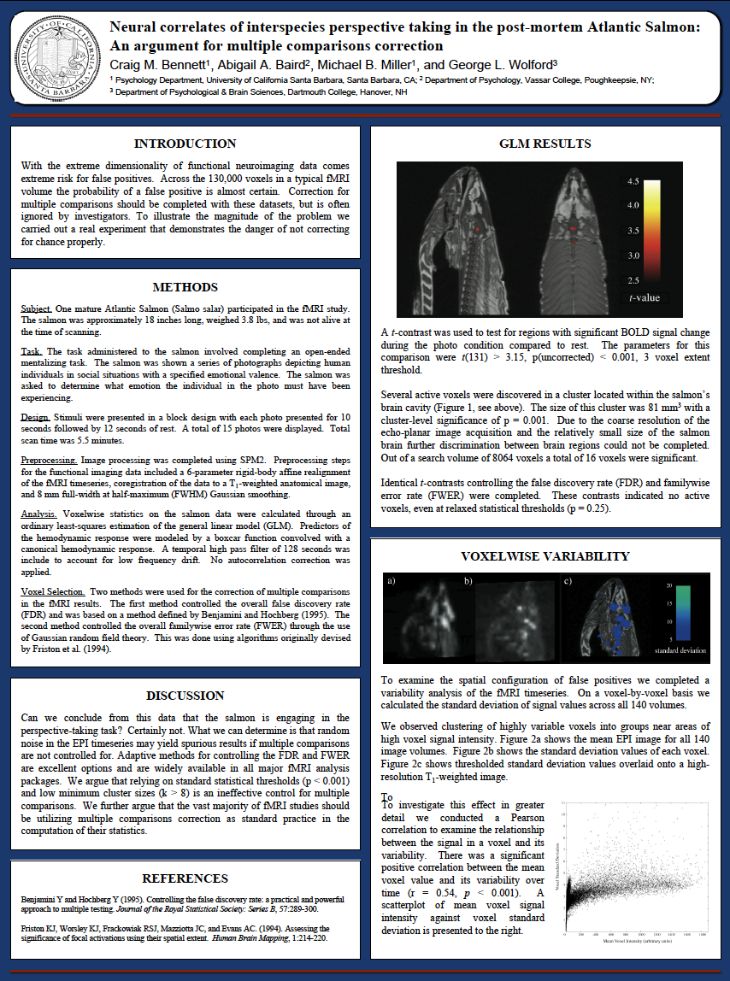
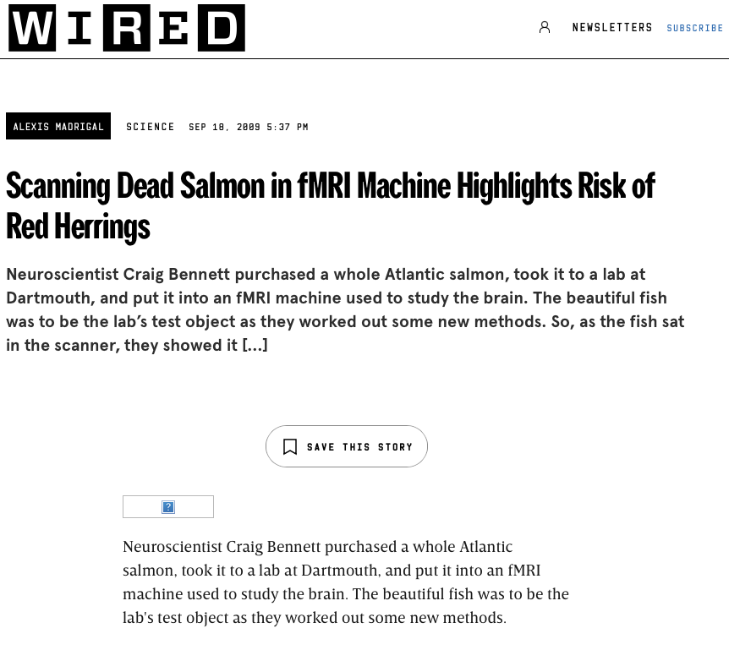
Scientific Spin and QRPs:
Do Dead Salmons Have Cognitive Empathy?
Sometimes we have to be “silly” to prove a point…
Link + Link
Original Work
(2009)
WIRED (2009)
Notes:
Study Overview:
Conducted by Craig Bennett et al. (2009) to highlight flaws in fMRI statistical practices.
Researchers placed a dead Atlantic salmon in an MRI scanner and showed it photographs of human faces displaying various emotions.
Findings:
Using uncorrected statistical thresholds, the analysis identified “brain activity” in the dead salmon when it was supposedly “viewing” the images.
Lesson:
The result was, of course, spurious—a vivid demonstration of false positives caused by not applying multiple comparison corrections in fMRI data.
Emphasized the need for rigorous statistical control and replication to avoid misleading conclusions in neuroscience.
Core Message:
Without proper statistical safeguards, even a dead fish can appear to have a neural response.

Slide 22
Scientific Spin and QRPs:
Key Concepts
The Replication Crisis: A concept referring to the widespread realization that many scientific findings cannot be reliably reproduced when studies are replicated, raising concerns about the credibility, transparency, and robustness of published research.
Questionable Research Practices: A set of research behaviors that fall short of outright fraud but distort scientific evidence, such as HARKing, p-hacking, and scientific spin.
Scientific Spin: A deliberate practice where scientists make their work appear more informative or meaningful than it actually is
False-Positive Psychology: A phenomenon where research methods and analytic flexibility lead scientists to report statistically significant results that are meaningless.

Slide 23
Scientific Spin and QRPs:
How to Combat QRPs and Scientific Spin
Removing the Incentive
Increase Transparency
Methodological Rigor
There is broad agreement that QRPs exist because of how we have set up a “publish-or-perish” system. But this system is not set in stone, and we could change it. For example, by journals embracing registered reports and encouraging null-results publications,
Some researchers have argued that the main reason why QRPs are omnipresent is that scientific work lacks transparency. Thus, if we increase transparency, we also reduce the opportunity for engaging in QRPs (e.g., see Open Science Framework).
To combat the presence of QRPs, future scientists must embrace a culture where researchers and reviewers expect/demand more rigorous methods in research programs.

Slide 24

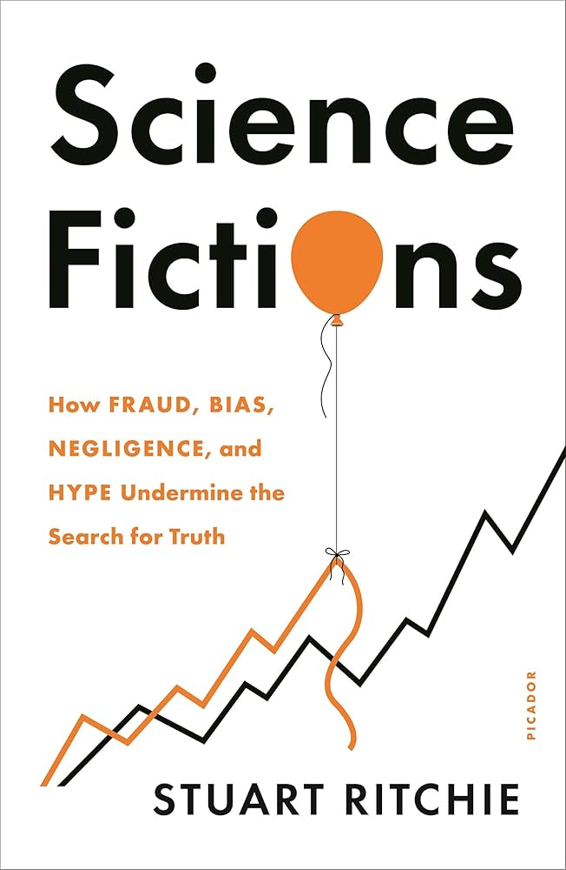
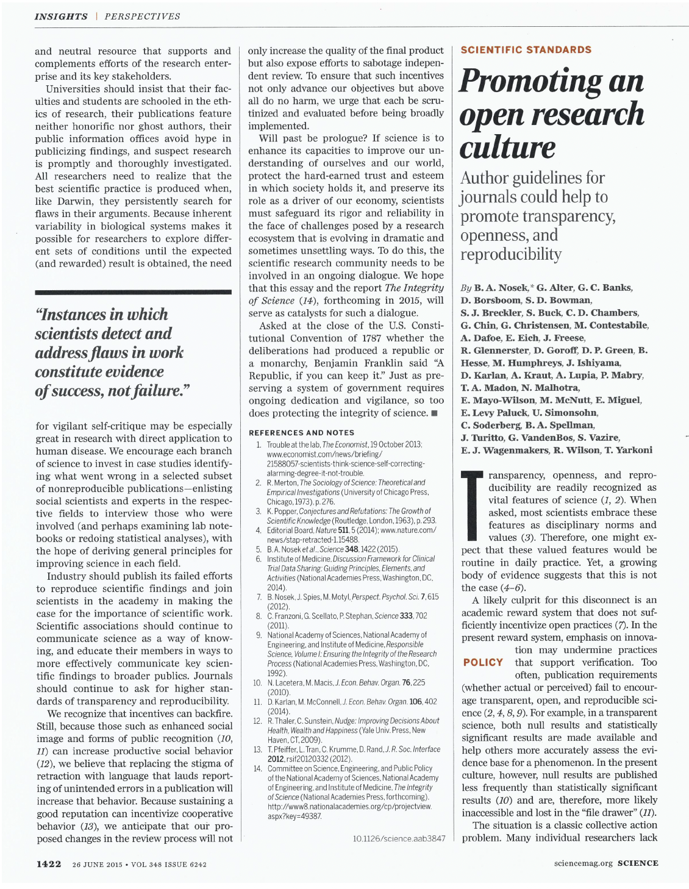

Scientific Spin and QRPs:
Notable Publications
On false-positive psychology and the replication crisis
OSF
Chambers (2017)
Richie (2020)
Nosek et al. (2015)

Slide 25
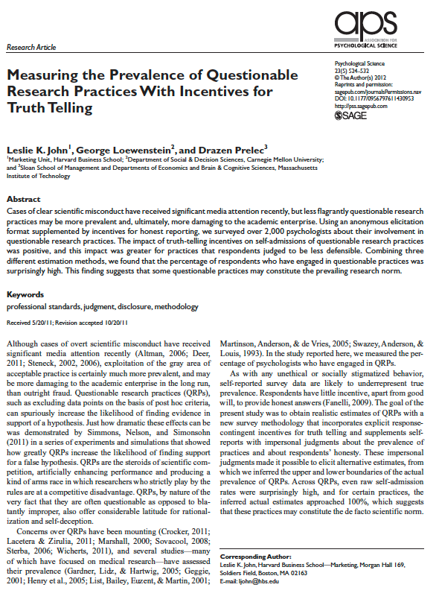
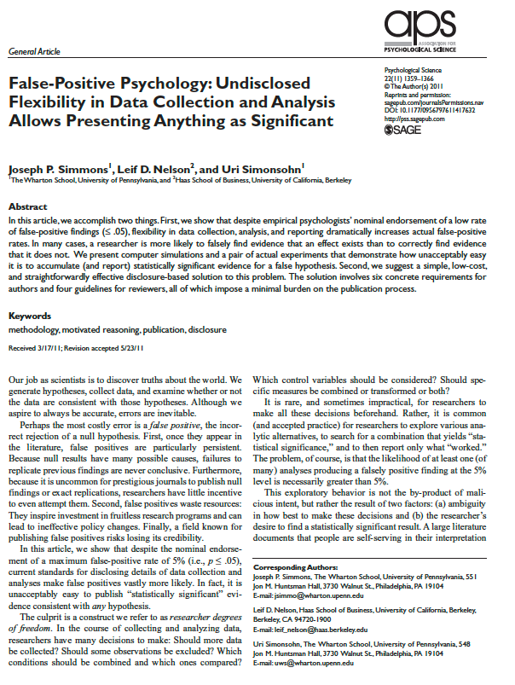
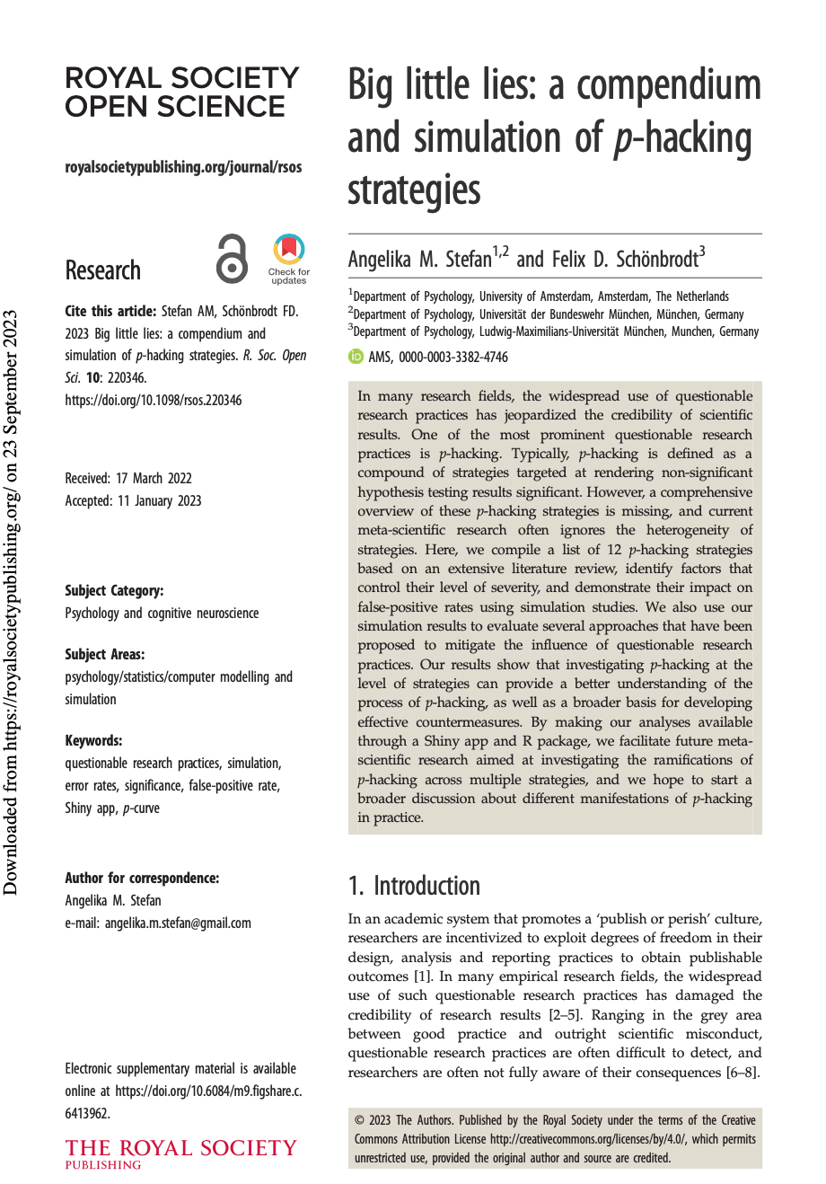
Scientific Spin and QRPs:
Key Publications on QRPs
John et al. (2012)
Simmons et al (2011)
Stefan & Schönbrodt (2023)

Slide 26
Spin and QRPs in Psychopathy Research

Slide 27
Spin and QRPs in Psychopathy Research:
A Field Rife with Spin and QRPs
It should be uncontroversial to state that psychopathy research has a problem with spin and QPRs
Documentation: Psychopathy Unmasked (2025) demonstrates numerous clear and undisputed examples of scientific spin and QRPs
Recall: Psychopathy research rose to prominence in an era where spin and QRPs was “standard” practice (i.e., in the 1990s and 2000s).
The use of spin and QRPs may have been driven by simple careerism (e.g., selling books, securing grants).
  Hare’s Without Conscience (1993) begins with an intriguing story about psychopaths having non-human-like brains.
  Fallon’s The Psychopath Inside (2013) is based on a neuroscientist “discovering” that they are a psychopath by studying their own MRI images.

Slide 28

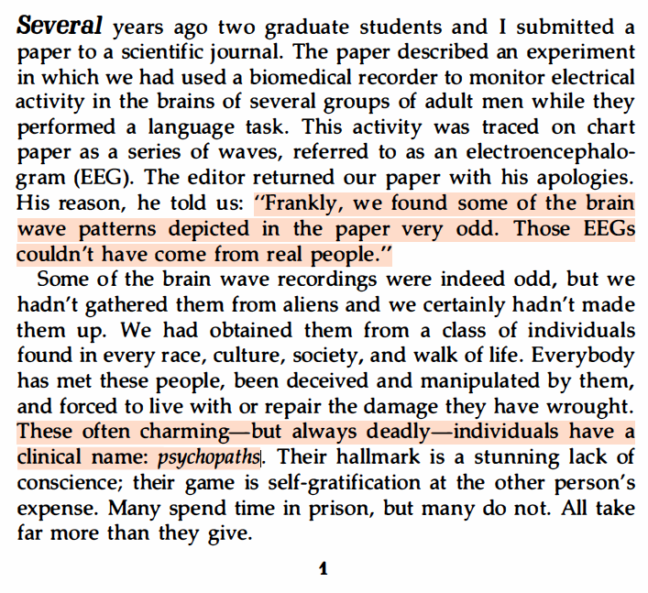
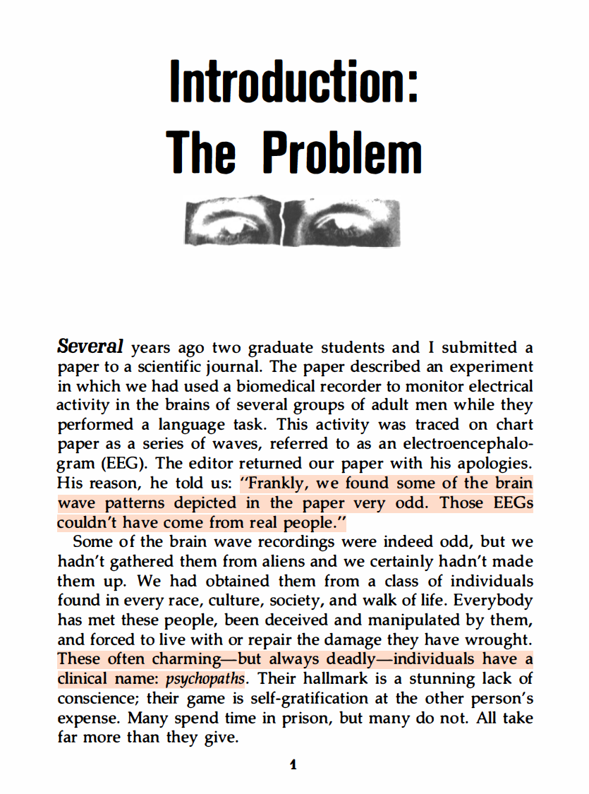

Spin and QRPs in Psychopathy Research:
NB: The first page of Without Conscience
Robert Hare in Without Conscience (1993, p. 1)

Slide 29


Spin and QRPs in Psychopathy Research:

Slide 30
Spin and QRPs in Psychopathy Research:
“The density measures from Brian’s paralimbic system were strikingly consistent with our findings from other psychopaths. In every region of the paralimbic system, Brian showed the same pattern of atrophy we have seen in other severe psychopaths. Brian has scored in the 99th percentile of the Psychopathy Checklist, and his brain data fit within that percentile on grey matter density. Brian’s paralimbic grey matter values were even more atrophied than most psychopaths.
I downed the rest of my quad espresso and sat back in my chair as I processed the results. I had looked at hundreds of psychopaths’ brains in my career, but the consistency of their brain abnormalities never ceased to amaze me.”
– Kent Kiehl, The Psychopath Whisperer (2014, p. 262)
Notes:
NB: How could it be that the expert researcher, Kent Kiehl, was “amazed” by the consistency of brain abnormalities when – in his academic research – he writes that such consistency has yet to be detected?

Slide 31
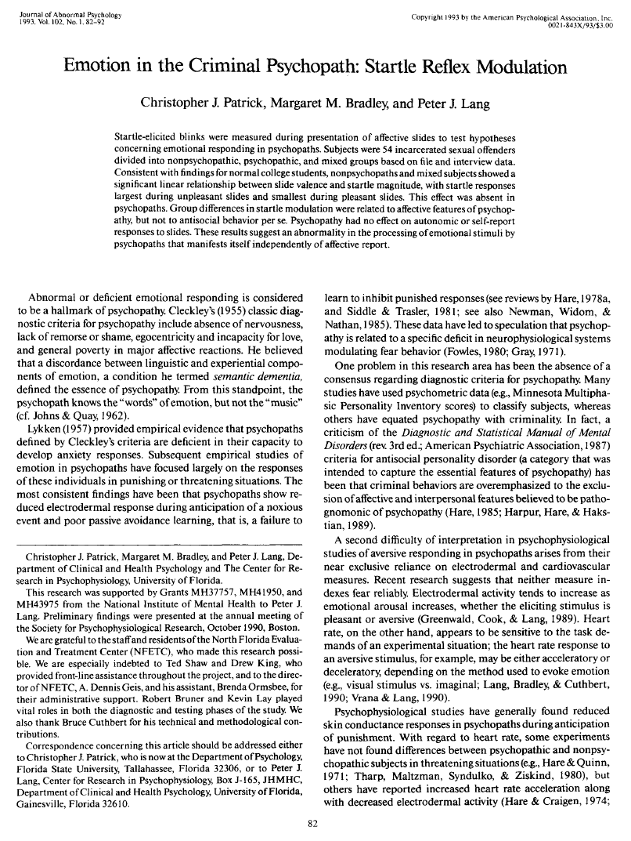
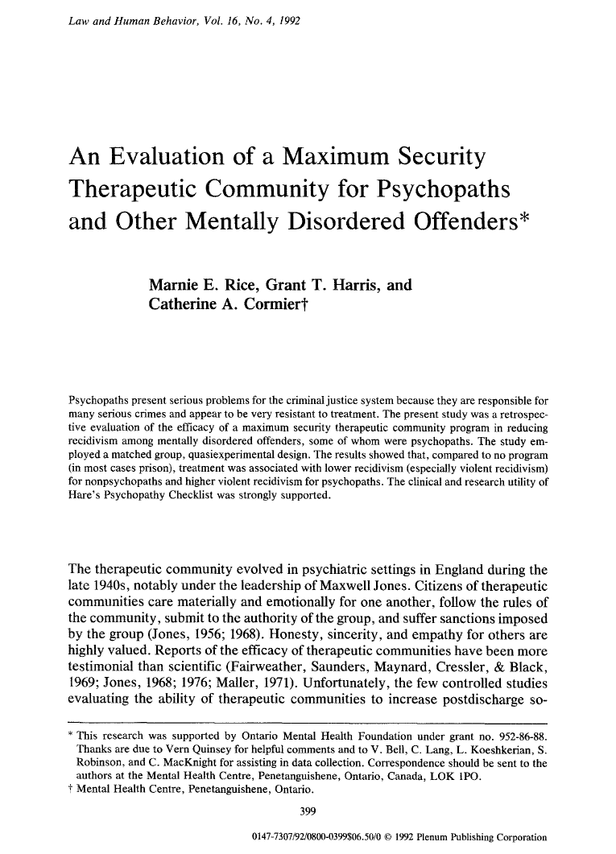
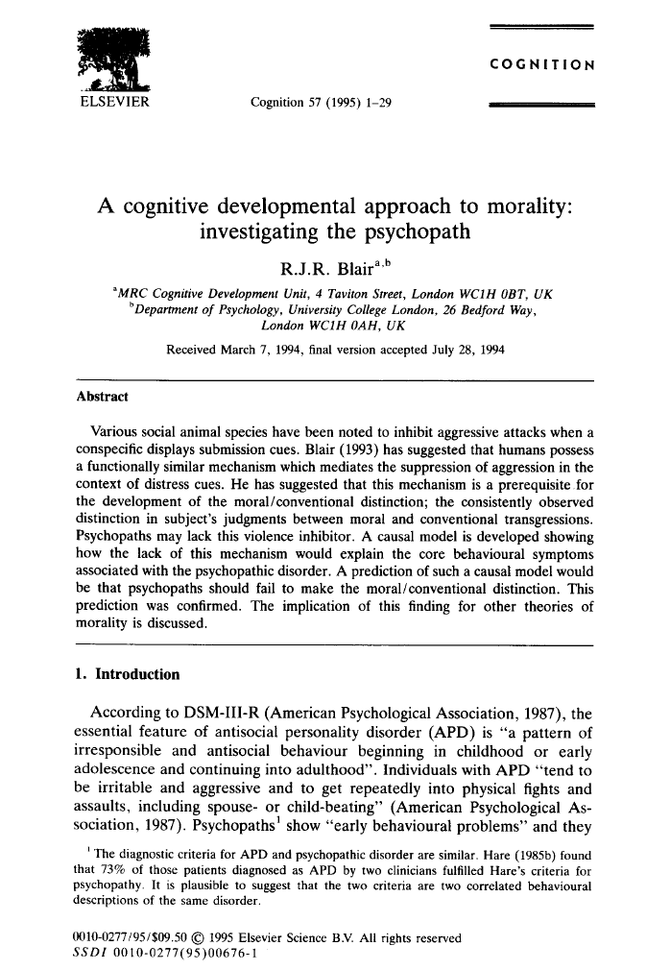
Spin and QRPs in Psychopathy Research:
Examples of Scientific Spin
Four of the most cited studies in psychopathy research; they are full of well-known “spin” tactics…
Citations:
1,333
Citations:
1,039
Citations:
2,407
Patrick et al. (1993)
Rice et al. (1992)
Blair (1995)

Slide 32
Spin and QRPs in Psychopathy Research:
Examples of Scientific Spin
Four of the most cited studies in psychopathy research; they are full of well-known “spin” tactics…
Challenge:
Can you spot the spin…?
QRP described as part of method…
Startle-reflex differences are common across all human sub-groups (NB: There are formidable limitations to Patrick et al.’s study).

Slide 33
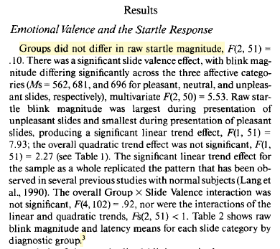
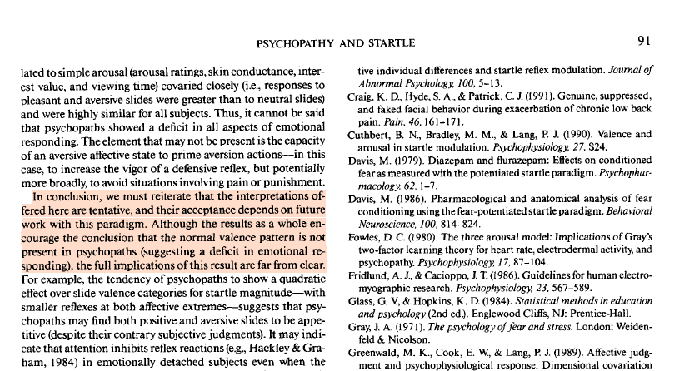
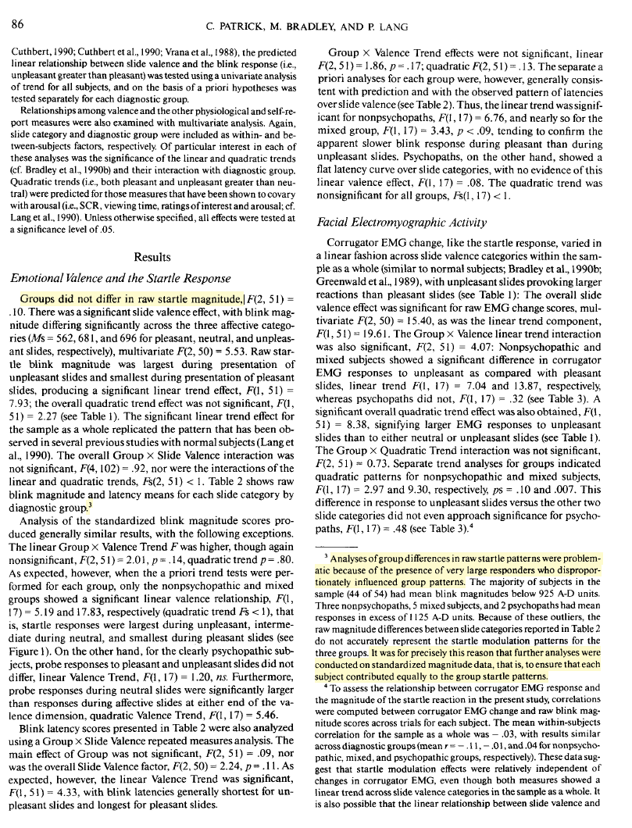
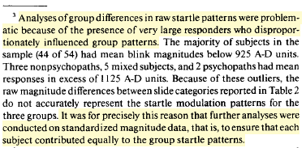
Spin and QRPs in Psychopathy Research:
Patrick et al. (1993)
Strong caveats are expressed only on the final page, contradicting the strong conclusion in the abstract.
Important research limitations are “buried” in the footnotes of the article

Slide 34
Spin and QRPs in Psychopathy Research:
Examples of Scientific Spin
Three of the most cited studies in psychopathy research; they are full of well-known “spin” tactics…
Citations:
1,333
Citations:
1,039
Citations:
2,407
Patrick et al. (1993)
Rice et al. (1992)
Blair (1995)

Slide 35
Spin and QRPs in Psychopathy Research:
Rice et al. (1992)
Study Design: The authors report to have conducted a “matched” control treatment outcome study…
Abstract
Matched Control Study: Pairs each subject in the experimental group with a control subject who shares key characteristics (e.g., age, gender, diagnosis). This design reduces confounding variables, allowing clearer comparison of treatment effects.

Slide 36
Spin and QRPs in Psychopathy Research:
Rice et al. (1992)
Sample (N = 322): 176 Treated vs. 146 Untreated → Later reduced to n = 205 (169 vs. 136)
Matching Criteria:
  The same age within 1 year at the time of the index offense.
  Charged with the same index offense.
  Equivalent in criminal history for each of property and violent offenses according to a system developed by Akman and Normandeau (1967).
  Charged with their index offenses no more than 2 years apart.
  NB: Original grouping had similar “follow-up” time with regards to recidivism.
Matched Control Study: Pairs each subject in the experimental group with a control subject who shares key characteristics (e.g., age, gender, diagnosis). This design reduces confounding variables, allowing clearer comparison of treatment effects.

Slide 37
Spin and QRPs in Psychopathy Research:
Rice et al. (1992)
Main Analysis of Treatment Outcome
Treatment study: Retrospective data from a community therapeutic program provided by the Social Therapy Unit (STU) at Oak Ridge.
Outcome: Tested the effect of the therapeutic program on (a) any form of recidivism and (b) violent recidivism across the entire sample
Follow-up Period: 10.5 years (SD = 4.94).
Matched Participants: 169 (Treated) and 136 (Untreated) (“many-to-one”).
Main results:
  Significant, yet small positive treatment effect in (a) any recidivism: 57% “treated” and 68% “untreated” matched comparison subjects recidivated.
  Non-significant with regards to (b) violent recidivism.
Summary: the authors found some evidence of a small, positive effect of treatment thus corroborating their main hypothesis.

Slide 38
Spin and QRPs in Psychopathy Research:
RECALL: Four Major Shortcomings in Rice et al. (1992)
NB: There are arguably many more problems with the study…
1: Deviates from “Matched Control” Design
After the initial main analysis, the authors give up on the “matching” criteria and can no longer isolate a potential treatment effect (i.e., properly control for potential outcome confounds).
2. Removal of Samples from Analysis
In the analysis comparing “treated” vs. “untreated” psychopathic participants, the authors remove n = 17 “untreated” participants without any justification. The results are “non-robust” as missing samples impact statistics.
3: Misleading Description of STU Program
The authors described the Social Therapy Unit’s services as “therapeutic” but must have known that they were antithetical to clinical and ethical best practices. It was widely known in the 1990s that the STU abused their patients.
4. Data Reliability Concerns
The authors describe the obtained file records as high quality, but the files were actually composed by lay case historians and inmates at Oak Ridge with no education in clinical or scientific work.

Slide 39
Spin and QRPs in Psychopathy Research:
Examples of Scientific Spin
Three of the most cited studies in psychopathy research; they are full of well-known “spin” tactics…
Citations:
1,333
Citations:
1,039
Citations:
2,407
Patrick et al. (1993)
Rice et al. (1992)
Blair (1995)

Slide 40
Spin and QRPs in Psychopathy Research:
Examples of Scientific Spin
Four of the most cited studies in psychopathy research; they are full of well-known “spin” tactics…
Challenge:
Can you spot the spin…?
Self-citation in abstract (revealing identity is a common spin tactic; might bias reviewers)
The term “confirm” is a very strong conclusion (NB: There are serious limitations to Blair’s study).

Slide 41
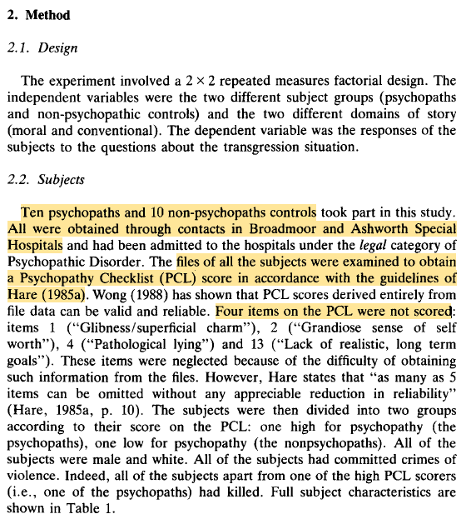
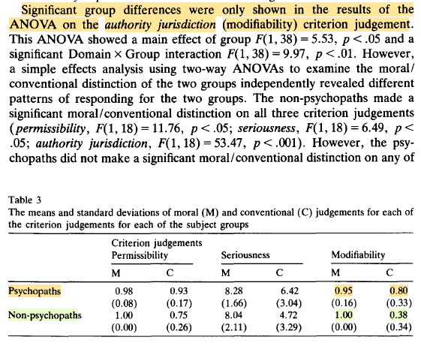
Spin and QRPs in Psychopathy Research:
Blair (1995)
Only a group difference on the “modifiability” criterion.
NB: the results are not consistent with the main hypothesis = that psychopathic persons don’t care about transgressions.
Small, non-random, “psychiatric” sample, scored only using “file” information, four PCL items removed.

Slide 42
Spin and QRPs in Psychopathy Research:
Examples of Scientific Spin
Three of the most cited studies in psychopathy research; they are full of well-known “spin” tactics…
Citations:
1,333
Citations:
1,039
Citations:
2,407
Patrick et al. (1993)
Rice et al. (1992)
Blair (1995)

Slide 43
Spin and QRPs in Psychopathy Research:
Three Widely Documented Types of QRPs
Most frequently observed examples of QRPs that “facilitates” scientific spin (from Larsen, 2025)
Excluding the Middle
Low Statistical Rigor
Analytical Flexibility
A frequent issue in psychopathy research is the exclusion or parsing out those participants who score between 2—30 on the PCL-R. This parsing of random samples exaggerates group differences and increases the possibility of a false-positive discovery.
Many studies rely on small, biased samples and fail to correct for familywise error rates (FWER), increasing the chance of false-positive findings. Such weak statistical practices give a misleading impression of robustness and reproducibility.
Researchers often take wide liberties in deciding how to analyze data, such as posthoc decisions between correlational or group-based methods, redefining variables, or parsing data. This flexibility allows results to be selectively presented in ways that best fit prior expectations.

Slide 44
Spin and QRPs in Psychopathy Research:
Coding Bias in the Review Literature
Coding bias is arguably a sub-type of scientific spin
Jalava et al. (2021) examined coding bias in structural neuroimaging (sMRI) research in PCL-R psychopathy samples.
METHOD: Compared the proportion of null-findings in review studies to the proportion of null-findings in the published original research.
HYPOTHSIS: The presence of coding bias should cause null effects to “disappear” or be “sifted” out of the review literature.
Coding Bias: A selective extraction of positive findings from original studies by authors of review literature (i.e., over-reporting of positive vs. null findings).

Slide 45
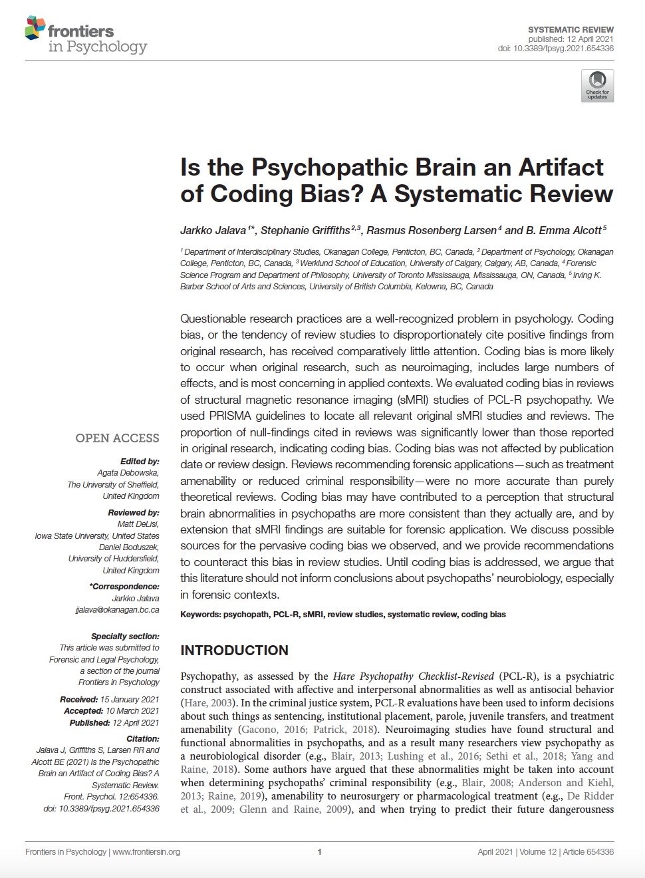
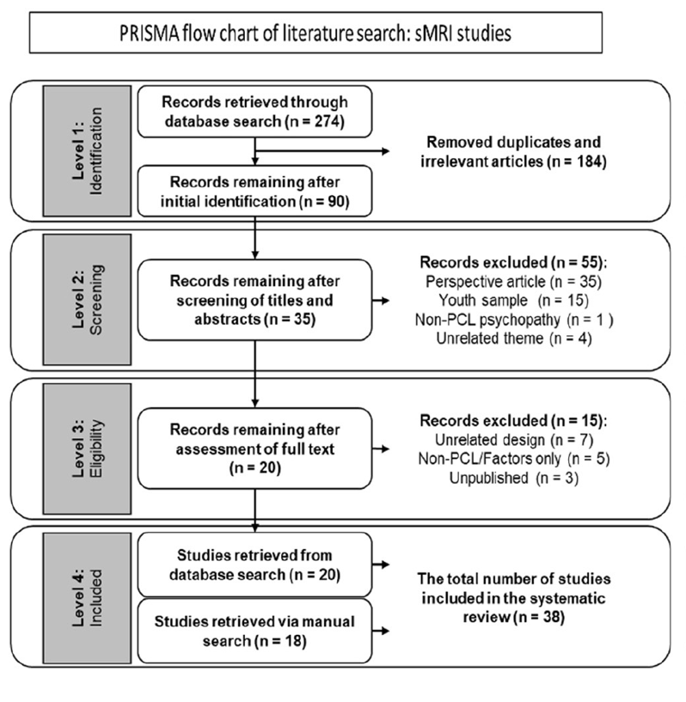
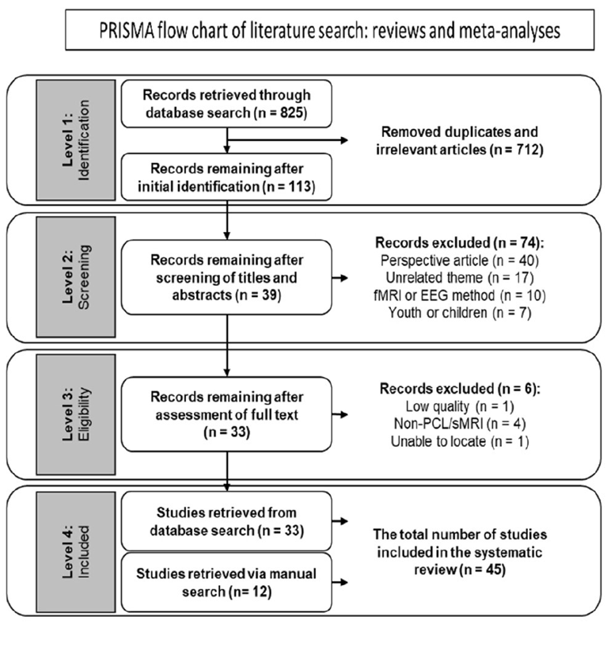
Spin and QRPs in Psychopathy Research:
Jalava et al. (2021)
VS.
Coding Bias: A selective extraction of positive findings from original studies by authors of review literature (i.e., over-reporting of positive vs. null findings).

Slide 46
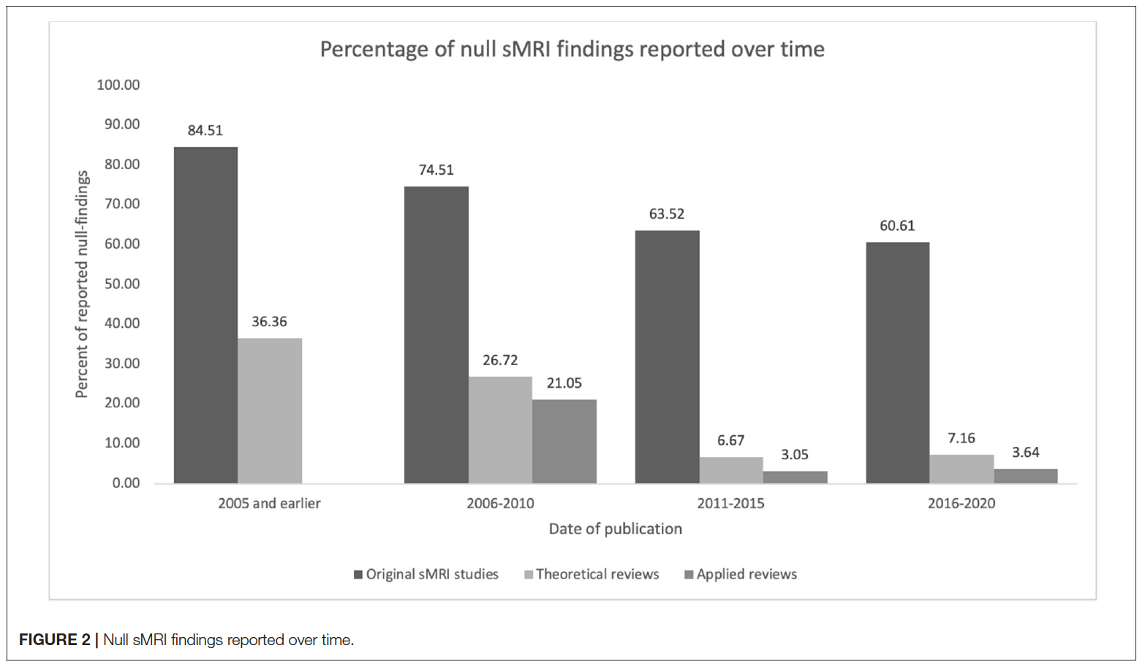
Spin and QRPs in Psychopathy Research:
Jalava et al. (2021)
Overview:
Across 38 studies comprising 791 reported effects, 64.1% of all effects were null findings.

Slide 47
Spin and QRPs in Psychopathy Research:
Jalava et al. (2021)
Coding bias is arguably a sub-type of scientific spin
Jalava et al. (2021) documents how the majority of review studies portray psychopathy as a neurodevelopmental disorder.
This view stands in clear contrast to the empirical research.
Notice that at least since Koenigs et al. (2011) it has been well-known that neuroimaging results in PCL samples are heterogenous.
Yet, the review literature systematically “spins” a different narrative.
For two decades, legal and forensic professionals relying on review literature about psychopathy neuroimaging would have been misled.

Slide 48

Spin and QRPs in Psychopathy Research:
“…what we found was that the nulls had virtually disappeared from the review literature, as if the review literature acted as a sift, like a miner panning for gold in a river.”
– Psychopathy Unmasked (Larsen, 2025, p. 139)

Slide 49
Spinning Psychopathy in Public Media

Slide 50

Psychopathy in Public Media:
Researchers and Experts in the Media
There are numerous examples of psychopathy researchers giving misleading information about psychopathy
Documentary: The Psychopath Next Door (CBC)

Slide 51

Psychopathy in Public Media:
Researchers and Experts in the Media
There are numerous examples of psychopathy researchers giving misleading information about psychopathy
Documentary: Psychopath (BBC)

Slide 52
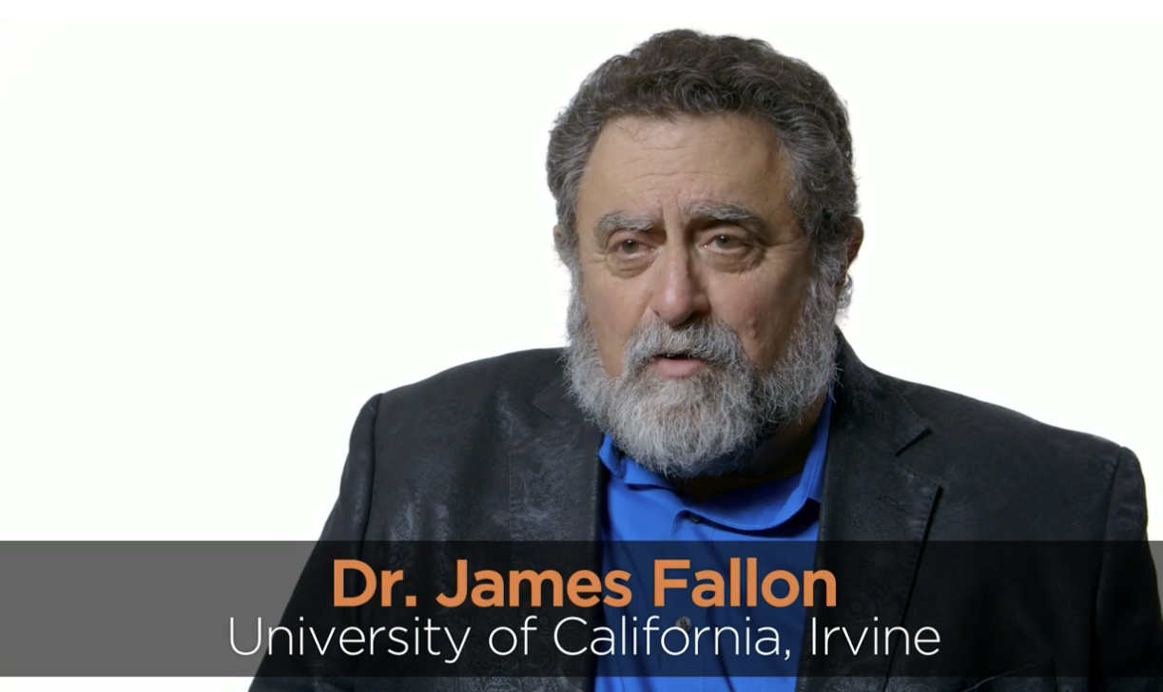
Psychopathy in Public Media:
Researchers and Experts in the Media
There are numerous examples of psychopathy researchers giving misleading information about psychopathy
Big Think interview with James Fallon

Slide 53


Psychopathy in Public Media:
An Epidemic of “Fake” Experts
Media platforms like YouTube, TikTok, etc. are rife with clinicians, influencers, etc. who “appear” to be experts on psychopathy
Big Think interview with Kevin Dutton

Slide 54


Psychopathy in Public Media:
An Epidemic of “Fake” Experts
Media platforms like YouTube, TikTok, etc. are rife with clinicians, influencers, etc. who “appear” to be experts on psychopathy
Interview with pseudonymous authors, M.E. Thomas
(part 2 and part 3)

Slide 55

Psychopathy in Public Media:
An Epidemic of “Fake” Experts
Media platforms like YouTube, TikTok, etc. are rife with clinicians, influencers, etc. who “appear” to be experts on psychopathy
“My name is Patric Gagne’s, I have a doctorate in clinical psychology, and I’m a diagnosed sociopath…”
Business Insider interview

Slide 56

Psychopathy in Public Media:
An Epidemic of “Fake” Experts
Media platforms like YouTube, TikTok, etc. are rife with clinicians, influencers, etc. who “appear” to be experts on psychopathy
Interview with a “criminal psychopath”

Slide 57
Critical Reflections

Slide 58



Critical Reflections:
Scientific Spin and QRPs
Endemic Problem
Unsolvable Problem?
Legal and Ethical Issues
QRPs and scientific spin in psychopathy research are seemingly systemic rather than isolated one-off instances. Decades of selective reporting and exaggerated claims have produced a literature that overstates certainty and conceals ambiguity.
The persistence of QRPs and scientific spin suggests that this may be an unsolvable problem, one embedded in the structural incentives within the field itself, where novelty and certainty are valued over accuracy and restraint, leading to a gradual erosion of credibility within the field.
The persistence of QRPs and scientific spin in psychopathy research carries profound ethical and legal implications. When flawed or overstated findings inform forensic assessments or judicial decisions, they risk undermining due process and contributing to unjust outcomes.

