Slide 1

Psychopathy and Crime
The Science, Ethics, and Legal Influence of a Controversial Diagnosis
Module 7
Two Theories of Psychopathy
Has psychopathy been validated?
Copyright © Rasmus Rosenberg Larsen
Licensed under CC BY 4.0.

Slide 2

Any questions..?
© OpenAI (LLM-generated image)

Slide 3
Psychopathy and Crime
FSC350
Module 1
Introduction – What is Psychopathy?
Module 7
Two Theories of Psychopathy
Module 2
The Problem of Psychopathy
Module 8
Psychopathy and Scientific Spin
Module 3
Psychopathy and Forensic Risk
Module 9
Psychopathy and Ethics
Module 4
Psychopathy and Treatment
Module 10
Explaining a Lack of Evidence (Part I)
Module 5
Psychopathy and Moral Psychology
Module 11
Explaining a Lack of Evidence (Part 2)
Module 6
The Neuroscience of Psychopathy
Module 12
The Future of Psychopathy Research

Slide 4
This Module’s Agenda:
What is a “Theory”?
Explaining Psychopathy
The Emotion Theory of Psychopathy
The Cognitive Theory of Psychopathy
Research on the Emotion Theory
Research on the Cognitive Theory
Critical Reflections

Slide 5
What is a “Theory”?

Slide 6
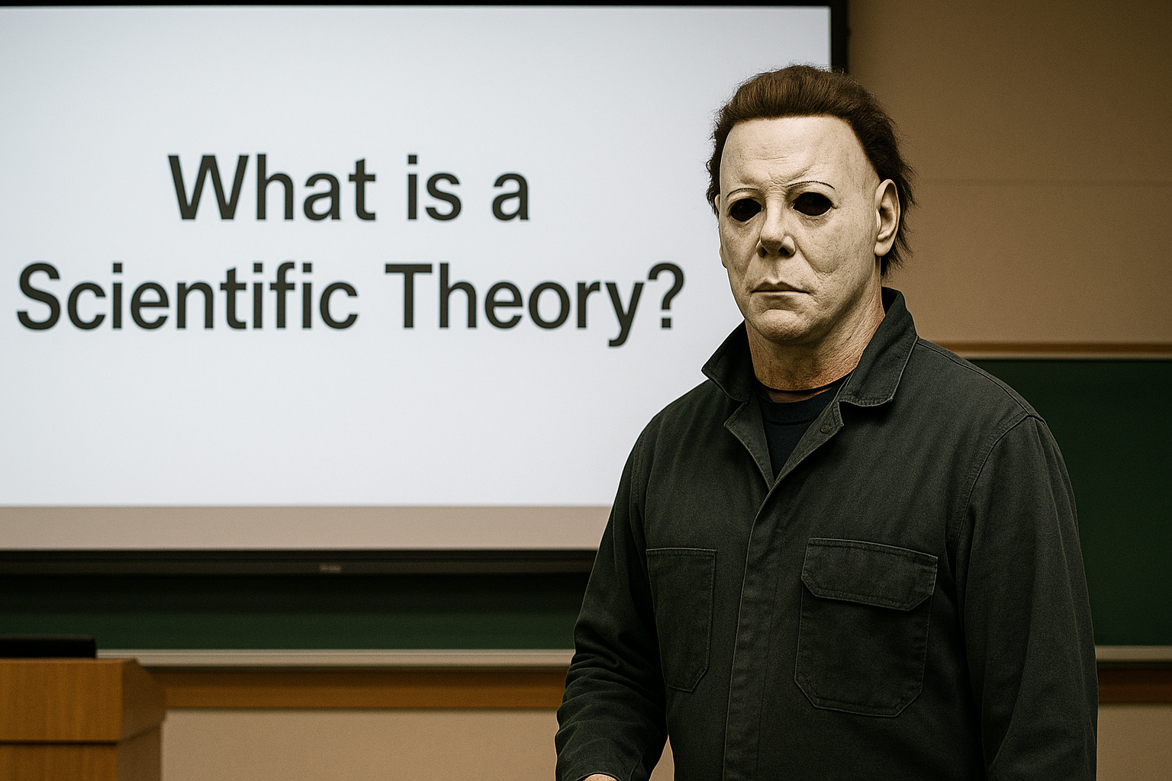
What is a “Theory”?

Slide 7
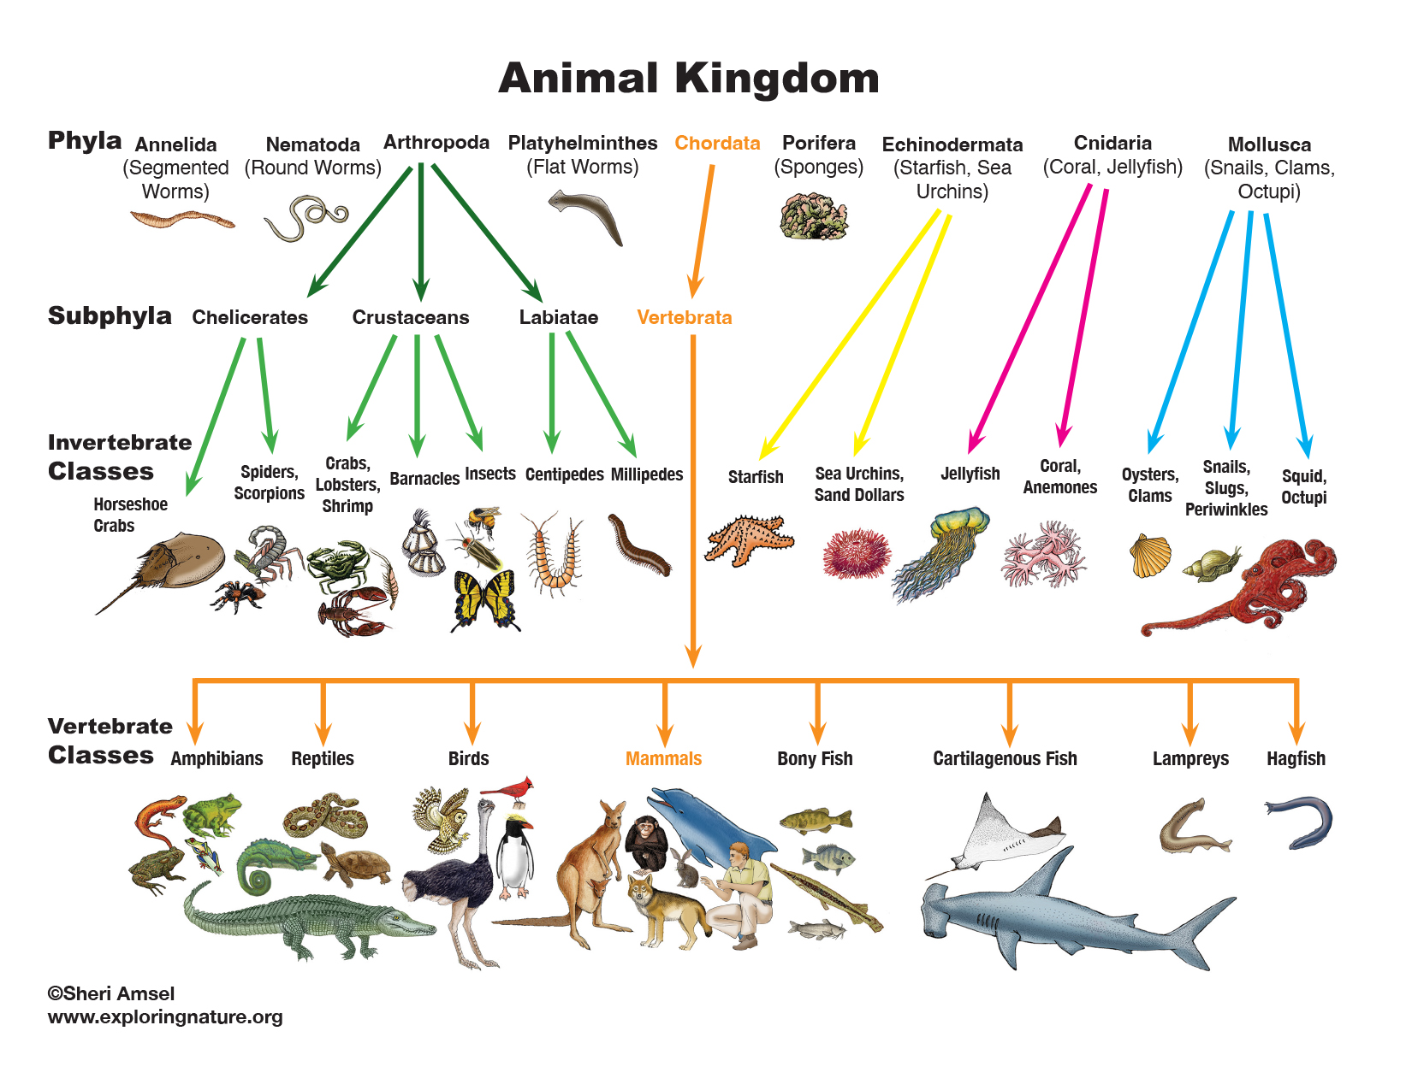

What is a “Theory”?
Scientific Theories
A scientific theory is an attempt to give a “why” (i.e., explanation) of the “what” (i.e., the facts).
Facts
Explanation
The “What”
The “Why”

Slide 8
What is a “Theory”?
Scientific Theories
A scientific theory is an attempt to give a “why” (i.e., explanation) of the “what” (i.e., the facts).
Facts
Explanation
“Observation”
“Theory”
The “What”
The “Why”

Slide 9
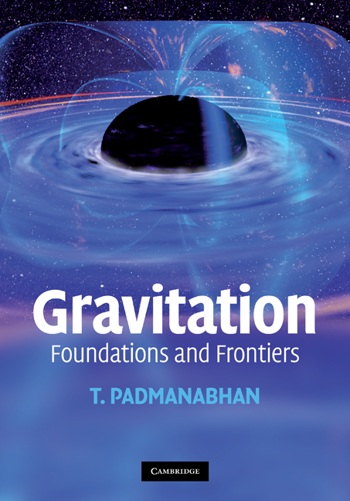

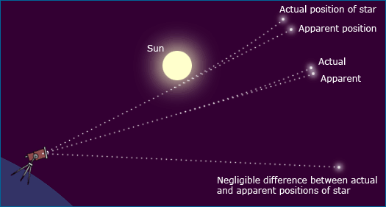
What is a “Theory”?
Scientific theories can be “tested” because they make clear predictions…
Hypothesis: A prediction about an experimental outcome derived from a theory.
A good theory…
…can explain facts…
…and can therefore make factual predictions.

Slide 10

What is a “Theory”?
Watch this video by Vox explaining how Einstein’s theory of general relativity was (partially) corroborated by this photo of a solar eclipse.

Slide 11
What is a “Theory”?
The Scientific Method
Observation & Information:
(Identify gaps in “knowledge”)
Question Formulation:
(Can the “knowledge-gap” be closed?)
Refinement:
(Develop further hypotheses, and refining the theory)
Revise or Reject:
(Theory is either revised or rejected)
Theory:
(Formalize explanation that closes the “gap”)
Hypothesis:
(Testable predictions inferred from “theory”)
Experimentation:
(The concrete testing of a hypothesis)
Analysis:
(Rigorous statistical analysis of data)
NB: In inferential statistics the scientific method is adapted to the format of default/null hypothesis testing.
Hypothesis Support:
(Corroborate theory)
Hypothesis Rejection:
(Reject or revise theory)

Slide 12
What is a “Theory”?
Conventional Signs of a “Good” Theory
1. Falsifiability: A good theory must be testable and falsifiable. It should specify, a priori, what type of evidence or experimental outcome would count as inconsistent with it. If no conceivable evidence can contradict a theory, it is not “scientific.”
2. Explanatory Scope: The theory must be able to account for all relevant aspects of the phenomenon under investigation. A theory that explains only some of the evidence, or ignores inconsistencies, fails to meet this criterion.
3. Simplicity (Parsimony): Among competing explanations, the simplest one that adequately accounts for the facts is preferable. A good theory is one where there is no seemingly simpler and equally explanatory alternative.
Theory Corroboration: When a theory has “survived” and been “refined” by sustained empirical testing.

Slide 13
Explaining Psychopathy

Slide 14

Explaining Psychopathy:
What Exactly Are We Aiming to Explain?
To have a theory of psychopathy is to “explain” the phenomenon described by clinicians…
The Patient Stereotype
Description
Instantiates
Clinical Proto/Stereotype: A real-life person that “fits” or represents the constellation of behavioral signs and psychological traits associated with a specific condition.

Slide 15
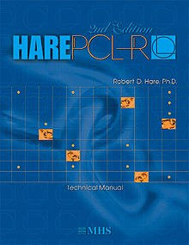
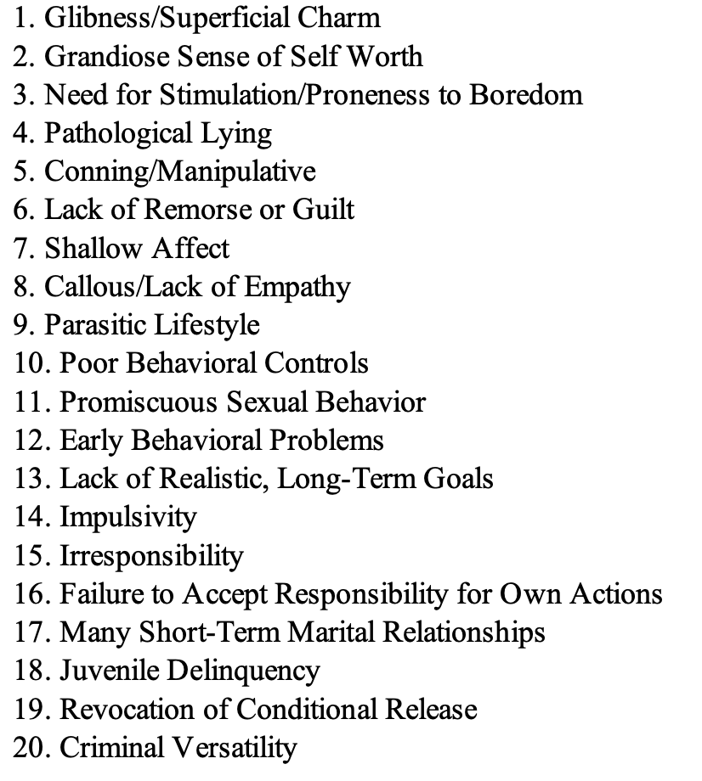
Explaining Psychopathy:
What Exactly Are We Aiming to Explain?
The PCL psychopathic stereotype
Description

Slide 16


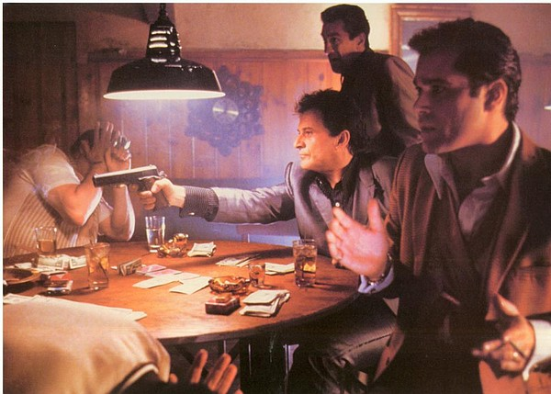
Explaining Psychopathy:
What Exactly Are We Aiming to Explain?
Media created fictional examples of the PCL psychopathic prototype
“Holly” in Badlands
“Todd” in Breaking Bad
“Tommy” in Goodfellas

Slide 17


Explaining Psychopathy:
What Exactly Are We Aiming to Explain?
Alleged real-life examples of the PCL psychopathic prototype
Theodore Bundy
(serial killer)
Bernie Madoff
(Financial fraudster)

Slide 18

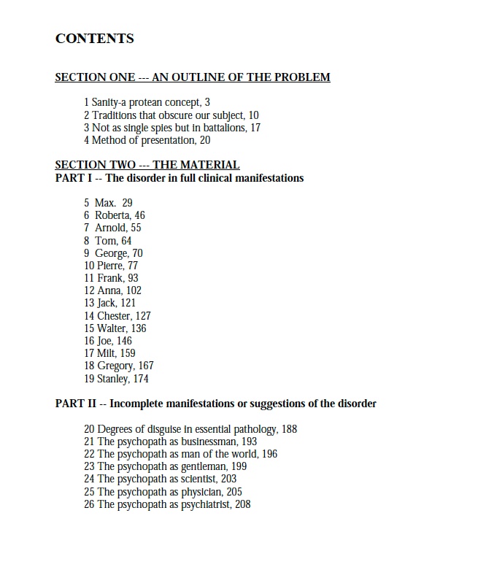
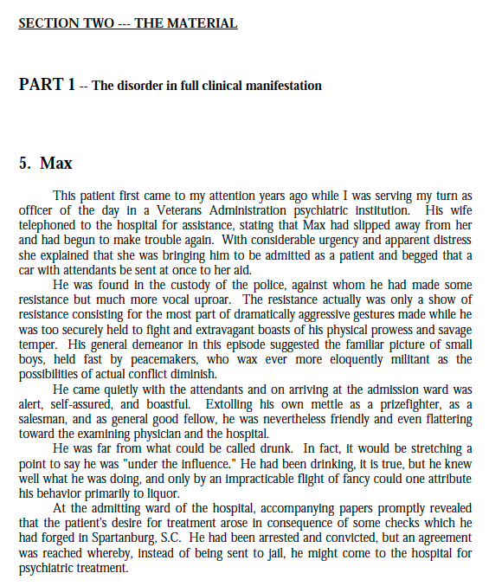
Explaining Psychopathy:
What Exactly Are We Aiming to Explain?
To this date, The Mask of Sanity is the only comprehensive narrative description of “real-life” psychopathic patients (15 patients, ~158 pages = around one third of the book)

Slide 19
Explaining Psychopathy:
Theories of Psychopathy
The aim to find a “why” (i.e., explanation) of the “what” (i.e., the facts).
Facts
Explanation
“Observation”
Two Main Theories
The Emotion Theory
vs.
The Cognitive Theory
The “What”
The “Why”

Slide 20
Explaining Psychopathy:
Two Theories of Psychopathy
NB: Some researchers endorse both theories, thus explaining psychopathy as a dual-deficit disorder…
Claim #5 – Psychopathy is Theoretically Corroborated: Researchers hold that empirical evidence supports or validates our theoretical understanding of psychopathy, and this scientific account therefore makes up a powerful explanation of psychopathic persons’ criminal and antisocial lifestyle.
The Emotion Theory: This theory proposes that psychopathy stems from impairments in the biological systems responsible for generating emotions, resulting in a reduced or absent capacity to feel certain emotions.
1:
2:
The Cognitive Theory: This theory proposes that psychopathy arises from impairments in executive functions, the mental processes responsible for self-control and impulse regulation, resulting in highly impulsive and disinhibited behavior.
Notes:
NB: It could be argued that the “dual-deficit” view is inconsistent or raises unanswered questions. For example, is it possible for a person to be deprived of, or low on emotion/affect, while at the same time having persistent impulse control problems? The idea of a highly impulsive unapathetic person might be an impossibility (i.e., impulse control is often about controlling emotions).

Slide 21
The Emotion Theory of Psychopathy

Slide 22
The Emotion Theory of Psychopathy:
Background and Key Claims
The Basics: Psychopathy explained as a complete or substantial lack of emotion…
One of the oldest and most endorsed theories, dating back to Benjamin Rush (1786); popularized by Hervey Cleckley and Robert Hare.
Different modern sub-versions:
  The Low-Fear Hypothesis (Lykken, 1995)
  The Integrated Emotion Systems (Blair et al., 2005)
Core Premises: Humans are inherently emotional; feelings of joy, anger, jealousy, or sadness shape how we think, act, and relate to others.
Therefore, a profound lack of emotion fundamentally transforms a person’s psychology; a mindset deprived of pro-social attitudes.

Slide 23
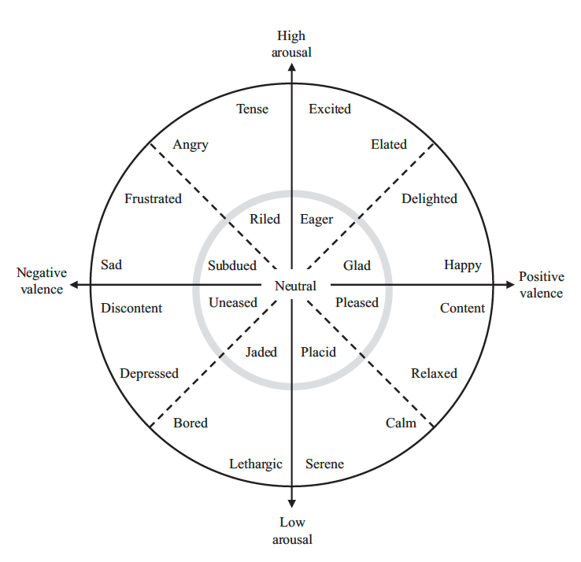
The Emotion Theory of Psychopathy:
Low Arousal: The emotion theory of psychopathy proposes that psychopathic persons experience only mild, near-neutral emotions, never reaching the high arousal positive/negative states shown at the outer edges of the circumplex model.
Moral Psychology: A lack of emotion might profoundly impact your pro-social and moral attitudes.
Notes:
Core idea: Emotional/affective states in psychopathy rarely reach arousal levels that meaningfully alter cognition or behaviour.
Superficial affect (Cleckley): Some feelings may be present, but they are shallow and low-arousal.
“Emotional poverty” (Hare): Limited range and depth of feelings; when emotion appears, little occurs beneath the surface.
Circumplex implication: Emotions cluster near the neutral center (low arousal, near-neutral valence), with few or no experiences at the outer, high-arousal periphery.
Functional consequence: Weakened emotional signals → reduced impact on motivation, decision-making, and social behaviour.
Circumplex Model of Emotion (Affect)
Core idea (from your note):
Emotional states can be located in a 2-D space defined by valence (pleasant ↔ unpleasant) and arousal (activated/energized ↔ deactivated/calm). Each affect label captures both how positive/negative it feels and how physiologically/mentally activated one is.
Axes and layout
Horizontal axis: Valence — positive (right) to negative (left).
Vertical axis: Arousal — high activation (up) to low activation (down).
Center ≈ neutral valence + low arousal (e.g., “content,” “neutral”).
Distance from center reflects intensity; farther out = stronger affect.
Quadrants with examples
High arousal, positive valence: excited, elated, enthusiastic.
High arousal, negative valence: angry, afraid, alarmed.
Low arousal, negative valence: sad, bored, sluggish.
Low arousal, positive valence: calm, relaxed, serene.
How the model is used
Mapping labels to coordinates: emotion words cluster in regions (not points).
State dynamics: affect varies continuously over time; movement across the circle captures shifts (e.g., stress → relief).
Measurement: brief self-reports (e.g., valence and arousal sliders; PANAS variants) or physiological proxies (heart rate, skin conductance) to index arousal.
Interpretive notes
Category flexibility: discrete emotion terms (anger, fear, joy) are treated as **regions

Slide 24





The Emotion Theory of Psychopathy:
The Emotion Theory of Psychopathy
Nutshell: Psychopathy explained as a complete or substantial lack of emotion…
Psychopath
“Meh”
Sentiment
Trigger
Sensible
Emotion
Behavior
Inducing
State
Perception
Non-
Psychopath
Outraged

Slide 25



The Emotion Theory of Psychopathy:
RECALL: The Notion of “Moral Colorblindness”
Cleckley, Hare, Blair and others argued that a lack of emotion leads to a lack of “moral values”
…and popular culture has been fascinated by this idea for decades…
Anton Chigurh
No Country for Old Men
Dexter Morgan
Dexter
Patrick Bateman
American Psycho

Slide 26
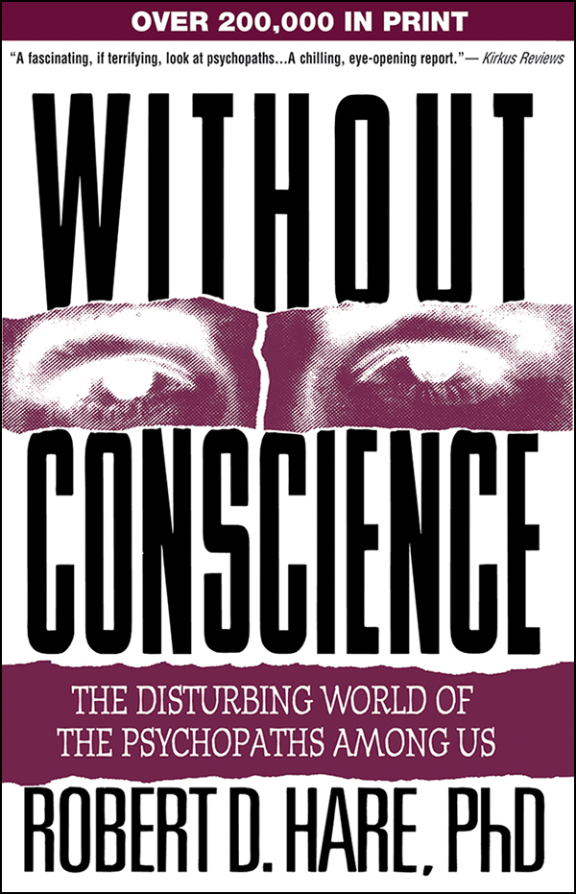
The Emotion Theory of Psychopathy:
“Psychopaths seem to suffer a kind of emotional poverty that limits the range and depth of their feelings. While at times they appear cold and unemotional, they are prone to dramatic, shallow, and short-lived displays of feeling. Careful observers are left with the impression that they are play-acting and that little is going on below the surface.”
Quote from Without Conscience (1993, 52)

Slide 27
The Emotion Theory of Psychopathy:
“Without suffering or enjoying in significant degree the integrated emotional consequences of experience, the psychopath will not learn from it to modify and direct his activities as other men whom we call sane modify and direct theirs. […] It is entirely impossible for him to see another person from the aspect of major affective experience, since he is blind to this order of things or blind in this mode of awareness.”
Cleckley (1988), The Mask of Sanity (p. 373)

Slide 28
The Emotion Theory of Psychopathy:
“A simple analogy here will help. The psychopath is like a color-blind person who sees the world in shades of gray but who has learned how to function in a colored world. He has learned that the light signal for "stop" is at the top of the traffic signal . When the color-blind person tells you he stopped at the red light, he really means he stopped at the top light. He has difficulty in discussing the color of things but may have learned all sorts of ways to compensate for this problem, and in some cases even those who know him well may not know that he cannot see colors. Like the color-blind person, the psychopath lacks an important element of experience-in this case, emotional experience but may have learned the words that others use to describe or mimic experiences that he cannot really understand.”
Quote from Without Conscience (1993)

Slide 29
The Cognitive Theory of Psychopathy

Slide 30
The Cognitive Theory of Psychopathy:
Background and Key Claims
Psychopathy explained as an impairment of executive functions such as impulse control…
Proposed by Gorenstein & Newman (1980); later re-named as the Response Modulation Hypothesis (Hamilton et al., 2018).
Gained prominence in the 1990s as an alternative to the emotion theory.
The theory emerged after studies showed psychopathic individuals display normal emotional reactions, inconsistent with the emotion theory.
The cognitive theory explains psychopathy in terms of cognitive dysfunction.
Core Idea: Psychopathy is a deficit in attention and information processing, leading to poor impulse control and difficulty modulating behavior.

Slide 31
The Cognitive Theory of Psychopathy:
Getting Specific About the Details
Not a lack of emotion; but instead, a response modulation deficit = causing high impulsivity and disinhibition
Attention deficit: Defective ability to handle different types of co-occurring information streams (during perception stages).
Faulty Response Modulation?
  When humans initiate a goal-directed action, they are normally receptive to new information/cues in order to modulate behavior.
  Threat cues competes for primary attention to change behavior.
  Psychopathy is thus theorized as an inability to properly perceive threat cues; deficient processing of information outside attention span.

Slide 32

The Cognitive Theory of Psychopathy:
Trivial Example of Response Modulation
Psychopathy is understood as an “information bottleneck” that produces attention deficits, resulting in incomplete or distorted processing of threat cues and, consequently, impaired response modulation (see Hamilton et al., 2018)
Response Modulated Behavior
Dominant Response Set: “I want to drink this delicious cup of chocolate…”
New Information: “But it’s burning hot…!”
Response Modulation: Because of this new information, the person now regulates their dominant response set; for example, wait for the beverage to cool down before drinking.

Slide 33

The Cognitive Theory of Psychopathy:
Psychopathy as an Attention Disorder
Not a lack of emotion; but instead, a response modulation deficit = causing high impulsivity and disinhibition
Perhaps as portrayed by the character “Tommy”
The stereotype is that of a “disinhibited” or “impulsive” person elbowing their way through life…
“Tommy” in Goodfellas

Slide 34
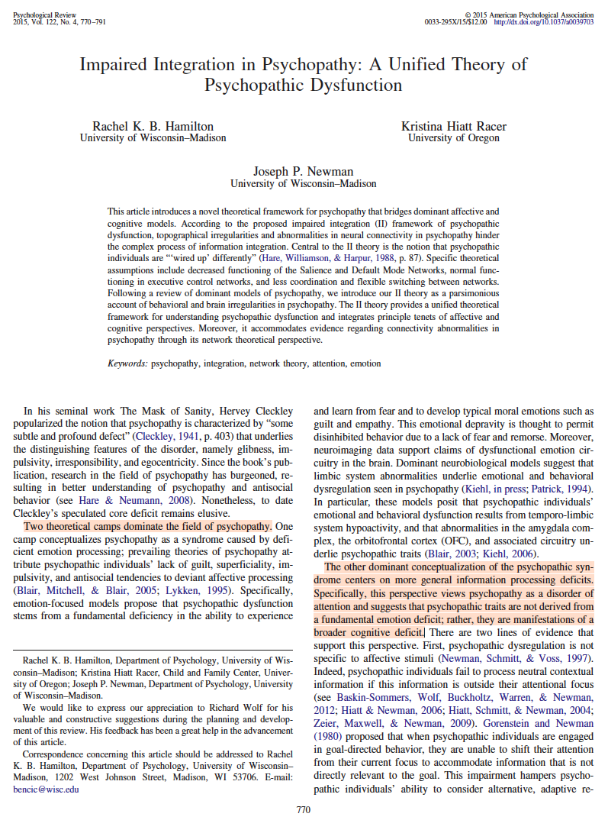
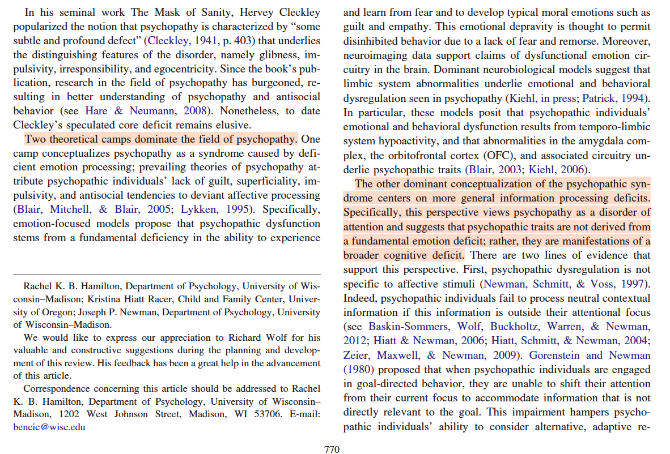

The Emotion Theory of Psychopathy:
Hamilton et al. (2015)

Slide 35
Research on the
Emotion Theory

Slide 36
Research on the Emotion Theory:
Testability and Falsifiability
Main Hypothesis: Psychopathic individuals exhibit muted or atypical emotional responses compared to non-psychopathic individuals.
Two Strengths (i.e., “Good” Theory):
  Specifies what sort of evidence would corroborate the theory (i.e., reduced emotions).
  Specifies what would falsify it; finding that psychopathic persons’ emotional capacities are comparable to those of others.
The Emotion Theory: This theory proposes that psychopathy stems from impairments in the biological systems responsible for generating emotions, resulting in a reduced or absent capacity to feel certain emotions.

Slide 37

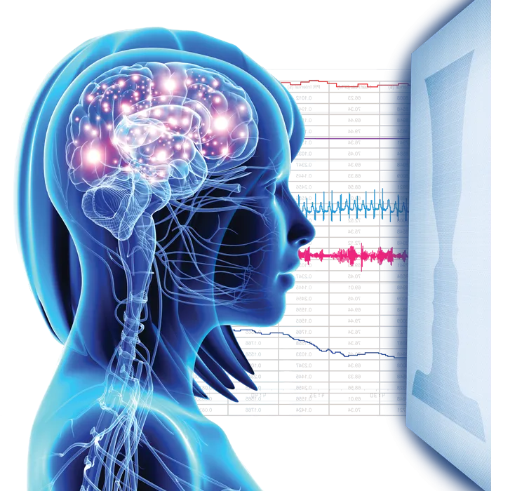
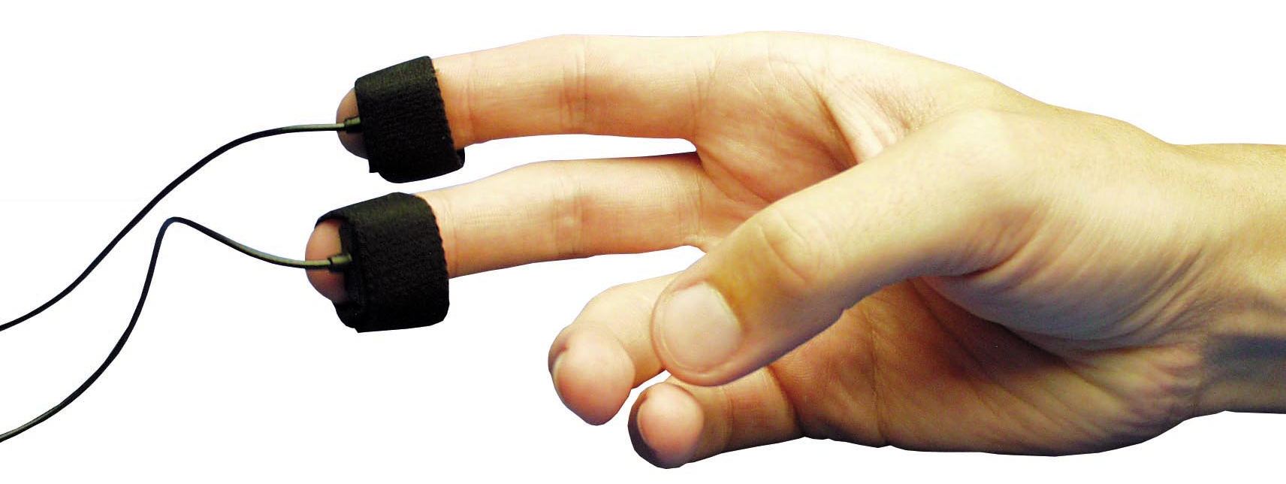
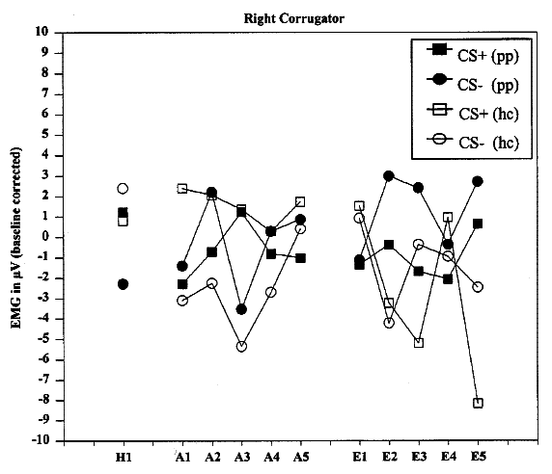
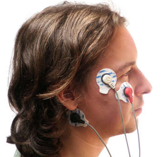
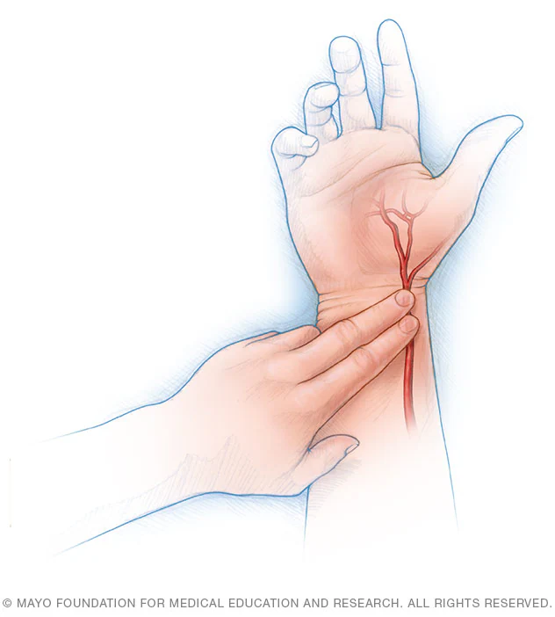
Research on the Emotion Theory:
How to Test the Emotion Theory
Emotion theory has been tested using a variety of different technologies and methods
Design: Stimulus Study
Physiological Systems
Technologies Used
Interpretation of Data
Step 1: Performs a task designed to elicit emotion (e.g., nervousness)
Step 2: Researchers measure physiological changes linked to these emotional states
Central Nervous System (CNS): brain activity
Autonomic Nervous System (ANS): heart rate, sweat gland, and muscle activity.
Neuroimaging (e.g., MRI)
Electrodermal activity (sweat)
Electrocardiography (pulse)
Electromyography (muscle)
If no physiological changes in PCL samples = corroborates theory.
If similar physiological responses across PCL samples and controls = inconsistent with emotion theory.
Notes:
Experimental Design:
Step 1: Participant performs a task designed to elicit emotion (e.g., fear, joy, anger).
Step 2: Researchers measure physiological changes linked to emotional states.
Physiological Systems Monitored:
Central Nervous System (CNS): brain and sensory activity
Autonomic Nervous System (ANS): heart rate, gland, and organ responses
Somatic Nervous System (SNS): skeletal muscle activity (no current data in psychopathy studies)
Technologies Used:
Neuroimaging (MRI) – brain activity
Electrodermal activity (EDA) – sweat gland response
Electrocardiography (ECG) – heart rate
Electromyography (EMG) – muscle activation
Interpretation:
No physiological changes → supports emotion theory
Comparable physiological responses → challenges emotion theory

Slide 38
Research on the Emotion Theory:
Stimulus and Conditioning Studies
These study designs are paired with the use of psychophysiological or neuroimaging technologies
1. Stimulus-Response Studies
2. Conditioning Studies
Design: Participants are exposed to emotionally charged stimuli (e.g., pictures).
Purpose: Measure immediate emotional and physiological reactions (e.g., changes in heart rate, skin conductance).
Focus: Examines direct affective responses to external emotional cues.
Design: Participants passively learn associations between neutral cues and aversive outcomes (e.g., a specific picture followed by a white-noise burst or mild shock).
Purpose: Measure anticipatory or learned fear responses rather than immediate reactions.
Focus: Tests emotional learning and fear conditioning.

Slide 39
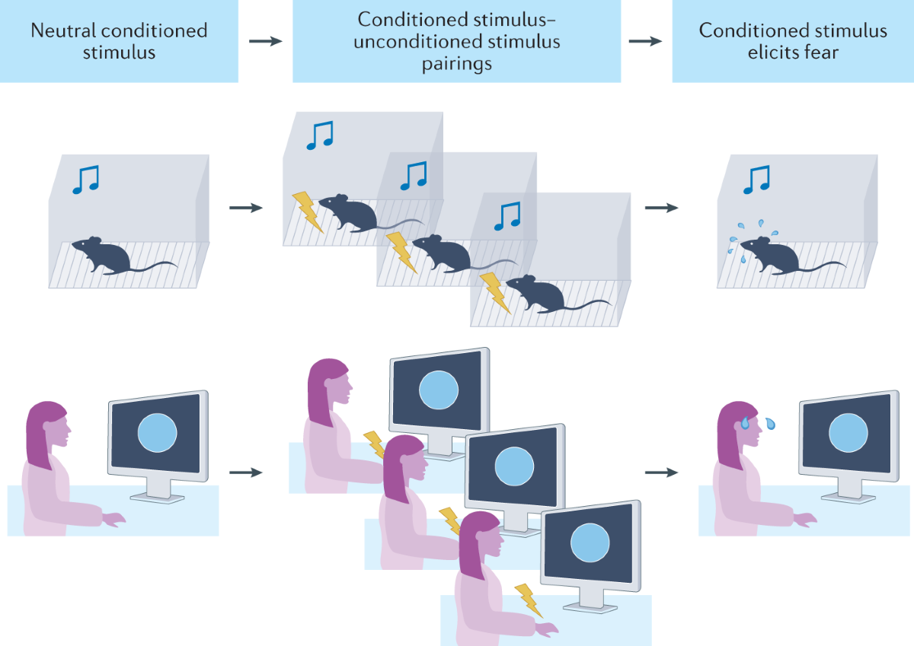
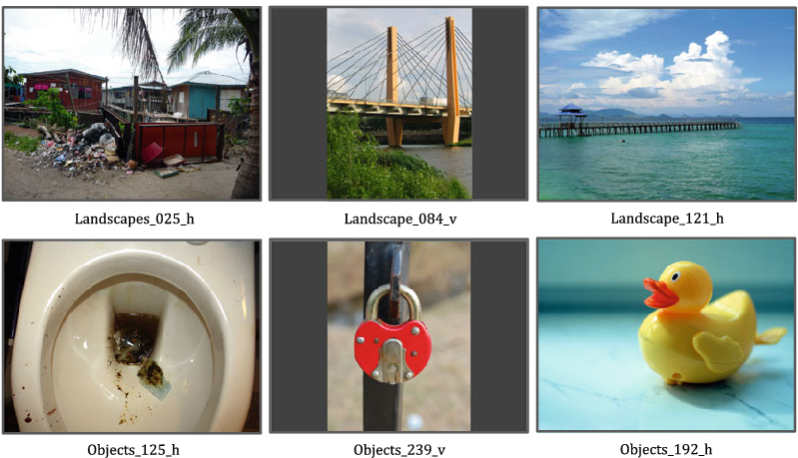
Research on the Emotion Theory:
Stimulus and Conditioning Studies
These study designs are paired with the use of psychophysiological or neuroimaging technologies
1. Stimulus-Response Studies
2. Conditioning Studies

Slide 40
Research on the Emotion Theory:
Overview of Empirical Evidence
From psychophysiological studies of the Autonomic Nervous System (ANS)
Between 1980–2023: 27 experiments (N = 1,849) tested emotional responses in PCL psychopathy samples using ANS measures.
A total of 47 “effect clusters” from psychophysiological measures:
  Disproving evidence: 30 clusters (≈64%)
  Inconclusive evidence: 15 clusters (≈32%)
  Supportive evidence: 2 clusters (≈4%)
Key Point: No study exclusively supported the emotion theory; those with partial support also showed inconclusive or contradicting results.
Key Limitation: Studies are highly heterogeneous in how they collect, structure, and analyze physiological data (e.g., interval vs. peak).
Conclusion: Findings are inconsistent with the claim that psychopathy involves uniformly muted emotional processes.

Slide 41
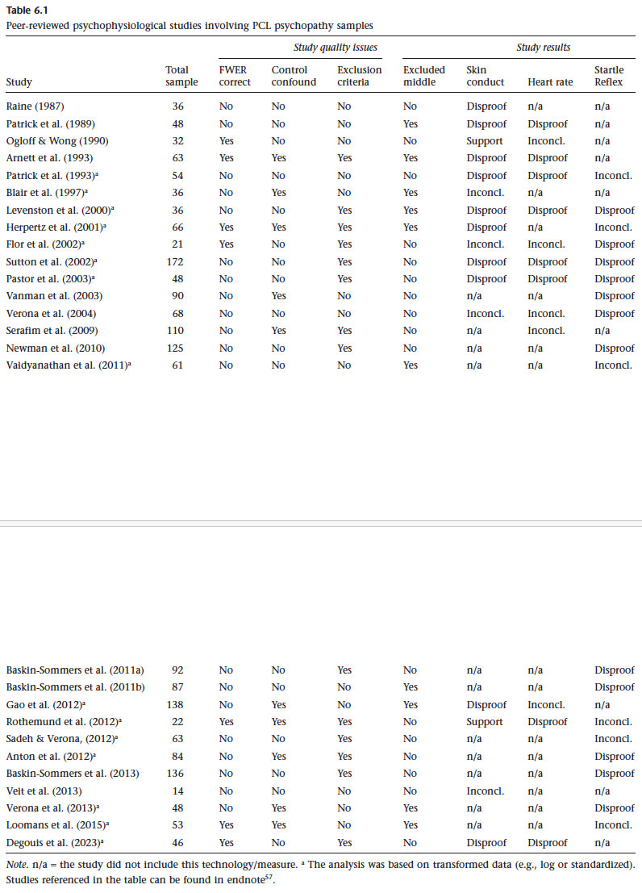
Support: Data align with the hypothesis that psychopathy involves muted or blunted emotional processes.
Disproof: Data contradict the hypothesis (e.g., most effects are non-significant or positive, indicating normal or heightened emotional responses).
Inconclusive: Results show no consistent pattern (e.g., a mix of null, positive, and negative effects).

Slide 42
Research on the Emotion Theory:
Rothemund et al. (2012)
NB: Arguably the strongest evidence in support of the emotion theory
Design: Classical conditioning experiment testing how participants learn to associate a neutral cue (e.g., a face) with an unpleasant stimulus (white noise).
Sample: Compared 11 psychopathic participants (PCL-R mean = 24.7) with 11 healthy controls.
Results:
  Skin conductance: Psychopathic group showed minimal change across conditions → supports emotion theory (muted emotional learning).
  Electromyography: No clear group difference in frowning (corrugator) activity; startle reflex slightly reduced.
  Heart rate: No difference between groups.
Limitations: Small, nonrandom sample (i.e., psychopathic participants were hand-selected for high Factor 1 traits score >8).
Conclusion: Provides partial support for the emotion theory, though overall findings were mixed and limited by methodological constraints.

Slide 43
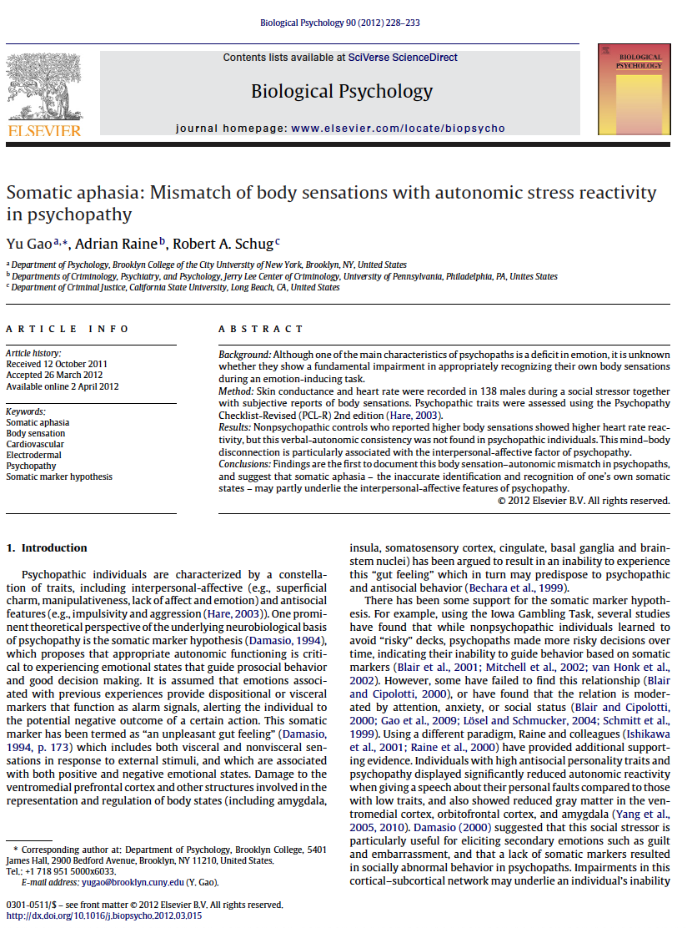
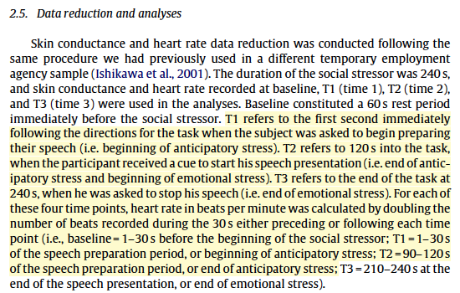
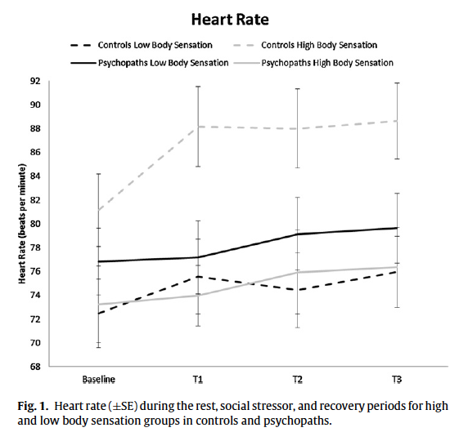
Research on the Emotion Theory:
Complex Continuous Data and Researcher Degree of Freedom
Psychophysiological studies yield complex continuous data that introduces an enormous range of choices, decisions, and discretionary actions available to researchers
Gao et al. (2012)
Notes:
Researcher Degree of Freedom (RDF) refers to the range of choices, decisions, and discretionary actions available to researchers when designing, analyzing, and reporting a study. These decisions—often made after seeing the data—can substantially influence the outcomes and interpretation of research findings.
Core Definition
In methodological terms, researcher degrees of freedom describe the flexibility that researchers have at various stages of the scientific process—such as data collection, exclusion criteria, variable selection, model specification, or statistical thresholds. When such flexibility is exercised without preregistration or transparency, it can unintentionally (or intentionally) increase the risk of false-positive findings or biased interpretations.
Common Examples
Deciding when to stop data collection (e.g., continuing until significance is reached).
Choosing which variables or outcomes to report.
Applying different exclusion criteria for participants or data points.
Selecting statistical models or transformations post hoc.
Reporting only significant results while omitting null findings.
Consequences
Excessive researcher degrees of freedom can lead to:
Inflated Type I error rates (false positives).
Publication bias and p-hacking.
Reduced reproducibility and credibility of scientific findings.
References
Simmons, J. P., Nelson, L. D., & Simonsohn, U. (2011). False-positive psychology: Undisclosed flexibility in data collection and analysis allows presenting anything as significant. Psychological Science, 22(11), 1359–1366.
Gelman, A., & Loken, E. (2013). The garden of forking paths: Why multiple comparisons can be a problem, even when there is no “fishing expedition” or “p-hacking.” Working paper, Columbia University.

Slide 44
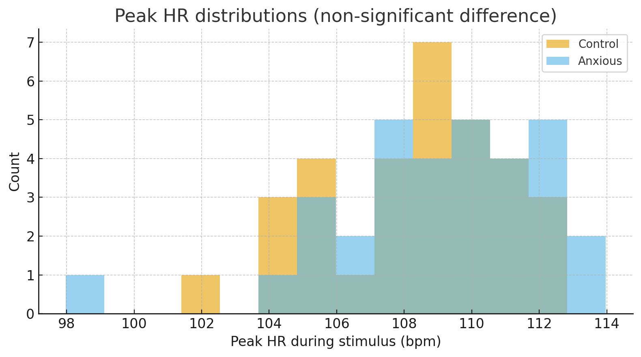
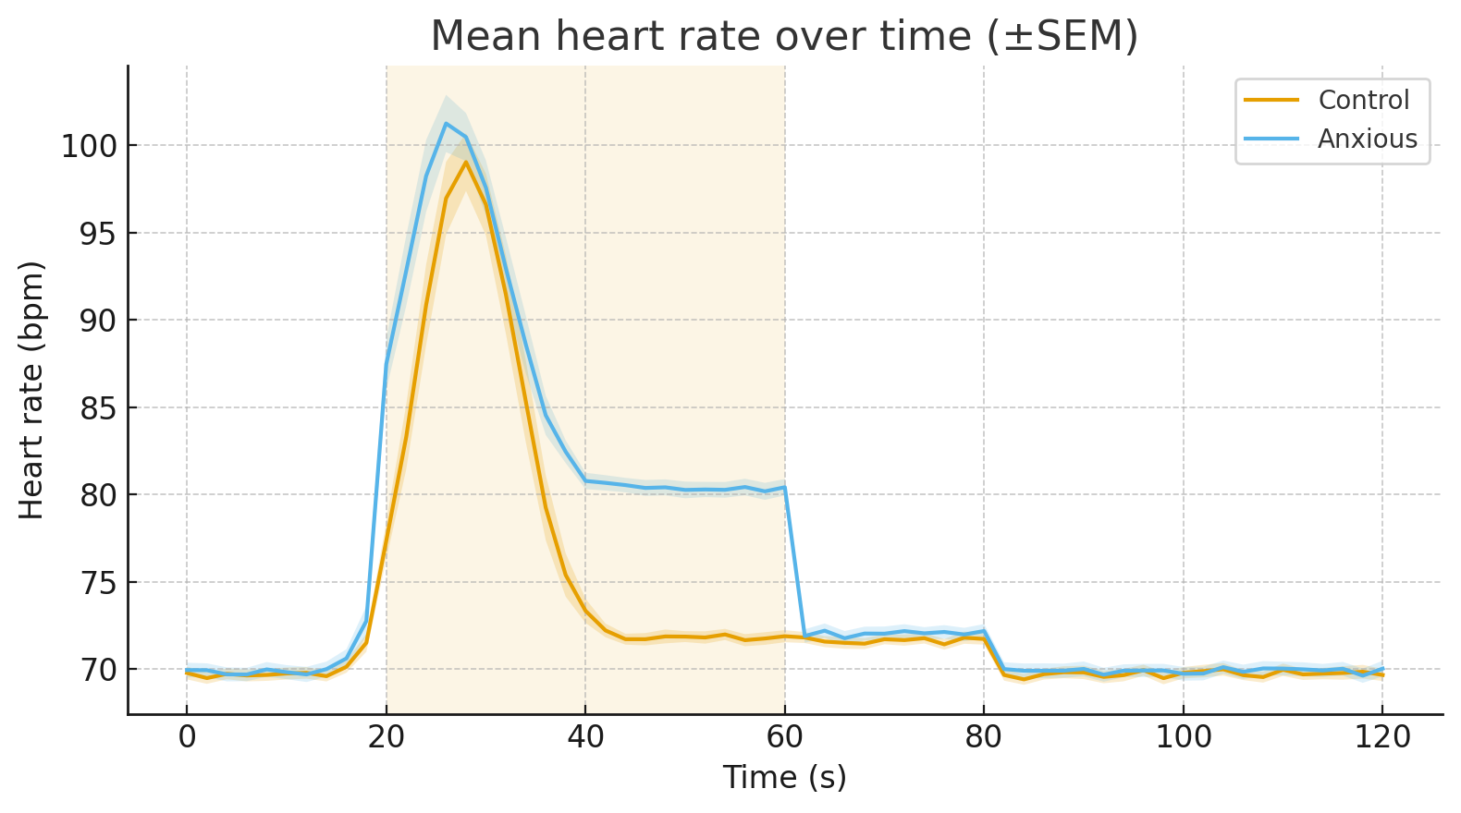
Research on the Emotion Theory:
These Two Graphs and Analyses are Based on the Same (Fictional) Data
Researchers Can “Generate” Significant Effects:
If you analyze only peak heart rate (left graph), the groups do not differ statistically.
When you analyze the continuous trajectory (e.g., group means over time) (right graph), the Anxious group is significantly higher.
Notes:
This fictional dataset was generated by ChatGPT using the following prompt:
“Here's a challenge for you. Generate a fictive dataset from a psychophysiological study where the researchers measured heart rate (pulse) while giving an anxiety conditioning test to two groups. Make the data such that when we are analyzing the data in peak heart rate, then results are not statistically significant between two groups. But if we measure the continuous flow of heart rate data, for example, intervals of 2 seconds, then the analysis is significant.”
The synthetic dataset that meets the prompt constraints:
Design: 64 participants (32 Control, 32 Anxious). Heart rate (bpm) recorded every 2 seconds from 0–120 s. A stimulus window runs from 20–60 s.
Constructed effect: Both groups show a similar transient peak shortly after stimulus onset, but the Anxious group has a sustained elevation during 20–60 s.
Validation (two independent tests)
Peak HR during 20–60 s (per-subject maximum): Welch t-test, p = 0.361 → not significant.
Mean HR during 20–60 s (per-subject average across the full window): Welch t-test, p = 1.82×10⁻¹⁸ → significant.

Slide 45
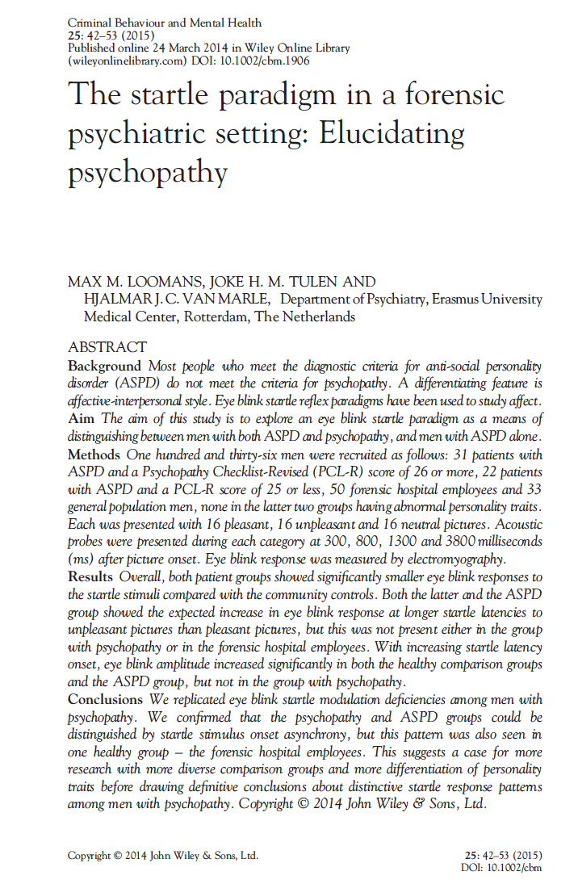
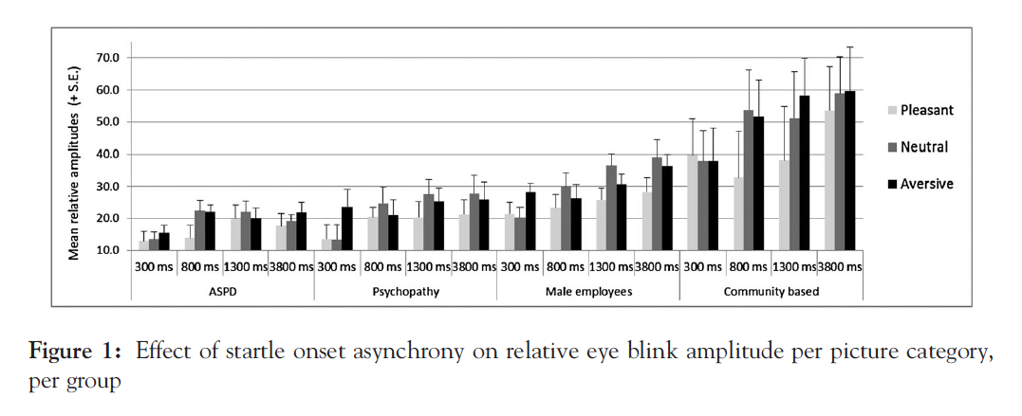
Research on the Emotion Theory:
Non-Standardized Methods
NB: Psychophysiological studies often use different research designs making it difficult to compare data and results
In this study, researchers decided to introduce acoustic probes at 300, 800, 1300, and 3800ms after initial stimulus. In other studies, these intervals might be set differently (e.g., Verona et al., 2013).
Loomans et al. (2015)

Slide 46
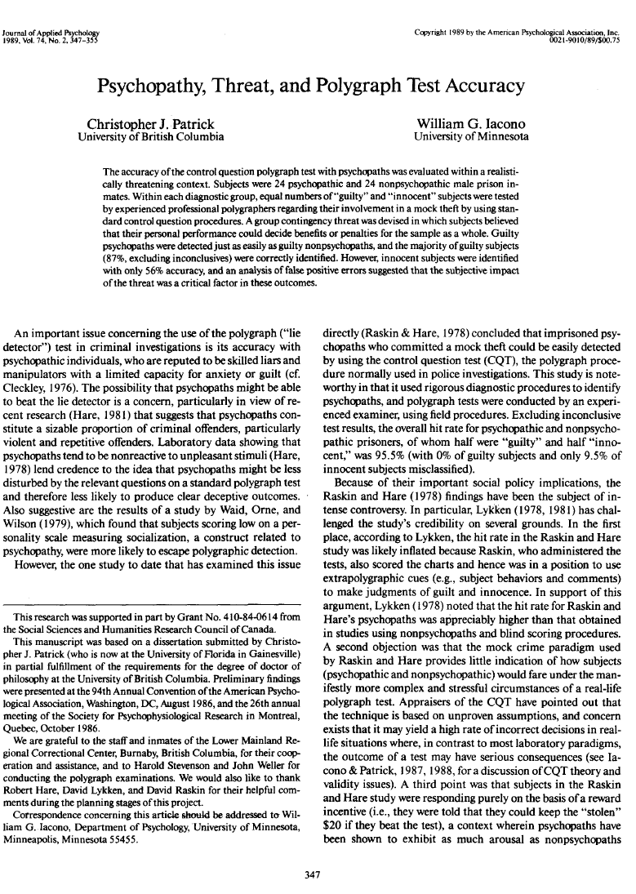
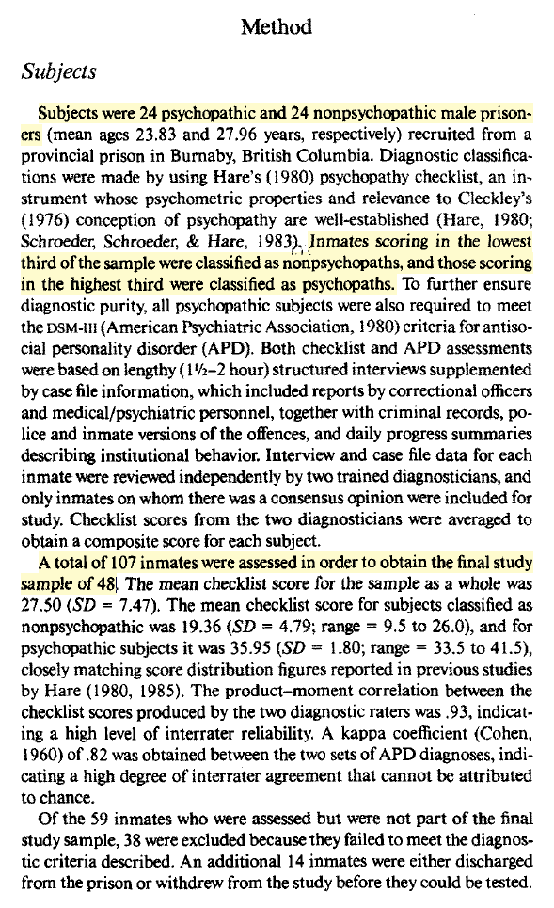
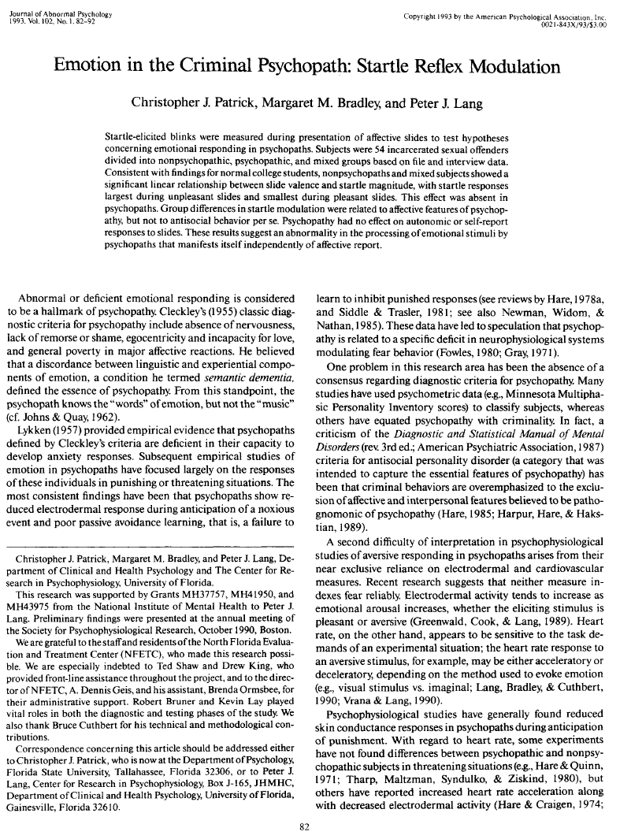
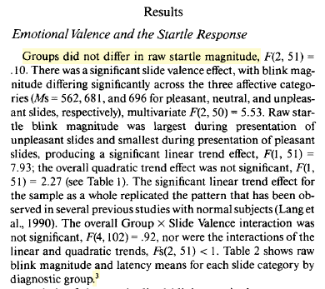
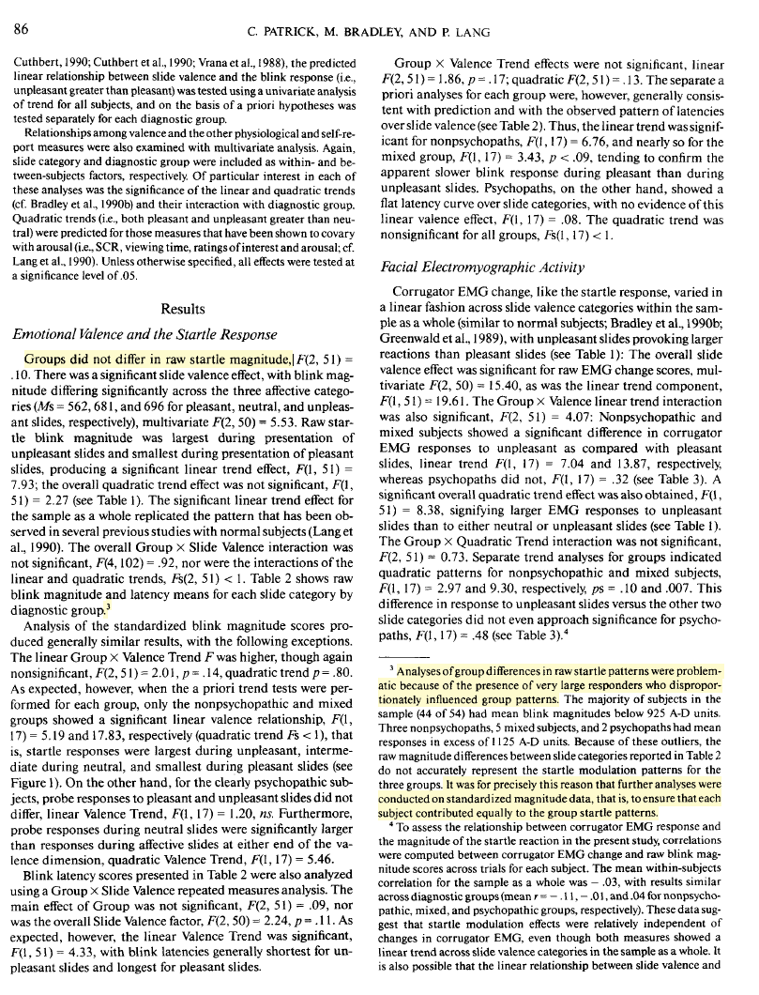
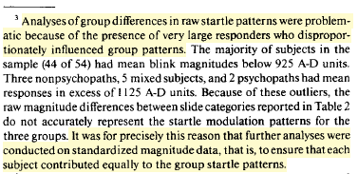
Research on the Emotion Theory:
Odd Data Structure and Analytic Decisions
Some psychophysiological studies includes truly odd (i.e., non-conventional) research design and analytic decisions
Excluded the Middle
Even when there are no group differences in the “raw” data, researchers make important analytic decisions that are “buried” in the footnotes.
Patrick & Iacono (1989)
Patrick et al. (1993) – NB: among the most cited studies in the field

Slide 47
Research on the
Cognitive Theory

Slide 48
Research on the Cognitive Theory:
Testability and Falsifiability
Main Hypothesis: Psychopathic individuals exhibit poor and atypical attention deficits compared to non-psychopathic individuals.
Two Strengths (i.e., “Good” Theory):
  Specifies what sort of evidence would corroborate the theory (i.e., very poor attention deficits).
  Specifies what would falsify it; finding that psychopathic persons’ attention deficit is comparable to that of others.
The Cognitive Theory: This theory proposes that psychopathy arises from impairments in executive functions, the mental processes responsible for self-control and impulse regulation, resulting in highly impulsive and disinhibited behavior.

Slide 49
Research on the Cognitive Theory:
Attention Studies
There are two common research designs in this paradigm
1. Passive-Avoidance Task
2. Go/No-Go Task
Task: Participants play a gambling-style card game where one card type leads to rewards and another to losses, thus learning the pattern through feedback.
Purpose: To measure how quickly individuals learn to inhibit a dominant response when it produces negative outcomes.
Focus: Psychopathy is hypothesized to slow this learning process due to an attention deficit: an overfocus on rewards and failure to register punishment cues.
Task: Participants view a rapid sequence of symbols and must press a button for target symbols (“go”) but withhold pressing for non-target symbols (“no-go”); rewards for correct and losing for errors.
Purpose: To assess how well individuals can inhibit automatic or dominant responses.
Focus: Psychopathic persons are hypothesized to make more errors (i.e., pressing for non-targets) due to alleged attention deficits.

Slide 50
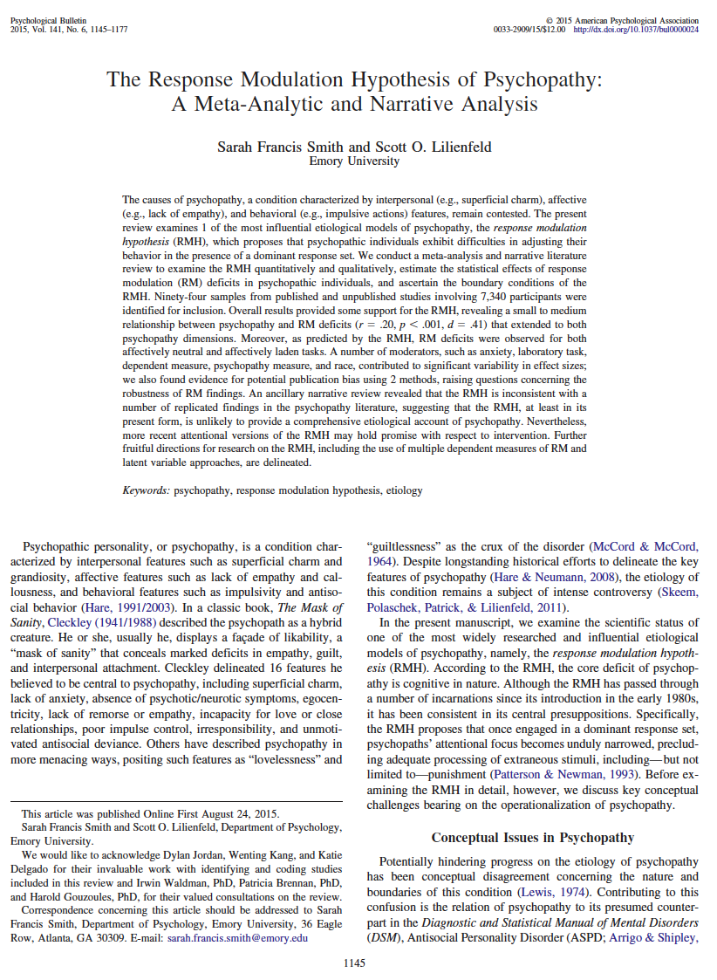
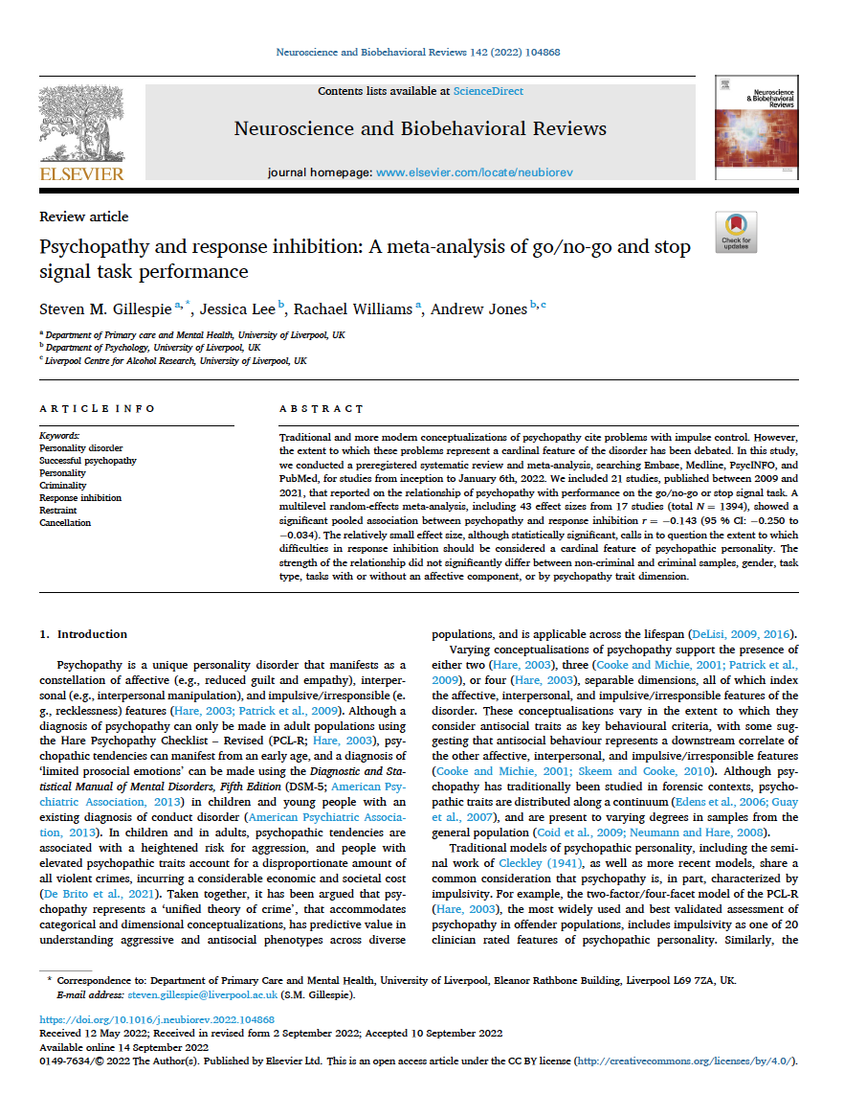
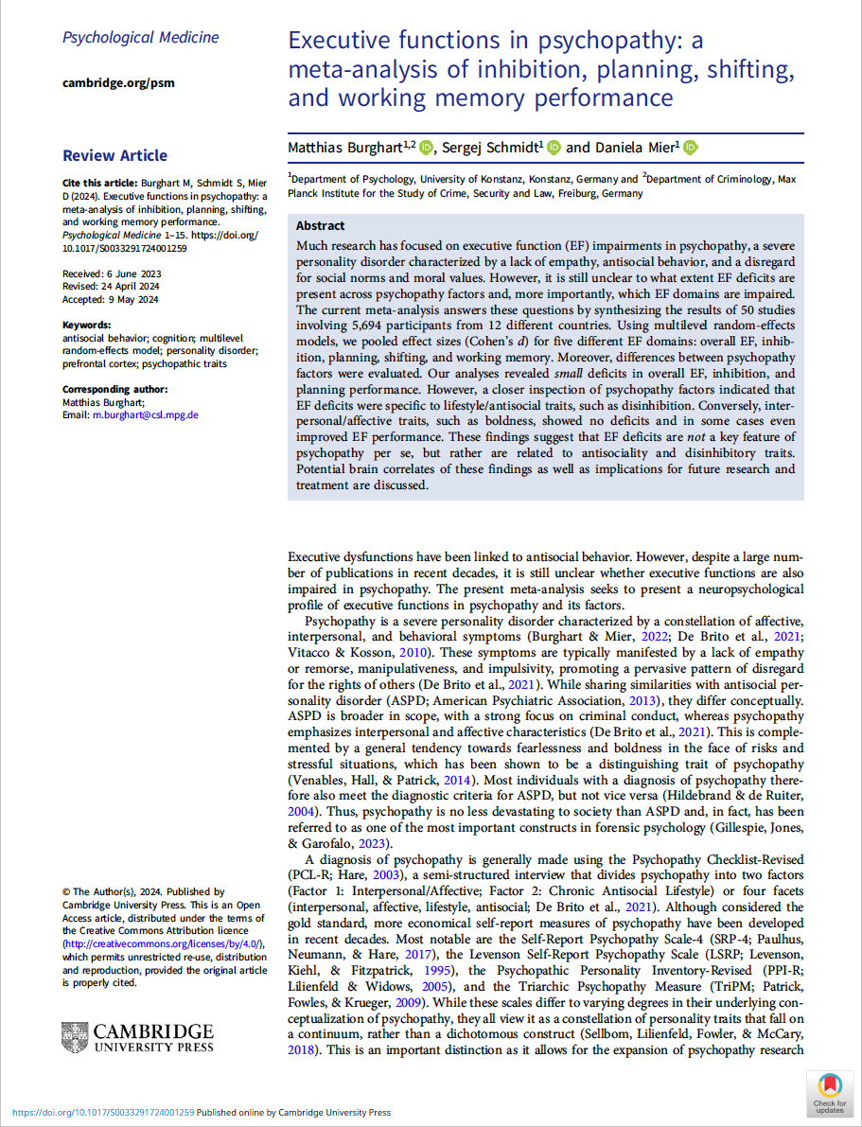
Research on the Cognitive Theory:
Meta-Analytic Review of Evidence
Meta-analyses suggest some response-modulation differences in PCL samples (around r = .19), but their magnitude falls much short of the cognitive theory’s predictions.
Smith & Lilienfeld (2015)
Gillespie et al. (2022)
Burghart et al. (2024)

Slide 51
Research on the Cognitive Theory:
Meta-Analytic Review of Evidence
Meta-analyses suggest some response-modulation differences in PCL samples (around r = .19), but their magnitude falls much short of the cognitive theory’s predictions.
Smith & Lilienfeld: “the RMH [response modulation hypothesis] is inconsistent with a number of replicated findings in the psychopathy literature, suggesting that the RMH, at least in its present form, is unlikely to provide a comprehensive etiological account of psychopathy”
Burghart et al: “It can be concluded that psychopathy is not characterized by severe global EF [executive function] dysfunction and that EF impairments are not a key feature of this disorder.” (p. 10)
Smith & Lilienfeld (2015)
Burghart et al. (2024)

Slide 52
Research on the Cognitive Theory:
Three major points highlighted by Smith & Lilienfeld (2015)
Weak overall effect: Across 56 studies, the correlation between PCL scores and test performance was very small (r = 0.19), explaining only about 3.6% of the variance in PCL scores (i.e., too weak to indicate a meaningful relationship).
Inconsistent findings: Results varied widely (r = −0.46 to 0.60), with 14% of studies showing better performance among psychopathic individuals, contradicting the claim that psychopathy involves general attention deficits.
Publication bias: Studies with larger effects were more likely to be published. Adjusting for this bias reduced the estimated correlation to r ≈ 0.14, a negligible association explaining less than 2% of the variance in PCL scores.

Slide 53
Research on the Cognitive Theory:
Two Additional Comments
From Larsen (2025, p. 173-174)
Laboratory vs. Real Life: Laboratory attention effects likely do not generalize to real-life contexts. Experimental tasks use weak, low-stakes cues, whereas real-world moral or legal situations involve much stronger triggers that reliably activate response modulation. Thus, small experimental attention deficits are unlikely to persist under real-life conditions, undermining the cognitive theory’s explanatory power.
Unclear Relevance: Even if valid, the small effect found by Smith and Lilienfeld is not unique to psychopathy; similar weak associations appear in studies of IQ, ADHD, and other conditions. Since these conditions are not linked to extreme behaviors, it is implausible that such minor attention differences could uniquely account for the psychopathic prototype.

Slide 54
Critical Reflections

Slide 55
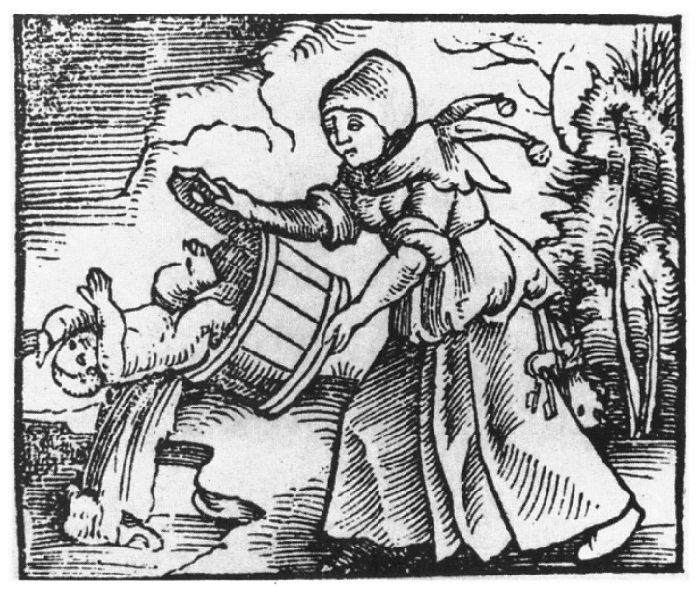


Critical Reflections:
What is the Status of the Two Theories of Psychopathy?
Falsified Theories?
Realistic Claims?
Analytic Flexibilities
Has the two psychopathy theories been falsified? Larsen (2025) argues that they indeed have been falsified. Some might call this “throwing the baby out with the bathwater,” but perhaps there is no baby – no substantial emotional or attention deficits have been found in PCL samples.
Are researchers testing nonsensical theories? We might ask whether it even makes sense to suggest that human beings could be so disordered as to lose the capacity for emotional processing or have extremely severe attention deficits (and still “appear” as if they are “normal”).
Continuous psychophysiological data can be “carved up” in countless ways depending on how researchers choose to segment, average, or model it. This flexibility allows the same dataset to be made to look like something else; yield spurious results.

