Slide 1
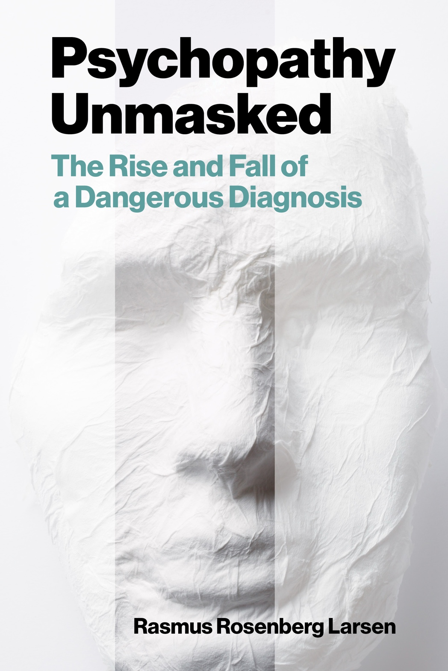
Psychopathy and Crime
The Science, Ethics, and Legal Influence of a Controversial Diagnosis
Module 12
The Future of Psychopathy Research
Class Discussion
Copyright © Rasmus Rosenberg Larsen
Licensed under CC BY 4.0.

Slide 2
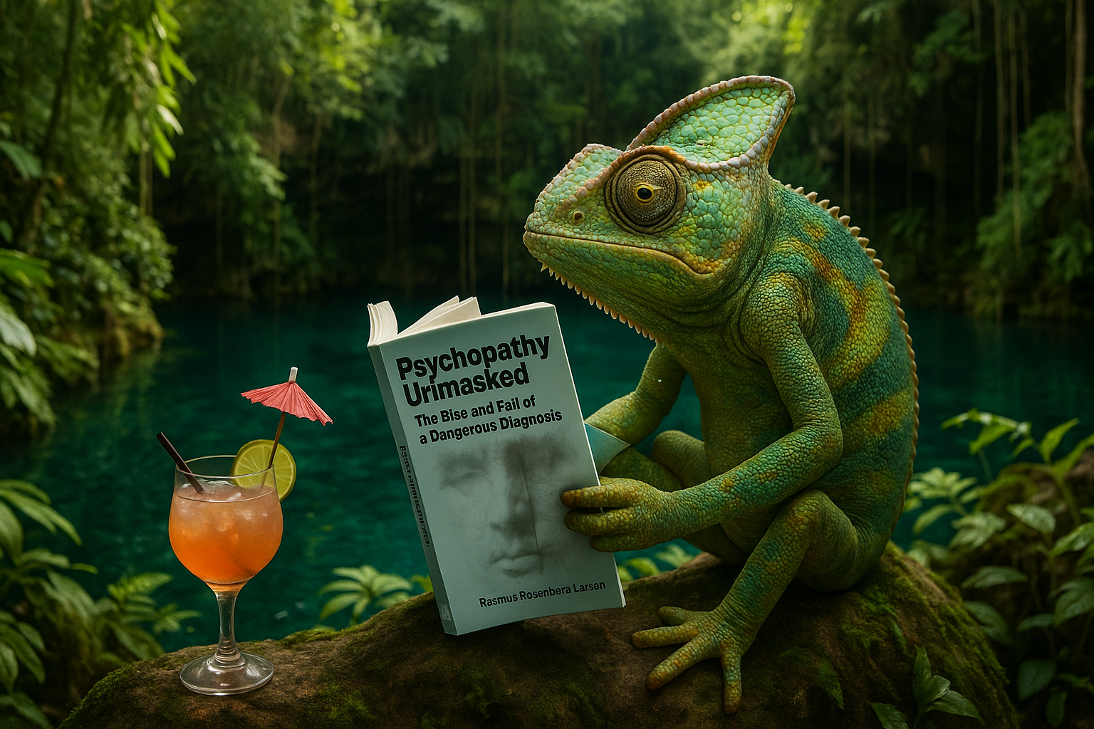
Any questions..?
© OpenAI (LLM-generated image)

Slide 3
Psychopathy and Crime
FSC350
Module 1
Introduction – What is Psychopathy?
Module 7
Two Theories of Psychopathy
Module 2
The Problem of Psychopathy
Module 8
Psychopathy and Scientific Spin
Module 3
Psychopathy and Forensic Risk
Module 9
Psychopathy and Ethics
Module 4
Psychopathy and Treatment
Module 10
Explaining a Lack of Evidence (Part I)
Module 5
Psychopathy and Moral Psychology
Module 11
Explaining a Lack of Evidence (Part 2)
Module 6
The Neuroscience of Psychopathy
Module 12
The Future of Psychopathy Research

Slide 4
This Module’s Agenda:
Psychopathy as a Zombie Idea
Objections
Critical Reflections
Class Discussion

Slide 5
Psychopathy as a “Zombie” Idea

Slide 6




Psychopathy as a “Zombie” Idea:
Zombies in Science
Zombie Idea: An idea that is (a) intuitively appealing, and (b) has no referent in reality.
Intuitively Appealing
No Referent in Reality
For some reason, scientists find the idea intuitively and rationally appealing (e.g., due to bias, misinterpretations).
When an idea has no “particular” referent in reality, it means that its “reality” is that of a fiction (e.g., like a unicorn).

Slide 7

Psychopathy as a “Zombie” Idea:
Zombie Ideas Are Rare in the Sciences
Because scientists are generally pretty good at accepting evidence and discarding falsified ideas…

Slide 8

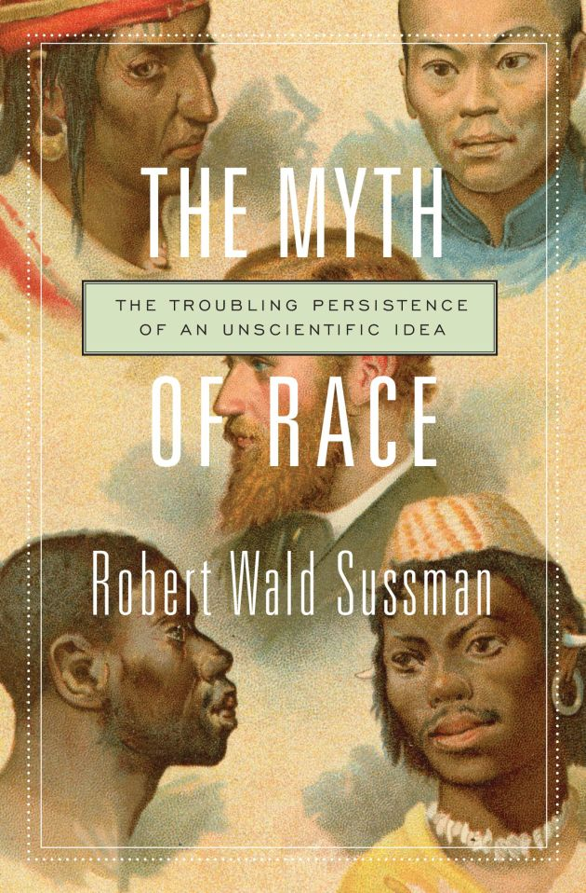
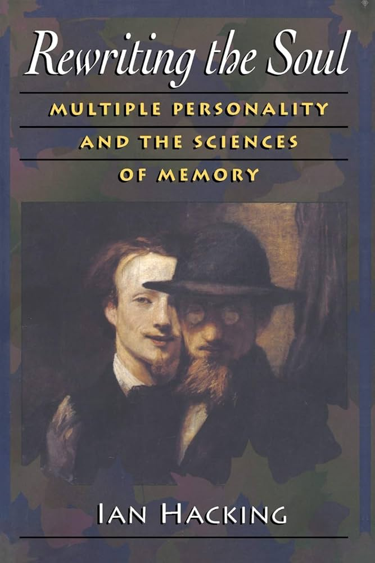
Psychopathy as a “Zombie” Idea:
Historical Examples of Zombie Ideas
NB: Some zombie ideas are short-lived, begging the question whether they are truly “zombies”…
Cold Fusion
Biological Race
Multiple Personality Disorder
Simon (1999)
Sussman (2014)
Hacking (1995)

Slide 9

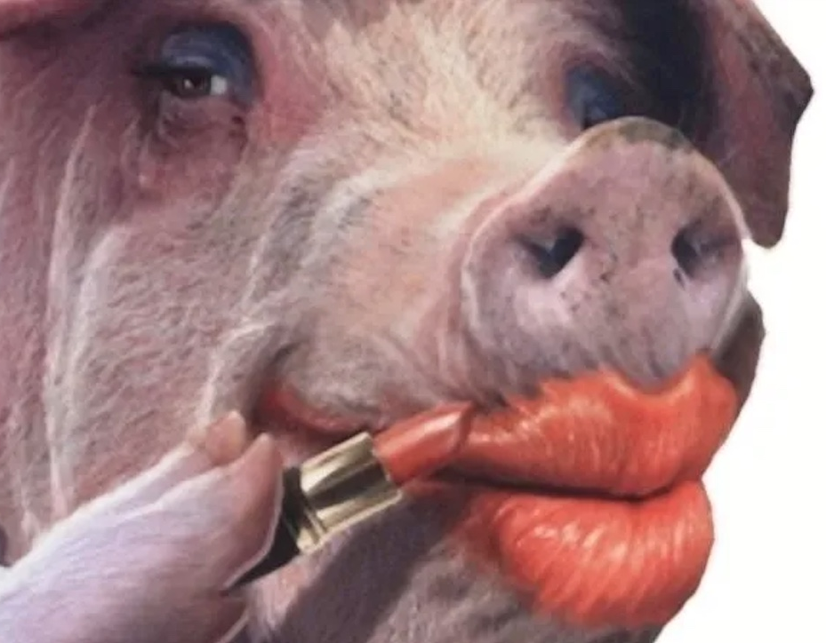
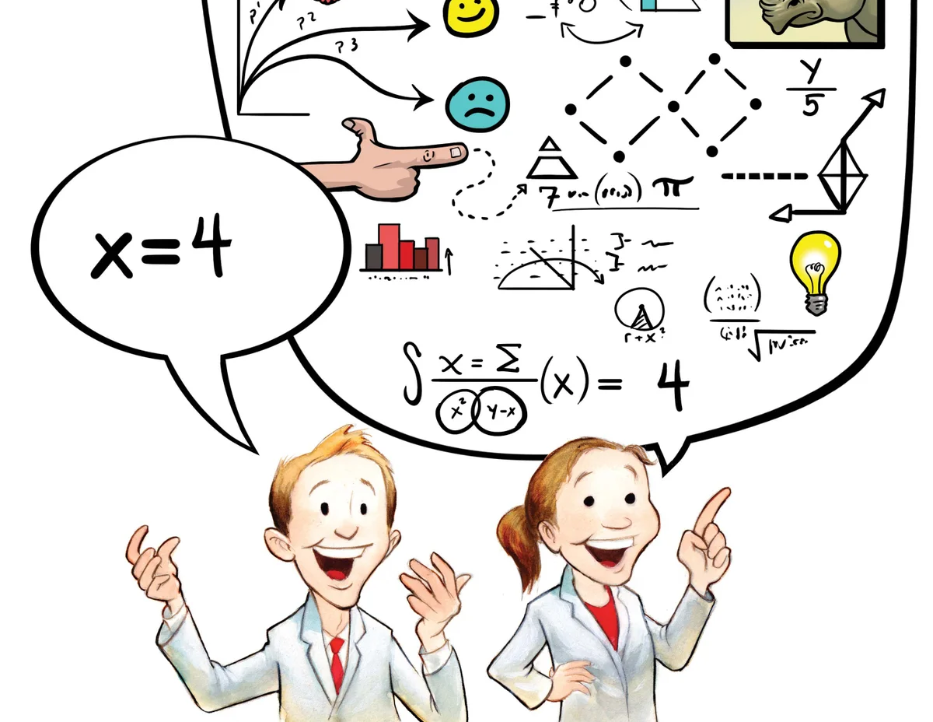
Psychopathy as a “Zombie” Idea:
Three Reasons for Skepticism
Reasons that “supports” the suspicion that psychopathy is “not real” and therefore a “zombie” idea…
1. Little “Positive” Evidence
2. False Abductive Trigger
3. Concept is Redundant
No clear confirmatory or “positive” evidence has ever been presented to support the idea that psychopaths “exists”. That is, we’ve never documented a real person who “fits” or “instantiates” the idea of psychopathy.
The clinical prototype is not a so-called “abductive trigger”; a phenomenon that needs a specific concept and scientific explanation. The original Cleckley-Hare prototype was factually misrepresented.
There is, and always was, a much simpler and evidence-based way to account for (or explain) the individuals that fits the Cleckley-Hare clinical prototype (e.g., substance misuse, PTSD, etc.).

Slide 10
Psychopathy as a “Zombie” Idea:
Summary
Why it’s “reasonable” to believe that psychopathy might be a zombie idea…
Reason #1: Researchers have not presented any clear, replicated empirical evidence to show psychopathy “is real” (Larsen, 2025)
Reason #2: There are reasons to doubt whether any “particular” human being exists that properly “instantiate” the idea of psychopathy (e.g., the issue of “abductive trigger” and “redundancy”).
Reason #3: Researchers continue to frame psychopathy as an intuitively appealing idea despite the lack of clear evidence-based progress in the field.
Inference: Therefore, it’s reasonable to believe that psychopathy could turn out to be a zombie idea (i.e., an idea without a clear, instantiating “referent” in reality).
NB: This is (emphatically!) not the same as saying that we have “proven” that psychopathy is a zombie idea.

Slide 11
Psychopathy as a “Zombie” Idea:
A Challenge for Future Researchers
Main Point: The claim that psychopathy may be a “zombie idea” should be uncontroversial because it is falsifiable: critics can directly test it..!
The Central Challenge: To refute the zombie-explanation, one must simply present a clear, real-world case of a truly psychopathic person:
  Someone who unequivocally fits the full prototypical description (e.g., profound moral blindness, absence of emotion, impulsivity).
  And for whom no simpler or better-established explanation of their behavior or personality is plausible.
Implication: If psychopathy genuinely exists as a distinct clinical entity – and purportedly affects ~1% of the population – it should be straightforward to identify such an unequivocal case.

Slide 12
Objections

Slide 13
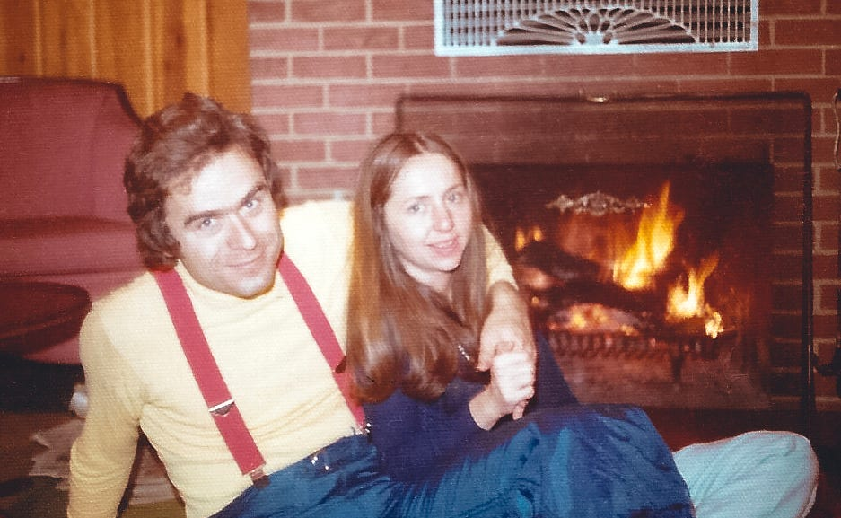

Objections:
Two Objections to the “Zombie” Idea Perspective
Serial Killers Are “Real” Psychopaths
Some Positive Research Evidence
Review: Larsen, 2025, p. 235-237
Review: Larsen, 2025, p. 237-238
Notes:
Larsen’s Response to the ”Ted Bundy” Objection:
First Point
Appeals to serial killers rely on anecdotal, not scientific, evidence. Because these individuals have never been studied under controlled conditions, we cannot confidently assert that they lack empathy, possess “moral colorblindness,” or otherwise meet the conceptual criteria for psychopathy. Such claims amount to speculation rather than empirical fact.
Second Point
Empirical work provides little support for the view that serial killers fit mainstream conceptions of psychopathy. Hickey et al. (2018) examined detailed information on five infamous offenders and found that only one—Ted Bundy—scored above the PCL-R diagnostic threshold. This indicates substantial psychological heterogeneity among serial killers, limiting the force of this objection.
Third Point
Even in Bundy’s case, there are strong reasons to doubt that psychopathy is the most appropriate or parsimonious explanation. Accounts describe him as emotionally volatile rather than unemotional, and his behaviour shows evidence of comorbid issues—severe alcohol use, necrophilic impulses, and possible delusional thinking. These factors may offer a simpler, more coherent explanation for his actions than invoking a poorly validated personality disorder.
Fourth Point
Invoking serial killers inadvertently highlights the limits of psychopathy research. Psychopathy is claimed to characterize roughly 1% of the population—approximately four million people in North America—yet only a tiny fraction of individuals who commit serial homicide exist, and even fewer meet psychopathy criteria. If the strongest defence of the construct applies only to rare, atypical cases, then its broader scientific and societal explanatory value is profoundly constrained.
Larsen’s Response to the ”Some Evidence of Psychopathy” Objection:
First Point
The objection rests on a faulty assumption: if a psychological construct is not real, experiments should yield only null results. This is incorrect. Even in fields where we are confident the phenomenon does not exist, studies routinely produce statistically significant findings.
Second Point
False-positive effects arise because psychological experiments allow considerable methodological and analytical flexibility. This flexibility can generate patterns that look meaningful but are not truly generalizable. Research on “null fields,” such as homeopathy, illustrates that experiments can produce significant effects even when no real phenomenon is present.
Third Point
A well-known example is the 2011 “Feeling the Future” studies, which claimed evidence for precognition. Although these findings were widely dismissed, they were not fraudulent; rather, flexible research practices produced statistically significant but false-positive results.
Fourth Point
This dynamic also appears in psychopathy research. For instance, our 2024 review of empathy studies showed that approximately 85–91% of results were null. When studies with high analytic flexibility were separated from more rigorous ones, the most rigorous studies produced about 95% null findings—precisely what we expect from a null field given the conventional 5% false-positive rate.

Slide 14
Objections:
Objection #1 – Serial Killers Are Real Psychopaths: Serial killers appear to display hallmark traits associated with psychopathy, thus “instantiating” the idea.
Response #1: Appeals to serial killers rely on anecdote, not science. These individuals have never been studied under controlled conditions, claims about their supposed lack of empathy or “moral colorblindness” remain speculative rather than empirically grounded.
Response #2: Research offers little evidence that serial killers uniformly fit psychopathy criteria. Hickey et al. (2018) found that only one of five well-known offenders (Ted Bundy) scored above the PCL-R threshold, indicating substantial heterogeneity among serial killers.
Response #3: Even Ted Bundy does not clearly exemplify psychopathy. Accounts describe emotional volatility and significant comorbid issues (alcohol misuse, necrophilic tendencies, possible delusional thinking), which may better explain his behaviour than an unvalidated personality disorder.
Response #4: Using serial killers as a defence of psychopathy underscores the construct’s limitations. Psychopathy is said to occur in about 1% of the population, yet serial homicide is extremely rare. If the best evidence for the construct rests on exceptional cases, its broader explanatory value is minimal.
Notes:
Larsen’s Response to the ”Ted Bundy” Objection:
First Point
Appeals to serial killers rely on anecdotal, not scientific, evidence. Because these individuals have never been studied under controlled conditions, we cannot confidently assert that they lack empathy, possess “moral colorblindness,” or otherwise meet the conceptual criteria for psychopathy. Such claims amount to speculation rather than empirical fact.
Second Point
Empirical work provides little support for the view that serial killers fit mainstream conceptions of psychopathy. Hickey et al. (2018) examined detailed information on five infamous offenders and found that only one—Ted Bundy—scored above the PCL-R diagnostic threshold. This indicates substantial psychological heterogeneity among serial killers, limiting the force of this objection.
Third Point
Even in Bundy’s case, there are strong reasons to doubt that psychopathy is the most appropriate or parsimonious explanation. Accounts describe him as emotionally volatile rather than unemotional, and his behaviour shows evidence of comorbid issues—severe alcohol use, necrophilic impulses, and possible delusional thinking. These factors may offer a simpler, more coherent explanation for his actions than invoking a poorly validated personality disorder.
Fourth Point
Invoking serial killers inadvertently highlights the limits of psychopathy research. Psychopathy is claimed to characterize roughly 1% of the population—approximately four million people in North America—yet only a tiny fraction of individuals who commit serial homicide exist, and even fewer meet psychopathy criteria. If the strongest defence of the construct applies only to rare, atypical cases, then its broader scientific and societal explanatory value is profoundly constrained.

Slide 15
Objections:
Objection #2 – Some Positive Evidence of Psychopathy: The research is not only “null” findings: there’s some, albeit little positive evidence of the reality of the disorder.
Response #1: The objection assumes that if a construct is not real, all studies should yield null results. This is mistaken: even in areas where the phenomenon being studied clearly does not exist (e.g., cold fusion), experiments still occasionally produce significant findings.
Response #2: Indeed, psychological research has substantial methodological and analytic flexibility, rendering false-positive effects common. “Null fields” like cold fusion, homeopathy, or pre-cognition show that significant results can appear even when no real phenomenon is present.
Notes:
Larsen’s Response to the ”Some Evidence of Psychopathy” Objection:
First Point
The objection rests on a faulty assumption: if a psychological construct is not real, experiments should yield only null results. This is incorrect. Even in fields where we are confident the phenomenon does not exist, studies routinely produce statistically significant findings.
Second Point
False-positive effects arise because psychological experiments allow considerable methodological and analytical flexibility. This flexibility can generate patterns that look meaningful but are not truly generalizable. Research on “null fields,” such as homeopathy, illustrates that experiments can produce significant effects even when no real phenomenon is present.
Third Point
A well-known example is the 2011 “Feeling the Future” studies, which claimed evidence for precognition. Although these findings were widely dismissed, they were not fraudulent; rather, flexible research practices produced statistically significant but false-positive results.
Fourth Point
This dynamic also appears in psychopathy research. For instance, our 2024 review of empathy studies showed that approximately 85–91% of results were null. When studies with high analytic flexibility were separated from more rigorous ones, the most rigorous studies produced about 95% null findings—precisely what we expect from a null field given the conventional 5% false-positive rate.

Slide 16

“For all the problems I have pointed out in the research paradigm, one glowing optimistic note shines brighter than the pessimism: the strength of the scientific method is exactly that if we study an idea that has no basis in reality — an idea that is not real — we will continuously fail to find convincing evidence of its existence.”
– Larsen (2025, p. 242)

Slide 17
Critical Reflections

Slide 18
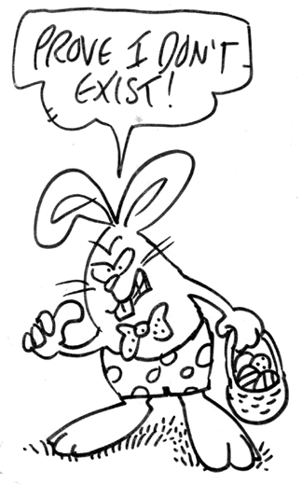
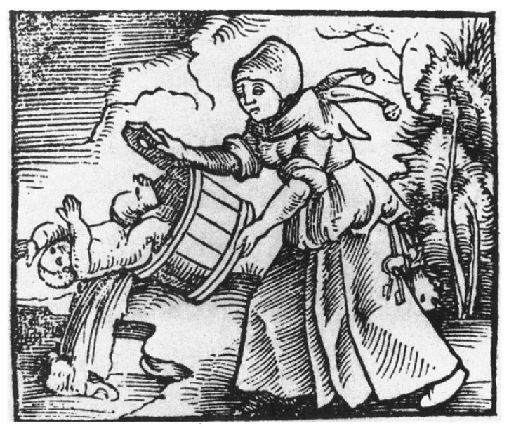

Critical Reflections:
The Future of Psychopathy Research
Proving a Negative
Babies and Bathwater
Adjusting the Diagnosis
According to Larsen (2025), we currently do not have clear evidence that psychopathy is “not real”; that is, we cannot prove that there are no real persons exist that match or “instantiates” the idea of psychopathy.
Perhaps discarding psychopathy research would be an overreaction? Despite its flaws, some researchers argue that the field has generated valuable insights and still contains elements worth preserving. Abandoning the construct entirely would be “throwing out the baby with the bathwater”.
Lilienfeld (2021) propose that the psychopathy prototype can be understood as simply having unusual configurations of ordinary personality traits (yet not disordered). This approach preserves the research paradigm by reframing psychopathy within the field of personality psychology.

Slide 19
Class Discussion

Slide 20
Class Discussion:
Personal and Institutional Resistance to “Null” Effects?
Do scientists avoid acknowledging the overwhelming null evidence because of the potential legal and professional consequences?
How do institutional incentives shape acceptance or rejection of problematic constructs (such as psychopathy)?

Slide 21
Class Discussion:
Public Understanding and the Influence of Cleckley
Do you think public understandings of psychopathy can meaningfully change, particularly given that some discredited concepts—such as “multiple personality disorder”—continue to persist in popular belief?
If you had the opportunity to pose a question or offer a comment to Hervey Cleckley, or another key figure in the early conceptualization of psychopathy, what would you choose to ask or say?

Slide 22
Class Discussion:
Biological Causes
Given the weak evidence for psychopathy as a biological disorder, how should we interpret epigenetic studies – e.g., those suggesting that environmental factors may activate or deactivate certain genes linked to psychopathic traits (e.g., Mariz et al., 2021)?
Do these findings ultimately reinforce the conclusion that there is still no strong biological basis for psychopathy?

Slide 23
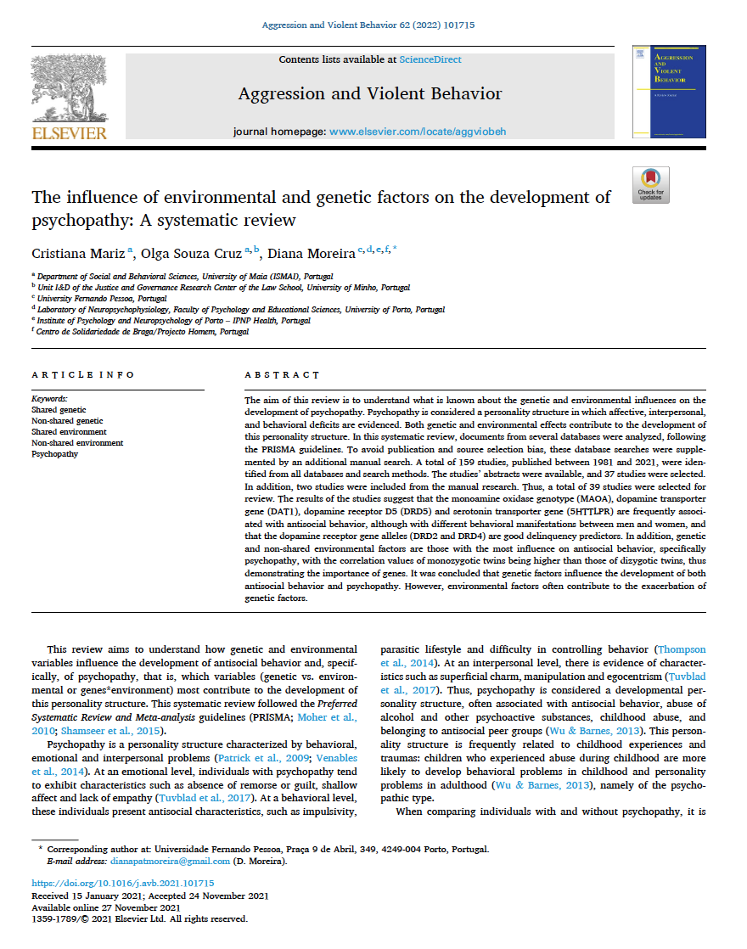
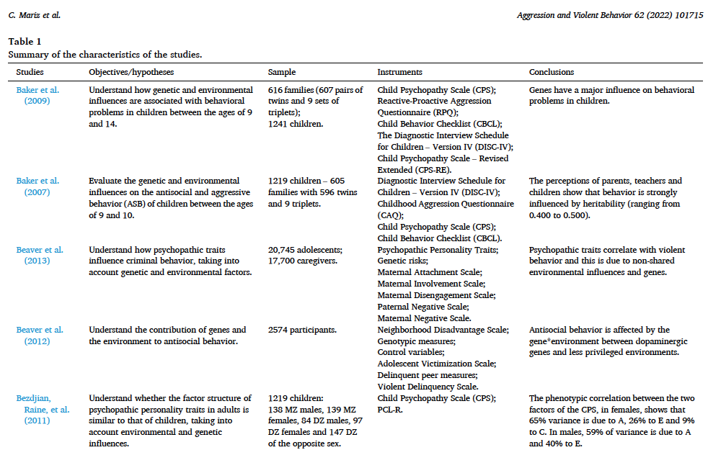
Class Discussion:
Mariz et al., 2021

Slide 24
Class Discussion:
Rethinking Psychopathy Research
What would psychopathy research look like if it were rebuilt from scratch, without assumptions about traits, checklists, or inherited stereotypes?
Are there individuals who are genuinely “dangerous” in a way that warrants classification?
How should morally sanctioned killing (e.g., soldiers in war) factor into judgments about normality, deviance, or loss of sanity?

Slide 25


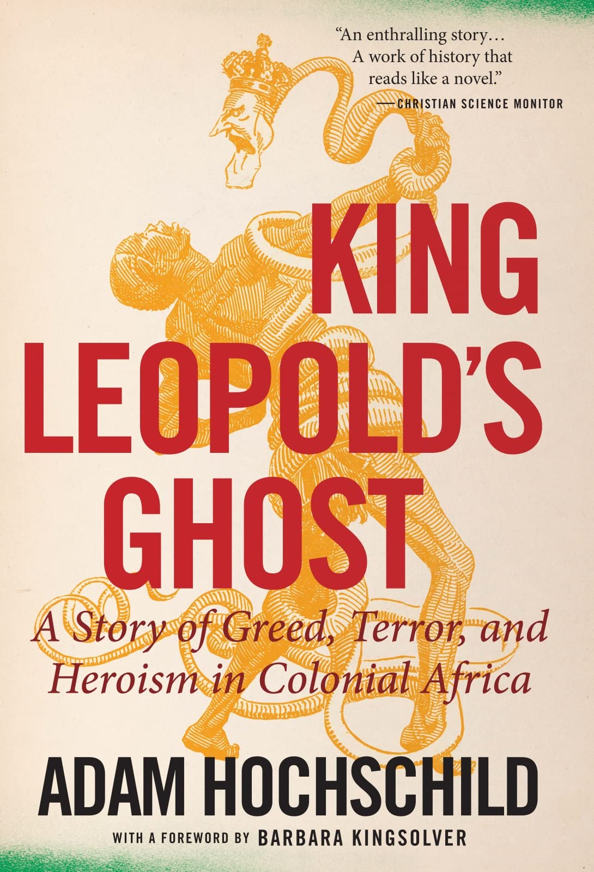
Class Discussion:
Recommendation
NB: It’s arguably problematic to assume that violence is a sign of psychological “abnormality”…

Slide 26
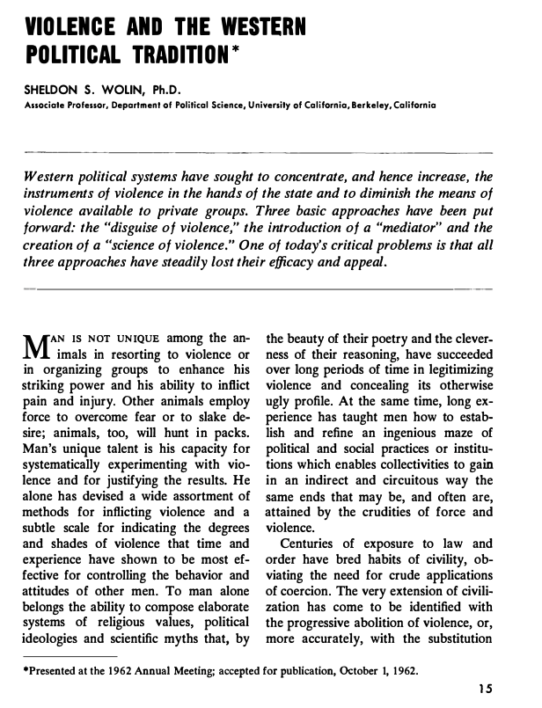
Class Discussion:
Sheldon Wolin on Human Nature
Wolin (1963, p. 15)
“Man’s unique talent is his capacity for systematically experimenting with violence and for justifying the results. He alone has devised a wide assortment of methods for inflicting violence and a subtle scale for indicating the degrees and shades of violence that time and experience have shown to be the most affective for controlling the behavior and attitudes of other men. To man alone belongs the ability to compose elaborate systems of religious values, political ideologies and scientific myths that, by the beauty of their poetry and cleverness of their reasoning, have succeeded over long periods of time in legitimizing violence and concealing its otherwise ugly profile.”

Slide 27
Class Discussion:
Validity of Related Constructs
If psychopathy is unreliable (or “not real”), what should we conclude about adjacent constructs (e.g., dark triad, dark tetrad, oppositional defiant disorder, conduct disorder)…?
On what basis do clinicians assert that certain individuals are “unusual” or “deviant”?

Slide 28
Class Discussion:
Selective Use of the Psychopathy Label
Why is the “psychopathy” label applied to offenders but rarely used to describe harmful institutional actors (e.g., Oak Ridge researchers)?
What does this selective application reveal about the social function of the label?

Slide 29
Class Discussion:
Legal Consequences of Abandoning Psychopathy
If psychopathy is ultimately accepted as a flawed construct, what would likely happen within the legal system? Would courts stop using the PCL-R, and could prior cases be re-examined?
How should justice systems address individuals who were harmed by being labeled “psychopathic”? What forms of redress or review might be appropriate?
If psychopathy is abandoned, how can forensic psychology regain public trust and professional credibility?

Slide 30
Class Discussion:
Responsibility and the NCR Doctrine
If psychopathy was a true neurobiological disorder, why is the NCR defence not available to those labeled psychopathic?
Why is psychopathy treated differently from other disorders in assessments of moral understanding and criminal responsibility?

Slide 31
Class Discussion:
Scientific Simplicity and Critical Inquiry
How do we avoid uncritically relying on longstanding or “simple” explanations in psychology?
What does it mean to treat simplicity as a scientific virtue without oversimplifying complex phenomena?
How should researchers weigh simplicity against other virtues, such as empirical adequacy, practicality, and evidential support?

