Slide 1
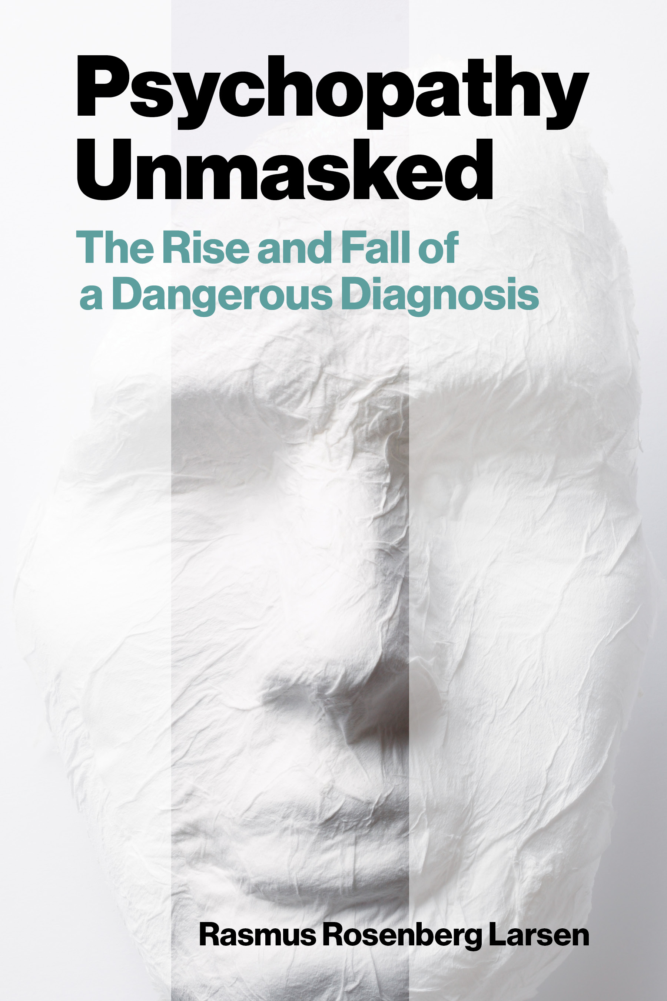
Psychopathy and Crime
The Science, Ethics, and Legal Influence of a Controversial Diagnosis
Module 4
Psychopathy and Treatment
Is Psychopathy a Chronic Condition?
Copyright © Rasmus Rosenberg Larsen
Licensed under CC BY 4.0.

Slide 2
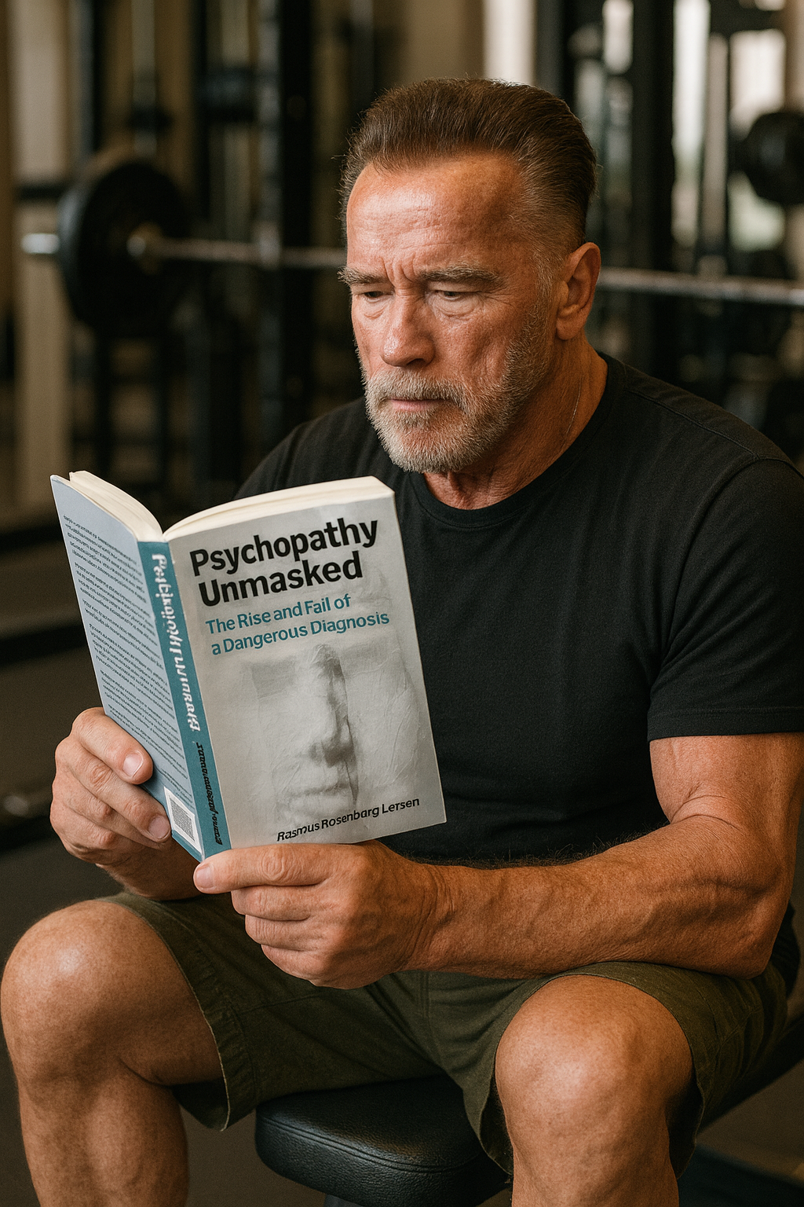
Any questions..?
© OpenAI (LLM-generated image)

Slide 3
Psychopathy and Crime
FSC350
Module 1
Introduction – What is Psychopathy?
Module 7
Two Theories of Psychopathy
Module 2
The Problem of Psychopathy
Module 8
Psychopathy and Scientific Spin
Module 3
Psychopathy and Forensic Risk
Module 9
Psychopathy and Ethics
Module 4
Psychopathy and Treatment
Module 10
Explaining a Lack of Evidence (Part I)
Module 5
Psychopathy and Moral Psychology
Module 11
Explaining a Lack of Evidence (Part 2)
Module 6
The Neuroscience of Psychopathy
Module 12
The Future of Psychopathy Research

Slide 4
This Module’s Agenda:
Psychopathy and Untreatability
Treatment and Rehabilitation
Treatment Research in PCL Samples
Critical Review of Rice et al. (1992)
Critical Reflections

Slide 5
Psychopathy and Untreatability

Slide 6
Psychopathy & Untreatability:
“Nothing Works”
Psychopathy is widely claimed to be fundamentally untreatable
Psychopathy is broadly seen as chronic and untreatable (i.e., traits assumed to be stable across lifespan + unresponsive to intervention).
This contrasts with the average justice-involved person, whose personalities and antisocial tendencies:
  Are often responsive to intervention in straightforward ways (Maruna, 1995).
  Tend to reliably diminish with age (i.e., the age-crime curve).
Psychopathic persons are thus perceived to be uniquely incorrigible.
Hare states in his 1993-book, Without Conscience: “No effective treatment has been found” / “Nothing works.”

Slide 7
Psychopathy & Untreatability:
Historical Developments
Psychopathy was not always framed as “untreatable.”
For example, Rush 1786-piece was optimistic about treatment; Rush emphasized the role of medicine in the moral improvement of society.
However, growing pessimism about the efficiency of clinical intervention in mid-20th century (the “nothing works period”).
In Cleckley’s The Mask of Sanity, he describes psychopathic persons as resistant to conventional treatment methods.
Cleckley emphasizes that the core issue is that psychopaths refuse to recognize having a problem (let alone a personality disorder).

Slide 8

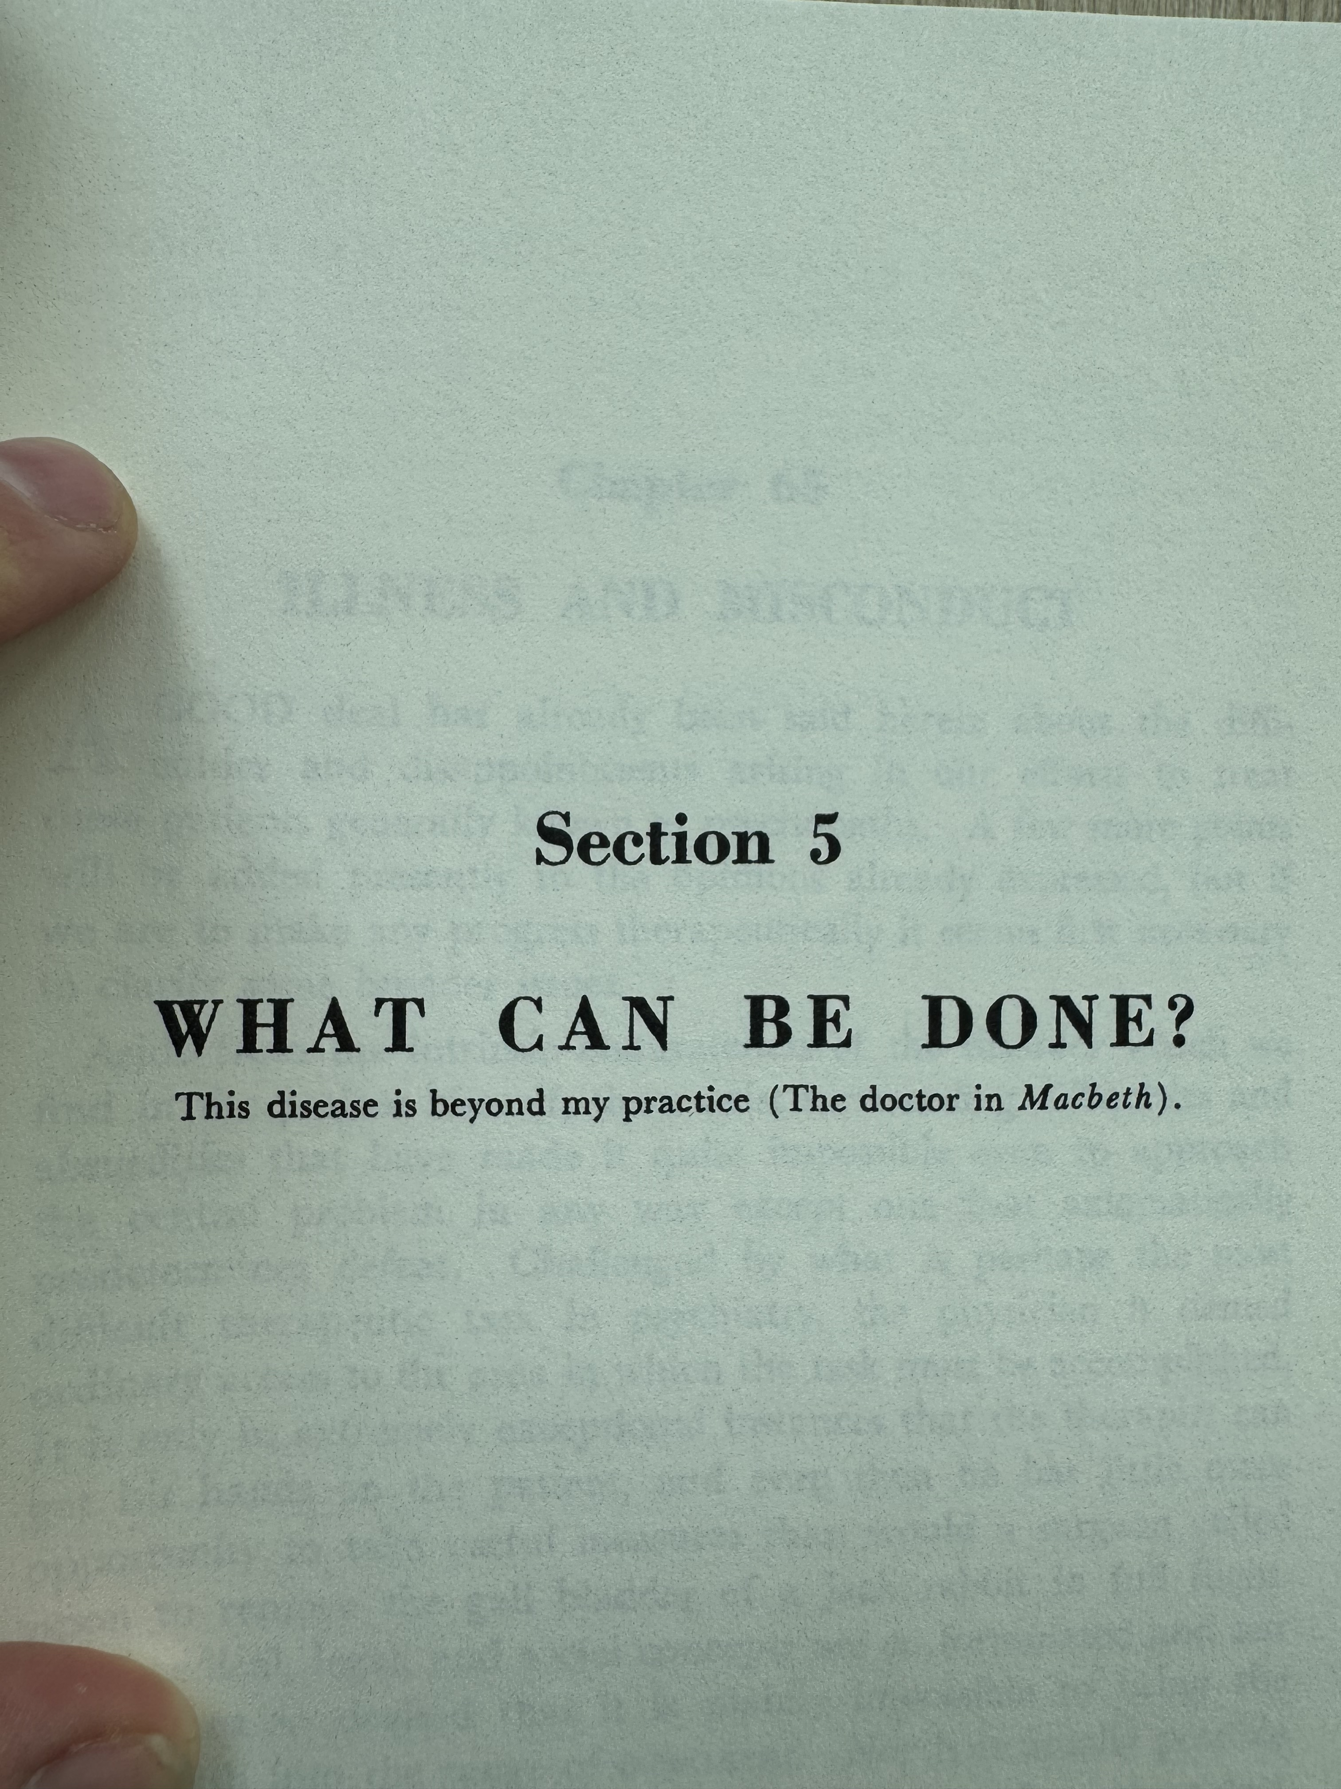
Psychopathy & Untreatability:
“I am no longer hopeful that any methods available today would be successful with typical psychopaths. I have now, after more than three decades, had the opportunity to observe a considerable number of patients who, through commitment or the threat of losing their probation status or by other means, were kept under treatment not only for many months but for years. The therapeutic failure in all such patients observed leads me to feel that we do not at present have any kind of psychotherapy that can be relied upon to change the psychopath fundamentally.”
Cleckley (1988), The Mask of Sanity (p. 439)
Cleckley citing Shakespeare (p. 416)

Slide 9
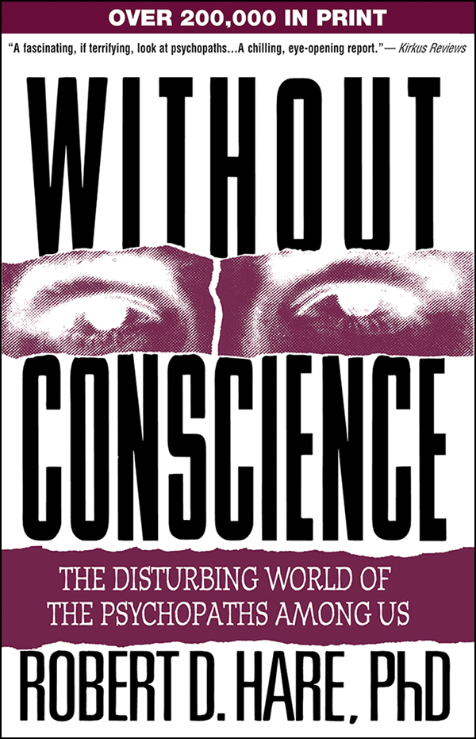
Psychopathy & Untreatability:
“Many writers on the subject have commented that the shortest chapter in any book on psychopathy should be the one on treatment. A one-sentence conclusion such as, ‘No effective treatment has been found,’ or, ‘Nothing works,’ is the common wrap-up to scholarly reviews of the literature.”
Quote from Without Conscience (1993)

Slide 10
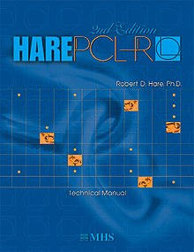
Psychopathy & Untreatability:
“Most clinicians and researchers are rightly pessimistic about the treatability of psychopaths with traditional methods. Unlike most other offenders, psychopaths suffer little personal distress, see little wrong with their attitudes and behavior, and seek (and remain in) treatment only when it is in their best interest to do so, such as when applying for probation or parole. It is therefore not surprising that they derive little benefit from traditional treatment programs, particularly those aimed at the development of empathy, conscience, and interpersonal skills.”
The Hare Psychopathy Checklist–Revised (2003, p. 158)

Slide 11
Psychopathy & Untreatability:
Three Prognoses of the Untreatability View
Researchers generally emphasize three interrelated prognostic claims when describing the “untreatability view”
1:
Unamenability: Psychopathic persons will resist, sabotage, and drop out of therapy; only participate insincerely, often by ulterior motives (e.g., to put “lipstick” on a parole application).
2:
Unresponsiveness: Even if treatment is completed, effects are minimal; conventional programs that works effectively on non-psychopathic offenders show little impact.
3:
Adverse Effects: Treatment may backfire, as it teaches better manipulation skills rather than fostering genuine change, thus exacerbating psychopathic traits and antisocial behavior.
Claim #2 – Chronically Untreatable: Often described as untreatable, psychopathic persons are seen as unresponsive to common psychological intervention and rehabilitation programs, thus comprising a chronic condition incapable of change.

Slide 12
Psychopathy & Untreatability:
Judicial Implications of the “Untreatability View”
Being deemed “untreatable” can have enormous negative implications in forensic settings
The implications of the label “untreatable” are multifaceted and difficult to study, but here are some well-documented negative consequences:
  Restricted Rehabilitation: Denying the person access to rehab programs.
  Harsher Sentencing: The person is seen as a chronic, permanent threat.
  Capital Sentencing: The person is a chronic threat to fellow inmates and staff.
  Juvenile Transfers: Youth offenders has been shifted to adult courts and institutions as they are presumed resistant to rehabilitation.
Key Forensic Issue: Risk evaluations often involves a consideration of treatment and/or rehabilitation prospects (Thomaidou et al., 2025).

Slide 13
Treatment and Rehabilitation

Slide 14



Treatment and Rehabilitation:
Discussion
What’s you intuitive understanding of the terms treatment and rehabilitation…?
(e.g., what might justice-involved persons need help with to minimize reconviction; and how can we help them?)
Everything you may think psychologists and psychiatrists do when they work in “treatment” and “rehabilitation,” the claim is that these are all 100% futile efforts in psychopathic persons.
“That’s a wild claim…”
→ Notice this is an unusual and quite staggering claim; indeed, there are virtually no mental health diagnoses that are presumed entirely resistant to clinical intervention.
Notes:
In this “brainstorming” exercise, students will try to come up with intuitive answers to what forensic psychologists and other practitioners can do to help people with rehabilitation (or desistance).

Slide 15
Treatment and Rehabilitation:
Forensic Rehabilitation and Desistance
Forensic rehabilitation programs are multifaceted strategies to assist breaking with a criminal lifestyle
In Canada, 38% of the justice-involved population are repeat-offenders.
Enormous human, social, and fiscal benefits from breaking that cycle.
Rehabilitation programs are designed and intended to do exactly that.
They typically involves an open-ended mix of therapeutic (e.g., psychological, psychiatric) and practical (e.g., job, housing) initiatives.
It is generally well-understood that rehabilitation or desistance is a complex task as different people have different needs.

Slide 16
Treatment and Rehabilitation:
Cognitive Behavioral Therapy (CBT)
NB: forensic rehabilitation programs often makes use of a mix of therapeutic methods and other initiatives
CBT is perhaps the most common type of treatment in forensic settings.
CBT has strong empirical support across mental health conditions; shown to facilitate personality and behavioral change.
Core assumption: Problematic behavior stems from maladaptive cognitive patterns (e.g., hostile attributions, low self-worth, substance misuse).
Therapeutic approach:
  Increase self-awareness of harmful thought patterns.
  Restructure cognition to promote healthier/better behavioral responses.
  Practice new behavioral skills (e.g., role-playing de-escalatory responses).
Goal: Cognitive change → Behavioral change → Reduced antisocial conduct.

Slide 17
Treatment and Rehabilitation:
Three Prognoses of the Untreatability View
The alleged futility of treatment and rehabilitation programs on psychopathic persons
Claim #2 – Chronically Untreatable: Often described as untreatable, psychopathic persons are seen as unresponsive to common psychological intervention and rehabilitation programs, thus comprising a chronic condition incapable of change.
1:
Unamenability: Psychopathic persons will resist, sabotage, and drop out of therapy; only participate insincerely, often by ulterior motives (e.g., to put “lipstick” on a parole application).
2:
Unresponsiveness: Even if treatment is completed, effects are minimal; conventional programs that works effectively on non-psychopathic offenders show little impact.
3:
Adverse Effects: Treatment may backfire, as it teaches better manipulation skills rather than fostering genuine change, thus exacerbating psychopathic traits and antisocial behavior.

Slide 18
Treatment Research in PCL Samples

Slide 19
Treatment Research in PCL Samples:
Overview: Psychopathy Treatment Research
NB: This sub-field is one of the least developed (i.e., lowest research output)
Focus: Most treatment research measures the effect of treatment on reducing recidivism rates (often mixed methods).
Scope: 21 published review studies summarizing dozens of treatment experiments (e.g., Polaschek, 2019: N = 48).
Overall Findings:
  A total of 86% (18/21) of all reviews dismiss the untreatability view.
  Only 1 review (Harris & Rice, 2006) argue in favor of the untreatability view.
  2 reviews were inconclusive (Gacono et al., 2001; D’Silva et al., 2004).
Consensus: Experts have broadly rejected the untreatability view.

Slide 20
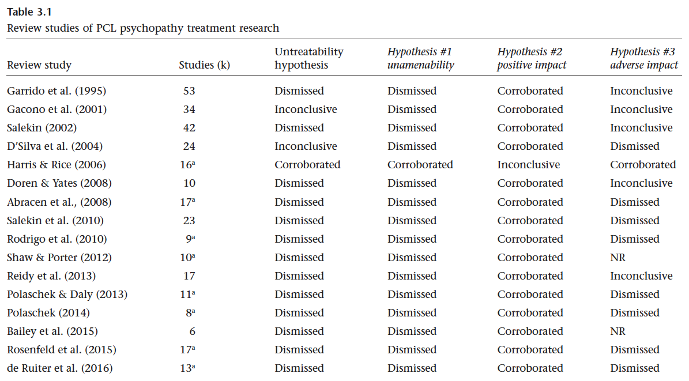

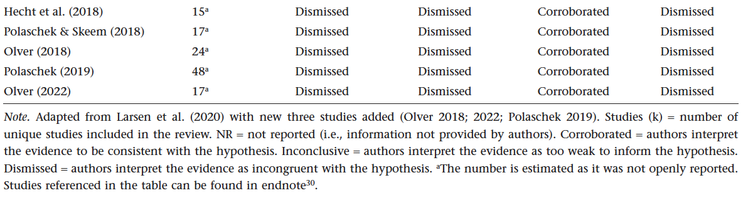
Treatment Research in PCL Samples:
Interpreting Table 3.1
Dismissed: Reviewers conclude evidence does not support the hypothesis.
Corroborated: Reviewers conclude evidence does support the hypothesis.
Inconclusive: Reviewers highlight insufficient or unclear evidence, expressing doubts about the hypothesis.

Slide 21
Treatment Research in PCL Samples:
Claim #1:
Unamenability: Psychopathic persons will resist, sabotage, and drop out of therapy; only participate insincerely, often by ulterior motives (e.g., to put “lipstick” on a parole application).
Evidence base: 20 reviews dismissed the unamenability hypothesis; 1 study (Harris & Rice, 2006) supports it.
Key finding: Psychopathic persons do engage with and complete treatment programs at rates incompatible with categorical untreatability.
However, researchers highlight challenges in therapy that are similar to other high-risk forensic patients (not unique to PCL psychopathy).
  Aggression, irritability, egocentrism.
  Poor motivation, weak therapeutic alliance.
  Higher likelihood of dropout.
Polaschek (2019): “high-risk status on its own ensures that the treatment process will be bumpy…”

Slide 22
Treatment Research in PCL Samples:
Claim #2:
Unresponsiveness: Even if treatment is completed, effects are minimal; conventional programs that works effectively on non-psychopathic offenders show little impact.
Evidence base: 20 reviews corroborate that psychopathic patients make positive gains; 1 study (Harris & Rice, 2006) dismissed it.
Key finding: Psychopathic persons can achieve meaningful behavioral and personality change through ordinary treatment programs.
Sources of Positive Evidence:
  Reviewers mainly rely on evidence from 19 studies (see Table 3.2, p. 77).
  Three key studies often cited by reviewers as evidence of positive impact, namely, Skeem et al. (2002), Olver & Wong (2009), and Caldwell et al. (2006).
  Treatment led to reduced recidivism rates and seriousness of outcomes.

Slide 23
Treatment Research in PCL Samples:
Claim #3:
Adverse Effects: Treatments may backfire, as it teaches better manipulation skills rather than fostering genuine change, thus exacerbating psychopathic traits and antisocial behavior.
Evidence base: Most reviews dismiss the hypothesis; 5 reviews are cautious; 1 review (Harris & Rice, 2006) claim adverse effects.
Key finding: Complete lack of empirical evidence; adverse effects essentially never occur in a reliable way.
Three studies mentioned in relation to adverse effects:
  Rice et al. (1992): Only study suggesting adverse effects (widely discredited).
  Seto & Barbaree (1999): Claim of adverse effects later retracted (2005 follow-up).
  Hughes et al. (1997): Mischaracterized; did not analyze or show adverse effects.

Slide 24
Treatment Research in PCL Samples:
Rice, Harris & Cormier (1992)
Retrospective study of data obtained from the Social Therapy Unit, Oak Ridge Mental Health Centre in Penetanguishene, Canada
Study Conclusion: Treatment makes PCL psychopathy worse.
There are various problems with Rice et al. (1992):
  The data did not derive from a clinical treatment program.
  Later investigations revealed severe maltreatment and abuse of patients.
  A 2017 Supreme Court decision ruled the program maltreated patients (appeal in 2020).
Malpractices in the Social Therapy Unit included:
  No informed consent.
  Forced harmful experimental use of hallucinogenic drugs.
  Shackling patients together in prolonged isolation without daylight.
There is widespread expert consensus that Rice et al. (1992) does not provide credible evidence for adverse treatment effects of psychopathy.

Slide 25
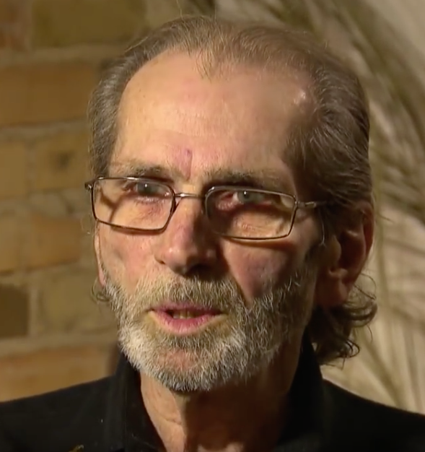
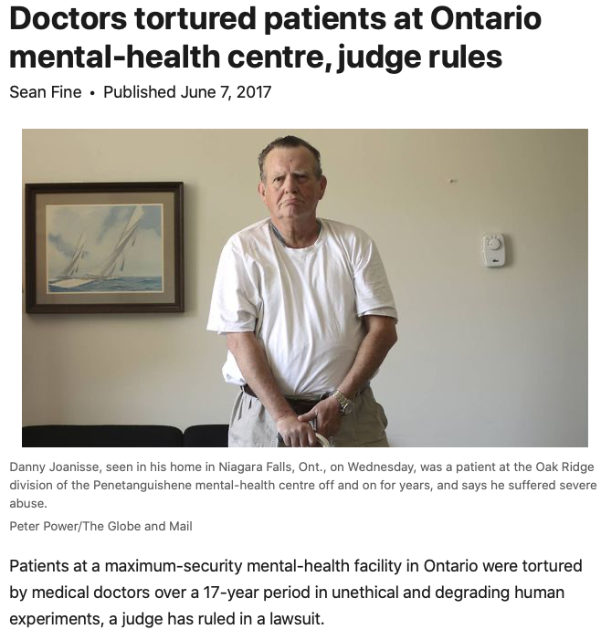

Treatment Research in PCL Samples:
Social Therapy Unity
Supervised by Elliott Barker and Gary Maier between 1965-1983 in a separate ward at Oak Ridge Mental Health Centre
CBC News:
The Secrets of Oakridge
At 8:58, Marnie Rice talks about their 1992-study
Link
The Fifth Estate:
The Oak Ridge Experiment

Slide 26
Critical Review of
Rice et al. (1992)

Slide 27
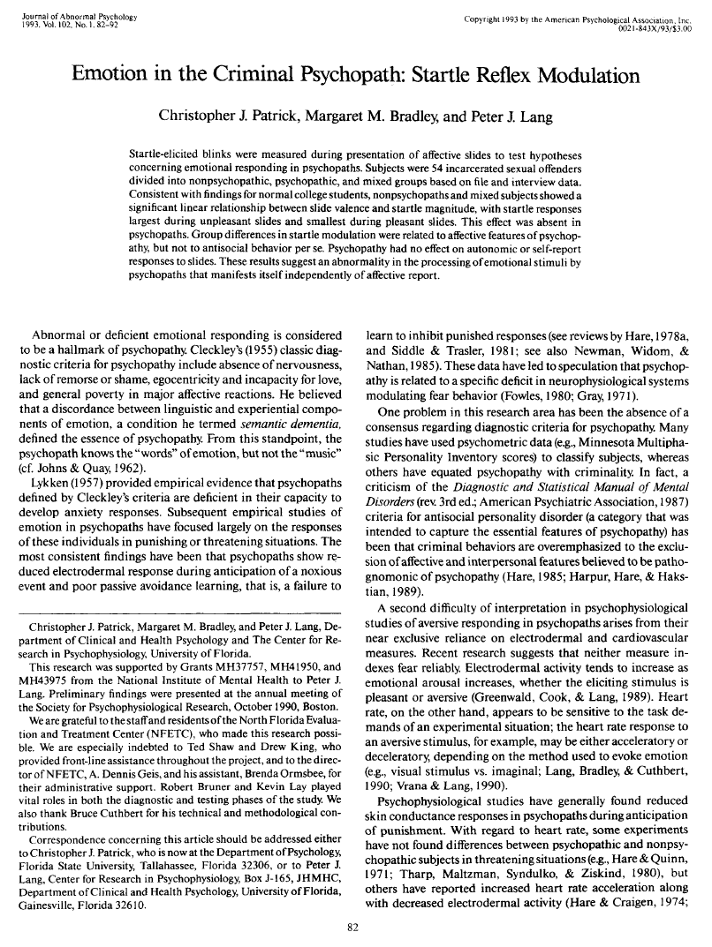
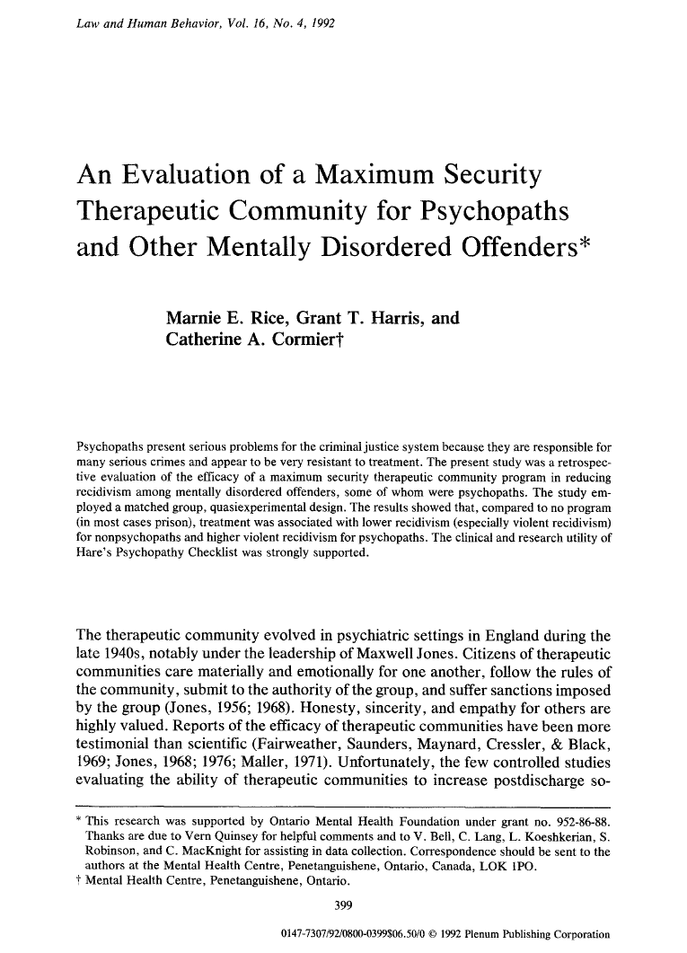
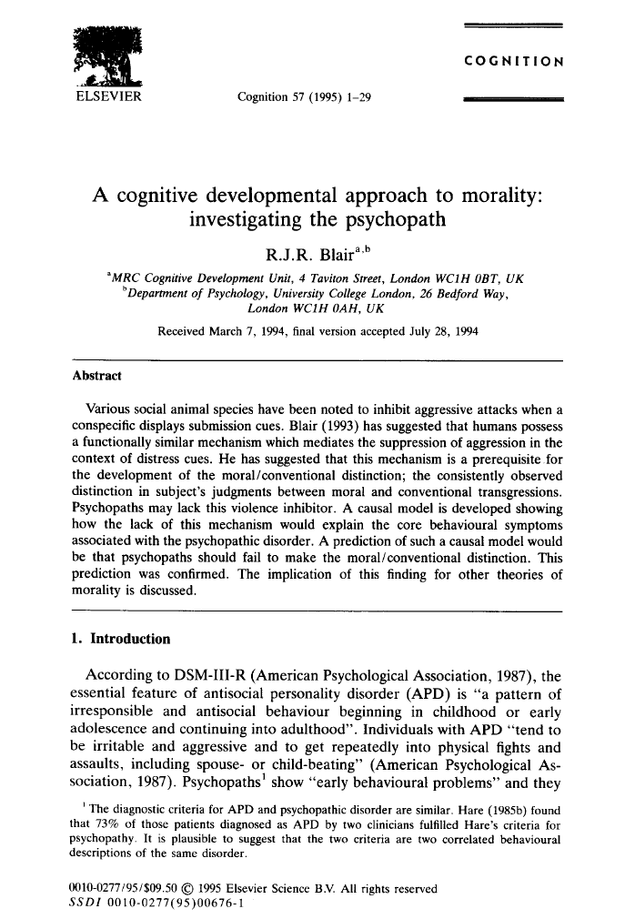
Critical Review of Rice et al. (1992):
Rice et al. (1992)
One of the most cited studies in psychopathy research…
Citations:
1,333
Citations:
1,039
Citations:
2,407
Patrick et al. (1993)
Rice et al. (1992)
Blair (1995)

Slide 28
Critical Review of Rice et al. (1992):
Rice et al. (1992)
Study Design: The authors report to have conducted a “matched” control treatment outcome study…
Abstract
Matched Control Study: Pairs each subject in the experimental group with a control subject who shares key characteristics (e.g., age, gender, diagnosis). This design reduces confounding variables, allowing clearer comparison of treatment effects.

Slide 29
Critical Review of Rice et al. (1992):
Rice et al. (1992)
Sample (N = 322): 176 Treated vs. 146 Untreated → Later reduced to n = 205 (169 vs. 136)
Matching Criteria:
  The same age within 1 year at the time of the index offense.
  Charged with the same index offense.
  Equivalent in criminal history for each of property and violent offenses according to a system developed by Akman and Normandeau (1967).
  Charged with their index offenses no more than 2 years apart.
  NB: Original grouping had similar “follow-up” time with regards to recidivism.
Matched Control Study: Pairs each subject in the experimental group with a control subject who shares key characteristics (e.g., age, gender, diagnosis). This design reduces confounding variables, allowing clearer comparison of treatment effects.

Slide 30
Critical Review of Rice et al. (1992):
Rice et al. (1992)
Main Analysis of Treatment Outcome
Treatment study: Retrospective data from a community therapeutic program provided by the Social Therapy Unit (STU) at Oak Ridge.
Outcome: Tested the effect of the therapeutic program on (a) any form of recidivism and (b) violent recidivism across the entire sample
Follow-up Period: 10.5 years (SD = 4.94).
Matched Participants: 169 (Treated) and 136 (Untreated) (“many-to-one”).
Main results:
  Significant, yet small positive treatment effect in (a) any recidivism: 57% “treated” and 68% “untreated” matched comparison subjects recidivated.
  Non-significant with regards to (b) violent recidivism.
Summary: the authors found some evidence of a small, positive effect of treatment thus corroborating their main hypothesis.

Slide 31
Critical Review of Rice et al. (1992):
Four Major Shortcomings in Rice et al. (1992)
NB: There are arguably many more problems with the study…
1: Deviates from “Matched Control” Design
After the initial main analysis, the authors give up on the “matching” criteria and can no longer isolate a potential treatment effect (i.e., properly control for potential outcome confounds).
2. Removal of Samples from Analysis
In the analysis comparing “treated” vs. “untreated” psychopathic participants, the authors remove n = 17 “untreated” participants without any justification. The results are “non-robust” as missing samples impact statistics.
3: Misleading Description of STU Program
The authors described the Social Therapy Unit’s services as “therapeutic” but must have known that they were antithetical to clinical and ethical best practices. It was widely known in the 1990s that the STU abused their patients.
4. Data Reliability Concerns
The authors describe the obtained file records as high quality, but the files were actually composed by lay case historians and inmates at Oak Ridge with no education in clinical or scientific work.

Slide 32
Critical Review of Rice et al. (1992):
Problem 1: Deviates from “Matched Control” Design
What are the consequences of this decision?
Matching criteria are supposed to “control” for potential confounds (i.e., criteria that impacts outcome variable = recidivism)
For example, the treated vs. untreated “psychopaths” are no longer matched on variables like age, index offence, or follow-up period.
Follow-up period: The higher violent recidivism rate could be explained by “treated” psychopaths being “at risk” for a longer period.
Notice that remove “matched” criteria deviates from the description of the study in the abstract and methods section (“scientific spin”..?).

Slide 33
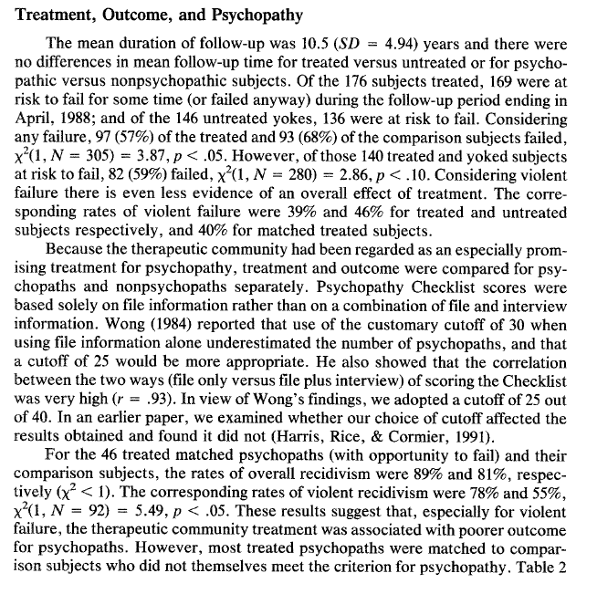
Critical Review of Rice et al. (1992):
Rice et al. (1992)
Exploratory Analysis involving “psychopathy”
Psychopathic persons seemed to have an “adverse” or “negative” treatment outcome effect…
HOWEVER, the group analysis is no longer “matched control” comparison…
…no estimate on the follow-up time of treated vs. untreated “psychopaths?

Slide 34
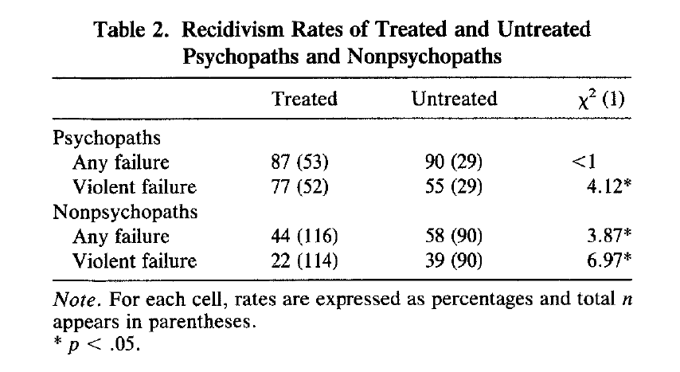

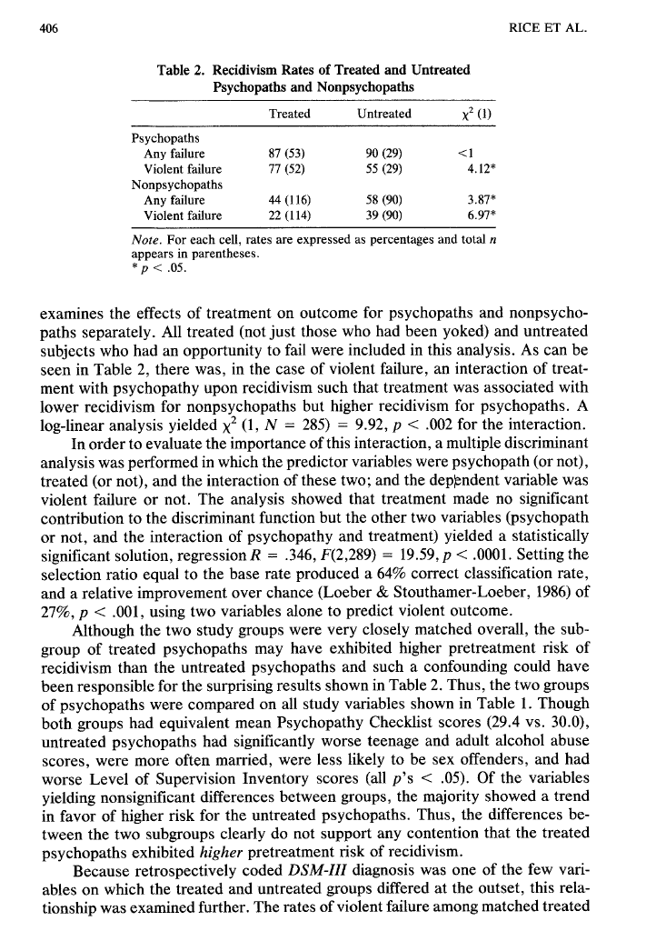
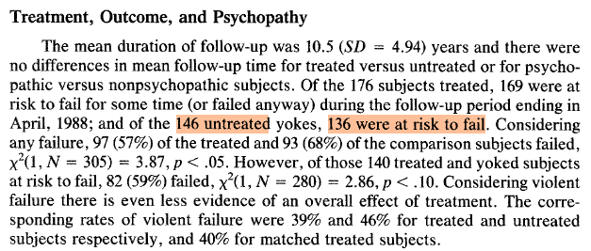
Critical Review of Rice et al. (1992):
Problem 2: Removal of Samples from Analysis
N = 17 participants are removed from the “untreated” column in Table 2
Percentage
Sample size
n = 169
(116 + 53)
n = 119
(90 + 26)
N = 17 missing participants

Slide 35
Critical Review of Rice et al. (1992):
Problem 2: Removal of Samples from Analysis
N = 17 participants are removed from the “untreated” column in Table 2
The authors do not specify which participants were removed, why, or how exclusions affected outcomes.
This lack of transparency makes it impossible to assess whether their “most interesting finding” (p. 409) reflects a true effect or a false positive caused by sampling bias.
When conducting a sensitivity analysis:
  Worst-case scenario: adding n = 17 to the row/column of “untreated psychopaths, violent recidivists” yields a p = 0.557 (effect disappears).
Conclusion: Findings are sensitive to data exclusions, casting doubt on their robustness.

Slide 36
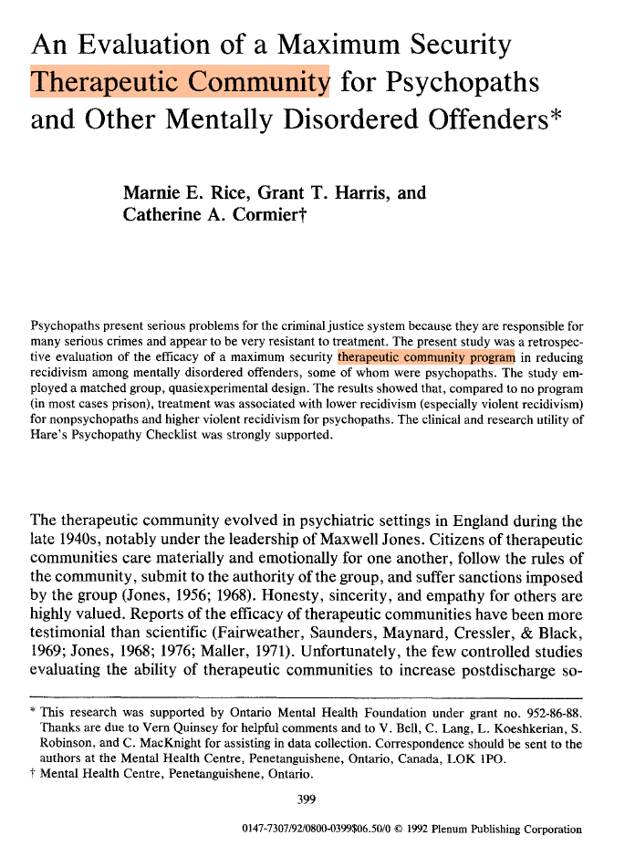
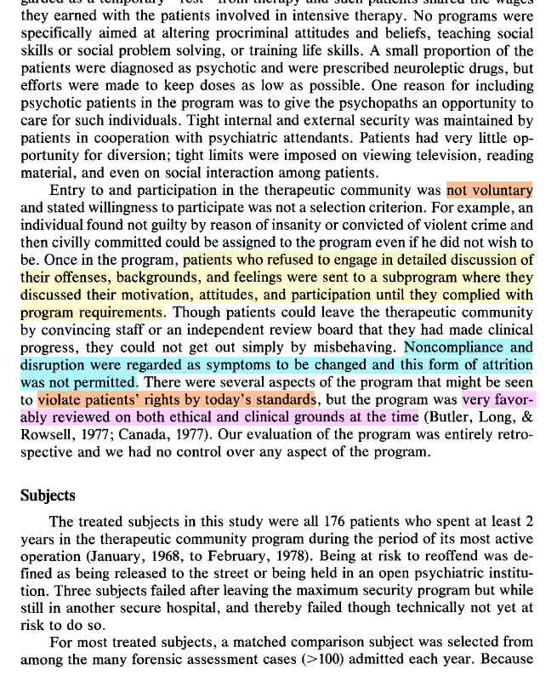
Critical Review of Rice et al. (1992):
Problem 3: Misleading Description of STU Program
NB: The STU was implicated in an Ontario Supreme Court ruling in 2017 (Barker v. Barker; appeal in 2020)

Slide 37
Critical Review of Rice et al. (1992):
Problem 3: Misleading Description of STU Program
The three infamous “therapeutic programs” documented in the Supreme Court lawsuits in 2017 and 2020
Defence Disruptive Therapy
Motivation, Attitude and Participation
Total Encounter Capsule
Patients were administered powerful psychoactive drugs (e.g., dexedrine, scopolamine) inducing intense hallucinations and paranoia, often lasting up to 24 hours or longer. During these episodes, they were strapped to non-drugged patients for observation. Reported effects included prolonged anxiety and psychosis lasting months after treatment.
Patients were isolated in sack gowns, forced to sit motionless for hours under the supervision of other violent patients. Progress was measured by “perfect days” of flawless obedience and posture, making release dependent on arbitrary behavioral criteria.
Patients were stripped naked and confined in a lit, soundproof cell for up to 11 days, often shackled together and injected with hallucinogenic drugs. They were monitored by other patients via cameras and fed only liquid nutrition through wall-mounted straws.

Slide 38
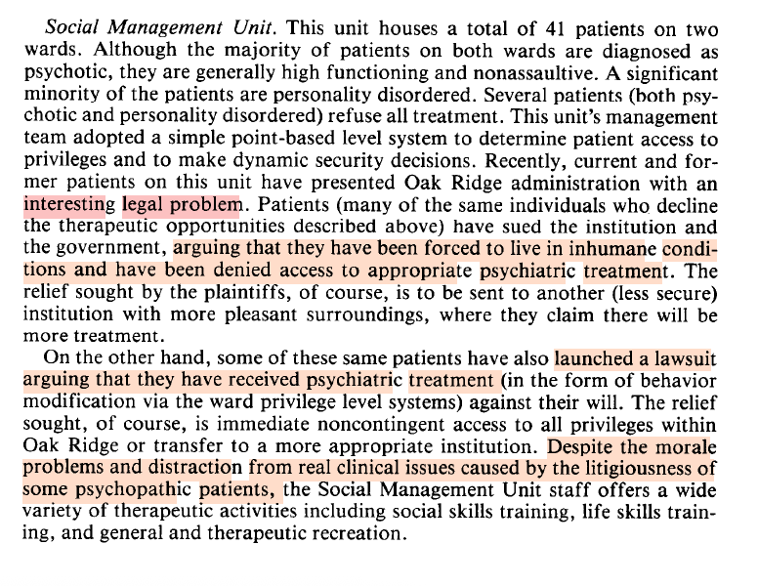
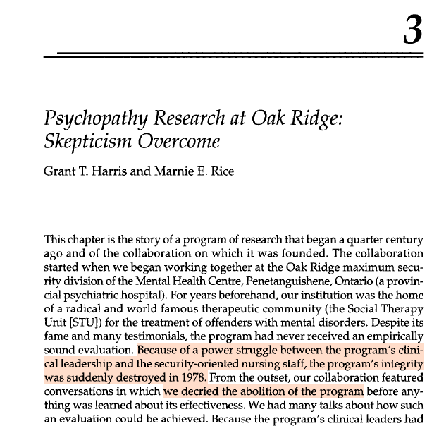
Critical Review of Rice et al. (1992):
Problem 3: Misleading Description of STU Program
Can the authors be rightfully accused on bias in their general attitudes about the STU…?
Rice & Harris (1993)
Harris & Rice (2007)

Slide 39
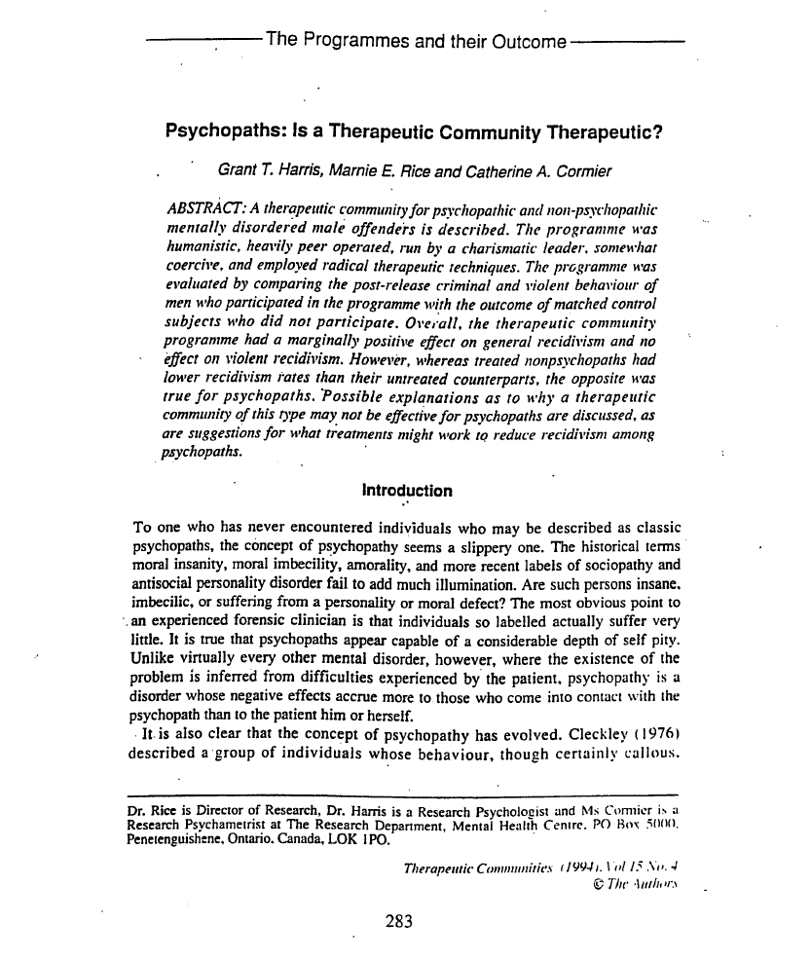
Critical Review of Rice et al. (1992):
Problem 3: Misleading Description of STU Program
Can the authors be rightfully accused on bias in their general attitudes about the STU…?
The authors misrepresented their study
Harris, Rice, and Cormier (1994)

Slide 40
Critical Review of Rice et al. (1992):
Problem 4: Data Reliability Concerns
The data retrieved from the STU was generated by lay people and inmates/patients
Rice et al. describes their data as “exceptionally complete” (p. 403).
But data records from STU were produced by lay “case historians” and even patients, due to chronic staff shortages (Hucker Report, 1984).
Quality Concerns:
  Reports were inconsistent, unprofessional, and often pejorative in tone.
  Lacked clear clinical descriptions or standardized observation protocols.
Scientific Implication: The psychopathy scores and matched-control comparisons were derived from unreliable sources.

Slide 41
Critical Questions

Slide 42

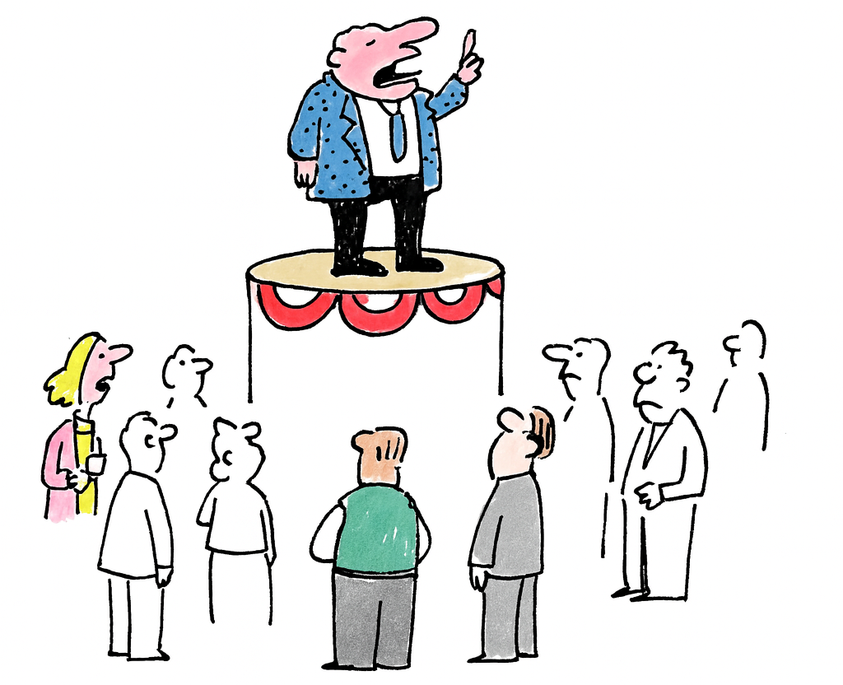

Critical Reflections:
Unanswered Questions
The Origins of the View
Advocacy from the Fringes
Dearth of Research
There appears to have never been any empirical evidence clearly indicating that PCL psychopathic persons are “untreatable.” Why, then, did researchers persist in promoting this view?
The “untreatability view” was advanced primarily through the PCL-R and a relatively small group of researchers (notably Rice and Harris). Why did they promote this perspective, and how did they manage to gain such influence?
There has been a remarkable dearth of empirical research on treatment of PCL psychopathy. Why has this gap persisted, and why has it not been meaningfully addressed?

Slide 43
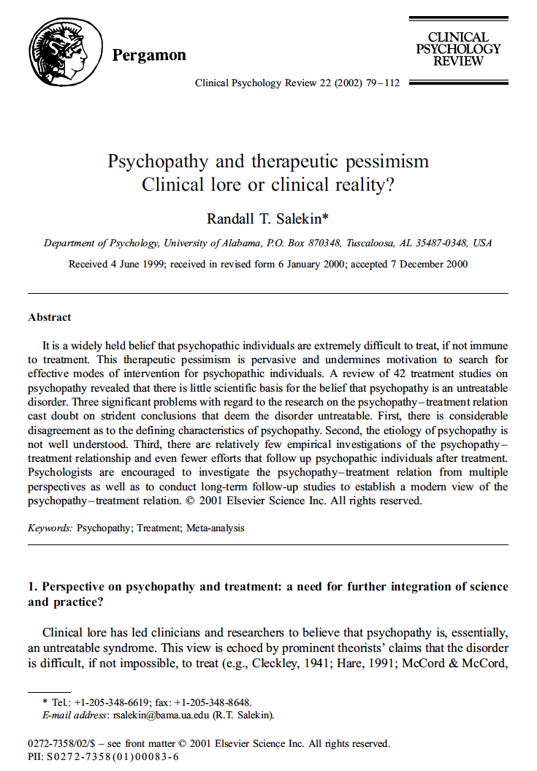
Critical Reflections:
“Although some reviewers (e.g., Salekin, 2002) have suggested that clinical pessimism might be replaced with clinical optimism, most clinicians and researchers are rightly pessimistic about the treatability of psychopaths with traditional methods.”
The Hare Psychopathy Checklist–Revised (2003, p. 158)
Notes:
NB: It’s an odd reference to a systematic review; indeed, in 2002, Salekin’s study was the only systematic review on the topic of treatment, and the PCL-R should arguably have acknowledged that the conclusion of this study was the best evidence-based position. Instead, the PCL-R manual brushes the study aside ”as if” it’s some sort of academic opinion.

Slide 44
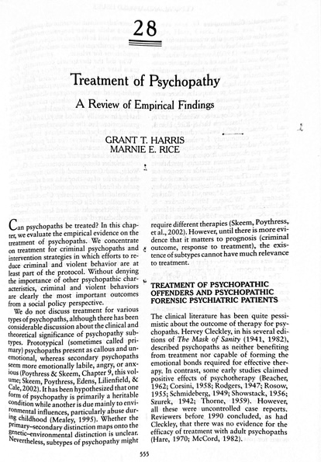
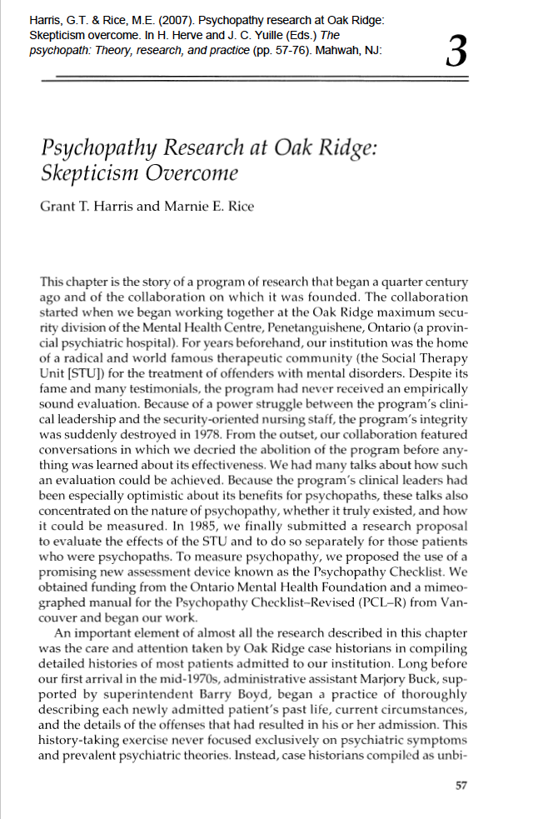
Critical Reflections:
Sign of Bias…?
In the mid-2000s, Grant Harris and Marnie Rice published two non–peer-reviewed review papers that could be accused of misrepresenting the scientific evidence (link and link).

Slide 45
Critical Reflections:
Odd Citation Practices
In psychopathy research, flashy or controversial findings tend to attract disproportionate attention, even when later shown to be misleading.
  Seto & Barbaree’s (1999) study suggesting adverse treatment effects has ~400% more citations Barbaree’s 2005 follow-up that recanted/corrected the record.
  Similarly, Rice et al.’s problematic 1992-study remains the most frequently cited treatment study in the field (~1,039 citations).
Collectively, Rice et al. (1992) and Seto & Barbaree’s (1999) has received more than 50% as many citations as the 19 studies in Table 3.2 (p. 77).
In conclusion, sensational results seem to overshadow more accurate but less striking findings.
Notes:
NB: Seto & Barbaree’s (1999) was never retracted by the journal.

