Slide 1
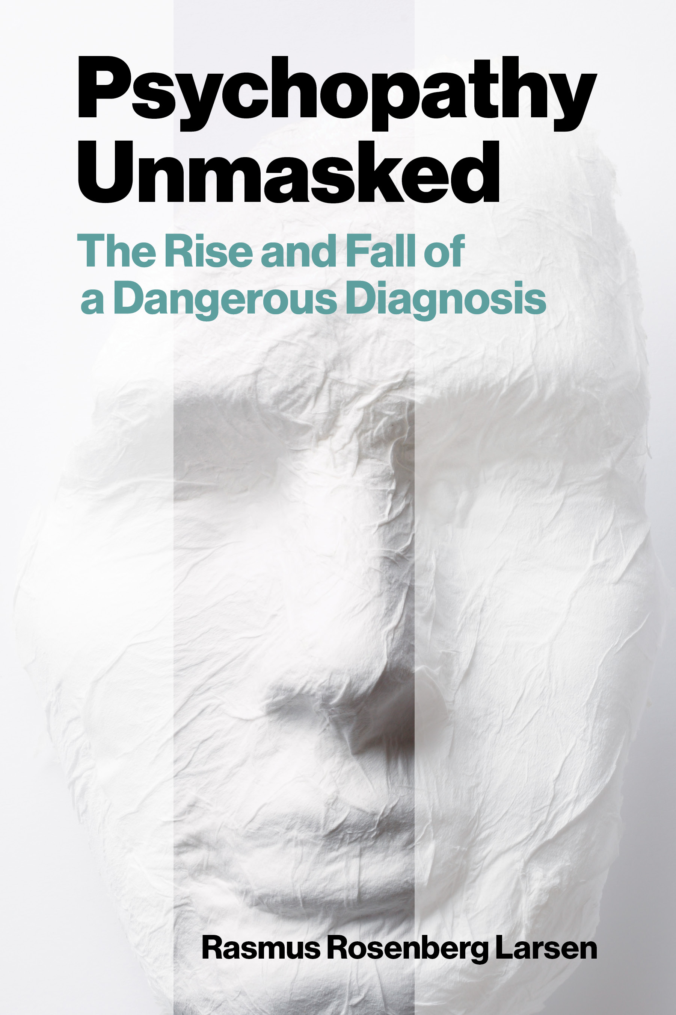

Psychopathy and Crime
The Science, Ethics, and Legal Influence of a Controversial Diagnosis
Module 1
Introduction
What is Psychopathy?
Instructor Name
email@address.com
Title
Department
Website | Social Media
INSERT PORTRAIT
Copyright © Rasmus Rosenberg Larsen
Licensed under CC BY 4.0.

Slide 2
This Module’s Agenda:
Course Information
Group Discussion:
  Sharing Perspectives on Psychopathy
What is Psychopathy?

Slide 3
Course Information

Slide 4
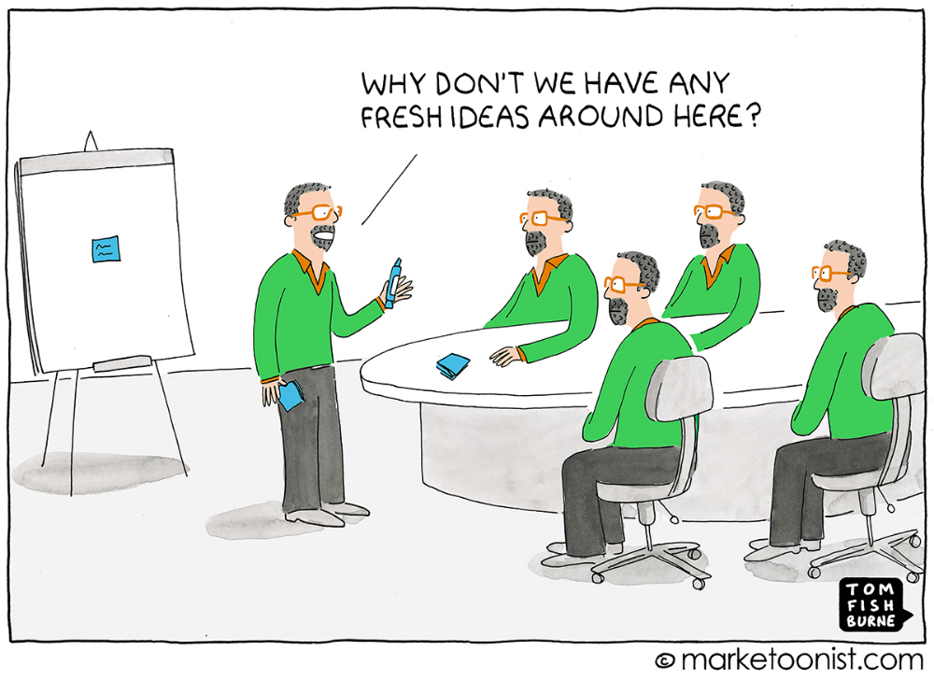
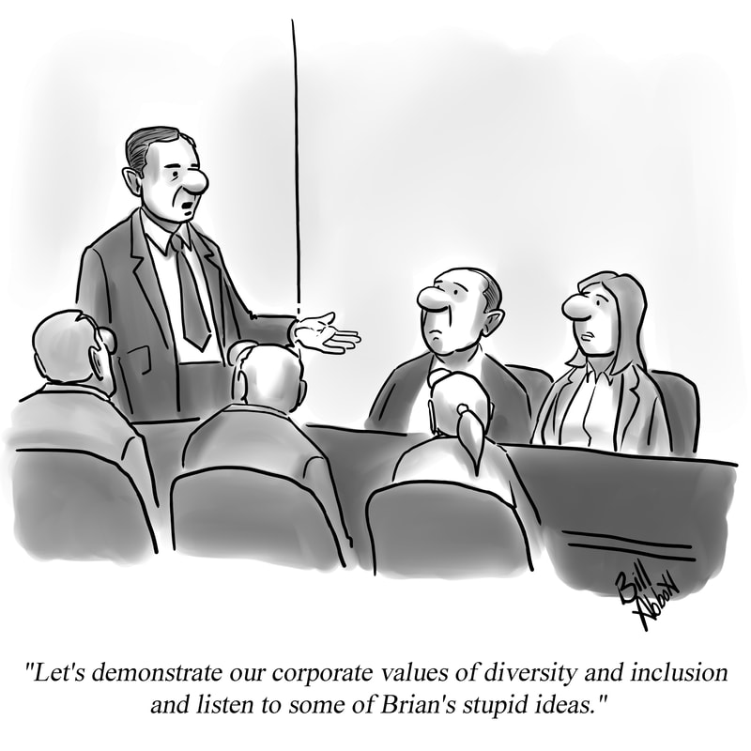
Course Information:
The Value of an Inclusive Learning Environment

Slide 5
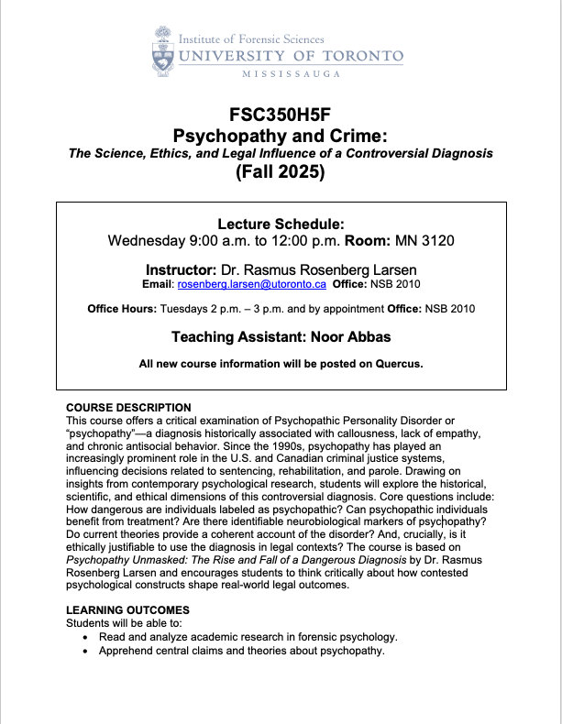
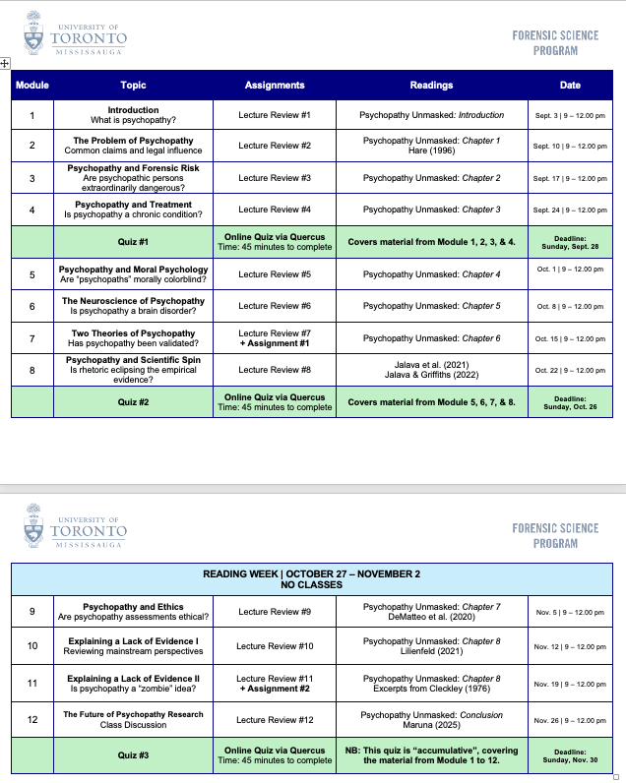
Course Information:
Course Syllabus

Slide 6
Course Information:
Course Description:
This course offers a critical examination of Psychopathic Personality Disorder or “psychopathy”—a diagnosis historically associated with callousness, lack of empathy, and chronic antisocial behavior. Since the 1990s, psychopathy has played an increasingly prominent role in the U.S. and Canadian criminal justice systems, influencing decisions related to sentencing, rehabilitation, and parole. Drawing on insights from contemporary psychological research, students will explore the historical, scientific, and ethical dimensions of this controversial diagnosis. Core questions include: How dangerous are individuals labeled as psychopathic? Can psychopathic individuals benefit from treatment? Are there identifiable neurobiological markers of psychopathy? Do current theories provide a coherent account of the disorder? And, crucially, is it ethically justifiable to use the diagnosis in legal contexts? The course is based on Psychopathy Unmasked: The Rise and Fall of a Dangerous Diagnosis by Dr. Rasmus Rosenberg Larsen and encourages students to think critically about how contested psychological constructs shape real-world legal outcomes.

Slide 7
Psychopathy and Crime
FSC350
Module 1
Introduction – What is Psychopathy?
Module 7
Two Theories of Psychopathy
Module 2
The Problem of Psychopathy
Module 8
Psychopathy and Scientific Spin
Module 3
Psychopathy and Forensic Risk
Module 9
Psychopathy and Ethics
Module 4
Psychopathy and Treatment
Module 10
Explaining a Lack of Evidence (Part I)
Module 5
Psychopathy and Moral Psychology
Module 11
Explaining a Lack of Evidence (Part 2)
Module 6
The Neuroscience of Psychopathy
Module 12
The Future of Psychopathy Research

Slide 8
Course Information:
Readings:
Larsen, Rasmus R. (2025). Psychopathy Unmasked: The Rise and Fall of a Dangerous Diagnosis (MIT Press).
  Access: UTM Library Link and UTM Bookstore or Online Retailers.
Additional readings are linked/uploaded to Quercus.

Slide 9

Course Information:
Learning Outcomes:
Read and analyze academic research in forensic psychology.
Apprehend central claims and theories about psychopathy.
Explore how psychopathy assessments have been used in the legal system.
Advance critical thinking skills in relation to interdisciplinary research.
Critical..

Slide 10
Course Information:
Final grades will be calculated according to the weights listed in the Grading Scheme. There will be no makeup assignments or extra credit assignments. The grades you earn are the grades you will receive. The breakdown of percentages into letter grades, GPA, and grade definitions is viewable here.
Grade Item | Date | % Final Grade
Quiz #1 | September 28 | 15%
Quiz #2 | October 26 | 15%
Quiz #3 | November 30 | 15%
Lecture Reviews (x 12) | Multiple Deadlines | 15%
Assignment #1 | October 19 | 20%
Assignment #2 | November 23 | 20%

Slide 11
Course Information:
Quizzes:
The quizzes are based on information from both the reading and lecture material (e.g., lecture slides). A typical quiz consists of approximately 40-50 questions, primarily multiple-choice and true/false. The quizzes are completed online via Quercus.

Slide 12
Course Information:
Lecture Reviews:
Students must complete a total of 12 Lecture Reviews consisting of short, online quizzes and exercises that engage students on information conveyed during the weekly in-class modules. A typical Lecture Review consists of approximately five questions. The Lecture Reviews are completed online via Quercus.

Slide 13
Course Information:
Written Assignments:
Students must complete a total of 2 x written assignments (see schedule below). An assignment consists of a 1-2-pages written answer to text and lecture specific questions. The assignments are accessed and submitted via Quercus.

Slide 14
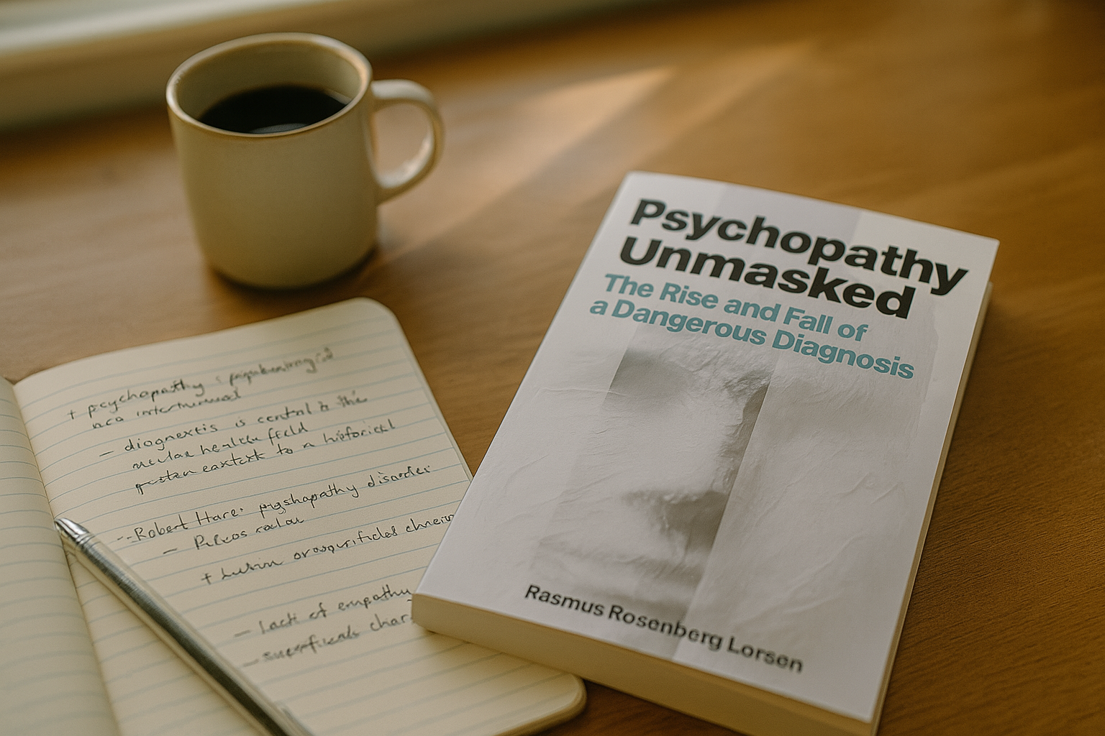

Course Information:
How to study…?

Slide 15

Course Information:
The Importance of Reading in FSC350
Reading Material
Grading
There is around 20-30 pages of reading material for each weekly module.
+ Take notes!
All quizzes and assignments are based on the reading materials. Thus, your final grade depends on reading…

Slide 16
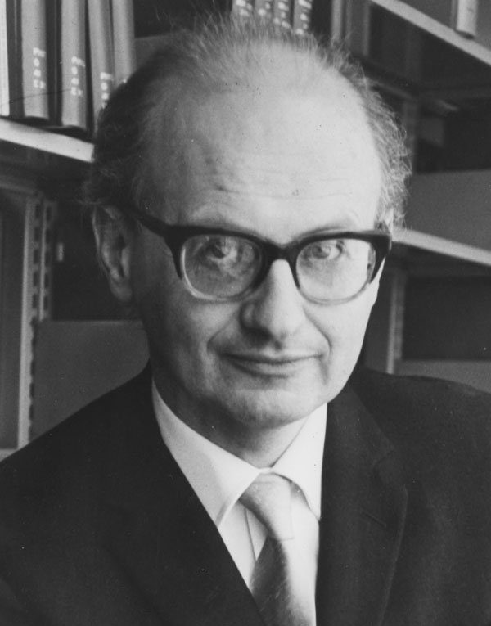
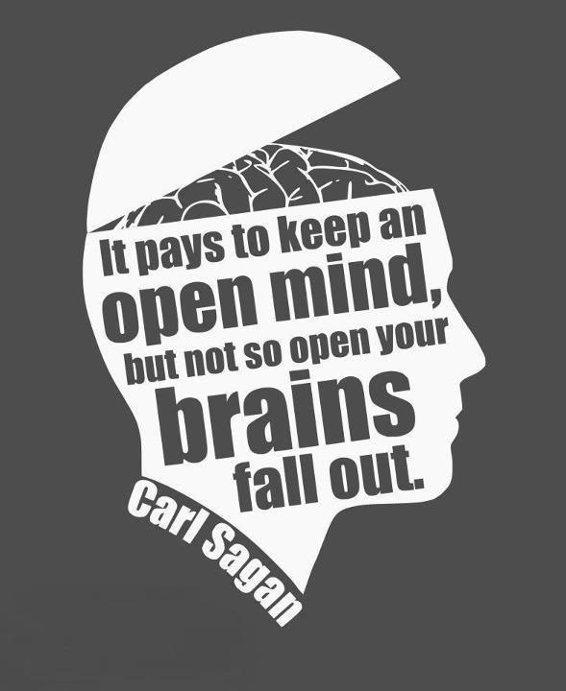
Course Information:
The Value of Curiosity and Critical Thinking
“The hallmark of scientific behaviour is a certain scepticism even towards one’s most cherished theories. Blind commitment to a theory is not an intellectual virtue: it is an intellectual crime.”
Imre Lakatos, in the Introduction: Science and Pseudoscience (1970, p. 1)

Slide 17

Course Information:
Any questions..?

Slide 18
Group Discussion

Slide 19
Group Discussion:
Group Discussions
Question #1
Which psychological traits are stereotypically associated with “psychopathy”…?
Question #2
What is the importance or relevance of psychopathy to the legal system (e.g., courts, prisons, etc.)…?
Question #3
Which movies/shows do you think offer the most accurate depiction of “psychopaths”?
Question #4
Can you think of a real-life example of a person who fit the “psychopath” stereotype?

Slide 20
What is Psychopathy..?

Slide 21

What is Psychopathy…?
What is Psychopathy?

Slide 22

What is Psychopathy…?
The Stereotypical Psychopath
“Psychopaths are social predators … [who are] completely lacking in conscience and in feelings for others, they selfishly take what they want and do as they please, violating social norms and expectations without the slightest sense of guilt or regret.”
Quote from Without Conscience (1993)

Slide 23

What is Psychopathy…?
Common Description in Scientific Research
“Psychopathy refers to a personality disposition to charm, manipulate, and ruthlessly exploit other persons. Psychopathic persons are lacking in conscience and feelings for others; they selfishly take what they want and do as they please without the slightest sense of guilt or regret. Psychopathy is among the oldest and arguably the most heavily researched, well-validated, and well-established personality disorder.” (Hare et al., 2012)

Slide 24

What is Psychopathy…?
Patient Prototype instantiates the Condition
The Patient Stereotype
Disorder Description
Instantiates
Clinical Proto/Stereotype: A real-life person that “fits” or represents the constellation of behavioral signs and psychological traits associated with a specific condition.

Slide 25
What is Psychopathy…?
Central Definitions
Psychopathy: The concept refers to a type of personality disorder defined by a collection of callous personality traits and antisocial behavioral characteristics.
Personality Disorder: An enduring pattern of inner experience and behavior that deviates markedly from the expectations of the individual’s culture (Link).
Clinical Construct: A syndromic set of measurable traits and behaviors that together are deemed clinically relevant but not necessarily disorderly.

Slide 26
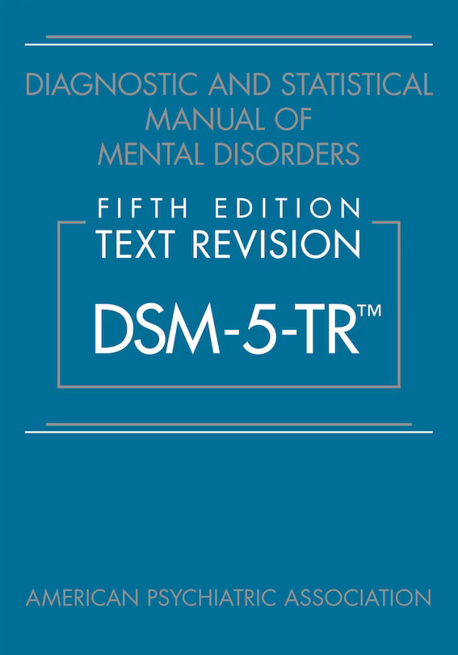
What is Psychopathy…?
Classifying Mental Disorders
Diagnostic and Statistical Manual of Mental Disorders (DSM-5-TR)
Published by the American Psychiatric Association.
Provides standardized criteria for diagnosing mental disorders (most clinicians use it).
All diagnoses are organized by disorder categories (e.g., depressive, neurodevelopmental, personality).
Primarily used in the United States and Canada for research, teaching, and insurance billing.

Slide 27
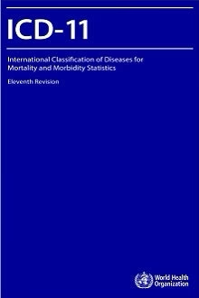
What is Psychopathy…?
Classifying Mental Disorders
International Classification of Diseases (ICD-11)
Published by the World Health Organization (WHO).
Intended for global use in health systems worldwide (e.g., clinical care, health statistics, epidemiology).
Covers all diseases and health conditions, not only mental disorders.
Aligns with DSM in many areas, but differences exist (e.g., personality disorder categories).
Freely available online in multiple languages.

Slide 28
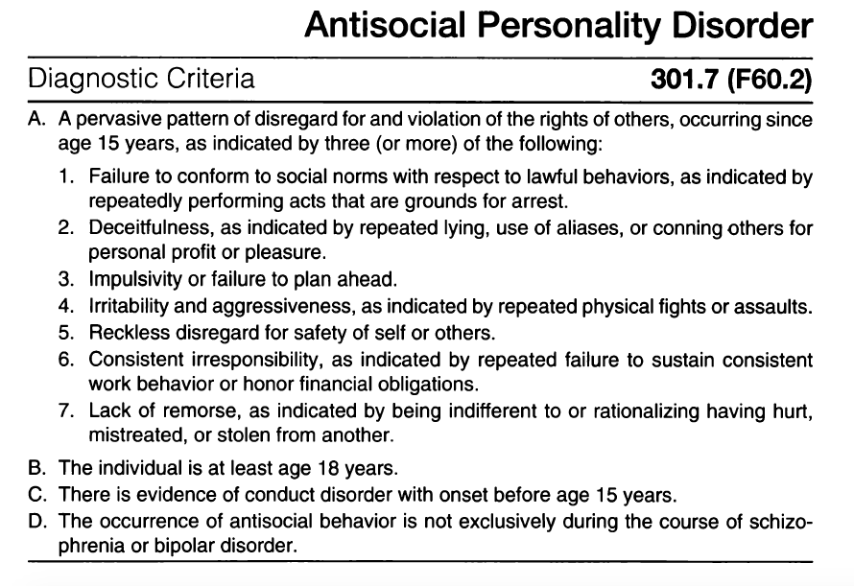
What is Psychopathy…?
DSM-5-TR → Psychopathy is defined as a sub-type of Antisocial Personality Disorder

Slide 29
What is Psychopathy…?
Taxonomy of DSM-5-TR Personality Disorders (PD)
Personality Disorders
Cluster A
Cluster B
Cluster C
Other
Paranoid PD
Borderline PD
Avoidant PD
Personality Change Due to Another Medical Condition.
Schizoid PD
Histrionic PD
Dependent PD
Specific Types of Personality Disorders
Schizotypal PD
Narcissistic PD
Obsessive-Compulsive PD
Other Specified PD
Antisocial PD
Unspecified PD
Psychopathic Subtype

Slide 30
What is Psychopathy…?
Conceptual Nuances and Potential Confusions
Psychopath: Today’s clinicians and scientists tend to avoid the term “psychopath,” as it is increasingly seen as derogatory.
Psychopathic: An adjectival derivative clinicians sometimes use to indicate that a person has either sub-clinical or clinical levels of psychopathy.
Psychopathic Traits: This concept is used traits associated with psychopathy or that a person has some (but not all) of the traits (i.e., sub-clinical).

