Slide 1
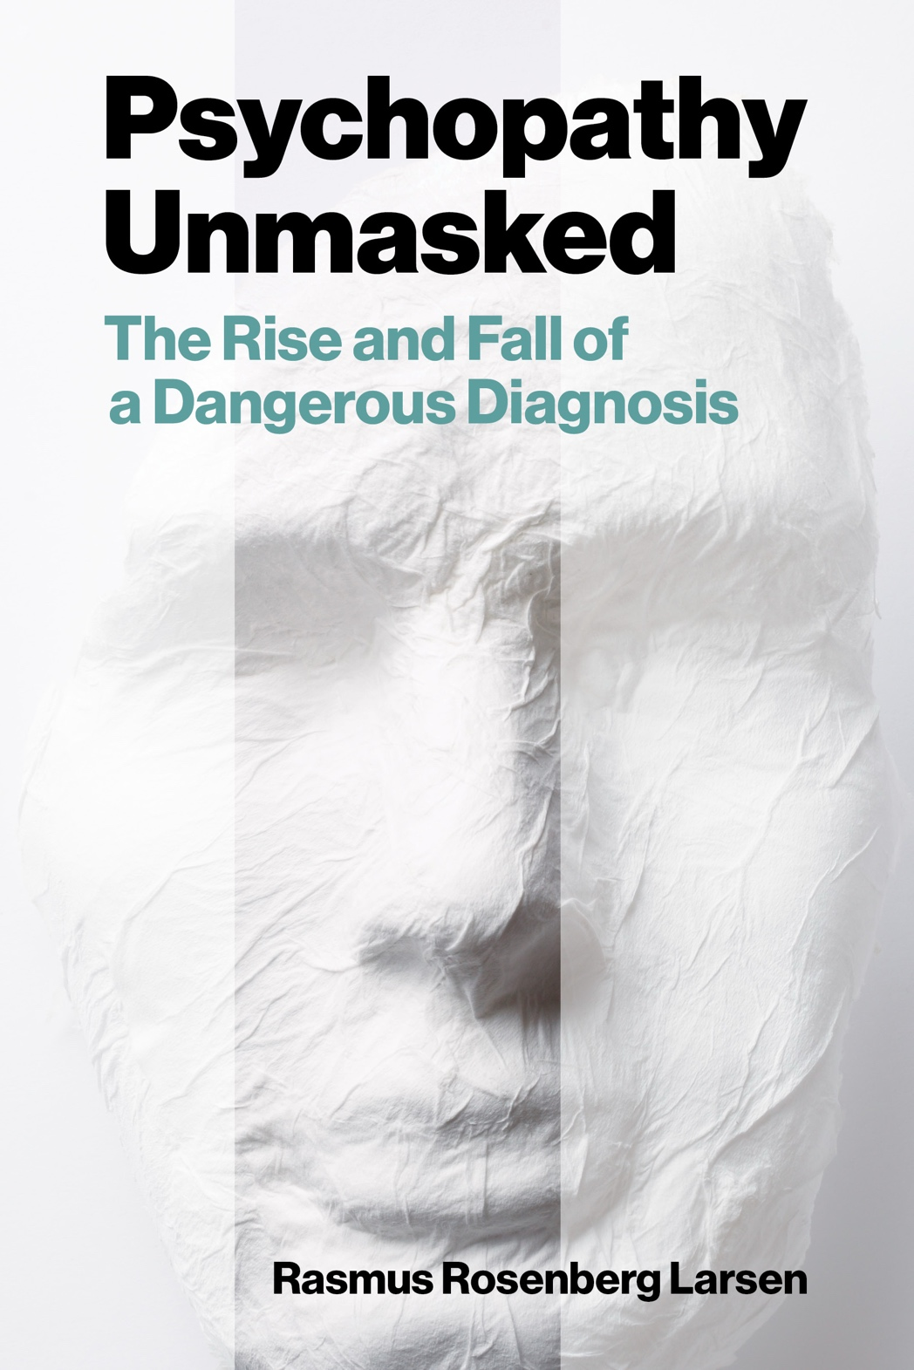
Psychopathy and Crime
The Science, Ethics, and Legal Influence of a Controversial Diagnosis
Module 11
Explaining the Lack of Evidence (Part II)
Is Psychopathy a Zombie Idea..?
Copyright © Rasmus Rosenberg Larsen
Licensed under CC BY 4.0.

Slide 2
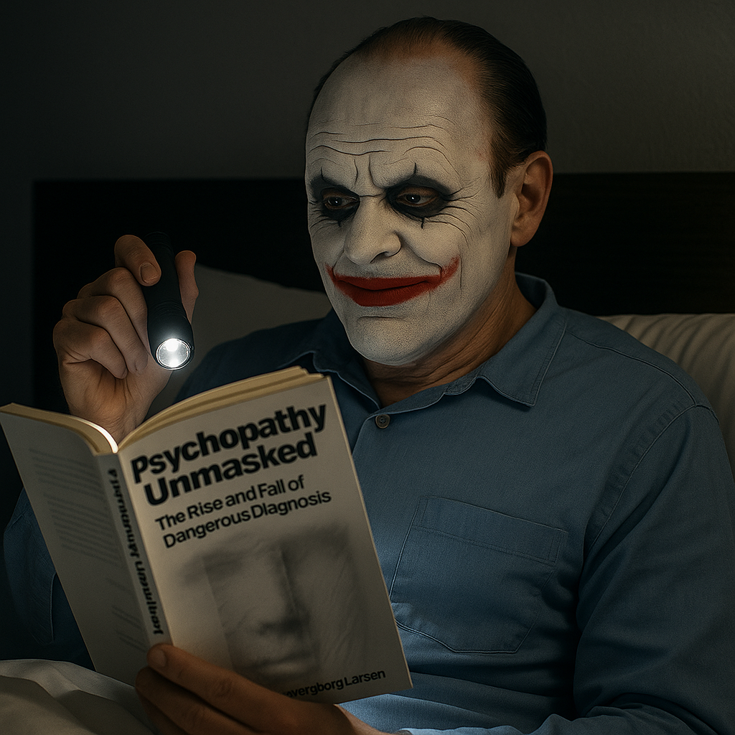
Any questions..?
© OpenAI (LLM-generated image)

Slide 3
Psychopathy and Crime
FSC350
Module 1
Introduction – What is Psychopathy?
Module 7
Two Theories of Psychopathy
Module 2
The Problem of Psychopathy
Module 8
Psychopathy and Scientific Spin
Module 3
Psychopathy and Forensic Risk
Module 9
Psychopathy and Ethics
Module 4
Psychopathy and Treatment
Module 10
Explaining a Lack of Evidence (Part I)
Module 5
Psychopathy and Moral Psychology
Module 11
Explaining a Lack of Evidence (Part 2)
Module 6
The Neuroscience of Psychopathy
Module 12
The Future of Psychopathy Research

Slide 4
This Module’s Agenda:
Explaining the Lack of Evidence
What is a “Zombie” Idea?
Psychopathy as a Zombie Idea
Objections

Slide 5
Explaining the
Lack of Evidence

Slide 6


Explaining the Lack of Evidence:
A Strange Failure to Prove the Obvious…?
Psychopathy is alleged to be an extreme psychological construct/disorder…
vs.
We are not searching for a “needle in a haystack”…
…psychopathic persons allegedly stick out like a “sore thumb”.

Slide 7

“[Because of self-correction] Scientific fields therefore rarely find themselves in a situation where there is a fundamental disconnect between its central ideas and the available evidence. Because it is exactly these types of unsupported ideas that scientific work is supposed prevent us from endorsing.”
Larsen (2025, p. 210)

Slide 8

Explaining the Lack of Evidence:
Central Question:
Why is it that there has never been any scientific progress in corroborating some of the most basic claims about psychopathy?

Slide 9


Explaining the Lack of Evidence:
Two Basic or Mainstream Accounts
NB: There are perhaps many possible ways to account for the apparent failures in psychopathy research…
It’s Simply Too Hard!!
We Can’t Measure it..!
Contemporary research might not be sophisticated enough to study a personality disorder like psychopathy.
Assessment tools like the PCL-R might be flawed: not “identifying” properly psychopathic persons.

Slide 10


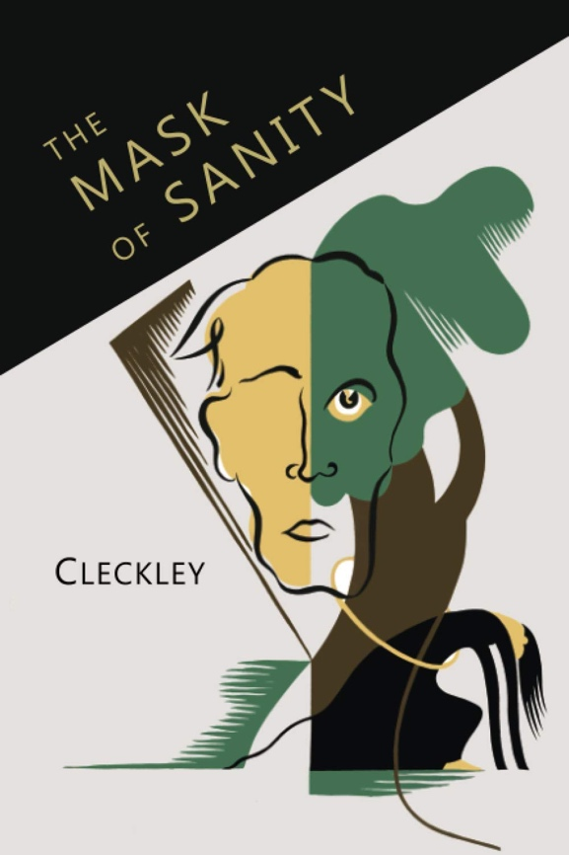
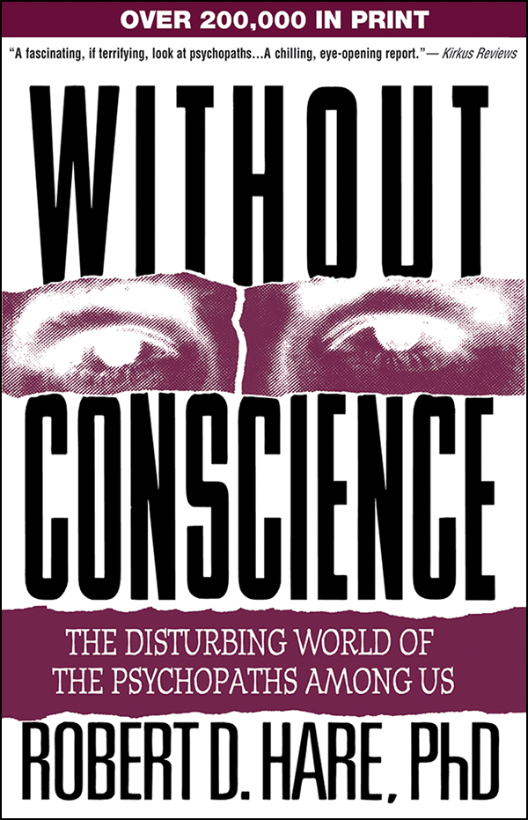
Explaining the Lack of Evidence:
Researching the PCL Psychopathy Prototype
The Cleckley/Hare Prototype
Result: Spurious Findings!
It’s Simply Too Hard!!
We Can’t Measure it..!
Clinical Proto/Stereotype: A real-life person that “fits” or represents the constellation of behavioral signs and psychological traits associated with a specific condition.

Slide 11

Explaining the Lack of Evidence:
Legitimate Explanations, Yet Not Very Convincing..!
There are plenty of reasons to believe that these two mainstream explanations are unconvincing…
It’s Simply Too Hard!!
We Can’t Measure it..!
For example: Underestimates how much good research exists = many rigorous studies on PCL psychopathy.
For example: Studies using alternative assessments tools (e.g., self-report) produce equally inconsistent results.

Slide 12

Explaining the Lack of Evidence:
Proposing an Alternative Explanation
NB: This idea might be controversial, but it is a powerful explanation of the lack of evidence of psychopathy
Psychopathy = Not “Real”
The idea is wrongheaded; there is no entity in reality (i.e., person) that matches the idea of a “psychopath”

Slide 13

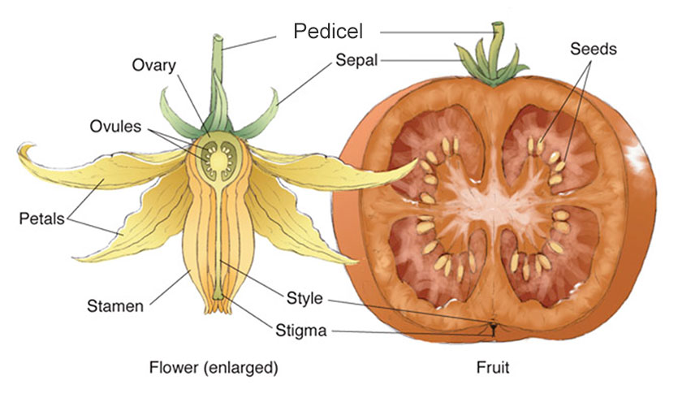
Explaining the Lack of Evidence:
Particulars and Universals
It’s because of the discovery of particular “tomatoes” that we infer (instantiate) the universal “Tomato”
Particulars instantiates Universals
Instantiates
Universal: A term used to denote entities in reality that are responsible for the structure, order, and regularity we can observe in particulars; we say that particulars instantiate universals (example of universals: “tomato”, “mammal”, “bone”, etc.).
Source: Arp et al., 2015; Armstrong, 1989; Smith, 1997.

Slide 14
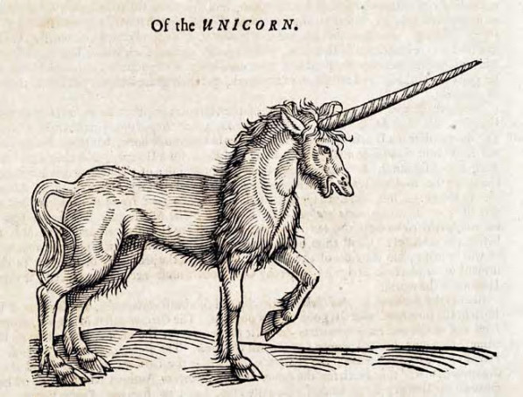
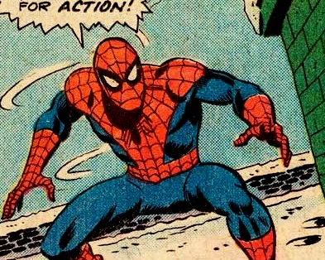
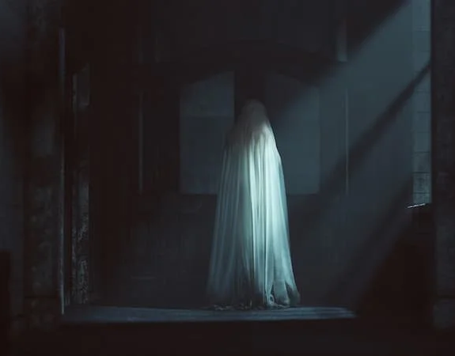
Explaining the Lack of Evidence:
Three Examples of “Not Real” Entities
To say an idea is “not real” is perhaps intuitively meaningful, but it’s a bit more complicated…
Unicorn
Spiderman
Ghost
There’s no particular animal in reality that “instantiates” the universal idea of a unicorn. HOWEVER, there’s a particular fictional tale that “instantiates” the universal idea of a unicorn as a “mythical animal”.
There’s no particular person in reality that “instantiates” the universal idea of spiderman. HOWEVER, there’s a particular comic book that “instantiates” the universal idea of “fantasy superhero spiderman”.
There’s no particular entity in reality that “instantiates” the universal idea of a ghost. HOWEVER, there’s a particular set of phenomena that humana have had wrongful interpretations of, e.g., mysterious sound or hallucination.

Slide 15

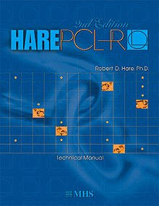
Explaining the Lack of Evidence:
Psychopathy = Not “Real”
To say that an idea of psychopathy is “not real” is to say that “its reality is that of a fiction” (Larsen, 2025, p. 213)
Fiction
20-Item Checklist
The Cleckley/Hare Prototype
Idea of Psychopathy
Selects
“Match”
They do NOT
Instantiate a
Universal
The tool “selects” a person that appears to “match” the 20-item checklist
The persons “selected” accurately represent the “prototype” = they are real people
No human beings instantiate the idea of psychopathy

Slide 16

Explaining the Lack of Evidence:
Explanatorily Good
The proposal that psychopathy is “not real” can indisputably explain the lack of evidence in psychopathy research…
Psychopathy = Not “Real”
Result: Spurious Findings!
The idea is wrongheaded; there is no entity in reality (i.e., person) that matches the idea of a “psychopath”
Trivial Truth: If some entity is not real –if it doesn’t exist – then you’ll never find any clear evidence of it..!

Slide 17

Explaining the Lack of Evidence:
Question:
If psychopathy is “not real” – and there has never been any evidence of it – why do scientists keep “believing” in and perpetuate the idea of psychopathy…?
© OpenAI (LLM-generated image)

Slide 18
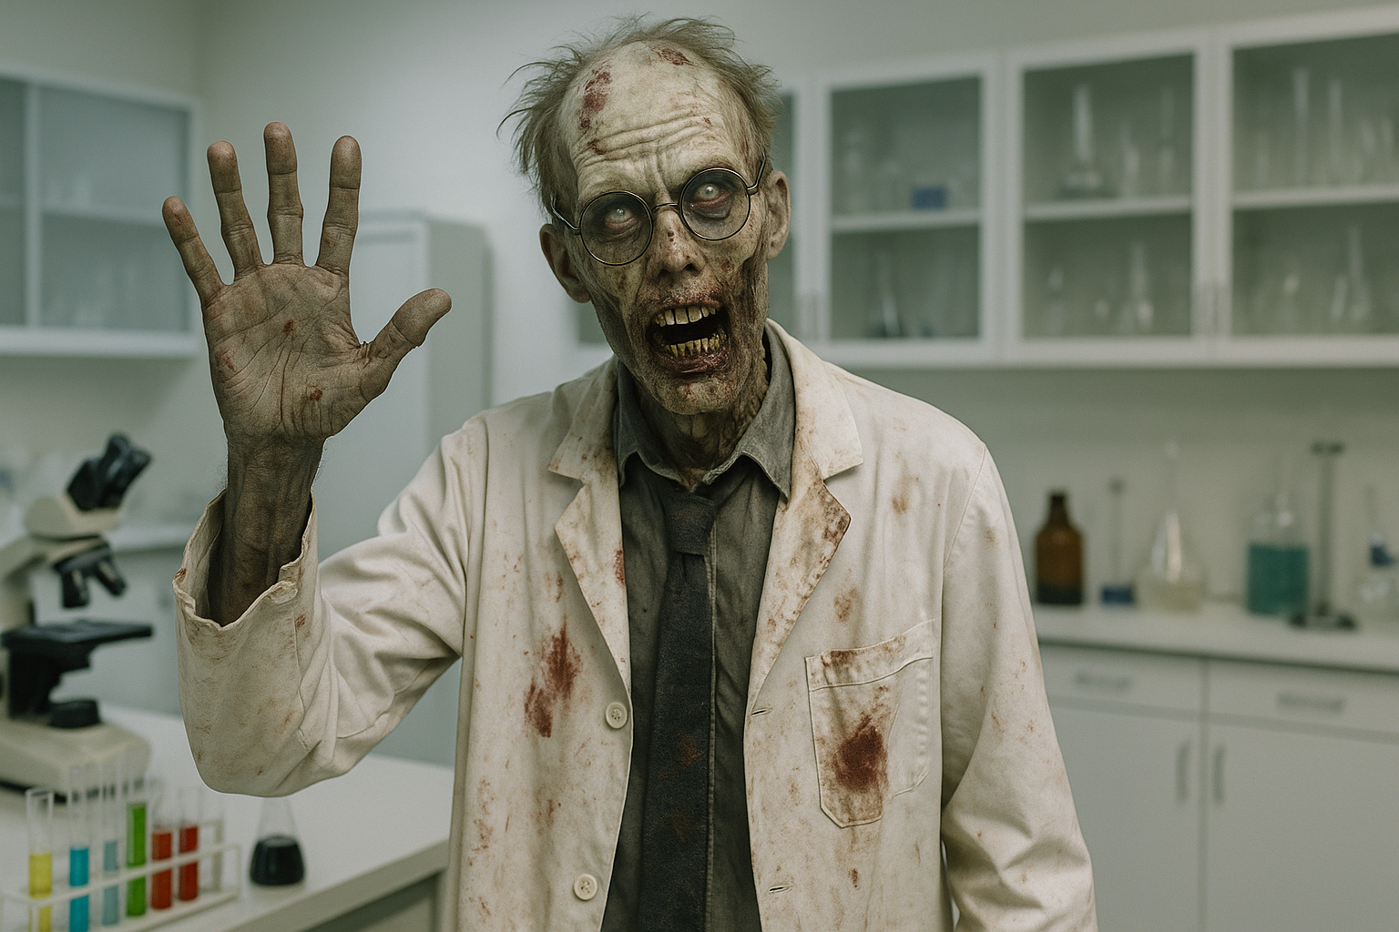
Explaining the Lack of Evidence:
ANSWER:
…maybe because psychopathy is a “zombie” idea…
© OpenAI (LLM-generated image)

Slide 19
What is a “Zombie” Idea..?

Slide 20




What is a “Zombie” Idea..?
Zombies in Science
Zombie Idea: An idea that is (a) intuitively appealing, and (b) has no referent in reality.
Intuitively Appealing
No Referent in Reality
For some reason, scientists find the idea intuitively and rationally appealing (e.g., due to bias, misinterpretations).
When an idea has no “particular” referent in reality, it means that its “reality” is that of a fiction (e.g., like a unicorn).

Slide 21
What is a “Zombie” Idea..?
Zombie Ideas in Science
The concept of a “zombie idea” is a fairly recent notion…
The history of science is full of ideas that have been falsified: geocentrism, biological race theory, creationism, phrenology, etc.
It is exactly because of scientific research that we have discovered or came to realize how these ideas were wrongheaded.
Now, some ideas are wrongheaded, yet they are still intuitive appealing.
What distinguishes a “false idea” from a “zombie idea” seems to be that the scientific community fails to discard the latter from their canon.
Thus, a zombie idea is one that “outlives” its epistemic appeal.

Slide 22
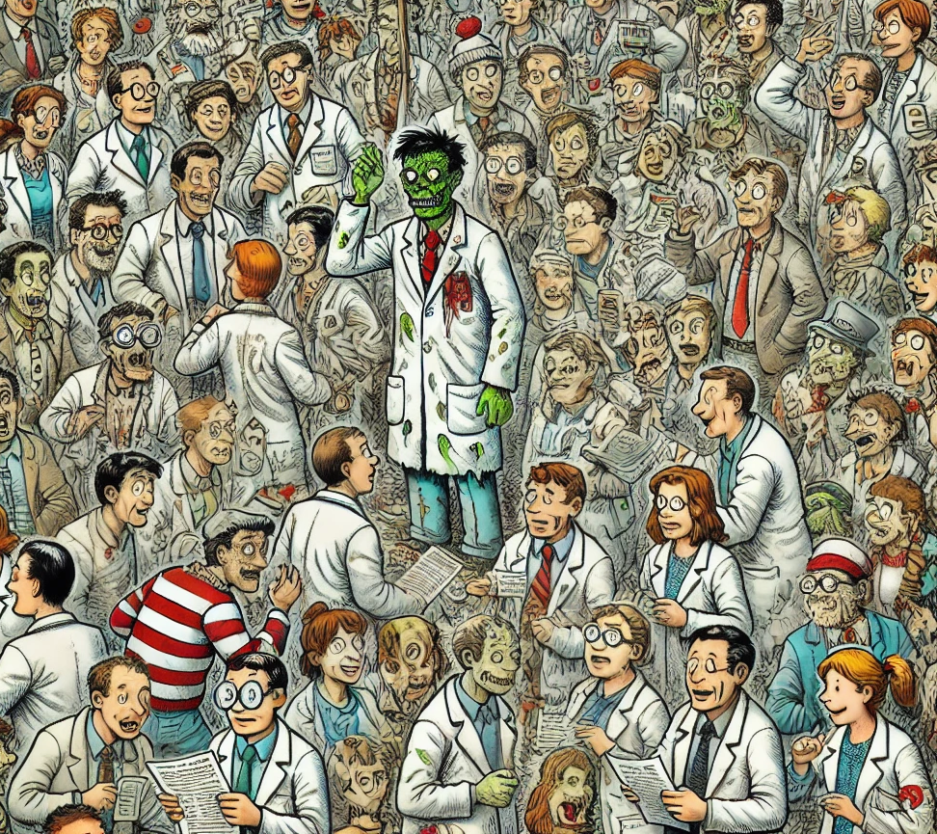
What is a “Zombie” Idea..?
Zombie Ideas Are Rare
Because scientists are generally pretty good at accepting evidence and discarding falsified ideas…

Slide 23

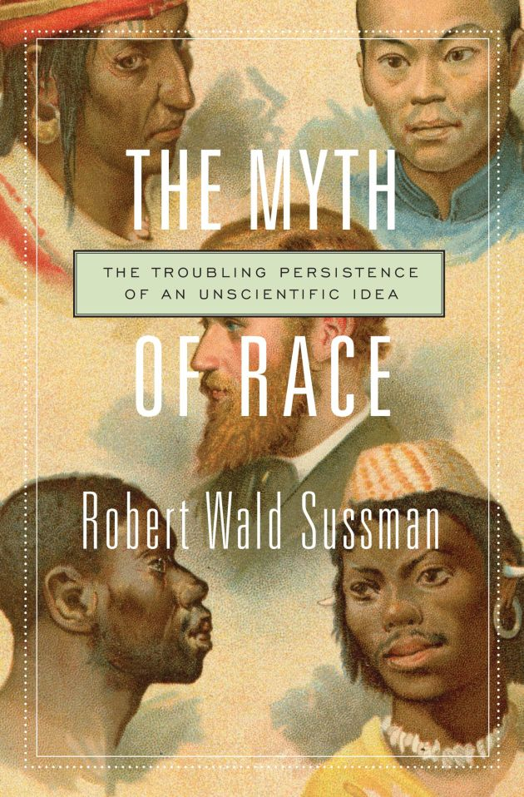
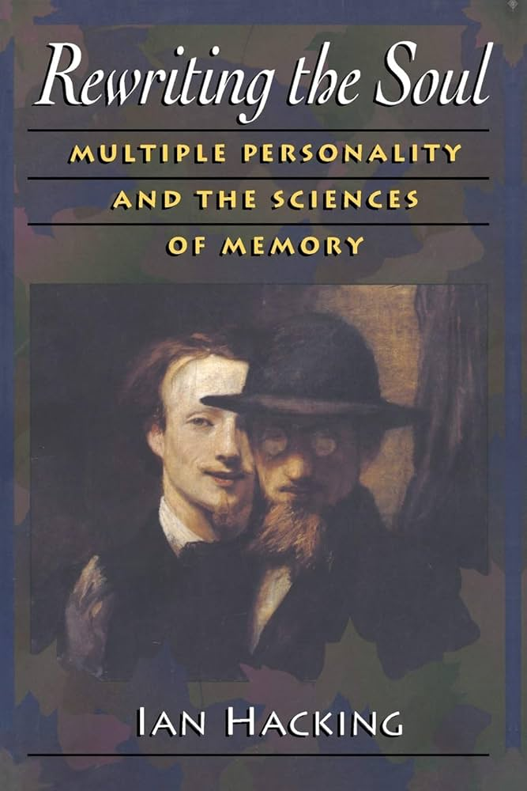
What is a “Zombie” Idea..?
Historical Examples of Zombie Ideas
NB: Some zombie ideas are short-lived, begging the question whether they are truly “zombies”…
Cold Fusion
Biological Race
Multiple Personality Disorder
Simon (1999)
Sussman (2014)
Hacking (1995)

Slide 24
What is a “Zombie” Idea..?
How it Works
The self-sustaining lifecycle of a zombie idea…
So, a zombie idea is an idea that persist inside the sciences despite its lack of empirical support.
Key Characteristics:
  Intuitively appealing – they continuously “infect” new generations of scientists.
  Resist falsification and continue to attract attention.
  Often there will be the illusion of progress despite stagnant findings.
Challenges:
  Zombie ideas might be difficult to “kill” or get rid of.
  To “prove” that some idea is a “zombie”, it requires proof of a negative.
  Absence of evidence ≠ evidence of absence (appeal to ignorance fallacy).

Slide 25
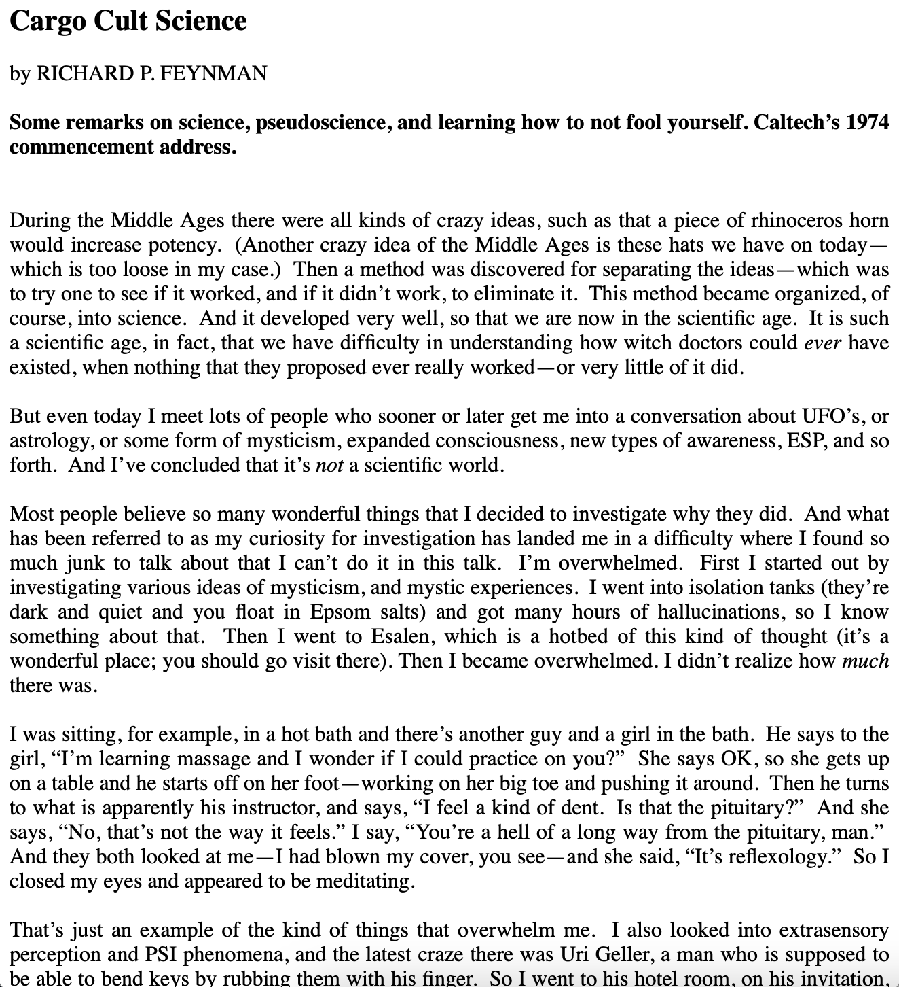
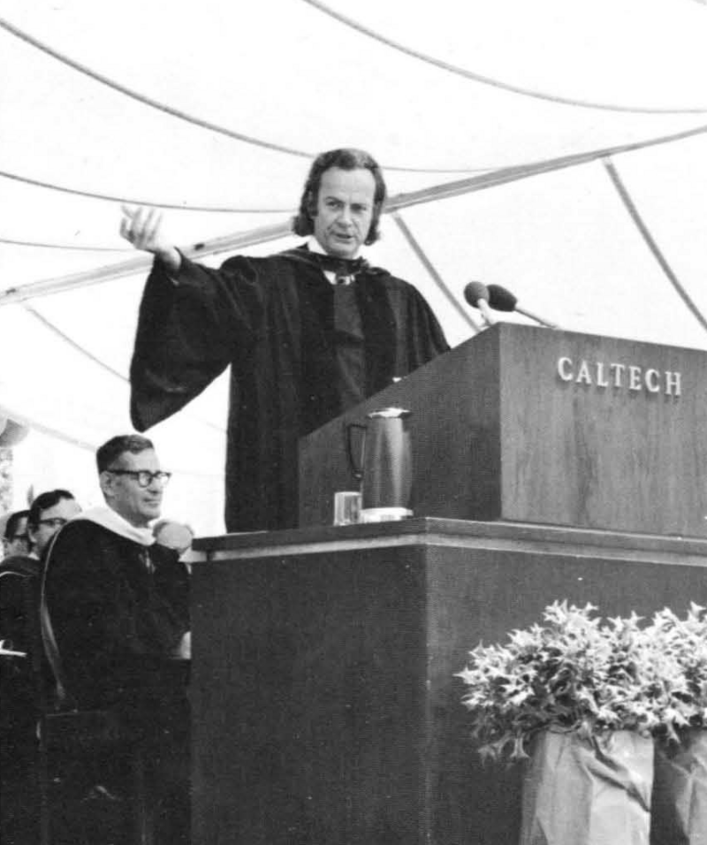
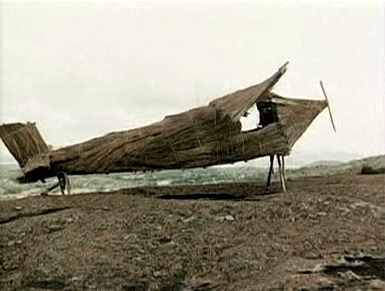
What is a “Zombie” Idea..?
Zombie Ideas Thrive in “Cargo Cult” Science
Cargo Cult Science: settings where the external appearance of scientific inquiry are maintained but the deeper norms of critical scrutiny are fundamentally neglected by scientists themselves…
Feynman (1974)
Nulius in Verba Podcast (link + link)
Notes:
Zombie ideas persist most readily in environments that resemble Feynman’s Cargo Cult Science: settings where the external trappings of scientific inquiry are maintained but the deeper norms of critical scrutiny are neglected. In such environments, an idea can survive long after empirical evidence has failed to support it because researchers continue to reproduce the formal appearance of rigorous investigation—null hypothesis tests, sophisticated statistical models, or elaborate experimental paradigms—without allowing inconvenient findings to challenge the underlying assumptions. The result is a research tradition that continuously “performs” science while insulating its core commitments from meaningful falsification. Like cargo cult practitioners who construct symbolic runways in the hope that airplanes will land, scientists engaged in these practices enact methodological rituals that imitate genuine inquiry but lack the substantive epistemic mechanisms that would allow entrenched claims to be corrected or abandoned.
Within this dynamic, zombie ideas gain longevity because the institutional incentives of the field reward confirmatory findings, conceptual novelty, and theoretical coherence over error detection and self-correction. When negative or ambiguous results are ignored, suppressed, or reframed as partial successes, ideas that should have been discarded instead become part of the field’s inherited landscape. Each new study—regardless of its evidentiary weakness—adds an additional layer of apparent legitimacy, making it increasingly difficult for the community to recognize that the research program is stagnating. In this way, cargo-cult conditions create a hospitable environment for zombie ideas: they allow theories with little empirical support to remain animated by methodological ritual, disciplinary inertia, and the persistent belief that the next experiment will finally reveal the signal that decades of work have failed to find.

Slide 26
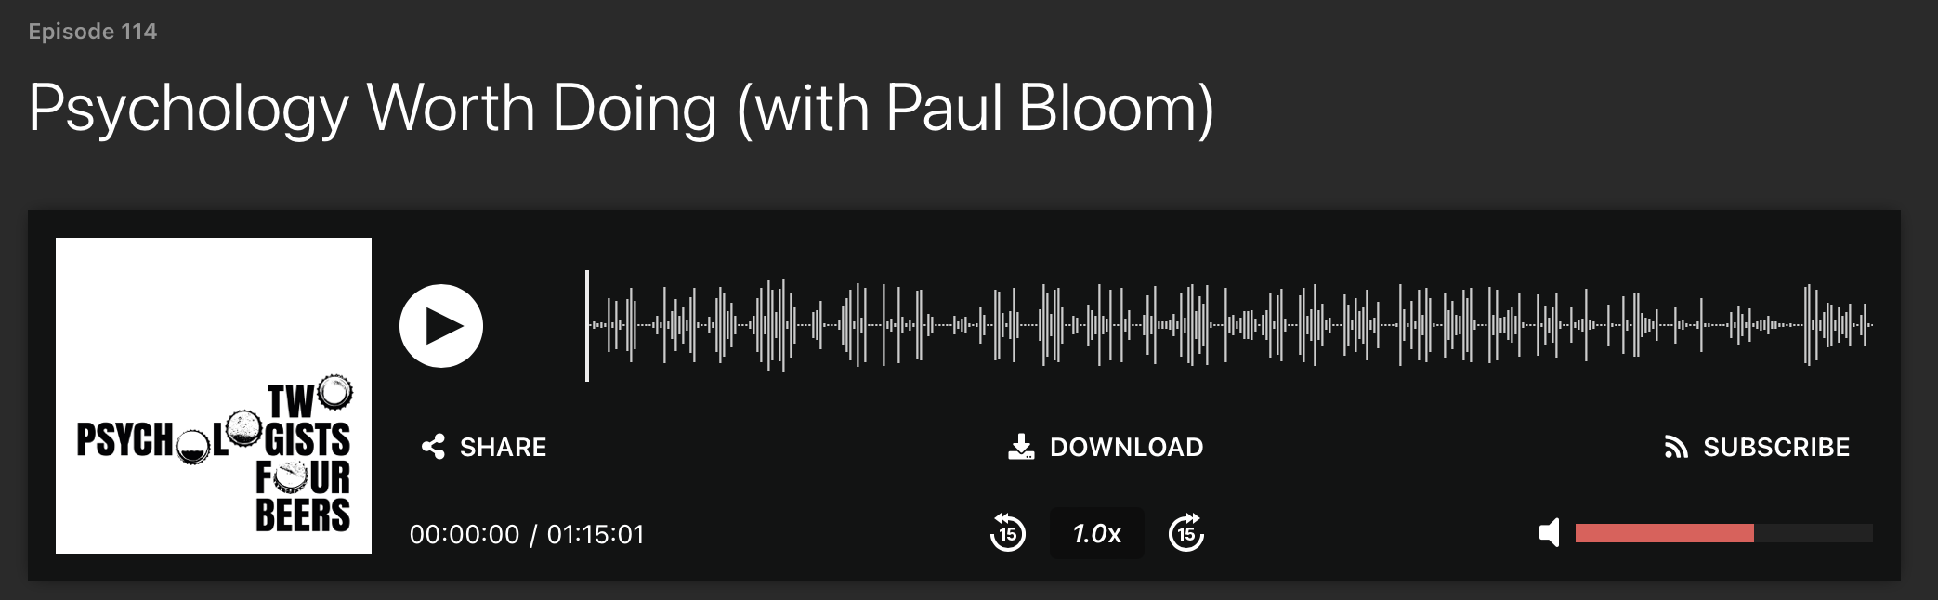
What is a “Zombie” Idea..?
Do Zombie Ideas Attract “Low Quality” Scientists..?
Yoel Inbar’s Law: This observation was made in a conversation between Dr. Yoel Inbar and Paul Bloom
“The more intuitively interesting a field is, the lower quality work there will be in it.” (link)
Research Quality
Intuitive Appeal

Slide 27
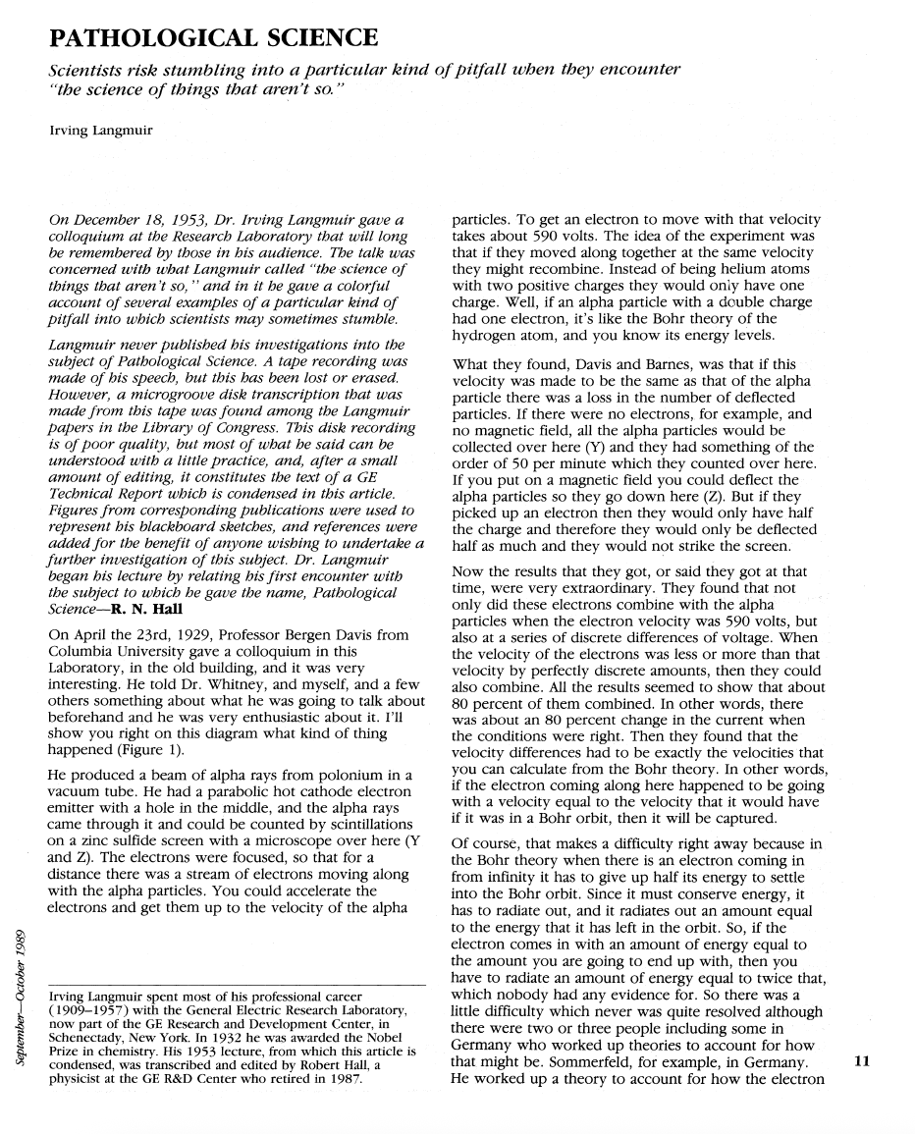
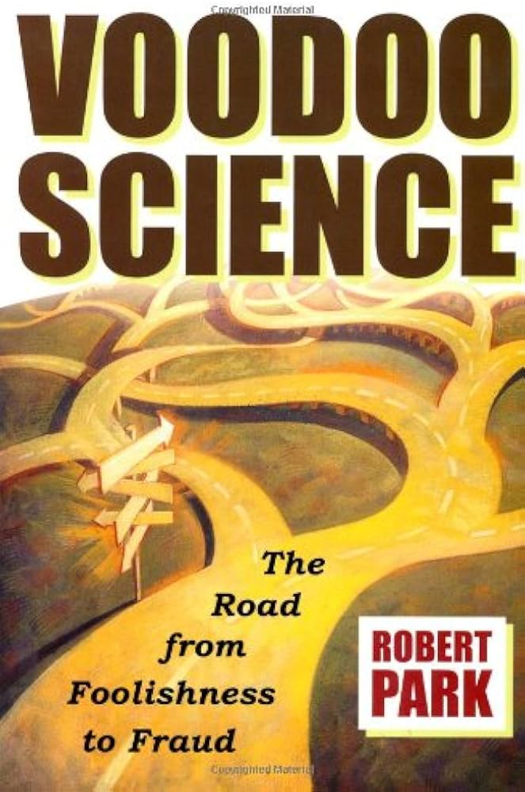
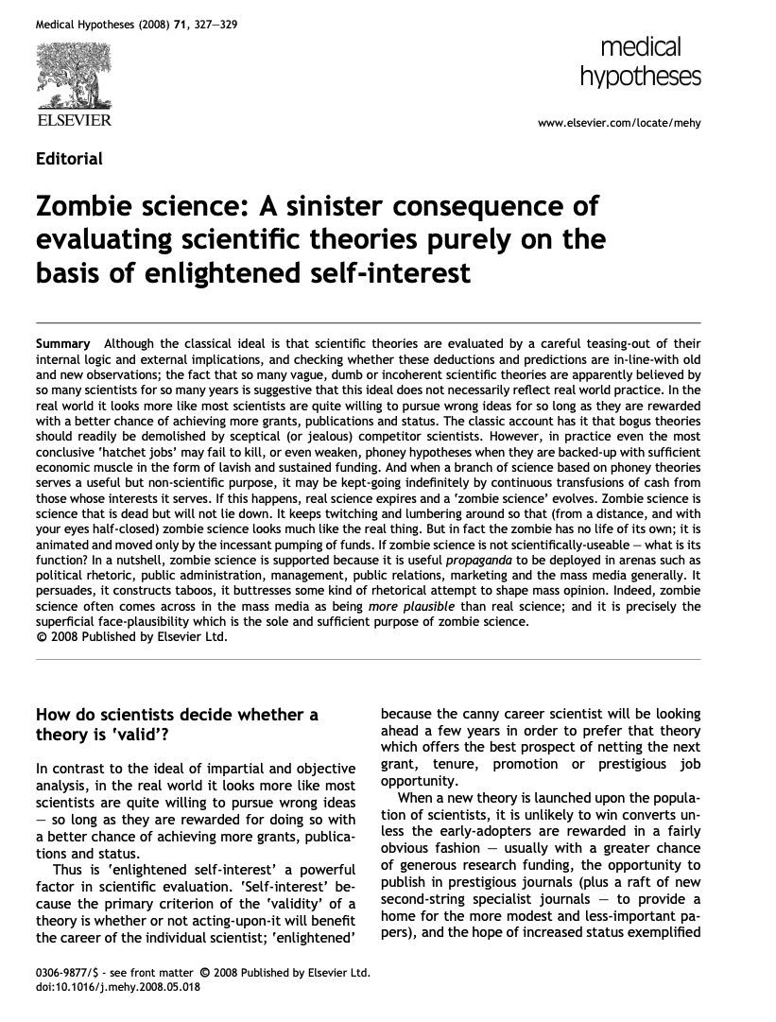
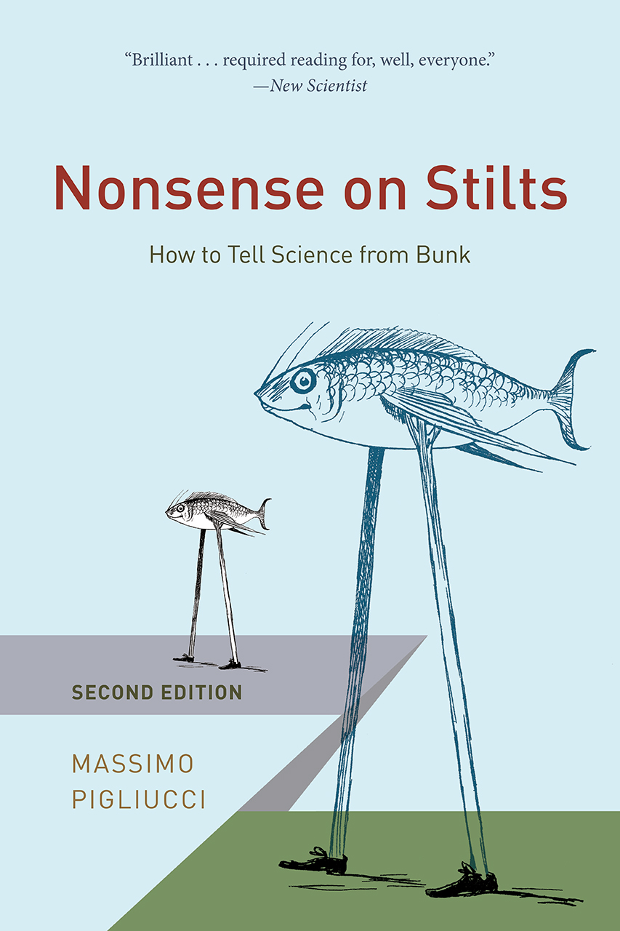
What is a “Zombie” Idea..?
Research Literature
The term “zombie idea” is new, but the general notion of “mistaken” scientists is as old as science itself…
Langmuir, 1953
Parks, 2000
Charlton, 2008
Pigliucci, 2018

Slide 28
Psychopathy as a “Zombie” Idea

Slide 29

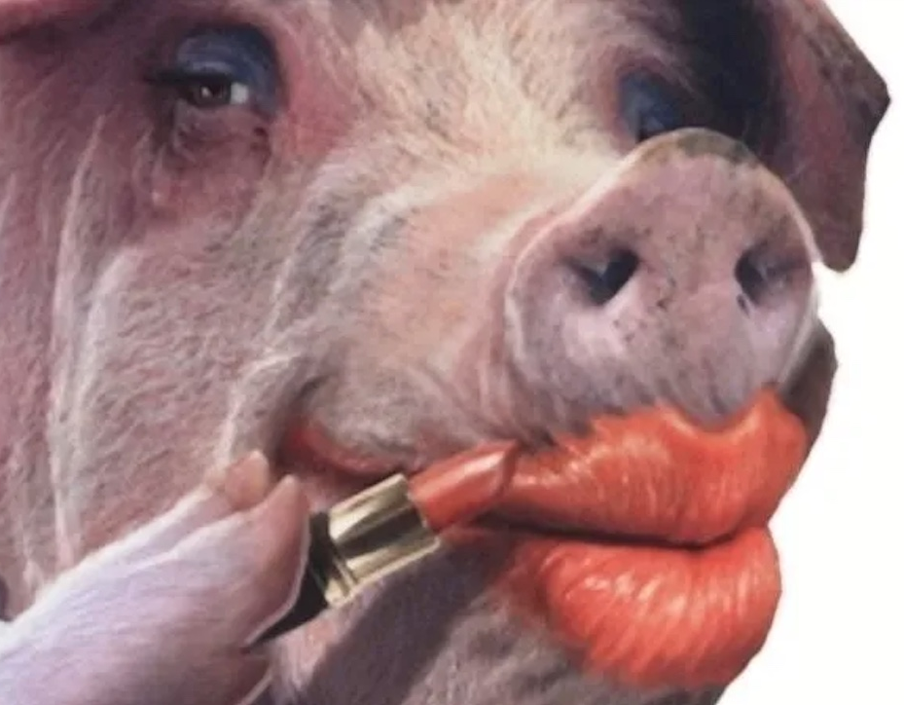
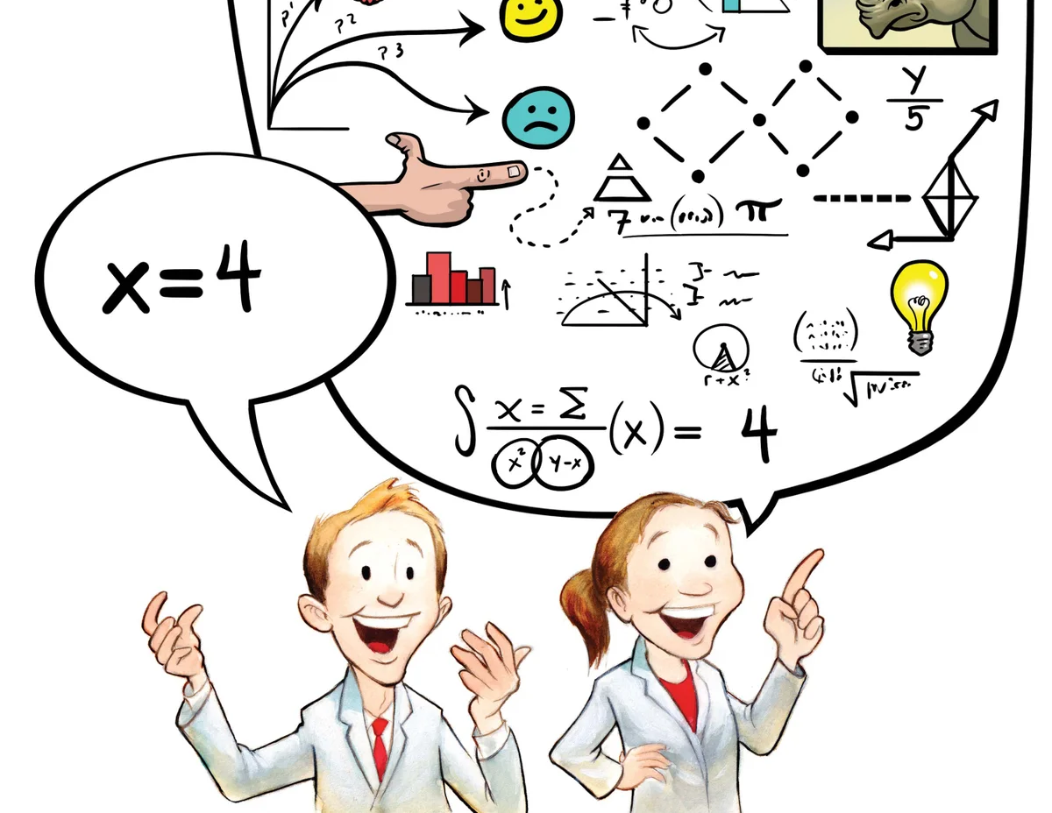
Psychopathy as a “Zombie” Idea:
Three Reasons for Skepticism
Reasons that “supports” the suspicion that psychopathy is “not real” and therefore a “zombie” idea…
1. Little “Positive” Evidence
2. False Abductive Trigger
3. Concept is Redundant
No clear confirmatory or “positive” evidence has ever been presented to support the idea that psychopaths “exists”. That is, we’ve never documented a real person who “fits” or “instantiates” the idea of psychopathy.
The clinical prototype is not a so-called “abductive trigger”; a phenomenon that needs a specific concept and scientific explanation. The original Cleckley-Hare prototype was factually misrepresented.
There is, and always was, a much simpler and evidence-based way to account for (or explain) the individuals that fits the Cleckley-Hare clinical prototype (e.g., substance misuse, PTSD, etc.).

Slide 30
Psychopathy as a “Zombie” Idea:
1. Little Positive Evidence
The research since 1980 have amassed little to no evidence corroborating the idea of psychopathy…
Skepticism about an idea is generally warranted if there is no robust experimental evidence to support the idea.
It’s indisputable that researchers have never presented any clear, replicated empirical evidence to corroborate the idea of psychopathy.
  For example, as shown in Larsen (2025), the five most common claims about psychopathy has never been clearly corroborated.
Common saying: “That which is asserted without evidence can be dismissed without evidence” (aka. Hitchens’ Razor).

Slide 31
Psychopathy as a “Zombie” Idea:
2. False Abductive Trigger
The prototype described by Cleckley/Hare was misrepresented and misleading…
To address this skepticism, we must appreciate how science “works”.
Scientific work usually begins with some fact-based observation that is surprising: we don’t understand the “why” of the “what”.
The encounter with puzzling factual observations is sometimes referred to as an “abductive trigger”.
This observation propels us into a mode of “abductive reasoning”.
Abductive Reasoning: A type of reasoning where we are providing support for some theory “a” as an explanation of some observed facts “b” (e.g., “a” is reasoned to be a probable cause of “b”).

Slide 32
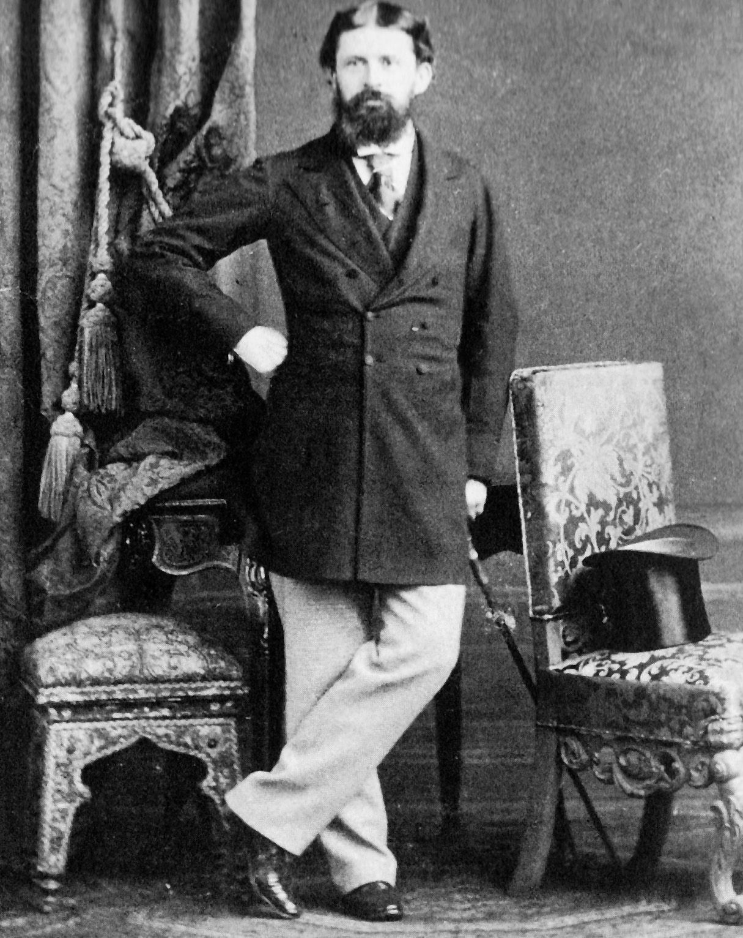
Psychopathy as a “Zombie” Idea:
Abductive Reasoning
Abductive Reasoning: A type of reasoning where we are providing support for some theory “a” as an explanation of some observed facts “b” (e.g., “a” is reasoned to be a probable cause of “b”).
It would be “unsurprising”; i.e., “A would explain C”.
Aka. “Abductive trigger”
The surprising fact C is observed.
But if A were true, C would be a matter of course.
Hence, there is reason to suspect that A is true.
The proposed “theory”.
Charles S. Peirce
(1839-1914)

Slide 33
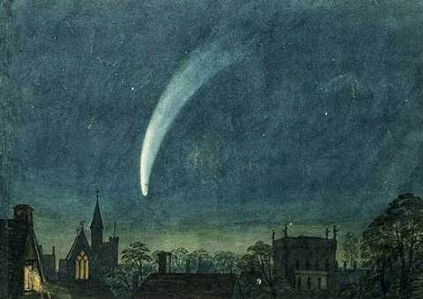
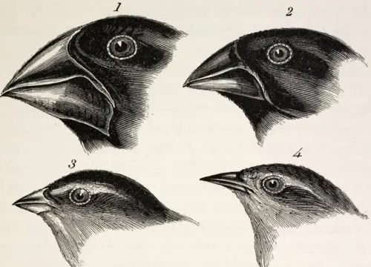
Psychopathy as a “Zombie” Idea:
Examples of Abductive Triggers
The history of science is full of similar examples…
Surprising Fact = Comet’s curved path
Surprising Fact = Similar distinct species
The curved path of “Newton’s Comet”
The species similarity in “Darwin’s Finches”
Notes:
Darwin’s Finches:
Darwin’s finches illustrate one of the clearest abductive triggers in the development of evolutionary theory: the realization that closely related species can diversify into distinct forms when isolated in different ecological niches.
The Observational Puzzle
During the Beagle voyage, Darwin collected several species of finch-like birds across the Galápagos Islands. At first, he did not regard them as particularly significant. Only later—after ornithologist John Gould examined the specimens in London—did Darwin learn that these were not varieties of a single species, but multiple distinct species, each confined to particular islands.
This created an explanatory tension:
The islands were geographically close and ecologically similar in many respects.
Yet the finches differed markedly in their beak shapes, feeding behaviors, and body sizes.
Despite these differences, they were clearly more similar to each other than to any species on distant islands.
Why This Triggered an Abductive Leap
Under the prevailing creationist view, each species was independently created. But if that were true, there was no clear reason for each island to have its own variation of the same basic bird, fine-tuned to local food sources:
Thick, strong beaks for cracking seeds
Long, slender beaks for probing cactus flowers
Sharp, pointed beaks for feeding on insects
Even a tool-using species that manipulates twigs to extract grubs
The most plausible explanation—what abductive reasoning pointed toward—was that these birds shared a common ancestor that reached the islands from the South American mainland. Once isolated on separate islands, they faced different ecological pressures, and over generations their descendants diverged into distinct species.

Slide 34
Psychopathy as a “Zombie” Idea:
The Origins of Psychopathy Research
The patient prototype as an “abductive trigger”…
Surprising Fact =
The Patient Prototype
Early researchers encountered a patient stereotype that seemed psychologically unlike “ordinary” individuals.
This observation conflicted with prevailing assumptions about normal human psychology.
The mismatch created an abductive trigger: an explanatory puzzle that demanded an account of why these patients were so different.

Slide 35
Psychopathy as a “Zombie” Idea:
Disagreement About the Prototype
Clinicians disagreed about the abductive trigger; they disagreed on “what” or which “observed facts” to explain…
Early clinicians (Rush, Pinel, Prichard, etc.) described widely divergent patient prototypes.
This confusion persisted into the 1970-1980s, when psychopathy was called the “most elusive category” in psychiatry (Lewis, 1974).
Consensus did not emerge until the 1990s, centered first on Cleckley’s Mask of Sanity and later on Hare’s PCL framework (1980; 1991; 2003).
Researchers were therefore responding to different abductive triggers: different observations that sparked their attempts to explain.
As Hare (2007) noted, it was as if experts were describing different disorders.

Slide 36
Psychopathy as a “Zombie” Idea:
Consensus Emerge Around Cleckley’s Work
In the 1990s, consensus emerge around Cleckley and Hare conception of psychopathy…
The Cleckley/Hare Prototype
Claimed Observations:
Moral Blindness
No Emotions
Extreme Impulse

Slide 37
Psychopathy as a “Zombie” Idea:
“A Voice Crying in the Wilderness…”
However, clinicians were never convinced by Cleckley’s conception and descriptions of psychopathy…
Cleckley’s prototype was largely dismissed by contemporaries as unworthy of scientific attention (i.e., not an abductive trigger).
Cleckley described himself as a “voice crying in the wilderness,” and called the psychopath the “forgotten man of psychiatry.”
By the 1980s, skepticism toward Cleckley’s ideas was mainstream.
Only a small subset of researchers (e.g., Lykken, Hare) championed his work; Cleckley died before seeing the influence of his work (in 1984).

Slide 38
Psychopathy as a “Zombie” Idea:
What Made Researchers Change Their Minds..?
In the 1970-1980s, it’s mainstream to be skeptical; but in the 1990s, psychopathy research goes mainstream..
Empirical Evidence: A few studies support Cleckley’s conception.
Anecdotal Accounts: Highly vivid case descriptions (e.g., Hare, 1993) may have convinced many clinicians that the prototype was real.
Pop-Culture: Films like Silence of the Lambs fueled public fascination, increased demand for expertise, and influenced new generations of researchers, making psychopathy a compelling topic to study.
PROBLEM: Change in perspective not primarily driven by scientific “evidence”.

Slide 39
Psychopathy as a “Zombie” Idea:
Misguided Observation ≠ Not Surprising ≠ Abductive Trigger
Potentially surprising observations about the psychopathy prototype turned out to be “misrepresentations”…
The Cleckley/Hare Prototype
Claimed Observations:
Fact: Misrepresentations (Gullible?)
Moral Blindness
FACT: The prototype appears to have similar moral judgment and empathy.
No Emotions
FACT: The prototype have normal affective dispositions.
Extreme Impulse
FACT: The prototype have ordinary impulse control.

Slide 40

Psychopathy as a “Zombie” Idea:
“Without suffering or enjoying in significant degree the integrated emotional consequences of experience, the psychopath will not learn from it to modify and direct his activities as other men whom we call sane modify and direct theirs. […] It is entirely impossible for him to see another person from the aspect of major affective experience, since he is blind to this order of things or blind in this mode of awareness.”
Cleckley (1988), The Mask of Sanity (p. 373)

Slide 41
Psychopathy as a “Zombie” Idea:
“A simple analogy here will help. The psychopath is like a color-blind person who sees the world in shades of gray but who has learned how to function in a colored world. He has learned that the light signal for "stop" is at the top of the traffic signal . When the color-blind person tells you he stopped at the red light, he really means he stopped at the top light. He has difficulty in discussing the color of things but may have learned all sorts of ways to compensate for this problem, and in some cases even those who know him well may not know that he cannot see colors. Like the color-blind person, the psychopath lacks an important element of experience-in this case, emotional experience but may have learned the words that others use to describe or mimic experiences that he cannot really understand.”
Quote from Without Conscience (1993)

Slide 42
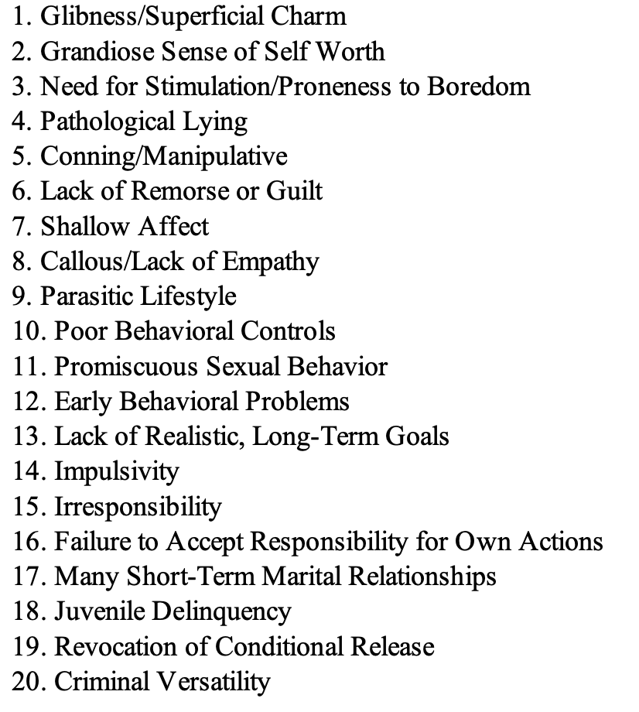
Psychopathy as a “Zombie” Idea:
Not Abnormal, Nor Surprising..!
There is arguably nothing “abductive triggering” about the Cleckley-Hare prototype…
The Cleckley/Hare Prototype
Problem:
If we disregard the traits that are associated with the misrepresented aspects of the Cleckley-Hare prototype, we end up with a prototype that is utterly trivial – and not abnormal – from a psychological perspective…
Notes:
The observed reality is not a “proper” abductive trigger because we already have a reasonable understanding of what we observe…

Slide 43
Psychopathy as a “Zombie” Idea:
Example of Taking a Wrong Cognitive Turn
When a misread “Abductive Trigger” leads science astray...
Imagine two psychiatrists assessing the same patient:
  One sees substance-withdrawal symptoms = a straightforward diagnosis.
  The other sees a new personality disorder, treating the case as a curiosity that demands a novel theory.
What if the first psychiatrist is correct, the second was wrong?
Parallel to psychopathy research: Researchers assume the Cleckley-Hare prototype reflects a genuine personality disorder.
But if this stereotype is itself misinterpreted, then decades of theorizing about psychopathy may be fundamentally misguided.

Slide 44



Psychopathy as a “Zombie” Idea:
Misrepresentative Observations
The bunk diagnosis of Multiple Personality Disorder is an infamous case where clinicians made misrepresentative observations…
“I feel like a completely different person when I get upset…”
“Hmm.. she must have two different and separate personalities..!”

Slide 45
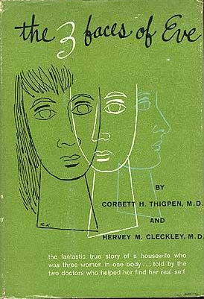
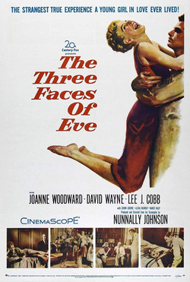
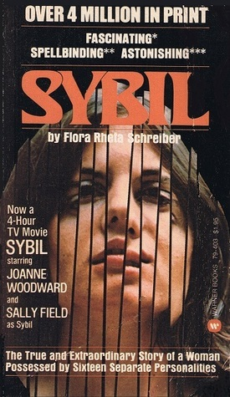
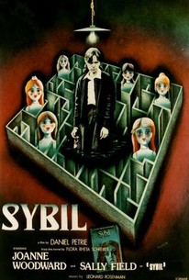
Psychopathy as a “Zombie” Idea:
The Lucrative Business of “Being Wrong”
Cleckley (and others) made a small fortune (and fame!) promoting the idea of “Multiple Personality Disorder”…
Thigpen & Cleckley (1957)
Oscar-Winner in 1957
(Joanne Woodward, Best Actress)
Schreiber (1976)
Series in 1976
Multiple Emmy Awards

Slide 46
Psychopathy as a “Zombie” Idea:
3. The Concept is Redundant
There are simpler ways to make sense of the Cleckley-Hare prototype…
Core Idea: Psychopathy an unnecessarily complex explanation for something already understood in behavioral science.
This is not a new proposal: Scott Lilienfeld argued (2019; 2021) that psychopathy might be an outlier in normal personality psychology.
Key Claim: When we review ”real life” examples of the psychopathy prototype, these can be explained by:
  Established personality psychology, or
  Existing mental health diagnoses
  (…or a combination of both)

Slide 47
Psychopathy as a “Zombie” Idea:
The Scientific Virtue of Simplicity
If an explanation is unnecessarily complicated compared to its alternatives, scientists will deem the theory redundant.…
Core Problem: Scientists prefer simpler, established explanations over new, more complex ones.
Simplicity is a longstanding scientific quality standard in rational theorizing.
In practice, it means first asking whether existing theories already account for the observations.
Paul Meehl: “Do not concoct theories to explain facts already explained by an ensconced theory.” (2002)
Application to the previous example:
  Psychiatrist 1: follows the principle by explaining symptoms through well-established knowledge about substance withdrawal.
  Psychiatrist 2: violates the principle by inventing a novel personality disorder to explain facts already adequately explained.

Slide 48
Psychopathy as a “Zombie” Idea:
Cleckley’s Patient Vignettes
There are 15 patient vignettes included in The Mask of Sanity; none of them instantiates the idea of psychopathy…
Normal Personality (non-criminal): Patients that are utterly normal but may not have behaved in ways that complied with the social norms of upper-or middle-class life in the state of Georgia during the post−World War II era (five cases: Roberta, Pierre, Anna, Milt, and Stanley).
Normal Personality (criminal): Patients who are mostly petty criminals often with unsavory personalities, but arguably with no clear indications of psychological abnormalities (two cases: Tom and Gregory).
Other Mental Health Diagnoses: Patients who have a long history of severe problems with addiction, post-traumatic stress disorder (PTSD), homelessness, clinical depression, tertiary syphilis, suicide attempts and threats, and so on (eight cases: Max, Arnold, George, Frank, Jack, Chester, Walter, and Joe).

Slide 49
Psychopathy as a “Zombie” Idea:
Summary
Why it’s “reasonable” to believe that psychopathy might be a zombie idea…
Reason #1: Researchers have not presented any clear, replicated empirical evidence to show psychopathy “is real” (Larsen, 2025)
Reason #2: There are reasons to doubt whether any “particular” human being exists that properly “instantiate” the idea of psychopathy (e.g., the issue of “abductive trigger” and “redundancy”).
Reason #3: Researchers continue to frame psychopathy as an intuitively appealing idea despite the lack of clear evidence-based progress in the field.
Inference: Therefore, it’s reasonable to believe that psychopathy could turn out to be a zombie idea (i.e., an idea without a clear, instantiating “referent” in reality).
NB: This is (emphatically!) not the same as saying that we have “proven” that psychopathy is a zombie idea.

Slide 50
Psychopathy as a “Zombie” Idea:
A Challenge for Future Researchers
Main Point: The claim that psychopathy may be a “zombie idea” should be uncontroversial because it is falsifiable: critics can directly test it..!
The Central Challenge: To refute the zombie-explanation, one must simply present a clear, real-world case of a truly psychopathic person:
  Someone who unequivocally fits the full prototypical description (e.g., profound moral blindness, absence of emotion, impulsivity).
  And for whom no simpler or better-established explanation of their behavior or personality is plausible.
Implication: If psychopathy genuinely exists as a distinct clinical entity – and purportedly affects ~1% of the population – it should be straightforward to identify such an unequivocal case.

Slide 51
Objections

Slide 52
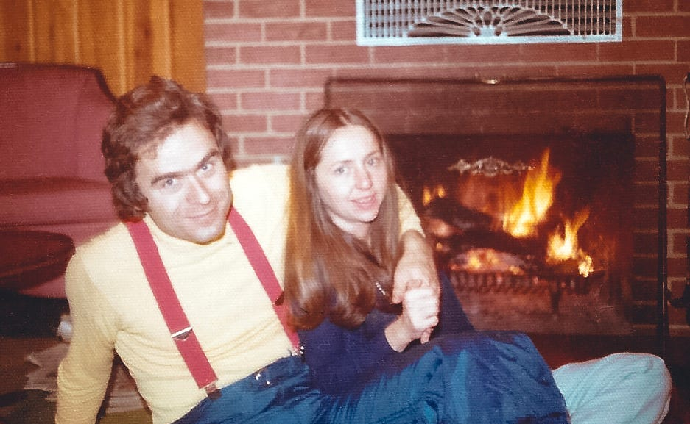

Objections:
Two Objections to the “Zombie” Idea Perspective
Serial Killers Are “Real” Psychopaths
Some Positive Research Evidence
Review: Larsen, 2025, p. 235-237
Review: Larsen, 2025, p. 237-238
Notes:
Larsen’s Response to the ”Ted Bundy” Objection:
First Point
Appeals to serial killers rely on anecdotal, not scientific, evidence. Because these individuals have never been studied under controlled conditions, we cannot confidently assert that they lack empathy, possess “moral colorblindness,” or otherwise meet the conceptual criteria for psychopathy. Such claims amount to speculation rather than empirical fact.
Second Point
Empirical work provides little support for the view that serial killers fit mainstream conceptions of psychopathy. Hickey et al. (2018) examined detailed information on five infamous offenders and found that only one—Ted Bundy—scored above the PCL-R diagnostic threshold. This indicates substantial psychological heterogeneity among serial killers, limiting the force of this objection.
Third Point
Even in Bundy’s case, there are strong reasons to doubt that psychopathy is the most appropriate or parsimonious explanation. Accounts describe him as emotionally volatile rather than unemotional, and his behaviour shows evidence of comorbid issues—severe alcohol use, necrophilic impulses, and possible delusional thinking. These factors may offer a simpler, more coherent explanation for his actions than invoking a poorly validated personality disorder.
Fourth Point
Invoking serial killers inadvertently highlights the limits of psychopathy research. Psychopathy is claimed to characterize roughly 1% of the population—approximately four million people in North America—yet only a tiny fraction of individuals who commit serial homicide exist, and even fewer meet psychopathy criteria. If the strongest defence of the construct applies only to rare, atypical cases, then its broader scientific and societal explanatory value is profoundly constrained.
Larsen’s Response to the ”Some Evidence of Psychopathy” Objection:
First Point
The objection rests on a faulty assumption: if a psychological construct is not real, experiments should yield only null results. This is incorrect. Even in fields where we are confident the phenomenon does not exist, studies routinely produce statistically significant findings.
Second Point
False-positive effects arise because psychological experiments allow considerable methodological and analytical flexibility. This flexibility can generate patterns that look meaningful but are not truly generalizable. Research on “null fields,” such as homeopathy, illustrates that experiments can produce significant effects even when no real phenomenon is present.
Third Point
A well-known example is the 2011 “Feeling the Future” studies, which claimed evidence for precognition. Although these findings were widely dismissed, they were not fraudulent; rather, flexible research practices produced statistically significant but false-positive results.
Fourth Point
This dynamic also appears in psychopathy research. For instance, our 2024 review of empathy studies showed that approximately 85–91% of results were null. When studies with high analytic flexibility were separated from more rigorous ones, the most rigorous studies produced about 95% null findings—precisely what we expect from a null field given the conventional 5% false-positive rate.

Slide 53
Objections:
Objection #1 – Serial Killers Are Real Psychopaths: Serial killers appear to display hallmark traits associated with psychopathy, thus “instantiating” the idea.
Response #1: Appeals to serial killers rely on anecdote, not science. These individuals have never been studied under controlled conditions, claims about their supposed lack of empathy or “moral colorblindness” remain speculative rather than empirically grounded.
Response #2: Research offers little evidence that serial killers uniformly fit psychopathy criteria. Hickey et al. (2018) found that only one of five well-known offenders (Ted Bundy) scored above the PCL-R threshold, indicating substantial heterogeneity among serial killers.
Response #3: Even Ted Bundy does not clearly exemplify psychopathy. Accounts describe emotional volatility and significant comorbid issues (alcohol misuse, necrophilic tendencies, possible delusional thinking), which may better explain his behaviour than an unvalidated personality disorder.
Response #4: Using serial killers as a defence of psychopathy underscores the construct’s limitations. Psychopathy is said to occur in about 1% of the population, yet serial homicide is extremely rare. If the best evidence for the construct rests on exceptional cases, its broader explanatory value is minimal.
Notes:
Larsen’s Response to the ”Ted Bundy” Objection:
First Point
Appeals to serial killers rely on anecdotal, not scientific, evidence. Because these individuals have never been studied under controlled conditions, we cannot confidently assert that they lack empathy, possess “moral colorblindness,” or otherwise meet the conceptual criteria for psychopathy. Such claims amount to speculation rather than empirical fact.
Second Point
Empirical work provides little support for the view that serial killers fit mainstream conceptions of psychopathy. Hickey et al. (2018) examined detailed information on five infamous offenders and found that only one—Ted Bundy—scored above the PCL-R diagnostic threshold. This indicates substantial psychological heterogeneity among serial killers, limiting the force of this objection.
Third Point
Even in Bundy’s case, there are strong reasons to doubt that psychopathy is the most appropriate or parsimonious explanation. Accounts describe him as emotionally volatile rather than unemotional, and his behaviour shows evidence of comorbid issues—severe alcohol use, necrophilic impulses, and possible delusional thinking. These factors may offer a simpler, more coherent explanation for his actions than invoking a poorly validated personality disorder.
Fourth Point
Invoking serial killers inadvertently highlights the limits of psychopathy research. Psychopathy is claimed to characterize roughly 1% of the population—approximately four million people in North America—yet only a tiny fraction of individuals who commit serial homicide exist, and even fewer meet psychopathy criteria. If the strongest defence of the construct applies only to rare, atypical cases, then its broader scientific and societal explanatory value is profoundly constrained.

Slide 54
Objections:
Objection #2 – Some Positive Evidence of Psychopathy: The research is not only “null” findings: there’s some, albeit little positive evidence of the reality of the disorder.
Response #1: The objection assumes that if a construct is not real, all studies should yield null results. This is mistaken: even in areas where the phenomenon being studied clearly does not exist (e.g., cold fusion), experiments still occasionally produce significant findings.
Response #2: Indeed, psychological research has substantial methodological and analytic flexibility, rendering false-positive effects common. “Null fields” like cold fusion, homeopathy, or pre-cognition show that significant results can appear even when no real phenomenon is present.
Notes:
Larsen’s Response to the ”Some Evidence of Psychopathy” Objection:
First Point
The objection rests on a faulty assumption: if a psychological construct is not real, experiments should yield only null results. This is incorrect. Even in fields where we are confident the phenomenon does not exist, studies routinely produce statistically significant findings.
Second Point
False-positive effects arise because psychological experiments allow considerable methodological and analytical flexibility. This flexibility can generate patterns that look meaningful but are not truly generalizable. Research on “null fields,” such as homeopathy, illustrates that experiments can produce significant effects even when no real phenomenon is present.
Third Point
A well-known example is the 2011 “Feeling the Future” studies, which claimed evidence for precognition. Although these findings were widely dismissed, they were not fraudulent; rather, flexible research practices produced statistically significant but false-positive results.
Fourth Point
This dynamic also appears in psychopathy research. For instance, our 2024 review of empathy studies showed that approximately 85–91% of results were null. When studies with high analytic flexibility were separated from more rigorous ones, the most rigorous studies produced about 95% null findings—precisely what we expect from a null field given the conventional 5% false-positive rate.

Slide 55

“For all the problems I have pointed out in the research paradigm, one glowing optimistic note shines brighter than the pessimism: the strength of the scientific method is exactly that if we study an idea that has no basis in reality — an idea that is not real — we will continuously fail to find convincing evidence of its existence.”
– Larsen (2025, p. 242)

Slide 56
Critical Reflections

Slide 57
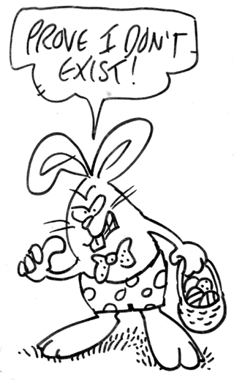
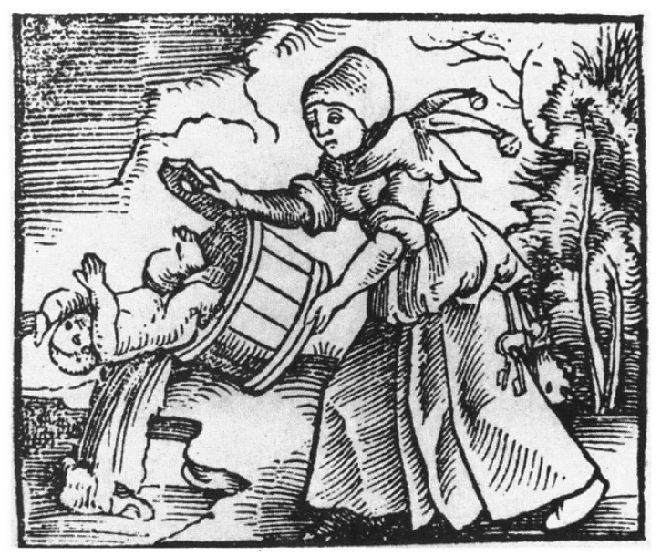

Critical Reflections:
The Future of Psychopathy Research
Proving a Negative
Babies and Bathwater
Adjusting the Diagnosis
According to Larsen (2025), we currently do not have clear evidence that psychopathy is “not real”; that is, we cannot prove that there are no real persons exist that match or “instantiates” the idea of psychopathy.
Perhaps discarding psychopathy research would be an overreaction? Despite its flaws, some researchers argue that the field has generated valuable insights and still contains elements worth preserving. Abandoning the construct entirely would be “throwing out the baby with the bathwater”.
Lilienfeld (2021) propose that the psychopathy prototype can be understood as simply having unusual configurations of ordinary personality traits (yet not disordered). This approach preserves the research paradigm by reframing psychopathy within the field of personality psychology.

