Slide 1
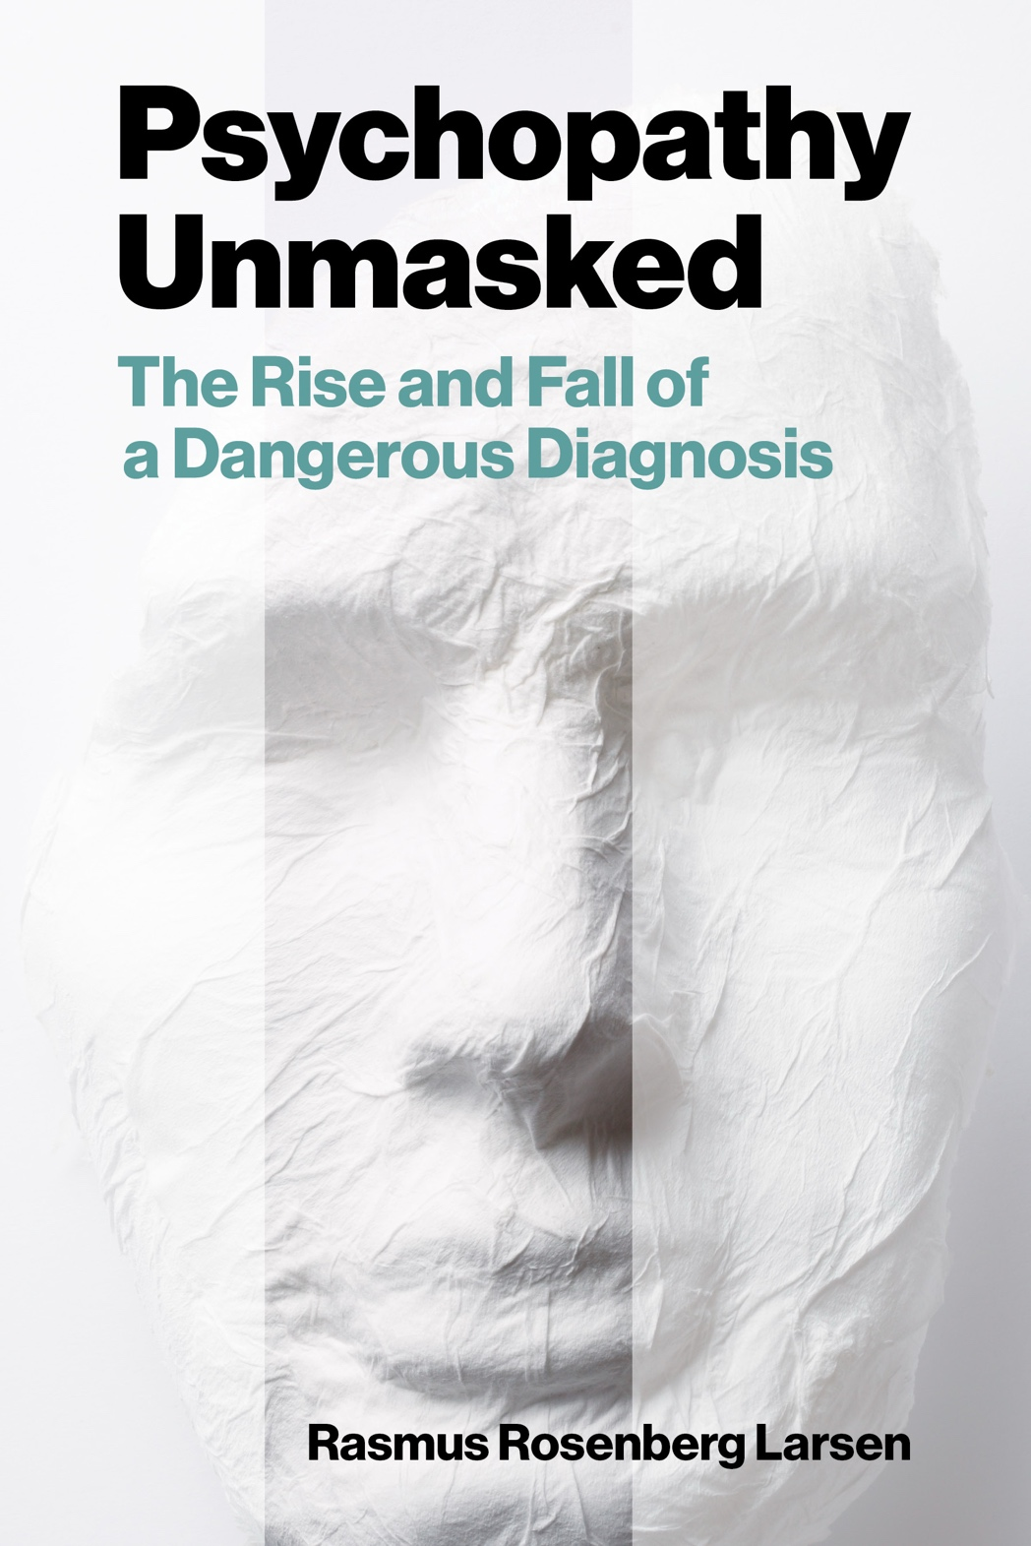
Psychopathy and Crime
The Science, Ethics, and Legal Influence of a Controversial Diagnosis
Module 10
Explaining the Lack of Evidence (Part I)
Reviewing Mainstream Perspectives
Copyright © Rasmus Rosenberg Larsen
Licensed under CC BY 4.0.

Slide 2
Assignment #2
Critical Analysis of Science Documentary

Slide 3

Assignment #2:
The Psychopath Next Door
CBC Documentary
(Torrie, 2014)
Notes:
3.04 Avoiding Harm
(a) Psychologists take reasonable steps to avoid harming their clients/patients, students, supervisees, research participants, organizational clients, and others with whom they work, and to minimize harm where it is foreseeable and unavoidable.
(b) Psychologists do not participate in, facilitate, assist, or otherwise engage in torture, defined as any act by which severe pain or suffering, whether physical or mental, is intentionally inflicted on a person, or in any other cruel, inhuman, or degrading behavior that violates 3.04(a).

Slide 4
Assignment #2:
Instructions
NB: Watch the documentary in full before writing. Organize your submission using clear subheadings.
Part A: Descriptive Claims in the General Population (~400–550 words) – 15 points
Identify 2-3 topics or claims in the documentary that you believe align with common lay descriptions of psychopathy. Briefly describe how the film presents these topics (use timestamps). Reflect on prior to taking this course, whether you agree or disagree with these descriptions? What informed your view (e.g., previous classes, media, personal assumptions)? Keep this section concise and self-aware; the aim is to surface assumptions, not to defend them.
Part B: Identifying Scientific Claims (~300 words) – 15 points
List three specific claims that the documentary presents as “scientific facts” about psychopathy. Quote or paraphrase precisely and include timestamps. For each claim, state what is being asserted and what evidentiary basis is implied.
Notes:
3.04 Avoiding Harm
(a) Psychologists take reasonable steps to avoid harming their clients/patients, students, supervisees, research participants, organizational clients, and others with whom they work, and to minimize harm where it is foreseeable and unavoidable.
(b) Psychologists do not participate in, facilitate, assist, or otherwise engage in torture, defined as any act by which severe pain or suffering, whether physical or mental, is intentionally inflicted on a person, or in any other cruel, inhuman, or degrading behavior that violates 3.04(a).

Slide 5
Assignment #2:
Instructions
NB: Watch the documentary in full before writing. Organize your submission using clear subheadings.
Part C: Credibility Appraisal of Scientific Claims (~450–550 words) – 40 points
Critically assess the evidence-based credibility of each claim. Anchor your appraisal in course concepts, materials, and discussions. You may include external academic sources to substantiate your critical appraisals.
Part D: Reflection of Scientific Spin (~300 words) – 25 points
(a) Identify and document one instance where there is evidence a specific scientist is engaging in scientific spin. Quote or paraphrase precisely and include timestamps. Build your argument by relating your analysis to the course concepts and support it with at least one external scholarly source. (b) Briefly reflect on the potential broader influence of this instance of spin (e.g., in forensics, public policy, education)
Additional: Writing quality and APA format – 5 points
Notes:
3.04 Avoiding Harm
(a) Psychologists take reasonable steps to avoid harming their clients/patients, students, supervisees, research participants, organizational clients, and others with whom they work, and to minimize harm where it is foreseeable and unavoidable.
(b) Psychologists do not participate in, facilitate, assist, or otherwise engage in torture, defined as any act by which severe pain or suffering, whether physical or mental, is intentionally inflicted on a person, or in any other cruel, inhuman, or degrading behavior that violates 3.04(a).

Slide 6
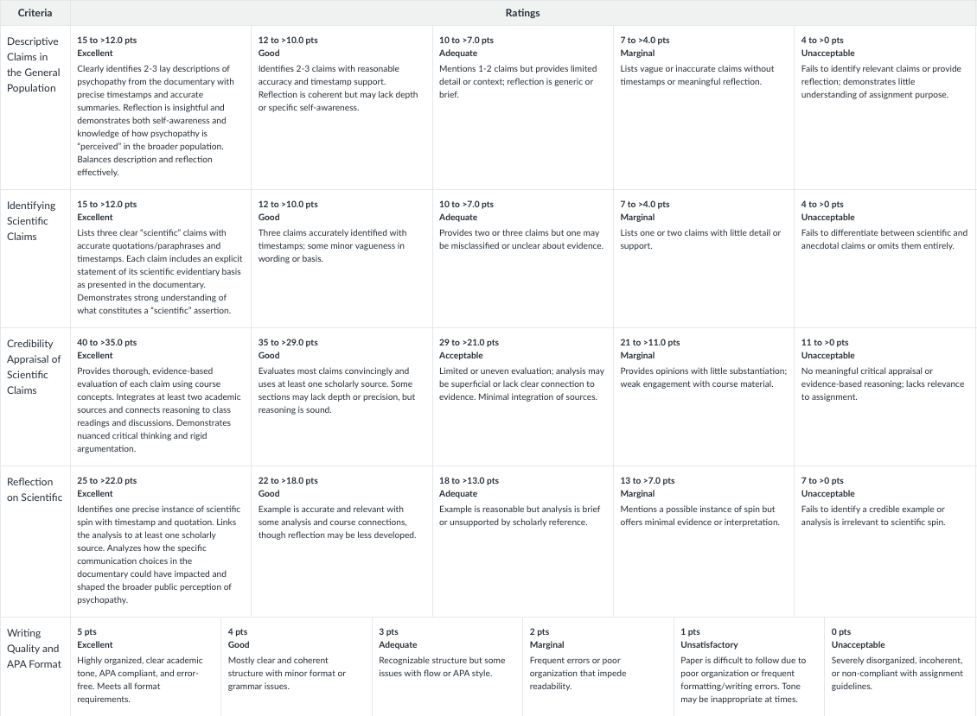
Assignment #2:
Rubric
Notes:
3.04 Avoiding Harm
(a) Psychologists take reasonable steps to avoid harming their clients/patients, students, supervisees, research participants, organizational clients, and others with whom they work, and to minimize harm where it is foreseeable and unavoidable.
(b) Psychologists do not participate in, facilitate, assist, or otherwise engage in torture, defined as any act by which severe pain or suffering, whether physical or mental, is intentionally inflicted on a person, or in any other cruel, inhuman, or degrading behavior that violates 3.04(a).

Slide 7
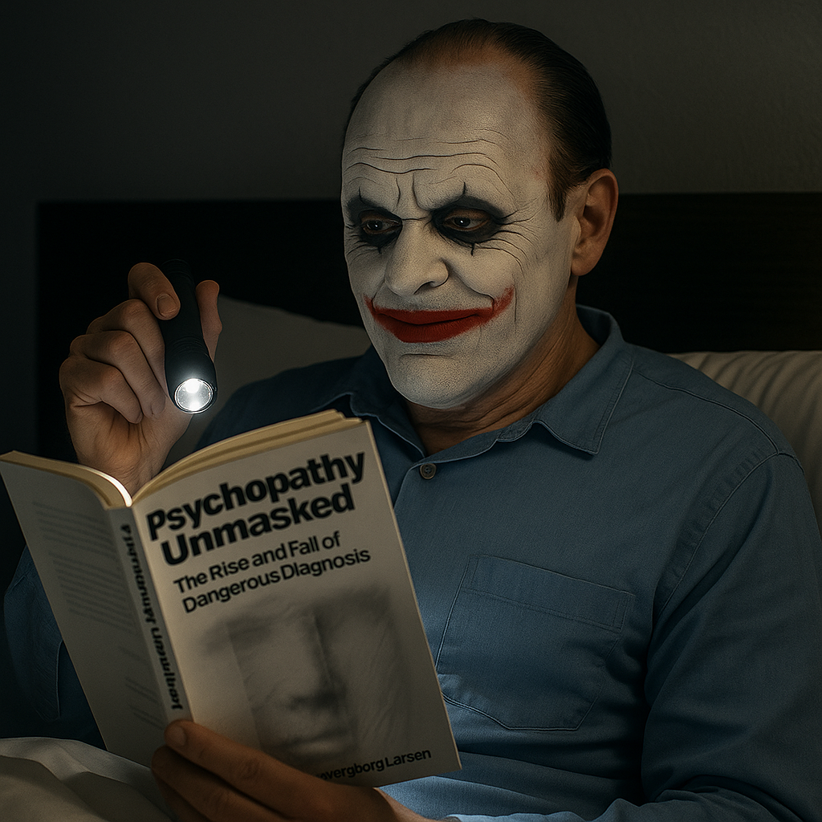
Any questions..?
© OpenAI (LLM-generated image)

Slide 8
Psychopathy and Crime
FSC350
Module 1
Introduction – What is Psychopathy?
Module 7
Two Theories of Psychopathy
Module 2
The Problem of Psychopathy
Module 8
Psychopathy and Scientific Spin
Module 3
Psychopathy and Forensic Risk
Module 9
Psychopathy and Ethics
Module 4
Psychopathy and Treatment
Module 10
Explaining a Lack of Evidence (Part I)
Module 5
Psychopathy and Moral Psychology
Module 11
Explaining a Lack of Evidence (Part 2)
Module 6
The Neuroscience of Psychopathy
Module 12
The Future of Psychopathy Research

Slide 9
This Module’s Agenda:
Psychopathy: An Oddly Elusive Construct
Explaining the Lack of Evidence
Overview: Assignment #2

Slide 10
Psychopathy:
An Oddly Elusive Construct

Slide 11
Psychopathy: An Oddly Elusive Construct
Contemporary Psychopathy Research
The systematic or “scientific” study of psychopathy increased drastically in the 1980s…
Recall: Psychopathy research “begins” with an observation about a specific patient proto- or stereotype.
  In short: There is a type of patient that “stands out” – seen by clinicians as “psychologically abnormal.”
In the 1990s, and amidst controversy, a group of researchers reached consensus on how to describe this prototype = PCL Psychopathy.
With this consensus in “description” and “assessment,” an entire research paradigm was born.

Slide 12

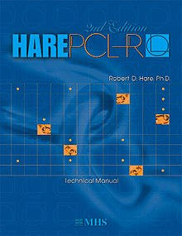

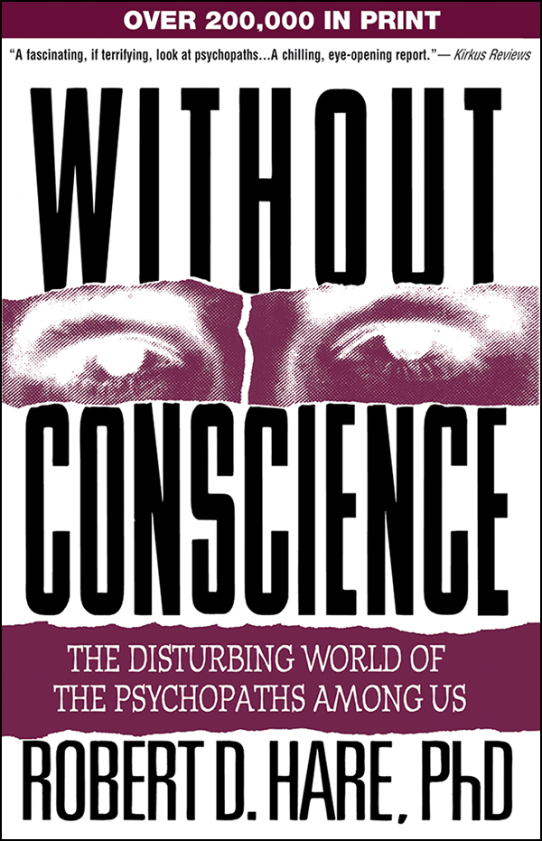
Psychopathy: An Oddly Elusive Construct
The PCL Psychopathy Prototype
The Cleckley/Hare Prototype
20-Item Checklist
Measures
or
Selects
Clinical Proto/Stereotype: A real-life person that “fits” or represents the constellation of behavioral signs and psychological traits associated with a specific condition.

Slide 13
Psychopathy: An Oddly Elusive Construct
Five Mainstream Claims About the PCL Prototype
1:
Psychopathic persons are extremely dangerous
The Cleckley/Hare Prototype
2:
Psychopathy is chronically untreatable
3:
Psychopathic persons are deprived of morality
4:
Psychopathy is a biological condition
5:
Psychopathy is theoretically corroborated

Slide 14
Psychopathy: An Oddly Elusive Construct
The Status of Psychopathy Research Anno 2025
FACT: None of the five mainstream claims have ever been convincingly corroborated in scientific research…
1:
Psychopathic persons are extremely dangerous
Fact: Only a weak-moderate link between psychopathy and recidivism, mostly due to Factor 2 items, and with important moderators (link, link, link).
2:
Psychopathy is chronically untreatable
Fact: Treatment outcome studies consistently show that psychopathic persons benefit from rehabilitation and treatment + no evidence of adverse effects (link, link).
3:
Psychopathic persons are deprived of morality
Fact: Psychopathic persons perform similar to non-psychopathic persons on empathy and moral reasoning tests (link, link, link).
4:
Psychopathy is a biological condition
Fact: Neurobiological and genetic research has never detected any consistent biomarkers correlated with psychopathy (link, link, link, link).
5:
Psychopathy is theoretically corroborated
Fact: Both emotion and cognitive theories of psychopathy have been all but falsified (link, link, link).

Slide 15
Psychopathy: An Oddly Elusive Construct
How Peculiar..!!
Scientists usually follow the empirical evidence = science is supposed to “self-correct”…
In most scientific fields, lack of empirical support leads to skepticism, revision, and eventual rejection of flawed ideas.
Psychopathy research seems to be an anomaly: There has never been robust evidence validating the major claims about psychopathy.
Despite this, psychopathy remains a “legitimate” idea, widely studied, published in top journals, and taught in university curricula.
This persistence reflects a disconnect between evidence and acceptance, challenging the notion that science “self-corrects”.

Slide 16


Psychopathy: An Oddly Elusive Construct
A Strange Failure to Prove the Obvious…?
Psychopathy is alleged to be an extreme psychological construct/disorder…
vs.
We are not searching for a “needle in a haystack”…
…psychopathic persons allegedly stick out like a “sore thumb”.

Slide 17
Psychopathy: An Oddly Elusive Construct
A Strange Failure to Prove the Obvious…?
Psychopathy is alleged to be an extreme psychological construct/disorder…
“[The psychopath] is unfamiliar with the primary facts or data of what might be called personal values and is altogether incapable of understanding such matters. It is impossible for him to take even a slight interest in the tragedy or joy or the striving of humanity as presented in serious literature or art. He is also indifferent to all these matters in life itself. Beauty and ugliness, except in a very superficial sense, goodness, evil, love, horror, and humor have no actual meaning, no power to move him. He is, furthermore, lacking in the ability to see that others are moved. It is as though he were colorblind, despite his sharp intelligence, to this aspect of human existence. It cannot be explained to him because there is nothing in his orbit of awareness that can bridge the gap with comparison. He can repeat the words and say glibly that he understands, and there is no way for him to realize that he does not understand.”

Slide 18
Psychopathy: An Oddly Elusive Construct
A Strange Failure to Prove the Obvious…?
Psychopathy is alleged to be an extreme psychological construct/disorder…
“A simple analogy here will help. The psychopath is like a color-blind person who sees the world in shades of gray but who has learned how to function in a colored world. He has learned that the light signal for "stop" is at the top of the traffic signal . When the color-blind person tells you he stopped at the red light, he really means he stopped at the top light. He has difficulty in discussing the color of things but may have learned all sorts of ways to compensate for this problem, and in some cases even those who know him well may not know that he cannot see colors. Like the color-blind person, the psychopath lacks an important element of experience-in this case, emotional experience but may have learned the words that others use to describe or mimic experiences that he cannot really understand.”
Quote from Without Conscience (1993)

Slide 19

Psychopathy: An Oddly Elusive Construct
A Strange Failure to Prove the Obvious…?
Psychopathy is alleged to be an extreme psychological construct/disorder…
“There’s still a lot of opposition – some criminologists, sociologists, and psychologists don't like psychopathy at all… I can spend the entire day going through the literature – it’s overwhelming, and unless you’re semi-brain-dead you're stunned by it – but a lot of people come out of there and say, ‘So what? Psychopathy is a mythological construct.’ They have political and social agendas: ‘People are inherently good,’ they say. ‘Just give them a hug, a puppy dog, and a musical instrument and they’re all going to be okay.”
Interview with Robert Hare in 2001
(by R. Hercz, Psychopaths Among Us)

Slide 20

“[Because of self-correction] Scientific fields therefore rarely find themselves in a situation where there is a fundamental disconnect between its central ideas and the available evidence. Because it is exactly these types of unsupported ideas that scientific work is supposed prevent us from endorsing.”
Larsen (2025, p. 210)

Slide 21
Explaining the
Lack of Evidence

Slide 22
Explaining the Lack of Evidence:
It’s a Big Mess…
Evidence does not support both “facts” and “explanations” or the psychopathy proto-type…
Facts
WRONG
Explanation
The Emotion Theory
The Cognitive Theory
The “What”
The “Why”
Notes:
NB: There’s a way in which both “facts” and “theory” in psychopathy research appears to be wrong.

Slide 23

Explaining the Lack of Evidence:
Central Question:
Why is it that there has never been any scientific progress in corroborating some of the most basic claims about psychopathy?

Slide 24


Explaining the Lack of Evidence:
Two Basic Accounts
NB: There are perhaps many possible ways to account for the apparent failures in psychopathy research…
It’s Simply Too Hard!!
We Can’t Measure it..!
Contemporary research might not be sophisticated enough to study a personality disorder like psychopathy.
Assessment tools like the PCL-R might be flawed: not “identifying” properly psychopathic persons.

Slide 25
Explaining the Lack of Evidence:
#1: It’s Simply Too Hard!!
Core Idea: The failure to corroborate core claims about psychopathy reflects the complexity of the phenomenon…
Common claim: Psychopathy is very difficult to study scientifically.
The Argument: It’s our methods and technologies that are inadequate; not the “observations” and “theories”.
  For example, task-based neuroimaging or risk prediction studies may simply be too limited to study a personality disorder like psychopathy.
Analogy: Studying psychopathy with today’s methods is like searching for alien life with binoculars.
Psychopathy research is excused for its lack of progress

Slide 26
Explaining the Lack of Evidence:
Objections
#1: It’s Simply Too Hard!!
This objection underestimates how much high-quality research already exists.
There are hundreds of rigorous studies on PCL psychopathy.
Researchers are not looking for obscure effects but testing bold claims (e.g., “psychopaths lack empathy”).
If these claims were accurate, we should have seen consistent evidence by now.
Therefore, the lack of progress cannot be explained by difficulty alone.

Slide 27
Explaining the Lack of Evidence:
#2: We Can’t Measure It..!
Core Idea: The lack of progress reflects problems with measurement...
Studies on “PCL Psychopathy” may not be studying “real” psychopathic persons.
PCL-based tools might misidentify (e.g., false-positives assessment).
This would contaminate research samples, leading to mixed or inconsistent results.
Analogy: studying a disease with a misdiagnosed patient sample will lead to unreliable results.
Implication: the problem lies in the diagnostic instruments.

Slide 28
Explaining the Lack of Evidence:
Objections
#2: We Can’t Measure It..!
Sample contamination exists, but it cannot fully explain the lack of evidence in psychopathy research.
Researchers routinely test for contamination using moderator, regression, and post hoc analyses.
The PCL scales remain widely accepted as the best tools to identify the psychopathic prototype.
Studies using alternative assessments tools (e.g., self-report) produce equally inconsistent results.
Invoking contamination whenever evidence is lacking is an unfalsifiable objection = it can always be used to explain a lack of evidence.
Conveniently protects weak ideas from disconfirmation.

